Slide 1
Clustering
What is clustering?
Def: Grouping a set of objects in such a way that objects in the same group are more similar to each other than to those in other groups (wiki)
Each group is called a cluster
Clustering algorithms need a similarity metric!

Slide 2
Similarity Metric
For us, data points are code submissions
Common Metric: Tree Edit Distance (TED) between Abstract Syntax Trees (ASTs)
Tree Edit Distance is defined as the minimum cost sequence of node edit operations that transforms one tree into the other
We propose an improved metric: normalized TED, which assigns heavier weight to nodes higher up (closer to the root) in the AST (inspired by top-down structure of programming)

Slide 3
Algorithms
Clustering is in the eye of the beholder, the most appropriate clustering algorithm for a particular problem often needs to be chosen experimentally
We experimented with several well-known algorithms, including
Centroid-based: k-means, weighted k-means and spectral clustering
Distribution-based: Gaussian mixture model
Density-based: DBSCAN and OPTICS (best performance so far)

Slide 4
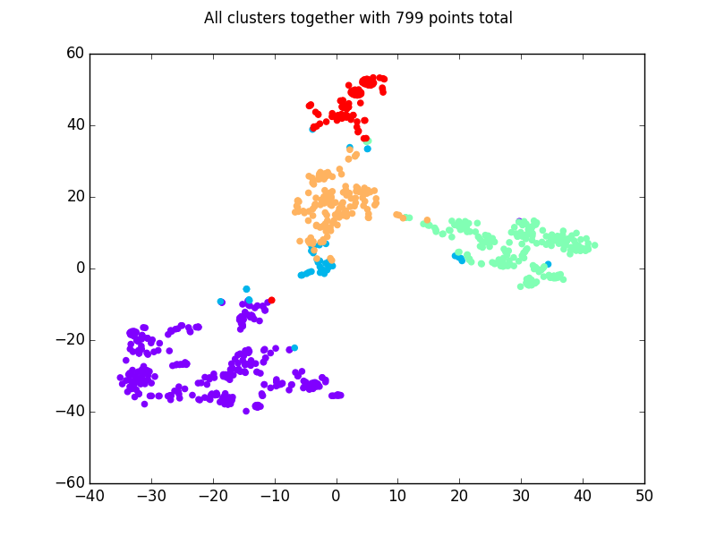
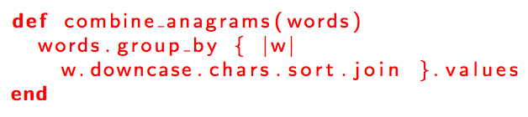
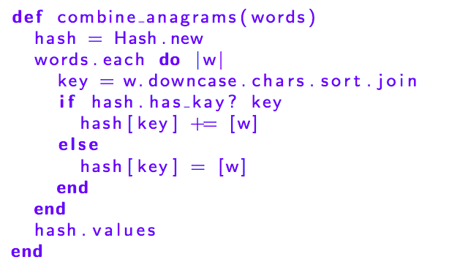
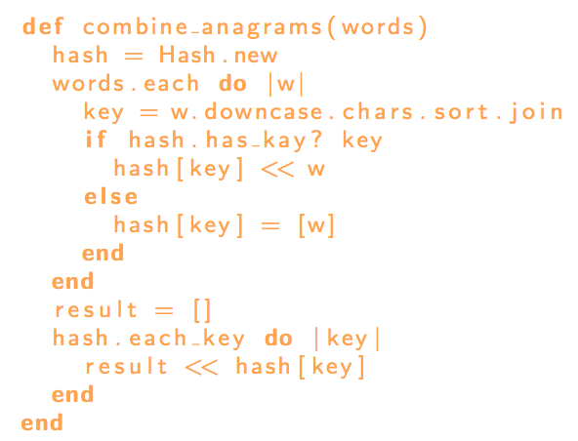
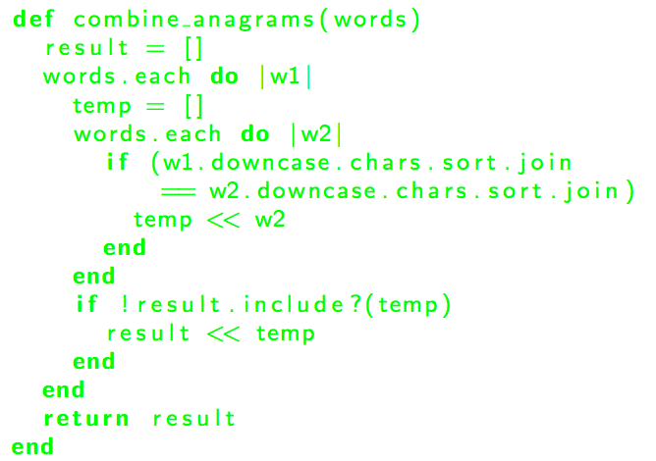
Example Result
t-SNE visualization of running OPTICS against normalized TED on a dataset of 800 submissions

Slide 5
Related Work
Feature Engineering for clustering student submissions Glassman, E. L., Singh, R., and Miller, R. C. proposes
Syntactic and Functional Variability of a Million Code Submissions in a Machine Learning MOOC Jonathan Huang, Chris Piech, Andy Nguyen, and Leonidas Guibas
construct a network of solutions using TED of AST to measure syntactic variability

Slide 6
Related Work
OverCode: Visualizing variation in student solutions to programming problems at scale Scott, J., Singh, R., Guo, P. J., , and Miller, R. C.
design and implement a system to visualize major groupings of variation among student submissions to a code assignment

Slide 7
Related Work
Codewebs: Scalable code search for moocs Nguyen, A., Piech, C., Huang, J., and Guibas, L.
compare “code phrases,” or subgraphs of ASTs, to determine the probabilistic semantic equivalence of two pieces of code
A Comparison of Source Code Plagiarism Detection Engines Lancaster, T., and Culwin, F.
use AST to detect plagiarism

