Slide 1
Ultimate Cycling Training System
The Ultimate Cycling Training System based on the power output measuring of cyclists to offer them real-time data required for performance tracking.

Slide 2


The Work Plan
1
Understanding the physics behind measuring power on a practical level. (Group Work)
2
Determining the connectivity protocol and learn the basics (ANT+, Bluetooth Low Power, etc.). (Pedro)
3
Installing the sensors and strain gauges on the bike and testing them.
4
Final Tests. (Group Work)
Deciding on the project electronic architecture. (Jorge & Karthika)
Android Application Programming and Development.( Youssef & Muhammad)
Data Acquisition and Processing (Prototyping).
Setting the used wireless connectivity protocol.
Project Presentation. (Group Work).
Acquired Data Management, Processing and Display. (Android Phone App and Smart Watches).
Implement the final board. (Arduino Nano)

Slide 3
Completed Tasks and Evaluation
1
Understanding the physics behind measuring power on a practical level. (Group Work)
2
Deciding on the project electronic architecture. (Jorge & Karthika)
Determining the connectivity protocol (ANT+, Bluetooth Low Power, etc.). (Pedro)
Android Application Programming and Development.( Youssef & Muhammad)
List of Components (Selecting and ordering components).
Connectivity Protocol ANT+ was chosen, but with Bluetooth Smart as a backup solution (We are working in both approaches) .
Basic wireless data transmission has been done with the Development Kit of Multiprotocol RF Module (nRF52 Nordic Semi-Conductors).
Met several complications deciding on the electronic architecture: (Availability, Price, Connectivity Compatibility, Delivery time…etc.).
Android Application programming (in process).

Slide 4
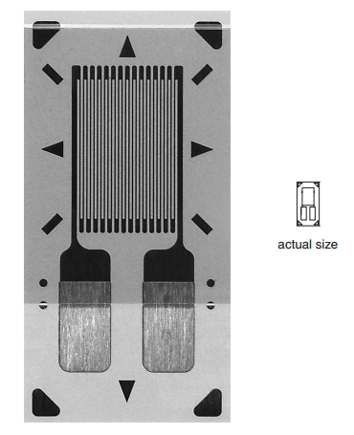
Strain Gauges (4x)
CEA-06-125UN-350
General purpose strain gauge
6.99mm x 2.54mm
350 Ohms
Must be used in a half or full-bridge configuration

Slide 5
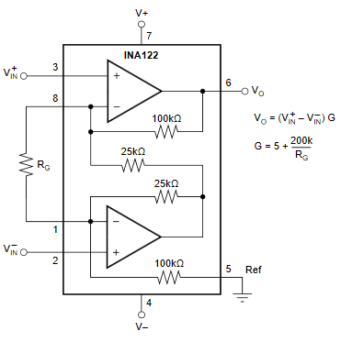
Instrumentation Amplifier
INA122
Gain determined by RG
Output range determined by supply voltage.
RG ~ 500 Ohms

Slide 6
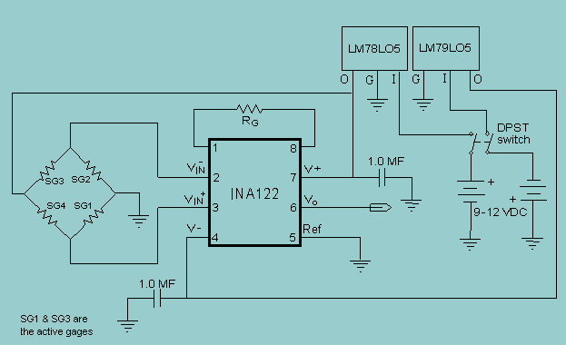
Signal Amplification
Behaviour:
R increase in tension
R decrease in compresion
Implementation:
Full bridge with two gauges in tension, two in compresion.
Eliminates errors due to temperature and imbalance of the bridge.

Slide 7
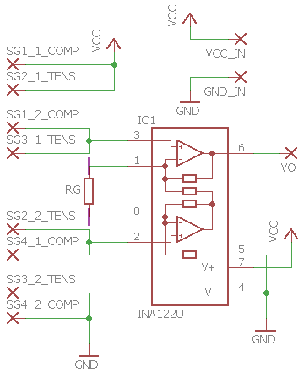
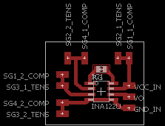
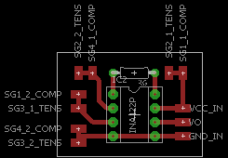
Signal amplification

Slide 8
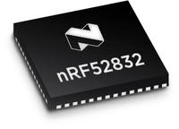
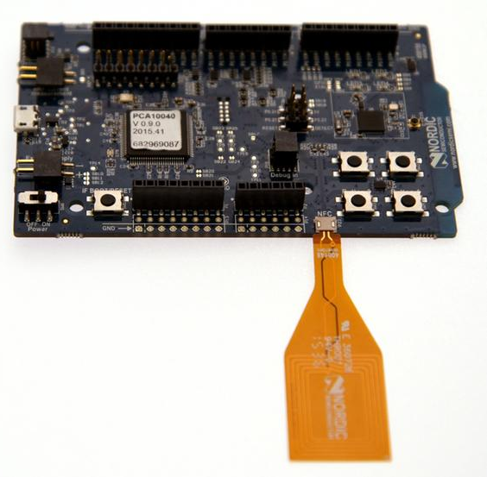
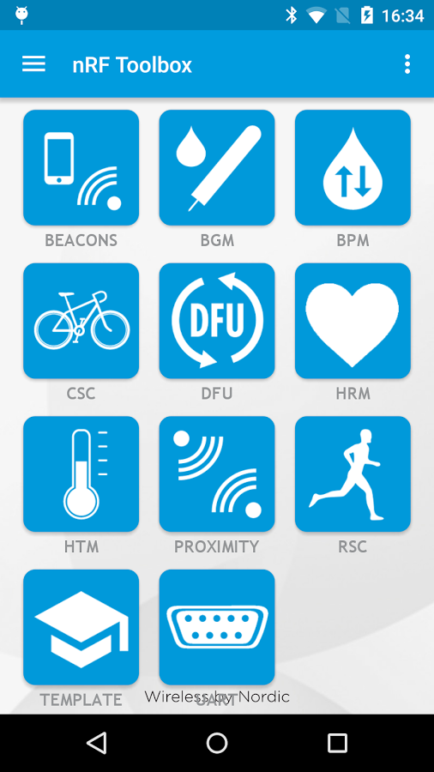

Ongoing work– nRF52 DK
Main Features:
nRF52832 SoC is a multiprotocol, low power radio module which supports: Bluetooth Smart, ANT and 2.4GHz.
nRF52 DK is a low cost single board development for nRF52832.
Android, IOs App for testing the module communication.

Slide 9

Ongoing work – Android programming
Acquiring proficient knowledge and practicing android programming
Discovering means of data delivery to the smart phone
Learning how to handle and utilize the delivered data for our specific needs

Slide 10
Further Remaining Work
3
Data Acquisition and Processing (Prototyping). ( Pedro , Youssef, Muhammed )
Installing the Sensors and Torque Sensor ( strain gauge based) on the bike and testing them. ( Jorge & Karthika).
Setting the used wireless connectivity protocol. ( Pedro )
Waiting for the delivery of the strain gauges to finish the torque sensor.
Determining sensitivity [V/N] of strain gauges measurements.
Prototyping the system using the Development Kit Board:
Wireless Communication protocol testing.
Torque sensor analog signal transmission (using an analog test signal).
Processing Torque sensor and cadence signal using the Android Phone App.

Slide 11
Further Remaining Work
Project Presentation. (Group Work).
Final Tests. (Group Work)
4
Implement the final board. (Arduino Nano). (Group Work)
Acquired Data Management, Processing and Display. (Android Phone App and Smart Watches). (Group Work).
Develop our final board using the nRF52832 module in combination with a microcontroller (Arduino Nano).
Sending the data to a smart phone using the final board.
Learn how to display the power using other devices such as commercial sport watches (Possible system expansion) .
Compare the power we are measuring with an commercial power meter.

