Slide 1
DB
Rutherford's Atomic Model
Grade 11 • Physics

Slide 2

Rutherford's Atomic Model
Understanding Rutherford's model
Atomic structure
Nuclear discovery
From your material · Page 7
2 / 8
Notes:
Rutherford discovered the nucleus in atoms.
Example: Gold foil experiment
Key words: nucleus = center of atom
Teacher Script: Let's learn about Rutherford's atomic model.
Communication Access: point to diagram

Slide 3
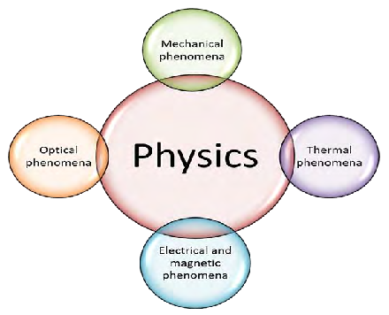
Nuclear Discovery
Nucleus dense, positive, small
Nucleus dense
Nucleus positive
Nucleus small
From your material · Page 7
3 / 8
Notes:
Nucleus is dense, positive, and small.
Example: Gold foil experiment
Key words: dense = crowded
Teacher Script: Nucleus is dense, positive, and small.
Communication Access: point to diagram

Slide 4
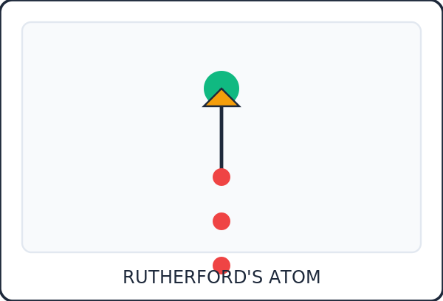
Electron Orbit
Electrons negative, move around nucleus
Electrons orbit
Electrons negative
Electrons move
4 / 8
Notes:
Electrons orbit the nucleus and are negative.
Example: Gold foil experiment
Key words: orbit = circle around
Teacher Script: Electrons orbit the nucleus and are negative.
Communication Access: point to diagram

Slide 5
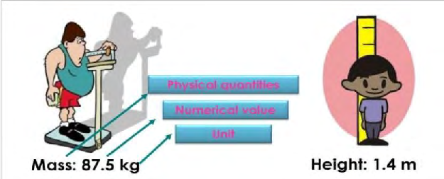
Gold Foil Experiment
Experiment shows, protons positive, nucleus small
Experiment shows
Protons positive
Nucleus small
From your material · Page 8
5 / 8
Notes:
Experiment shows protons are positive and nucleus is small.
Example: Gold foil experiment
Key words: protons = positive charge
Teacher Script: Experiment shows protons are positive and nucleus is small.
Communication Access: point to diagram

Slide 6
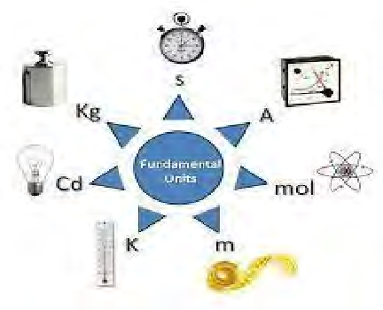
Draw and Label
Draw nucleus, draw electrons, label parts
Draw nucleus
Draw electrons
Label parts
From your material · Page 8
6 / 8
Notes:
Draw nucleus, draw electrons, and label parts.
Example: Nuclear diagram
Key words: label = write name
Teacher Script: Draw nucleus, draw electrons, and label parts.
Communication Access: draw on board

Slide 7
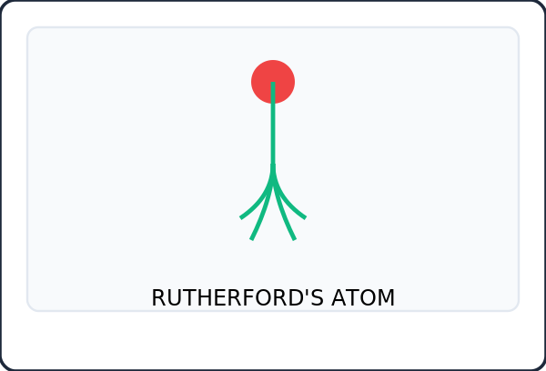
Review Rutherford's Model
Nucleus dense, positive, small, electrons orbit, negative
Nucleus dense
Nucleus positive
Nucleus small
7 / 8
Notes:
Review Rutherford's model: nucleus is dense, positive, and small; electrons orbit and are negative.
Example: Nuclear diagram
Key words: dense = crowded
Teacher Script: Review Rutherford's model.
Communication Access: point to diagram

Slide 8
All done!
8 / 8

