Slide 1
DB
Rutherford's Atomic Model
Grade 11 • Physics
Physics Grade 11 Standard 2

Slide 2
Visual Schedule
1
2
3
4
First
Then
Last
Done
calendar
book
checkmark
smile
5 mins
10 mins
10 mins
5 mins
Draft Bench
2 / 8

Slide 3
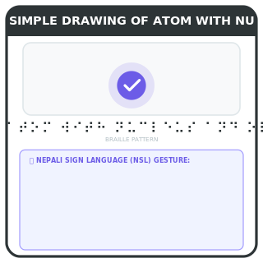
Rutherford's Atomic Model
Learn Rutherford's model of the atom
Understand Rutherford's experiment
Discover the nucleus
Learn about electrons
Rutherford's experiment showed that atoms have a small, dense center called the nucleus. Electrons orbit around the nucleus.
Key words
nucleus: center of the atom
electrons: particles that orbit the nucleus
Draft Bench
3 / 8
Example
Imagine a solar system where the sun is the nucleus and planets are electrons.
Notes:
Teacher Script: Today, we will learn about Rutherford's model of the atom. Let's start with his experiment.
Communication Access: point

Slide 4
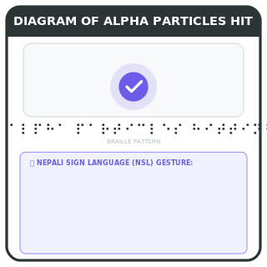
Rutherford's Experiment
Gold foil experiment
Gold foil experiment
Most particles pass through
Some particles bounce back
Rutherford shot alpha particles at a thin gold foil. Most passed through, but some bounced back, showing a small dense center.
Key words
alpha particles: positively charged particles
Draft Bench
4 / 8
Example
Imagine shooting a ball at a wall. Most balls pass through, but a few bounce back.
Notes:
Teacher Script: Rutherford did an experiment with alpha particles. Most passed through, but some bounced back. This showed a small dense center.
Communication Access: point

Slide 5
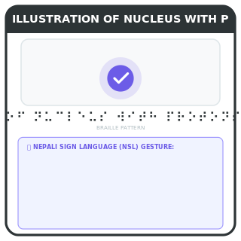
Nucleus
Small, dense center
Contains protons and neutrons
Positive charge
Most of the mass
The nucleus is small and dense. It contains protons and neutrons, giving it a positive charge and most of the mass.
Key words
protons: positively charged particles in nucleus
neutrons: neutral particles in nucleus
Draft Bench
5 / 8
Example
Think of a small, dense ball in the center of a large space.
Notes:
Teacher Script: The nucleus is the small, dense center. It contains protons and neutrons. It has a positive charge and most of the mass.
Communication Access: point

Slide 6
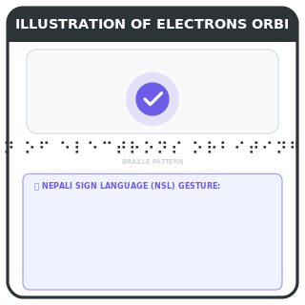
Electrons
Negatively charged particles
Orbit the nucleus
Much smaller than nucleus
Negative charge
Electrons are negatively charged particles that orbit the nucleus. They are much smaller than the nucleus.
Key words
electrons: negatively charged particles
Draft Bench
6 / 8
Example
Imagine tiny marbles orbiting a large ball.
Notes:
Teacher Script: Electrons are negatively charged particles that orbit the nucleus. They are much smaller than the nucleus.
Communication Access: point

Slide 7

Example
Nepali example
Atom like a city
Nucleus like a palace
Electrons like people
Think of an atom like a city. The nucleus is like a palace in the center. Electrons are like people who live around the palace.
Example
Imagine a city with a palace in the center and people living around it.
Draft Bench
7 / 8
Notes:
Teacher Script: Think of an atom like a city. The nucleus is like a palace in the center. Electrons are like people who live around the palace.
Communication Access: point

Slide 8
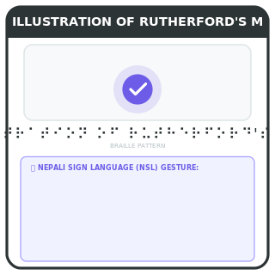
Review
Rutherford's model
Small dense nucleus
Electrons orbit nucleus
Positive and negative charges
Rutherford's model shows a small, dense nucleus with electrons orbiting around it. There are positive and negative charges.
Example
Imagine a small, dense ball with tiny marbles orbiting around it.
Draft Bench
8 / 8
Notes:
Teacher Script: Review: Rutherford's model shows a small, dense nucleus with electrons orbiting around it. There are positive and negative charges.
Communication Access: point

