Slide 1
DB
Set Theory Basics
Grade 7 • Mathematics
Standard 1, Standard 2, Standard 3

Slide 2
Visual Schedule
1
2
3
4
First
Then
Last
Done
book
pencil
checkmark
smiley face
5 mins
10 mins
10 mins
5 mins
Draft Bench
2 / 8

Slide 3
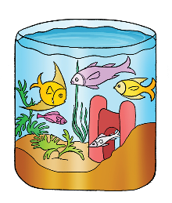
What is a Set?
A set is a collection of items.
Items in a set are unique
Sets can be finite or infinite
Sets can be equal or equivalent
A set is a group of distinct items. Sets can be counted or not counted. Sets can be the same or have the same number of items but not the same items.
From your material · Page 8
Key words
set: collection of items
Example
Draft Bench
3 / 8
A set of colors in a rainbow
Notes:
Teacher Script: Today, we will learn about sets. A set is a collection of items. Sets can be counted or not counted. Sets can be the same or have the same number of items but not the same items.
Communication Access: point
Sensory Note: null

Slide 4
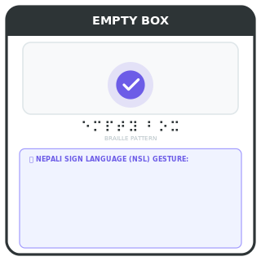
Null Set
A set with no items is called a null set.
A null set has no elements
It is denoted by ∅
Examples: set of female Prime Minister of Nepal
A null set is a set that has no items. It is denoted by the symbol ∅. Examples include a set of female Prime Minister of Nepal, as there has never been one.
Key words
null set: set with no elements
Draft Bench
4 / 8
Example
Set of female Prime Minister of Nepal
Notes:
Teacher Script: A null set is a set with no elements. It is denoted by the symbol ∅. Examples include a set of female Prime Minister of Nepal, as there has never been one.
Communication Access: point
Sensory Note: null

Slide 5
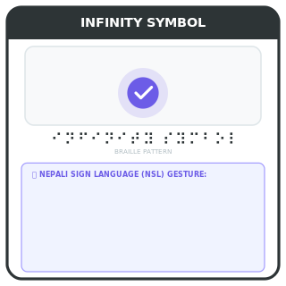
Finite and Infinite Sets
Sets can be finite or infinite.
Finite sets have a fixed number of elements
Infinite sets do not have a fixed number of elements
Examples: set of natural numbers is infinite
Sets can be finite or infinite. Finite sets have a fixed number of elements. Infinite sets do not have a fixed number of elements. Examples include the set of natural numbers, which is infinite.
Key words
finite set: set with a fixed number of elements
infinite set: set with no fixed number of elements
Draft Bench
5 / 8
Example
Set of natural numbers
Notes:
Teacher Script: Sets can be finite or infinite. Finite sets have a fixed number of elements. Infinite sets do not have a fixed number of elements. Examples include the set of natural numbers, which is infinite.
Communication Access: point
Sensory Note: null

Slide 6
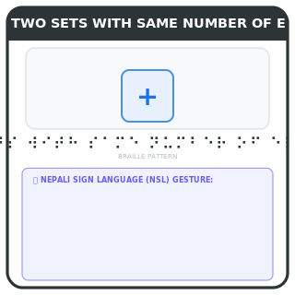
Equivalent and Equal Sets
Sets can be equivalent or equal.
Equivalent sets have the same number of elements
Equal sets have the same elements
Examples: set A and set B are equivalent
Sets can be equivalent or equal. Equivalent sets have the same number of elements. Equal sets have the same elements. Examples include set A and set B, which are equivalent.
Key words
equivalent set: sets with the same number of elements
equal set: sets with the same elements
Draft Bench
6 / 8
Example
Set A and set B, both have 3 elements
Notes:
Teacher Script: Sets can be equivalent or equal. Equivalent sets have the same number of elements. Equal sets have the same elements. Examples include set A and set B, which are equivalent.
Communication Access: point
Sensory Note: null

Slide 7
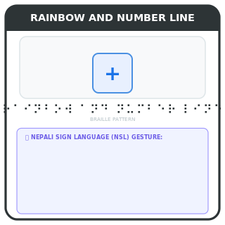
Practice with Sets
Practice identifying sets and their properties.
Identify sets in real life
Determine if sets are finite or infinite
Determine if sets are equivalent or equal
Practice identifying sets and their properties. Identify sets in real life. Determine if sets are finite or infinite. Determine if sets are equivalent or equal.
Key words
finite: set with a fixed number of elements
infinite: set with no fixed number of elements
Draft Bench
7 / 8
Example
Set of colors in a rainbow, set of natural numbers
Notes:
Teacher Script: Practice identifying sets and their properties. Identify sets in real life. Determine if sets are finite or infinite. Determine if sets are equivalent or equal.
Communication Access: point
Sensory Note: null

Slide 8
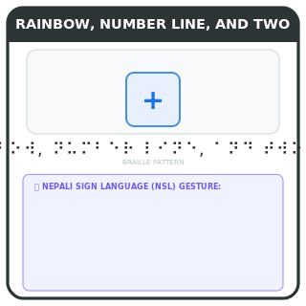
Review of Sets
Review key concepts of sets.
What is a set?
What is a null set?
What are finite and infinite sets?
Review key concepts of sets. What is a set? What is a null set? What are finite and infinite sets? What are equivalent and equal sets?
Key words
set: collection of items
null set: set with no elements
Draft Bench
8 / 8
Example
Set of colors in a rainbow, set of natural numbers
Notes:
Teacher Script: Review key concepts of sets. What is a set? What is a null set? What are finite and infinite sets? What are equivalent and equal sets?
Communication Access: point
Sensory Note: null

