Slide 1
DB
Rutherford's Gold Foil Experiment
Grade 11 • Physics

Slide 2
Visual Schedule
1
2
3
4
First
Then
Last
Done
First slide
Concept slide
Example slide
Review slide
5 mins
10 mins
10 mins
5 mins
Draft Bench
2 / 9

Slide 3
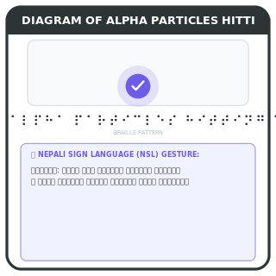
Rutherford's Experiment
Learn about Rutherford's gold foil experiment
Discover nucleus
Particles pass through
Few bounce back
This experiment helped us understand the structure of atoms.
Key words
alpha particles: Tiny charged particles
Draft Bench
3 / 9
Example
Imagine shooting tiny balls at a wall and only a few bouncing back.
Notes:
Teacher Script: Today we will learn about Rutherford's experiment.
Communication Access: Point to pictures

Slide 4
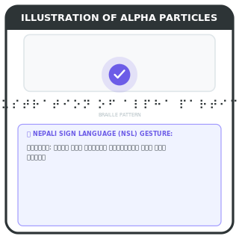
Alpha Particles
Alpha particles are positively charged
Alpha particles
Positively charged
Smaller than atoms
Alpha particles are like tiny, positively charged balls.
Key words
alpha particles: Tiny, positively charged particles
Draft Bench
4 / 9
Example
Think of a tiny, positively charged marble.
Notes:
Teacher Script: Alpha particles are tiny, positively charged.
Communication Access: Point to pictures

Slide 5

Gold Foil
Gold foil is very thin and flexible
Gold foil
Very thin
Flexible material
Gold foil is like a very thin, bendable sheet.
Key words
gold foil: Very thin, bendable gold sheet
Draft Bench
5 / 9
Example
Think of a thin, bendable gold sheet.
Notes:
Teacher Script: Gold foil is very thin and bendable.
Communication Access: Point to pictures

Slide 6
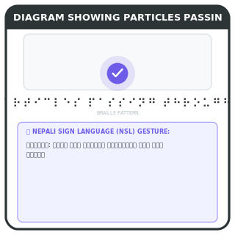
Experiment Results
Most particles pass through, few bounce back
Most particles
Pass through foil
Few bounce back
Most alpha particles pass through the foil, but a few bounce back.
Key words
deflection: Bouncing back
Example
Draft Bench
6 / 9
Most marbles pass through, but a few bounce back.
Notes:
Teacher Script: Most particles pass through, but a few bounce back.
Communication Access: Point to pictures

Slide 7
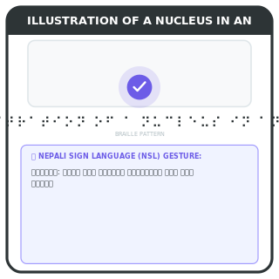
Nucleus Discovery
Experiment proved the existence of the nucleus
Nucleus dense
Very small
Contains protons
The experiment proved that atoms have a dense, small nucleus.
Key words
nucleus: Tiny, dense center of an atom
Draft Bench
7 / 9
Example
Think of a tiny, dense nucleus in the center of an atom.
Notes:
Teacher Script: The experiment proved the existence of the nucleus.
Communication Access: Point to pictures

Slide 8

Practice
Practice identifying alpha particles and nuclei
Identify particles
Locate nucleus
Practice identifying alpha particles and locating the nucleus.
Example
Find the alpha particles and the nucleus in the diagram.
Draft Bench
8 / 9
Notes:
Teacher Script: Practice identifying particles and locating the nucleus.
Communication Access: Point to pictures

Slide 9
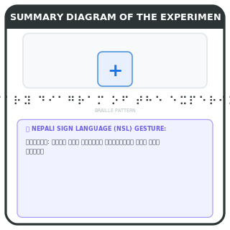
Review
Review Rutherford's experiment and findings
Experiment details
Nucleus discovery
Alpha particles
Review the key points of Rutherford's experiment and its findings.
Example
Recall the experiment and what it proved.
Draft Bench
9 / 9
Notes:
Teacher Script: Review the experiment and its findings.
Communication Access: Point to pictures

