Slide 1
DB
Rutherford's Experiment and Atomic Model
Grade 11 • Mathematics
N/A

Slide 2
Visual Schedule
1
2
3
4
First
Then
Last
Done
clock
light bulb
checkmark
smiley face
5 mins
10 mins
10 mins
5 mins
Draft Bench
2 / 7

Slide 3
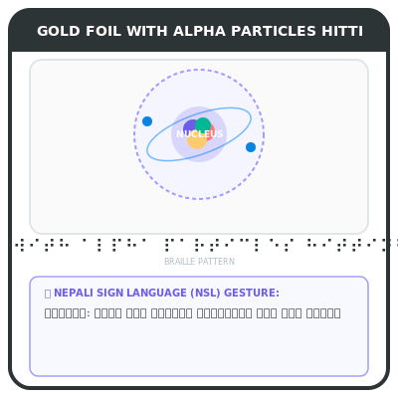
Rutherford's Experiment
Discovering atomic structure
Rutherford gold foil experiment
Nuclear model proposed
Nucleus center
Rutherford used gold foil to discover the nucleus. He found most particles passed through, but a few bounced back.
Key words
gold foil: thin sheet of gold used in experiment
Draft Bench
3 / 7
Example
Imagine shooting BBs at a wall; most pass through, but a few bounce back.
Notes:
Teacher Script: Let's learn about Rutherford's experiment.
Communication Access: point to each bullet

Slide 4
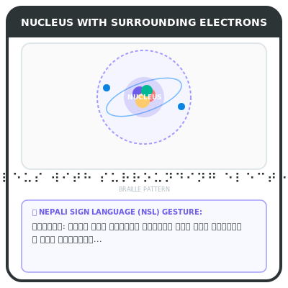
Nuclear Model
Nucleus contains protons and neutrons
Nucleus center
Protons positive
Electrons orbit
The nucleus is at the center and contains positive protons and negative electrons.
Key words
protons: positively charged particles in nucleus
Draft Bench
4 / 7
Example
Think of a sun with planets orbiting around it.
Notes:
Teacher Script: The nucleus is the center.
Communication Access: point to each bullet

Slide 5
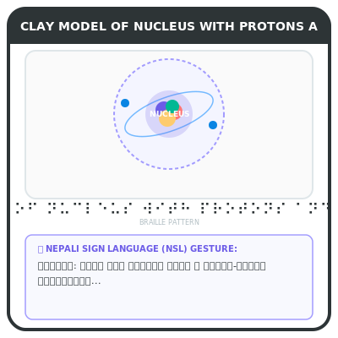
Model Building
Constructing atomic model
Use clay
Attach protons
Add electrons
We will use clay to build the atomic model. First, attach protons, then add electrons.
Key words
clay: plastic modeling material
Draft Bench
5 / 7
Example
Roll clay into small balls for protons and electrons.
Notes:
Teacher Script: Let's build the model.
Communication Access: point to each bullet

Slide 6
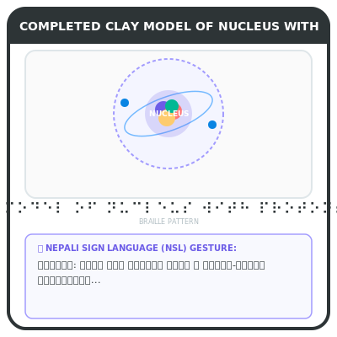
Building Model
Constructing atomic model
Build nucleus
Add electrons
Check model
Build the nucleus first, then add electrons. Check if the model is correct.
Key words
nucleus: central part of atom containing protons and neutrons
Draft Bench
6 / 7
Example
Place protons in the center and add electrons around.
Notes:
Teacher Script: Let's check the model.
Communication Access: point to each bullet

Slide 7
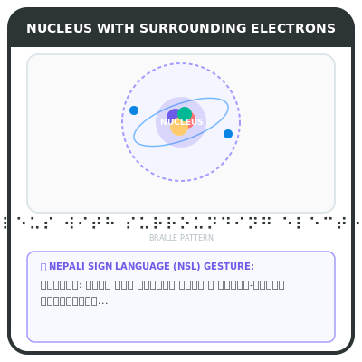
Review
Understanding atomic structure
Rutherford experiment
Nuclear model
Protons positive
Rutherford's experiment showed the nucleus. The nucleus contains protons and electrons orbit it.
Key words
electrons: negatively charged particles orbiting nucleus
Draft Bench
7 / 7
Example
Remember, most particles pass through, but a few bounce back.
Notes:
Teacher Script: Let's review what we learned.
Communication Access: point to each bullet

