Slide 1
DB
Rutherford's Experiment
Grade 11 • Physics
N/A

Slide 2
Visual Schedule
1
2
3
4
First
Then
Last
Done
clock
light bulb
checkmark
smiley face
5 mins
10 mins
10 mins
5 mins
Draft Bench
2 / 8

Slide 3
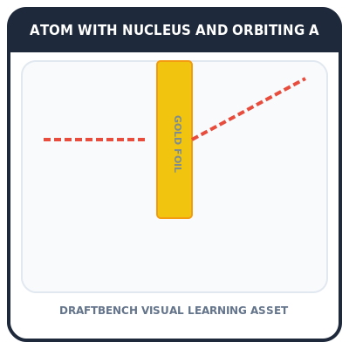
Rutherford's Experiment
Discovering the nucleus
Rutherford's gold foil experiment
Alpha particles
Positive charge
Rutherford used alpha particles to test the atom's structure. Alpha particles are positively charged and light in mass.
Key words
alpha particles: tiny, positively charged atoms
Draft Bench
3 / 8
Example
Think of alpha particles like tiny, positively charged balls.
Notes:
Teacher Script: Let's learn about Rutherford's experiment.
Communication Access: point to the visual

Slide 4
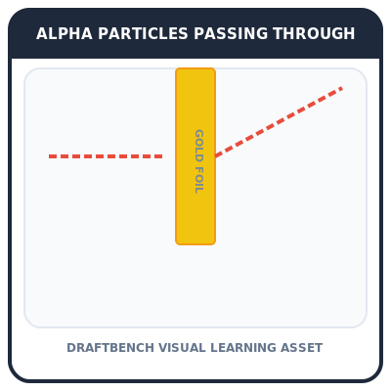
Alpha Particles
Light mass
Tiny, positively charged
Light in mass
Dense material
Alpha particles are very small and have a positive charge. They are also light in mass, making them easy to shoot through materials.
Key words
positively charged: carrying a positive electric charge
Draft Bench
4 / 8
Example
Imagine shooting tiny, positively charged balls through a sheet of paper.
Notes:
Teacher Script: Alpha particles are tiny and carry a positive charge.
Communication Access: gesture to show passing through

Slide 5
Experiment Results
Orbit nucleus
Most particles passed through
Some particles deflected
Positive charge
Most alpha particles passed through the gold foil, but some were deflected. This showed the nucleus has a positive charge.
Key words
deflected: changed direction due to force
Draft Bench
5 / 8
Example
Like a ball bouncing off a wall, some alpha particles were deflected.
Notes:
Teacher Script: Some particles were deflected, showing the nucleus has a positive charge.
Communication Access: point to the visual

Slide 6
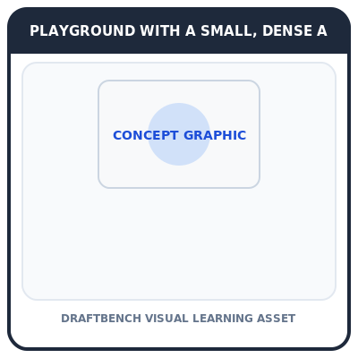
Nuclear Model
Find nucleus
Most particles passed through
Some particles deflected
Model created
Rutherford concluded that most particles pass through, but some are deflected. This led to the discovery of the nucleus.
Key words
nucleus: central part of the atom containing protons and neutrons
Draft Bench
6 / 8
Example
Imagine a playground with a small, dense area in the middle. Most balls pass through, but some bounce off.
Notes:
Teacher Script: Rutherford found the nucleus by observing how particles passed through.
Communication Access: point to the visual

Slide 7

Practice
Find electrons
Practice questions
Answer correctly
Get reward
Practice questions will help you understand Rutherford's experiment better. Answer correctly to get a reward.
Example
Solve the practice questions to win a prize.
Draft Bench
7 / 8
Notes:
Teacher Script: Let's practice with some questions.
Communication Access: point to the questions

Slide 8
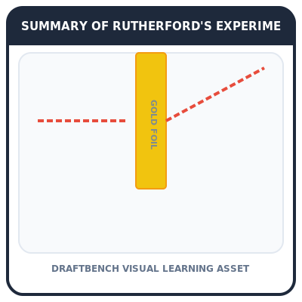
Review
Rutherford's experiment
Used alpha particles
Discovered nucleus
Created model
Rutherford used alpha particles to discover the nucleus. This led to the creation of the nuclear model.
Example
Remember, Rutherford used alpha particles to find the nucleus.
Draft Bench
8 / 8
Notes:
Teacher Script: Let's review what we learned today.
Communication Access: point to the visual

