Slide 1
DB
Short Lesson on Rutherford
Grade 11 • Physics
null

Slide 2
Visual Schedule
1
2
3
4
First
Then
Last
Done
clock
light bulb
checkmark
smiley face
5 mins
10 mins
10 mins
5 mins
Draft Bench
2 / 7

Slide 3
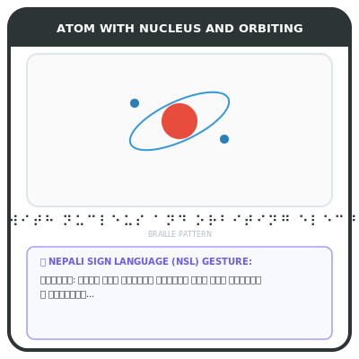
Rutherford's Experiment
Rutherford discovered nucleus
Gold foil experiment
Nucleus small, dense
Electrons orbit nucleus
Rutherford used gold foil to show nucleus exists. Tiny particles passed through mostly unaffected.
Key words
nucleus: center of atom
electrons: particles around nucleus
Draft Bench
3 / 7
Example
Imagine shooting bullets at a wall. Most pass through, but some bounce back.
Notes:
Teacher Script: Let's learn about Rutherford's experiment.
Communication Access: point to pictures
Sensory Note: null

Slide 4
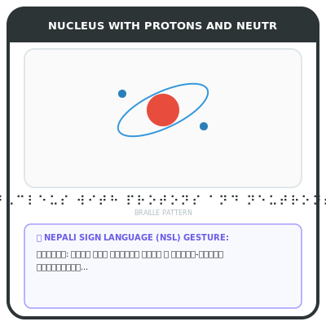
Nucleus
Nucleus is center of atom
Small, dense
Contains protons and neutrons
Nucleus is tiny but very dense. It contains protons and neutrons.
Key words
protons: positive charge
neutrons: no charge
Draft Bench
4 / 7
Example
Like a tiny ball in the middle of a big ball
Notes:
Teacher Script: Nucleus is center of atom.
Communication Access: point to pictures
Sensory Note: null

Slide 5
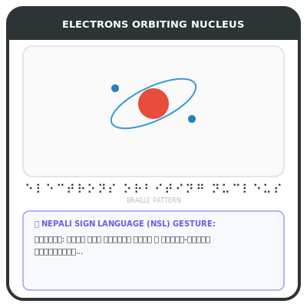
Electrons
Electrons orbit nucleus
Light, negative charge
Move around nucleus
Electrons are light and have negative charge. They move around nucleus.
Key words
negative charge: opposite of positive
Draft Bench
5 / 7
Example
Like planets around sun
Notes:
Teacher Script: Electrons move around nucleus.
Communication Access: point to pictures
Sensory Note: null

Slide 6
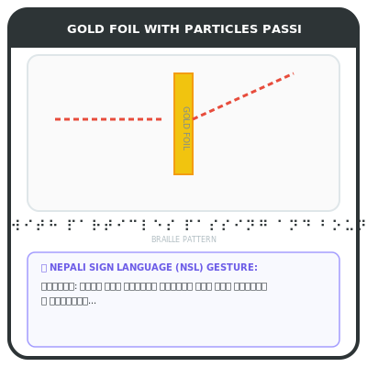
Example
Rutherford's experiment shows nucleus
Most particles pass
Some bounce back
Most particles pass through foil, but some bounce back. This shows nucleus exists.
Example
Like shooting bullets at wall
Draft Bench
6 / 7
Notes:
Teacher Script: Rutherford's experiment shows nucleus.
Communication Access: point to pictures
Sensory Note: null

Slide 7

Review
Rutherford discovered nucleus
Gold foil experiment
Nucleus small, dense
Electrons orbit nucleus
Rutherford used gold foil to show nucleus exists. Tiny particles passed through mostly unaffected.
Key words
nucleus: center of atom
electrons: particles around nucleus
Draft Bench
7 / 7
Example
Imagine shooting bullets at a wall. Most pass through, but some bounce back.
Notes:
Teacher Script: Review Rutherford's experiment.
Communication Access: point to pictures
Sensory Note: null

