Slide 1
DB
Lost Donkey Chapter
Grade 4 • English

Slide 2
Visual Schedule
1
2
3
4
First
Then
Last
Done
books
listening
review
checkmark
5 mins
10 mins
10 mins
5 mins
Draft Bench
2 / 7

Slide 3
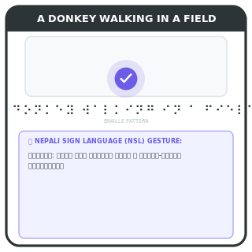
Lost Donkey Chapter
Understand the story
Read the chapter
Follow the donkey
Find the donkey
Learn about the donkey's journey and how it was found.
Key words
donkey: animal used for carrying things
Draft Bench
3 / 7
Example
Help the donkey find its way home.
Notes:
Teacher Script: Let's read the lost donkey story together.
Communication Access: point to pictures

Slide 4
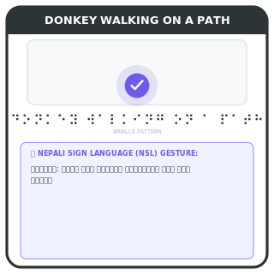
Donkey's Journey
Donkey travels to new place
Donkey leaves home
Meets new people
Finds new path
The donkey goes on a trip and meets different people and places.
Key words
journey: trip
Example
Draft Bench
4 / 7
Donkey goes to the market and meets farmers.
Notes:
Teacher Script: Where does the donkey go on its journey?
Communication Access: point to pictures

Slide 5
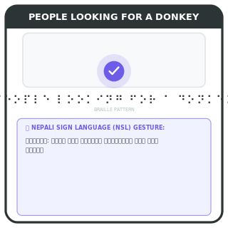
Lost Donkey
Donkey gets lost
Donkey wanders away
People search
Donkey is found
The donkey gets lost and people try to find it.
Key words
search: look for something
Example
Draft Bench
5 / 7
People look for the donkey in the fields.
Notes:
Teacher Script: What do people do when the donkey is lost?
Communication Access: point to pictures

Slide 6
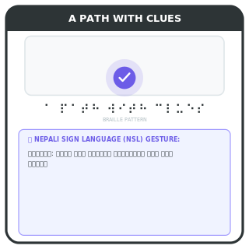
Help the Donkey
Find the donkey
Look for clues
Follow the path
Find the donkey
Use clues to find where the donkey is.
Key words
clues: hints to solve a problem
Draft Bench
6 / 7
Example
Follow the path to find the donkey.
Notes:
Teacher Script: Can you find the donkey? Look for clues.
Communication Access: point to pictures

Slide 7
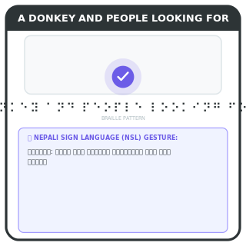
Review Lost Donkey
Remember the story
Read the chapter
Discuss the journey
Find the donkey
Review the story and the donkey's journey.
Example
Talk about the donkey's adventure.
Draft Bench
7 / 7
Notes:
Teacher Script: Let's review the lost donkey story together.
Communication Access: point to pictures

