Slide 1
A web tool for child-proofing(censoring) online content Literature Survey
January 20th, 2025
Mentor: Prof. Srimanta Mandal

Slide 2
Problem Statement
Given the rising attention^{[1]} on the mental health problems among youngsters with increased social media presence, we wanted to make the internet a safer and more productive place for everyone.
So, the goal is to create an interface that can curate existing content by blurring/removing hateful/abusive/non-child friendly content.
[1] – Australia’s ban on social media for teens under 16.
Following this, the Indian government enforced the requirement of parental consent strictly for usage of social media for teens.

Slide 3
Literature Survey

Slide 4
1. A Survey on Automatic Detection of Hate Speech in Text
1306 citations
ML models: SVM, Random Forest, Decision Trees, Logistic Regression, and Naive Bayes
CNN, DNN, LSTM
Text mining: N-grams, Bag-of-Words, TF-IDF, POS
Best F-measure (0.93) – combo of CNN, DNN, ML models
Average F-measure (0.77-0.9) – using traditional SVM

Slide 5
2. Hate speech detection: Challenges and solutions
315 citations
Keywords - Hatebase
ML: SVM, Logistic Regression, Naive Bayes, NNs
DL: BERT, CNNs, GRU based ensembles
Text mining: N-grams, Bag-of-Words, TF-IDF, POS
BERT – 82 percent accuracy on Stormfront Neural Ensembles – 91.17% F1-score
mSVM: 53.68% F1, outperforming BERT (52.34% F1) and others.

Slide 6
3. Detection of Hate Speech using BERT and Hate Speech Word Embedding with Deep Model
98 citations
Approach 1- Hate word embeddings with BiLSTM
Approach 2- Pre-trained BERT model
BiLSTM – 93% F1-score
BERT – 96% F1-score
(Both Results on combined dataset)

Slide 7
4. HateXplain: A Benchmark Dataset for Explainable Hate Speech Detection
599 citations
Data: Twitter and Gab scraping (total 20,148 posts)
Models: CNN-GRU (for local, sequential dependencies), BiRNN (bidirectional RNN), BiRNN with Attention (additional attention layer in model), BERT
69.8% accuracy, 68.7% Macro F1, 85.1% AUROC (due to diversity in dataset)

Slide 8
5. DeepHate: Hate Speech Detection via Multi-Faceted Text Representations
112 citations
Data: combination of 4 public datasets
Semantic rep.: word embeddings + (C-LSTM-Att) encoder
Sentiment rep.: sentiment specific embeddings + analysis (VADER) + (C-LSTM-Att) encoder
Topic rep.: Latent Dirichlet Allocation (LDA) to capture topics within the text.
(CNN at the heart of the system)
78.19% – 92.43% micro-F1 scores in publicly available datasets

Slide 9
6. A Character-based Convolutional Neural Network for Language-Agnostic Twitter Sentiment Analysis
63 citations
Data: multilingual Twitter dataset (128,189 tweets)
Framework: character based CNN (Conv-Char-S)
4-layer network-robust against typos, unseen words
(CNN at the heart of the system)
Accuracy: 72.0% (best among models)
F1-Score: 75.6% (highest)

Slide 10
7. Opinion Mining and Sentiment Analysis on a Twitter Data Stream
93 citations
Data: ~54.8k tweets scraped using Twitter API
Framework: Evaluation of Naive Bayes, SVMs, Random Forest, Sequential Minimal Optimization (SMO), J48: A Java implementation of the C4.5 decision tree algorithm.
Best performers: Bayesian Logistic Regression (76.6% accuracy, 0.750 F1) and SMO (74.9% accuracy, 0.718 F1).

Slide 11
Papers using Davidson et al. dataset

Slide 12
Detection of Hate Speech using BERT and Hate Speech Word Embedding with Deep Model
98 citations
Approach 1- Hate word embeddings with BiLSTM
Approach 2- Pre-trained BERT model
BiLSTM – 93% F1-score
BERT – 96% F1-score
(Both Results on combined dataset)

Slide 13
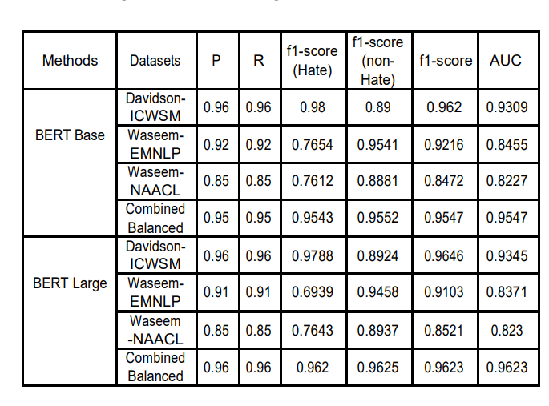






Slide 14
BERT-based Ensemble Approaches for Hate Speech Detection
This paper focuses on classifying hate speech in social media using multiple deep models that are implemented by integrating recent transformer-based language models such as BERT, and neural networks.
To improve the classification performances, they evaluated with several ensemble techniques, including soft voting, maximum value, hard voting and stacking.

Slide 15
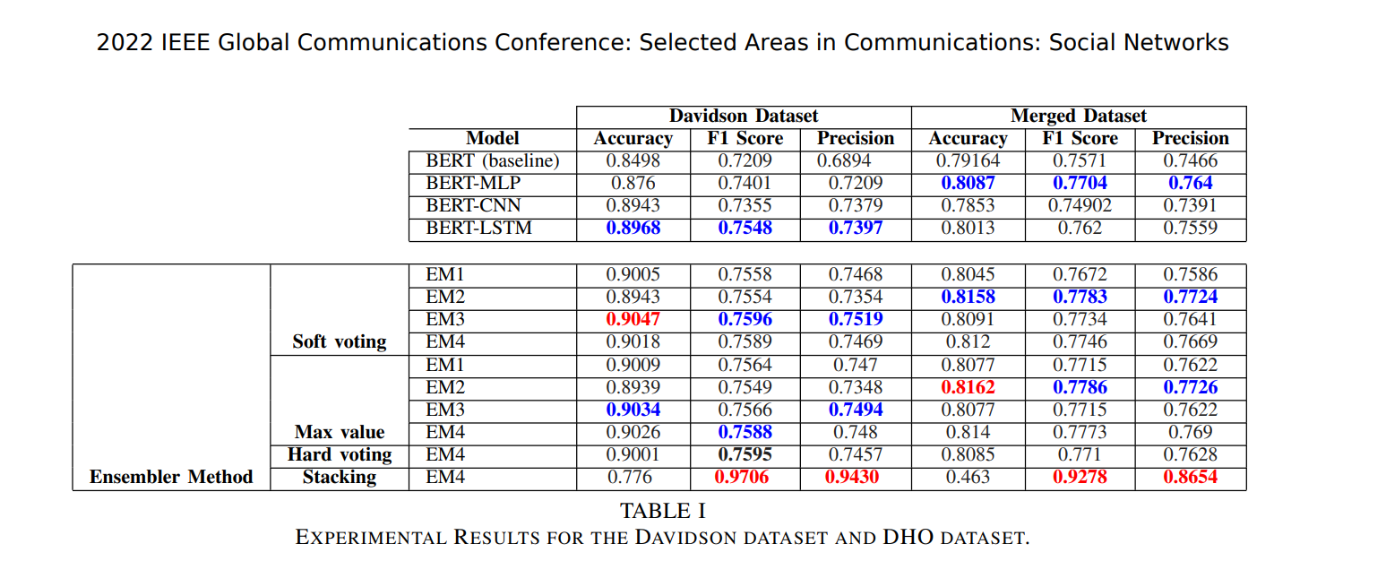


Slide 16
MetaHate: A Dataset for Unifying Efforts on Hate Speech Detection
For unifying efforts, their study advances in the critical need for a comprehensive meta-collection, advocating for an extensive dataset to help counteract this problem effectively. We scrutinized over 60 datasets, selectively integrating those pertinent into MetaHate.
MetaHate contains most of the data from the datasets used in the previous papers in our literature survey. Using this combined dataset with a strong tool like BERT could strongly enhance the performance of the model.

Slide 17
