Slide 1

DSA Miniproject
Console-based Monster-Rogue Chase game on an N × N dungeon
Build a TUI grid game on an N × N dungeon where a monster chases a rogue, and the rogue tries to avoid capture as long as possible. The dungeon contains walls, rooms, and corridors, and both characters move turn by turn. The monster uses a strategy to move one step closer to the rogue using shortest-path search (BFS/DFS), while the rogue moves to the adjacent square that maximizes distance from the monster. The game ends when the monster reaches the rogue.
Team:
PES2UG24CS042: Akash Singh
PES2UG24CS003: A Sheiman Joshi
PES2UG24CS019: Abhigyan Dutta

Slide 2
Project Overview & Key Features
TUI-based N × N dungeon grid game, where a monster chases a rogue, and the rogue tries to avoid capture as long as possible
The Dungeon contains walls, hidden rooms (the form of maze corners), and corridors, and both characters move turn by turn
The monster uses a strategy to move one step closer to the rogue using shortest-path while the rogue moves to the adjacent square that maximizes distance from the monster.
The game ends when the monster reaches the rogue.
The player pressed enter to play the chances for this game.

Slide 3
Data Structures in this project
Linear Data Structure-
Queue(Linked List Representation)-Used for BFS traversal for getting shortest path, Implements FIFO (First In First Out), Operations: enqueue(), dequeue(), isEmpty()
Non-Linear Data Structure-
Graph-The N×N dungeon grid represents a graph, Each cell is a node, Adjacent walkable cells are edges, BFS explores this graph structure in the shortest path possible.

Slide 4
Why did we use those Data Structures :
Queue (Linear): Used to power the BFS (Breadth-First Search) algorithm.
Its FIFO (First-In, First-Out) nature is essential for exploring the graph layer- by-layer, which is the only way to guarantee finding the absolute shortest path for the monster.
Graph (Non-Linear): The N x N dungeon grid is the graph. It's used to represent t he map, its rooms, and its walls.
Nodes = Walkable cells
Edges = Paths between adjacent cells

Slide 5
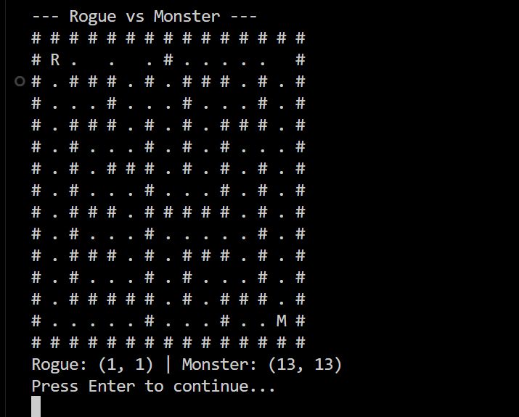
Workflow
The game displays a 15×15 dungeon grid
R=Rogue (you)
M= Monster (chaser)
#= Wall
. = Path
Press Enter to advance each turn
Rogue moves first(tries to run away)
Monster moves second(chases using shortest path)
Game continues until Monster catches Rogue

Slide 6
Summary
A Total of 12 Functions are included in this miniproject, namely: createQueue(), enqueue(Queue* q, Point p), dequeue(Queue* q), isQueueEmpty(Queue* q), freeQueue(Queue* q), initGame(GameState* game), clearScreen() (this is a win32 functionality which is optionally put by me to ensure the terminal isn’t flooded), printGame(GameState* game), isValid(GameState* game, int r, int c), moveRogue(GameState* game), moveMonster(GameState* game), and finally, main().

Slide 7
Summary
This project shows use of-
Queue used for BFS traversal the monster uses BFS (shortest-path search) to chase.
N x N dungeon grid represents a graph where each cell is node
Adjacent cell represents edges
The system effectively models monster-rogue chase game on N x N on a TUI (Terminal UI) – Based Interface.

Slide 8


