Slide 1
UltraGene
Technology Review

Slide 2
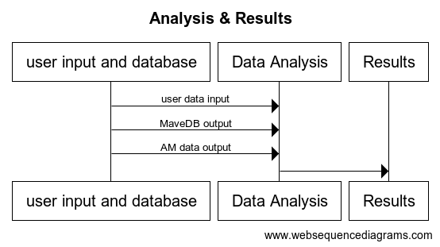
Background
Integrated Development Environment (IDE)
Notes:
We’re here to discuss a critical component of our technology review: the selection of an appropriate tool for data analysis. In our project, we are dealing with substantial datasets, including customer’s gene sequence and two extensive gene mutation databases. The challenge we face is not just handling these large datasets but also efficiently matching and analyzing them. Our primary criteria for selection were based on tool’s ability to manage large databases and integration capabilities.

Slide 3



Technologies
PyCharm
VS Code
Noteable
Notes:
Primarily use C language
Pycharm - IDE (Integrated Development Environment (IDE))
Vs code - code editor that provides a similar experience to an IDE thru extension
Notable - collaborative notebook platform that enable team to use and visualize data together

Slide 4
What we choose:
Noteable
Online version of JupyterNotebook.
Connect to “HUGE” database.
Cooperate with others.
Is a ChatGPT plugin.

Slide 5
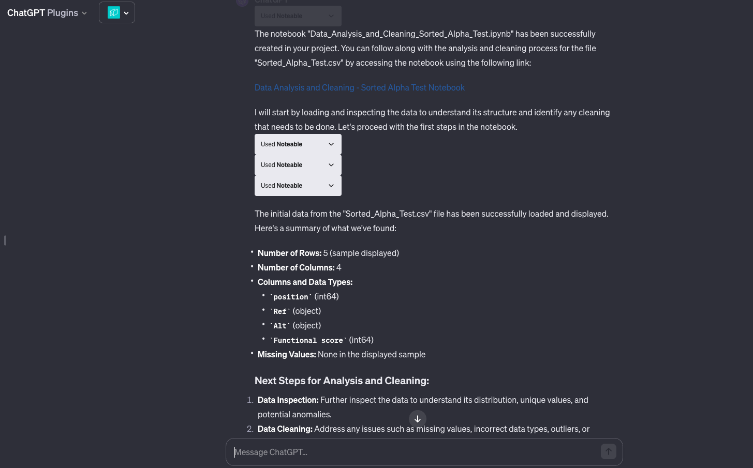
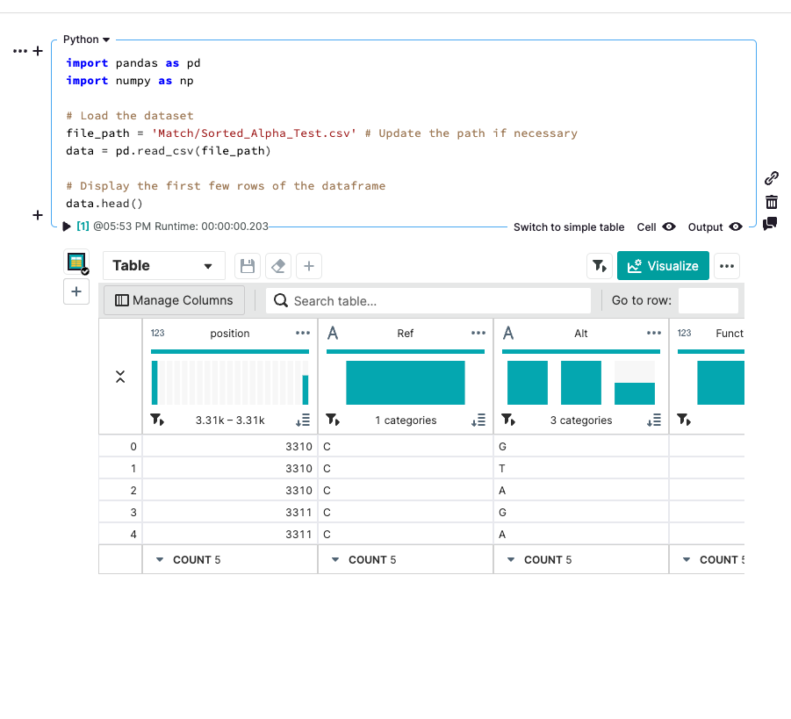
Appeal of choice

Slide 6
Drawback
Code Version Control Limitation
Performance Constraints
Integration with Other Tools
Cost
Project management
Great for data science ! Not so much for SE

