Slide 1

Project and Thesis-1 CSE-4100 Spring 2017
Ahsanullah University of Science & Technology Department of Computer Science & Engineering

Slide 2

Group memebers
Name: ID
Md.Shahadat Hossain 14.01.04.062
Abrar Akhyer Abir 14.01.04.069
Muhammad Muntasir mamoor 14.01.04.072
Md.Hasan Shahriar 14.01.04.096
Supervised By-
Dr. S.M Abdullah Al-Mamun
Professor
Department of Computer Science and Engineering
Ahsanullah University of Science and Technology

Slide 3
A STUDY OF A FEW DATA MINING ALGORITHMS

Slide 4

Abstract
Study on selected statistical, data mining algorithms
Implement the algorithms over a proposed dataset and model building
Compare the performance and accuracy of the models

Slide 5
Introduction
Our work
Problem definition
Process of solution

Slide 6
Our Work
Study on different data mining algorithms
Performence comparision over selected Dataset
Tools:Python,Sci-kit learn

Slide 7
Problem Definition
Create a structured format of Dataset
Apply mining algorithm on the data warehouse
Test the performance of the algorithms

Slide 8
Process of Solution
Data Collection
Data pre-processing
Algorithm Selection
Important Feature selection for each algorithm
Model Creation
Performance Testing
Comparison and visualization of algorithms.

Slide 9
Literature Review
Historical background for Data warehouse and mining
Data mining
Data warehouse for Data mining

Slide 10
Historical Background

Slide 11
Data Mining

Slide 12
Data warehouse for Data mining

Slide 13
Designing of Data Warehouse for Mining in Sales Data

Slide 14
Initial Dataset
Open source Dataset and collected from Tableau Community
24 attributes, 51290 transactional tuples, across 147 countries
10768 products divided into three categories and 17 Sub categories

Slide 15
Schema of Data Warehouse
Designed our Data Warehouse using snow flake schema
14 dimension tables and 1 fact table
The fact table contains 15 attributes; 1 as primary key, 8 as foreign key from dimention tables and rests are different measures of a single tuple

Slide 16
Snow-flake schema of our dataset

Slide 17
Selected Algorithms
Linear Regression
Polynomial Regression
Logistic Regression
K-Nearest Neighbor

Slide 18
Methodology for implementation of selected Algorithms

Slide 19
Objectives
Knowledge discovery
Extract hidden predictive information using selected algorithms

Slide 20
Preparing Dataset according to Objective
Data discretization: Part of data reduction but with particular importance, especially for numerical data
Data cleaning: Fill in missing values, smooth noisy data, identify or remove outliers, and resolve inconsistencies
Data integration: Integration of multiple databases, data cubes, or files
Data transformation: Normalization and aggregation
Data reduction: Obtains reduced representation in volume but produces the same or similar analytical results

Slide 21
Feature Selection
Pearson correlation

Slide 22
Feature Selection
Recursive feature elimination with cross-validation

Slide 23
Model Building
Using regression and classification algorithms

Slide 24
Model Evaluation
Train and test

Slide 25
Overview and implementation of selected Algorithms

Slide 26

Linear Regression
Linear regression is a technique that is useful for regression problems
An approach for predicting a quantitative response using a single feature
General form $y=β_{0}+xβ_{1}$

Slide 27
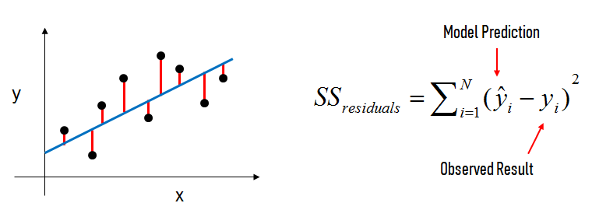
Linear Regression

Slide 28
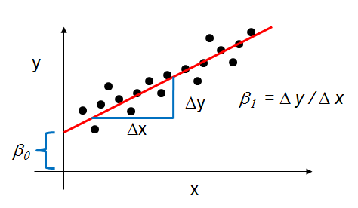

$y=β_{0}+xβ_{1}$

Slide 29

Multiple Linear Regression:
General Form:
$y=β_{0}+β_{1}x_{1}+…+β_{n}x_{n}$
Each $x$ represents a different feature, and each feature has its own coefficient.
For profit calculation we select sales, quantity & Discount as our feature then the equation will look like:
P$rofit=β_{0}+β_{1}×Sales+β_{2}×Quantity+β_{3}×Discount$

Slide 30



Model Evaluation Metrics for Regression
MAE : $\frac{1}{n}\sum_{i=1}^{n}{|y_{i}−py_{i}|}$
MSE: $\frac{1}{n}\sum_{i=1}^{n}{{(y_{i}−py_{i})}^{2}}$
RMSE: $\sqrt{\frac{1}{n} \sum_{i=1}^{n}{{(y_{i}−py_{i})}^{2}}}$

Slide 31
Implementation of Linear Regression:
At first we want to predict the profit of a particular product using linear regression algorithm
We have selected ‘Binney & Smith Sketch Pad, Blue ‘ as our product.
This product has been 23 times in whole dataset.
According to Pearson Correlation we select sales, Discount and quantity as our input feature.
3-fold cross validation
We get a RMSE value of 5.97e-14 which is near to zero. In train-test split we got 6.29e-14.

Slide 32
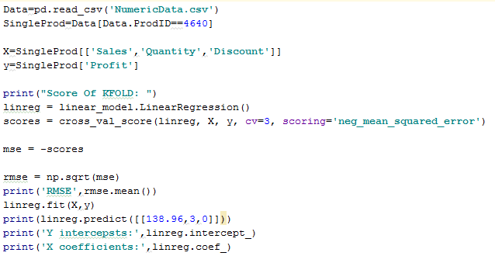

Slide 33
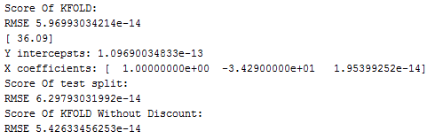
Output

Slide 34
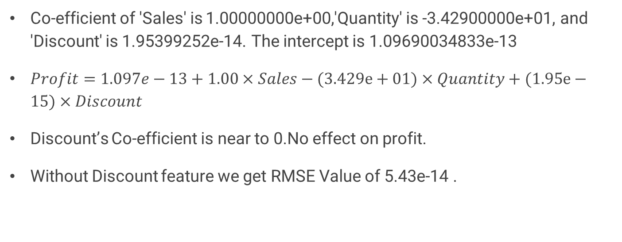
Result Analysis
Co-efficient of 'Sales' is 1.00000000e+00,'Quantity' is -3.42900000e+01, and 'Discount' is 1.95399252e-14. The intercept is 1.09690034833e-13
$Profit=1.097e−13+1.00×Sales−(3.429e+01)×Quantity+(1.95e−15)×Discount$
Discount’s Co-efficient is near to 0.No effect on profit.
Without Discount feature we get RMSE Value of 5.43e-14 .

Slide 35
Profit prediction for any product
We have large number of data now.(51290 tuples)
Pearson co-efficient value is between -.316 to .485 with target variable.
There is no linear relationship exist .
We pick some features that are not very close to zero and use them as our input features.
SellingPriceperunit, PurchasingPriceperUnit, Sales, Quantity & Discount as our feature vector X and Profit as our target variable y.
10-fold validation.
RMSE value of 98.76.

Slide 36
Shipping Cost prediction for a single product
“Binney & Smith Sketch Pad, Blue” is the selected product.
Input features are Sales, Quantity, OrderpriorityID, ShipmodeID & RegionID
3-fold validation.
RMSE value 3.31
Selecting feature according to pearson co-efficient gives us higher RMSE value.

Slide 37
Shipping Cost prediction for any product
Once again we didn’t found any strong linear relationship with shipping cost.
Input feature : Sales
10-fold CV
RMSE : 29.26
Using the input features of Shipping Cost does not improve the performance.

Slide 38

Polynomial Regression
The relationship between the independent var. x and the dependent var. y is modeled as an n-th degree polynomial in x.
Fits a nonlinear relationship between the value of x and the corresponding conditional mean of y .
General Form:
$$y_{i}=β_{0}+β_{1}x_{i}+β_{2}x_{i}^{2}+…+β_{m}x_{i}^{m}(i=1,2,3….,n)$$

Slide 39
Important notes of Polynomial Regression:
In many settings, such a linear relationship may not hold. That’s where the polynomial regression become popular.
The fitted model is more reliable when it is built on large numbers of observations.

Slide 40
Profit prediction for any product Using Polynomial regression
Input Features: SellingPriceperunit, PurchasingPriceperUnit, Sales, Quantity & Discount
10-fold CV.
We run polynomial regression using degree 1 to 4.
Using degree 3, we got RMSE : 0.34

Slide 41
Shipping Cost prediction for a single product Using polynomial regression
“Binney & Smith Sketch Pad, Blue” is the selected product .
Input features: Sales, Quantity, OrderpriorityID, ShipmodeID & RegionID
3-fold cross validation.
We got the RMSE value of 3.31 when we use polynomial with degree 1. We got higher RMSE value 23.18, 261.58 for using polynomial regression with degree 2, 3 respectively.

Slide 42
Shipping Cost prediction for any product
Input feature : Sales
Using degree 1 to 5 we get RMSE value of 29.26, 26.27, 26.74, 30.32, 89.53 respectively.

Slide 43
Result Analysis of Regression Algorithms

Slide 44
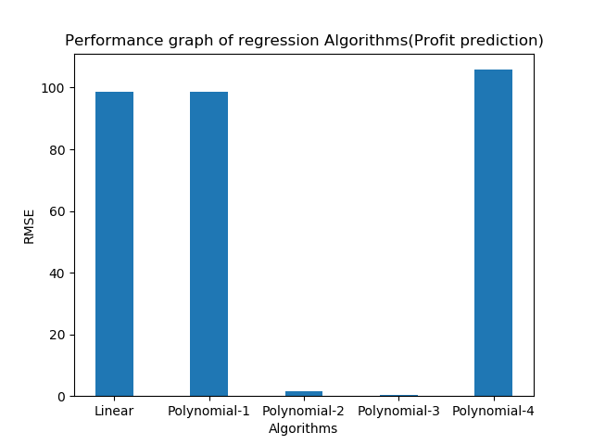
Result Analysis of Regression Algorithms

Slide 45
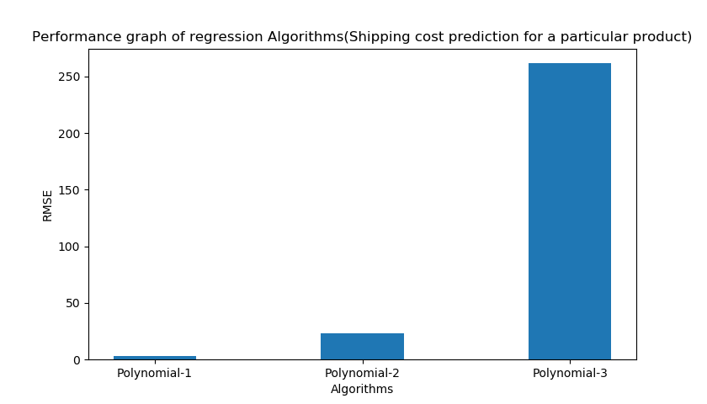
Result Analysis of Regression Algorithms

Slide 46
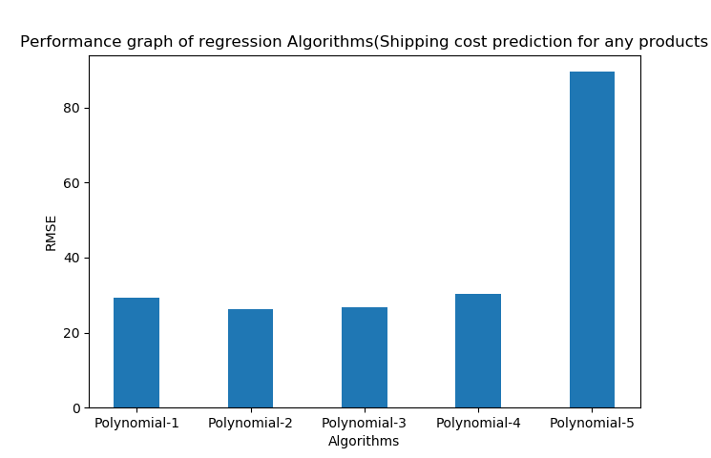
Result Analysis of Regression Algorithms

Slide 47
K-nearest neighbour
K-Nearest Neighbor (KNN) is a supervised learning algorithm.
Non-Parametric & Instance-Based
The K-nearest-neighbor (KNN) algorithm measures the distance between a query scenario and a set of scenarios in the data set.

Slide 48
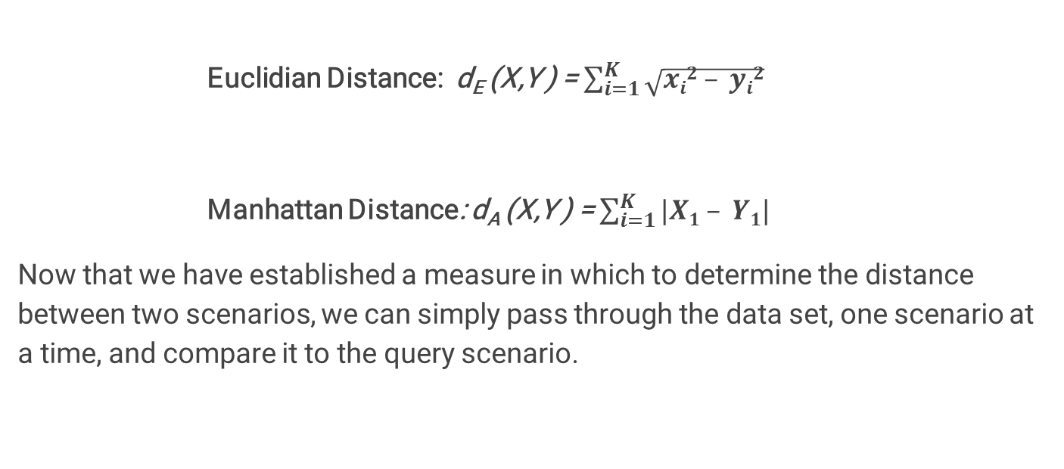
Two distance measuring techniques
Euclidian Distance: d_{E} (X,Y ) = $\sum_{i=1}^{K}{\sqrt{xi2 – yi2}}$
Manhattan Distance: d_{A} (X,Y ) = $\sum_{i=1}^{K}{|X1 – Y1|}$
Now that we have established a measure in which to determine the distance between two scenarios, we can simply pass through the data set, one scenario at a time, and compare it to the query scenario.

Slide 49
Implementation of K-Nearest neighbor
At first we want to predict the order priority of a product .
We have selected our input feature using RFECV.
After running RFECV we get 3 features ranking 1. They are DateDif, Discount & CategoryID.
10 fold cross-validation .
Run the KNN for k=500 to 600
Accuracy : 61.57 % (For k=595)

Slide 50
Shipping Mode prediction Using KNN
After running RFECV, we get one feature ranking 1 , DateDif
Input feature: DateDif
10 fold cross-validation .
Run the algorithm for k=1to 60
Accuracy : 81.40 %. (For k=595)

Slide 51
Logistic Regression
It is a statistical method for analyzing a dataset in which there are one or more independent variables that determine an outcome.
The goal of logistic regression is to find the best fitting model to describe the relationship between the dichotomous characteristic of interest and a set of independent variables

Slide 52
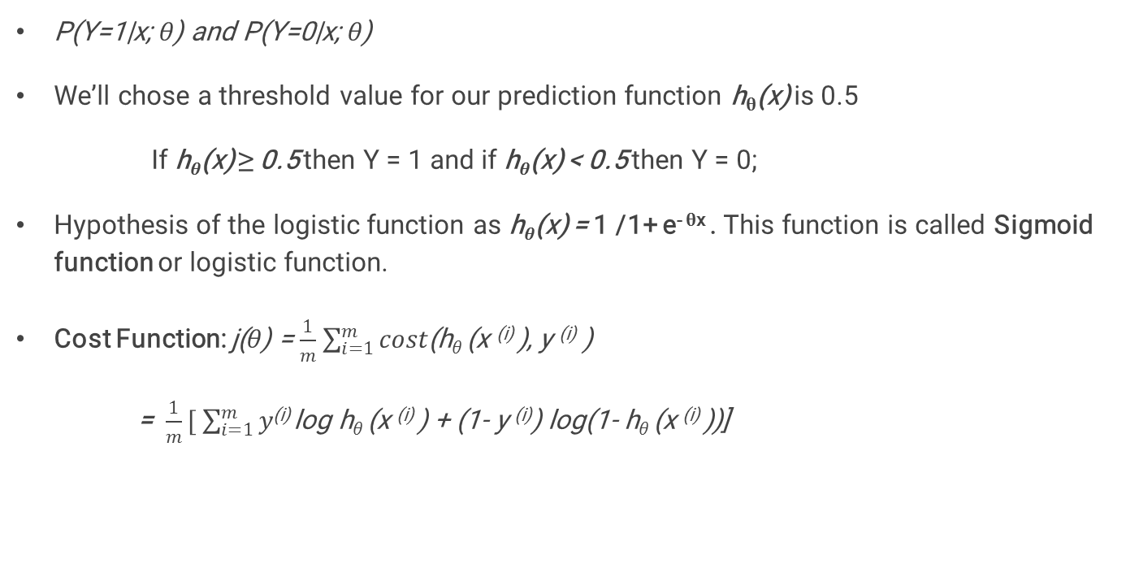
Derivation of logistic regression :
P(Y=1|x; θ) and P(Y=0|x; θ)
We’ll chose a threshold value for our prediction function h_{θ}(x) is 0.5
If h_{θ}(x) ≥ 0.5 then Y = 1 and if h_{θ}(x) < 0.5 then Y = 0;
Hypothesis of the logistic function as h_{θ}(x) = 1 /1+ e^{- θx} . This function is called Sigmoid function or logistic function.
Cost Function: j(θ) = $\frac{1}{m}$ $\sum_{i=1}^{m}{cost}$(h_{θ} (x ^{(i)} ), y ^{(i)} )
= $\frac{1}{m}[ \sum_{i=1}^{m}{y}$^{(i)} log h_{θ} (x ^{(i)} ) + (1- y ^{(i)}) log(1- h_{θ} (x ^{(i)} ))]

Slide 53
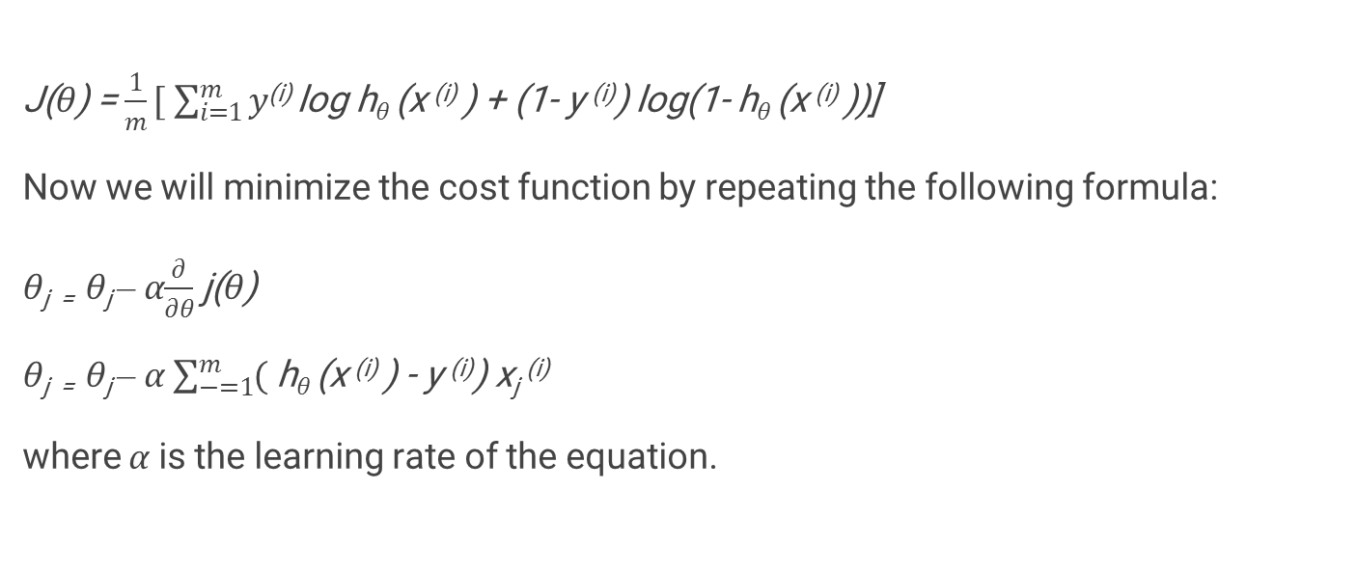
Gradient Descent
J(θ) = $\frac{1}{m}[ \sum_{i=1}^{m}{y}$^{(i)} log h_{θ} (x ^{(i)} ) + (1- y ^{(i)}) log(1- h_{θ} (x ^{(i)} ))]
Now we will minimize the cost function by repeating the following formula:
θ_{j =} θ_{j} – α$\frac{∂}{∂θ}$ j(θ)
θ_{j =} θ_{j} – α $\sum_{−=1}^{m}{(}$ h_{θ} (x ^{(i)} ) - y ^{(i)}) x_{j} ^{(i)}
where α is the learning rate of the equation.

Slide 54
Implementation of Logistic Regression
First, We try to predict the order priority of a product.
We have selected our input feature using RFECV.
After running RFECV we get 3 features ranking 1. They are DateDif, Discount & CategoryID.
10 fold cross-validation .
Accuracy : 62.73 %

Slide 55
Shipping Mode prediction Using Logistic regression
After running RFECV, we get one feature ranking 1 , DateDif
Input feature: DateDif
10 fold cross-validation .
Accuracy: 78.12 %

Slide 56
Result Analysis of Classification Algorithms

Slide 57
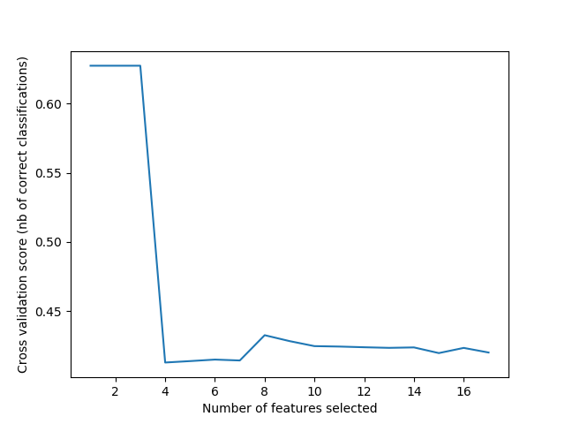
Accuracy vs Number of selected feature Graph

Slide 58
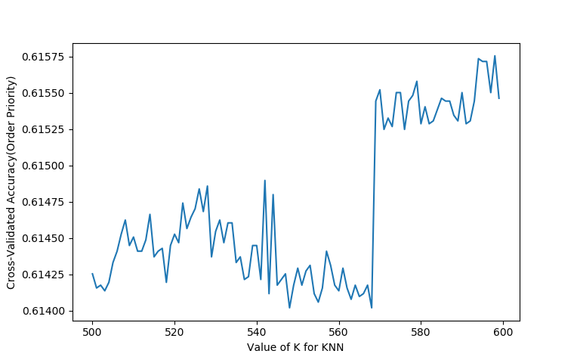
Selecting the best value of K for Order priority prediction

Slide 59
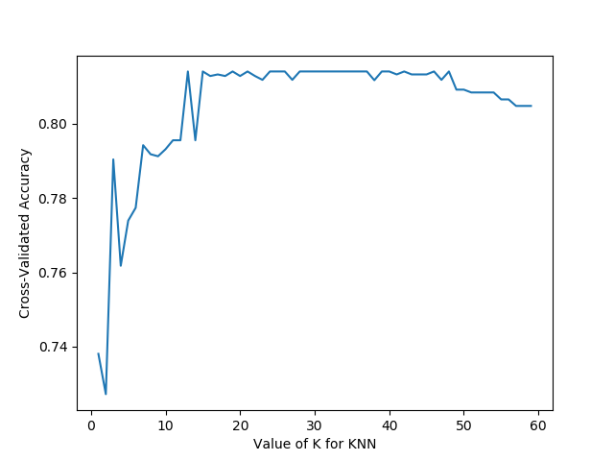
Selecting the best value of K for Shipping Mode prediction

Slide 60
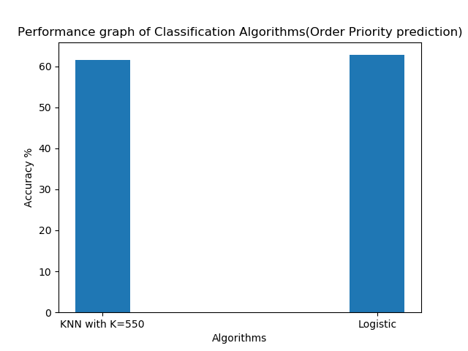
Result Analysis of Classification Algorithms

Slide 61
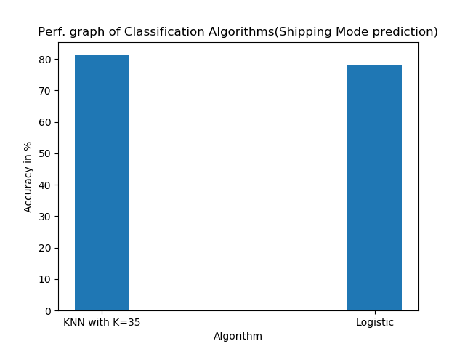
Result Analysis of Classification Algorithms

Slide 62
Future Plan

Slide 63

Concrete Planning (Continued)
edit
Thank You

