Slide 1
MID-SEMESTER STUDY SERIES · GRAPH THEORY · DAY 1
CS-5136: Graph Theory
Day 1 — From Real Problems to Graphs: the Shortest Superstring Problem
pages 1–33 · motivation, the overlap function, and the Hamiltonian-path reduction — with full derivations and worked examples
Built from: A. Bhattacharjee, “CS-5136: Graph Theory”, NIT Silchar

Slide 2
HEADS UP
Switching source — and what that changes
This deck now runs on your actual course material — CS-5136: Graph Theory (A. Bhattacharjee, NIT Silchar, 230 slide-pages) — since that's what your mid-sem really covers.
The “Day” count restarts here at Day 1 for this book. The earlier Combinatorial Optimization deck is a different course — keep it as background reading, not mid-sem syllabus.
Where it genuinely helps — today's TSP/Hamiltonian-path connection, spanning trees later on — I'll point to the exact spot in the Held Combinatorial Optimization notes as a cross-reference, since you already have that material.
SAME PROMISE AS BEFORE: every sketchy or ambiguous step gets a full, correct derivation; every dense idea gets a worked example; you get practice questions with answers at the end.
Day 1 · CS-5136 Graph Theory · Intro · pages 1–33
2

Slide 3
TODAY'S PLAN
What Day 1 covers
In today's deck
A note on “pages”
The real-world problems that motivate graph theory (railway planning, DNA sequencing)
The Shortest Superstring Problem (SSP) — formal definition
The overlap function — definition, worked example, and a key subtlety (it's directional)
The reduction of SSP to a shortest-Hamiltonian-path problem — built and proved correctly
A fully worked 5-fragment example, end to end
5 practice questions with full answers
Today = slide-pages 1–33 of 230 — the “Introduction” chapter, right up to where formal graph definitions begin (page 34).
Many raw pages are just build/reveal steps of one idea (one animation spread across up to 9 pages) — I've compressed those into single explanatory slides.
So this deck's ~19 slides carry the full content of those 33 pages, just without the repeats.
Day 1 · CS-5136 Graph Theory · Intro · pages 1–33
3

Slide 4
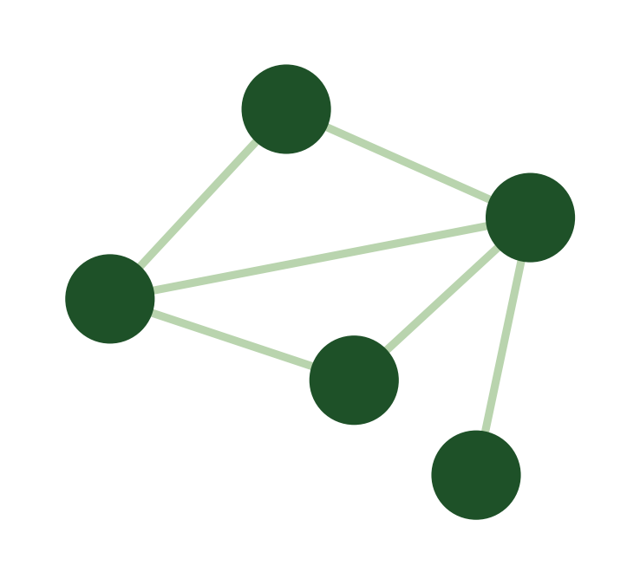
BIG PICTURE
Why model anything as a graph?
A graph is just: a set of items, plus a set of connections between pairs of them.
Telephone / computer networks
Transportation networks (bus, subway, train, plane)
Social networks (who is friends with whom)
Family trees, evolutionary trees
Molecular graphs (atoms and chemical bonds)
Many data structures in Computer Science itself
items + connections = a graph
Day 1 · CS-5136 Graph Theory · Intro · pages 1–33
4

Slide 5
MOTIVATING CASE STUDY
Delhi Metro: three planning problems
NEW TIMETABLE
STOCK CIRCULATION
CIRCULAR ROUTE
The schedule repeats every 60 minutes. Each departure/arrival gets a number mod 60.
What must these numbers satisfy?
Trains run a repeating weekly cycle. What's the minimum number of train-units needed to cover it?
A circular line where every segment between stations must be traversed exactly once.
Previews: algebraic / cycle-space view of graphs (~pg. 60)
A classic circulation/flow problem — exactly your Comb. Opt. reference book's territory
This is precisely an Eulerian circuit — formal treatment ~pg. 137
Day 1 · CS-5136 Graph Theory · Intro · pages 1–33
5

Slide 6
MOTIVATING CASE STUDY
Assembling a Genome from Fragments
Sequencing methods (Sanger 1977 / Gilbert 1977) read only short fragments of DNA — about 500–700 nucleotides at a time — not the whole genome at once.
So the genome is sheared into millions of small, overlapping fragments (“reads”) first, then each one is read separately.
The computational challenge: reassemble the short reads back into one full genomic sequence — a “superstring” containing all of them.
Until the late 1990s this “shotgun fragment assembly” was viewed as computationally intractable for genome-sized inputs — exactly the kind of problem graph theory turns out to help with.
Day 1 · CS-5136 Graph Theory · Intro · pages 1–33
6

Slide 7
DEFINITION
The Shortest Superstring Problem (SSP)
Input: strings s₁, s₂, …, sₙ.
Output: a shortest string s that contains every sᵢ as a substring.
“Contains sᵢ as a substring” just means sᵢ appears somewhere inside s — not necessarily at the start.
This is exactly the fragment-assembly problem: the sᵢ are the DNA reads, and s is the reconstructed genome.
The naive approach — just concatenate every string one after another — always works, but is almost never shortest, because reads usually overlap each other.
Day 1 · CS-5136 Graph Theory · Intro · pages 1–33
7

Slide 8
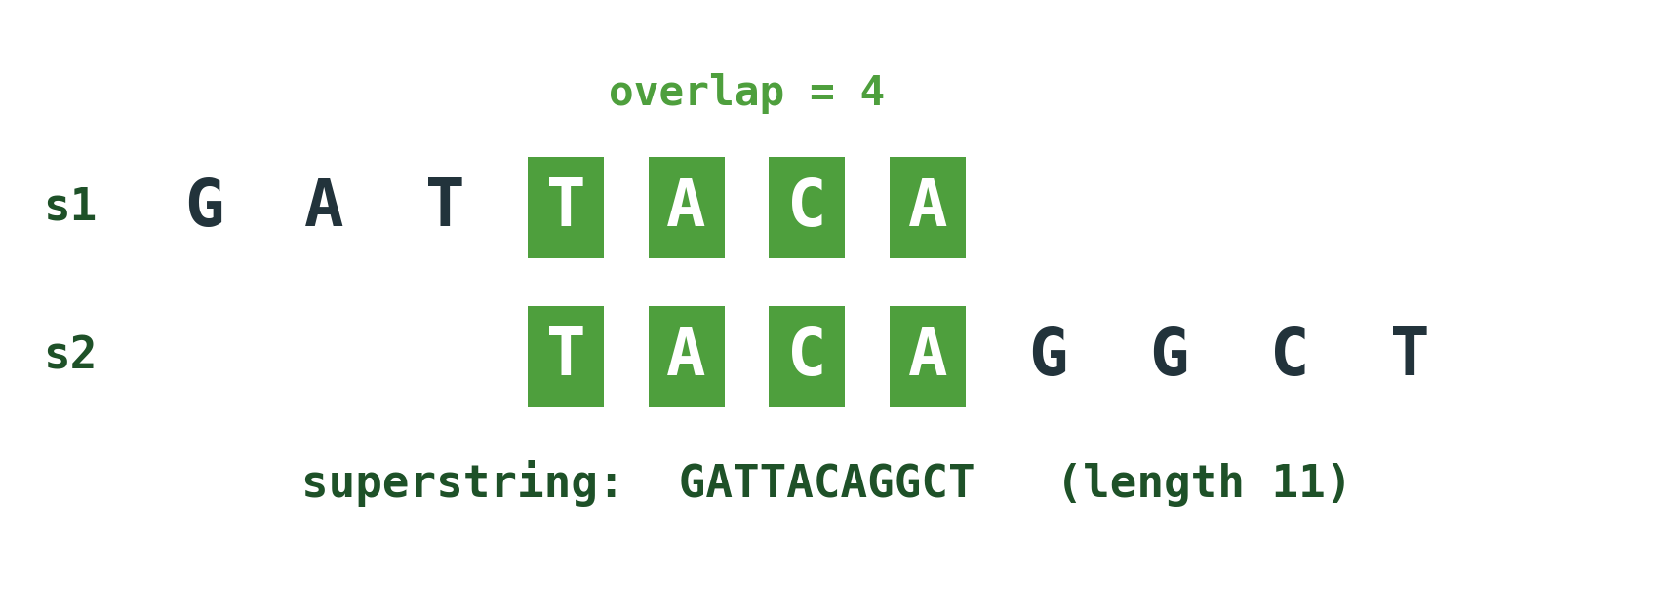
DEFINITION
The Overlap Function
overlap(sᵢ, sⱼ) := the length of the longest prefix of sⱼ that matches a suffix of sᵢ.
Gluing sᵢ and sⱼ along their overlap saves overlap(sᵢ,sⱼ) characters: the combined string has length |sᵢ| + |sⱼ| − overlap(sᵢ,sⱼ) instead of |sᵢ| + |sⱼ|.
Day 1 · CS-5136 Graph Theory · Intro · pages 1–33
8

Slide 9
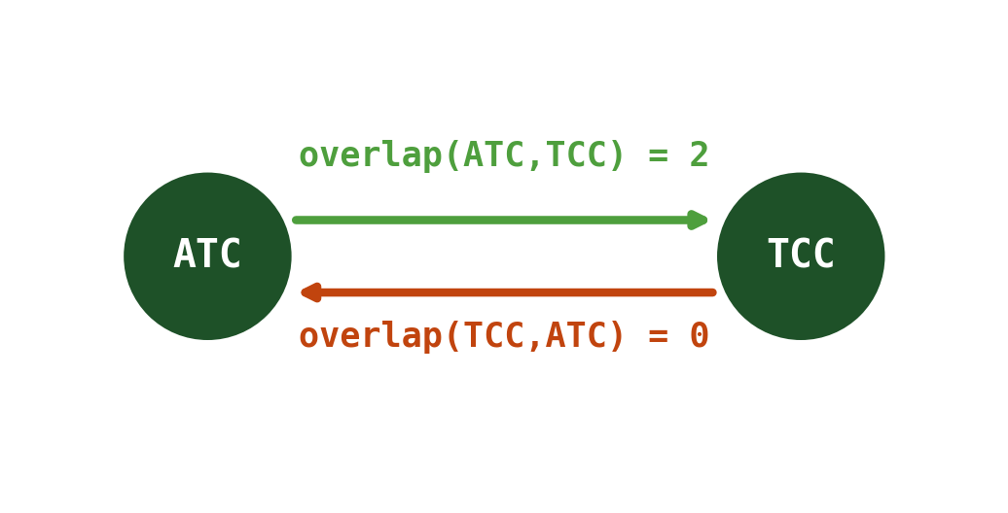
CAREFUL
overlap is NOT symmetric — and a numbers check
overlap(sᵢ,sⱼ) and overlap(sⱼ,sᵢ) are generally different — so the reduction graph coming up must be DIRECTED, not undirected.
Always ask “overlap of WHICH string's suffix with WHICH string's prefix” — direction matters.
NUMBERS CHECK: your slide's own worked example (s₁=aaaggcatcaaatctaaaggcatcaaa, s₂=aagcatcaaatctaaaggcatcaaa) states overlap(s₁,s₂)=12, but applying the definition to those exact two strings gives overlap(s₁,s₂) = 2 (their real shared boundary is just “aa”). The alignment picture on that slide appears to reuse s₁'s text on both lines instead of aligning with the actual s₂. Worth flagging to your instructor if it comes up — I've used the corrected value here.
Day 1 · CS-5136 Graph Theory · Intro · pages 1–33
9

Slide 10
EXAMPLE
Why we can't just concatenate
S = {000, 001, 010, 011, 100, 101, 110, 111} — all 8 length-3 binary strings.
Concatenating all 8 one after another: length 8×3 = 24.
But the string 0001110100 (length 10) already contains all 8 of them as substrings — by reusing overlaps between consecutive pieces.
(This particular string has a name: it's a de Bruijn sequence for n=3 — a string containing every length-3 binary string exactly once.)
So concatenation is a valid but usually very wasteful superstring. We need a systematic way to find the best ORDER to glue the strings in — that's what the graph reduction below gives us.
Day 1 · CS-5136 Graph Theory · Intro · pages 1–33
10

Slide 11
KEY IDEA
Turning SSP into a path problem
1. Build a DIRECTED graph G: one vertex per string sᵢ.
2. For every ordered pair (sᵢ,sⱼ) with i≠j, add an arc sᵢ→sⱼ — the graph is complete and directed (overlap is asymmetric, previous slide).
3. What we weight the arc with matters: your slide says “an edge of length overlap(sᵢ,sⱼ)” — but overlap is a SAVING, not something we want to add up and minimize directly.
4. Instead weight the arc sᵢ→sⱼ by d(sᵢ,sⱼ) := |sⱼ| − overlap(sᵢ,sⱼ) — the number of BRAND-NEW characters sⱼ contributes once it's glued onto sᵢ. Always ≥ 0.
WHY THIS FIX MATTERS: with raw overlap as the weight you'd need a MAXIMUM-weight Hamiltonian path (unusual framing); with d(sᵢ,sⱼ) as the weight you get the standard, more natural “shortest Hamiltonian path” framing — which is what the next slide proves.
Day 1 · CS-5136 Graph Theory · Intro · pages 1–33
11

Slide 12
PROOF
Shortest Hamiltonian path = shortest superstring
1. Fix an ordering (a Hamiltonian path) sᵢ₁ → sᵢ₂ → ⋯ → sᵢₙ through all n vertices.
2. Build the superstring left to right: start with sᵢ₁; by definition of overlap and d, each next string sᵢₖ₊₁ contributes exactly d(sᵢₖ, sᵢₖ₊₁) brand-new trailing characters.
3. So the final length telescopes: length = |sᵢ₁| + Σ d(sᵢₖ, sᵢₖ₊₁) over all n−1 arcs of the path = |sᵢ₁| + (total arc weight of the path).
4. Minimizing this over all orderings (and all choices of starting vertex) is exactly minimizing total arc weight over all Hamiltonian paths of G — i.e. finding a SHORTEST Hamiltonian path. ∎
NAME FOR THIS: “visit every vertex exactly once, minimize total arc weight, no need to return to the start” is the (directed) Path-TSP — a close cousin of the classic cycle-TSP.
Day 1 · CS-5136 Graph Theory · Intro · pages 1–33
12

Slide 13
WORKED EXAMPLE
5 DNA Fragments: S = {ATC, CCA, CAG, TCC, AGT}
Pairwise overlap(row, column):
overlap(row→col) | ATC | CCA | CAG | TCC | AGT
ATC | — | 1 | 1 | 2 | 0
CCA | 1 | — | 2 | 0 | 1
CAG | 0 | 0 | — | 0 | 2
TCC | 0 | 2 | 1 | — | 0
AGT | 0 | 0 | 0 | 1 | —
READ IT AS: row → column. E.g. the ATC row, TCC column cell = overlap(ATC,TCC) = 2. Darker green = biggest overlaps — good candidates for consecutive pieces in the best ordering.
Day 1 · CS-5136 Graph Theory · Intro · pages 1–33
13

Slide 14
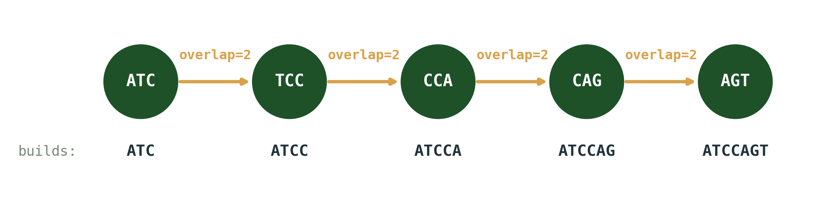
WORKED EXAMPLE
Finding the Shortest Hamiltonian Path
This order (ATC→TCC→CCA→CAG→AGT) uses overlap 2 at every single step — the maximum possible — giving superstring ATCCAGT, length 7 (total lengths 15, total overlap 8, 15−8=7).
COMPARE: the alphabetical order (AGT→ATC→CAG→CCA→TCC) gives AGTATCAGCCATCC — length 14, exactly twice as long! Ordering is everything.
Day 1 · CS-5136 Graph Theory · Intro · pages 1–33
14

Slide 15
CAREFUL
Which direction does this reduction actually prove?
What we just built: SSP can be SOLVED by solving a shortest-Hamiltonian-path (Path-TSP) instance. In reduction notation: SSP ≤ₚ Path-TSP (“SSP is no harder than Path-TSP”).
That alone does NOT show SSP is NP-hard! NP-hardness of SSP needs the reduction in the OTHER direction: showing that an arbitrary TSP instance can itself be encoded as an SSP instance (Path-TSP ≤ₚ SSP).
That second direction is exactly your slide's homework: “Show that any TSP can be formulated as a SSP.”
ON THE HOMEWORK: since that's posed as a graded exercise with a due date, I won't write out the full solution here — that should be in your own words for submission. The general shape such reductions take: encode each vertex/edge of the TSP instance as a specially built string, using characters chosen so that two strings only overlap substantially where the encoding “wants” them to — engineered so a short superstring corresponds exactly to a short tour. Come back once you've had a go and I'm happy to check your reasoning.
Day 1 · CS-5136 Graph Theory · Intro · pages 1–33
15

Slide 16
RECAP
Day 1 Cheat-Sheet
SSP: given s₁,…,sₙ, find a shortest string containing every sᵢ as a substring.
overlap(sᵢ,sⱼ) = longest prefix of sⱼ matching a suffix of sᵢ. (NOT symmetric!)
d(sᵢ,sⱼ) = |sⱼ| − overlap(sᵢ,sⱼ) = new characters sⱼ adds after sᵢ.
Shortest superstring = shortest Hamiltonian path w.r.t. weights d, in the complete directed graph on the strings.
This shows SSP ≤ₚ Path-TSP. NP-hardness of SSP needs the converse reduction (Path-TSP ≤ₚ SSP).
Day 1 · CS-5136 Graph Theory · Intro · pages 1–33
16

Slide 17
PRACTICE — SET A
Practice Questions: Definitions & the Overlap Function
Q1. Compute overlap(CATGAAT, AATCCGG). What string do you get by gluing these two together?
A. overlap = 3 (suffix “AAT” = prefix “AAT”). Glued: CATGAAT + CCGG = CATGAATCCGG (length 11).
Q2. From the fragment table (slide 13): overlap(ATC,TCC)=2 but overlap(TCC,ATC)=0. What does this force about the reduction graph?
A. It must be a DIRECTED graph — an undirected edge can't capture two different weights for the two directions.
Q3. Using d(sᵢ,sⱼ)=|sⱼ|−overlap(sᵢ,sⱼ), compute d(CAG,AGT) and d(AGT,CAG). Which direction actually appears in the optimal path?
A. overlap(CAG,AGT)=2 ⇒ d=3−2=1. overlap(AGT,CAG)=0 ⇒ d=3−0=3. The optimal path uses CAG→AGT (cheaper, d=1).
Day 1 · CS-5136 Graph Theory · Intro · pages 1–33
17

Slide 18
PRACTICE — SET B
Practice Questions: Building the Reduction
Q4. For S = {AAGT, GTCC, CCAA}, compute all pairwise overlaps, then find the shortest superstring by trying orderings.
A. AAGT→GTCC=2, GTCC→CCAA=2, CCAA→AAGT=2 (cyclic); all reverse directions = 0. Best: AAGT→GTCC→CCAA gives AAGTCCAA, length 8 (vs. 12 for a reverse-direction ordering).
Q5. True/False: “Since SSP reduces to shortest-Hamiltonian-path, SSP must be NP-hard.” Explain.
A. False. That reduction only shows SSP ≤ₚ Path-TSP (SSP is easy IF Path-TSP is easy). NP-hardness needs the reverse reduction (Path-TSP ≤ₚ SSP) — a separate argument.
Day 1 · CS-5136 Graph Theory · Intro · pages 1–33
18

Slide 19
DAY 1 RECAP
What to remember from pages 1–33
Real problems (scheduling, circulation, Euler tours, genome assembly) motivate graph models
SSP + the overlap function, precisely defined — and overlap is directional
The corrected reduction: shortest superstring = shortest Hamiltonian path w.r.t. d(sᵢ,sⱼ)=|sⱼ|−overlap(sᵢ,sⱼ)
Reduction direction matters for NP-hardness — SSP ≤ₚ Path-TSP shown; converse is the homework
COMING UP IN DAY 2 (pages 34–50): the formal definition of a graph, vertices & edges, parallel edges, self-loops, and the first hard terminology of the “Abstraction” chapter.
Just say “Day 2” whenever you're ready for the next set.

