Slide 1
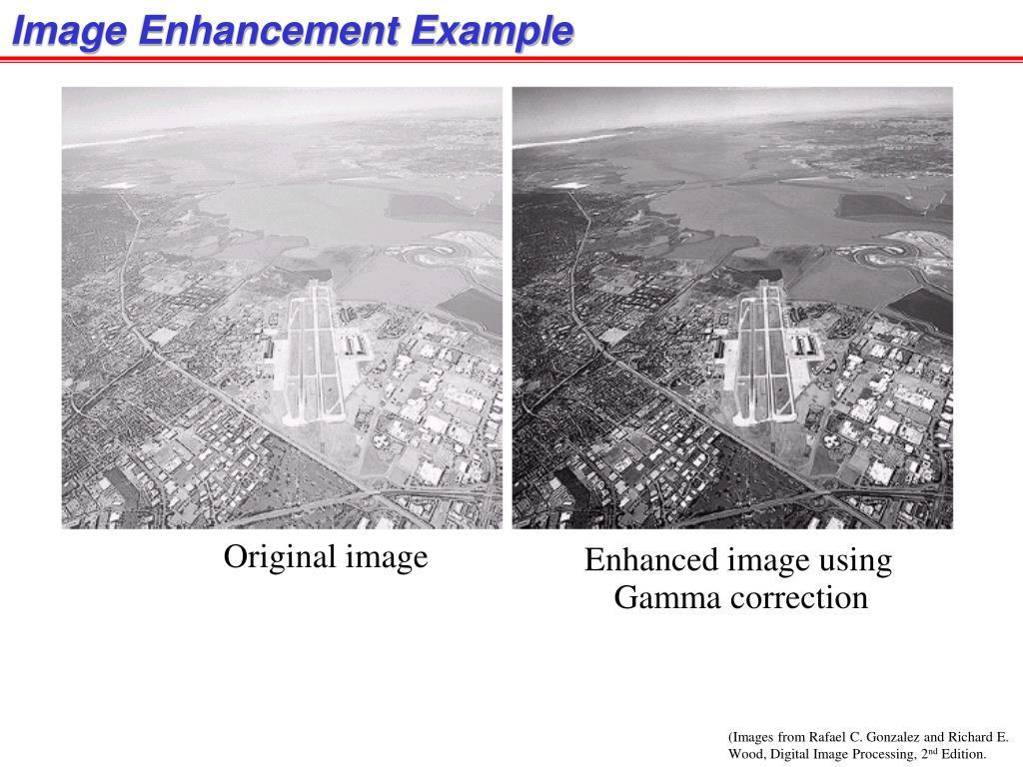
What is digital image processing?
Definition:
Digital Image Processing (DIP) is the use of computer algorithms and mathematical techniques to process, analyze, and improve digital images.
In simple words:
Digital Image Processing means using a computer to manipulate an image so that we can improve it, extract useful information from it, or understand its contents.
A digital image is represented as a matrix of pixels, where each pixel contains numerical information about brightness or color.
Simple Example
Suppose we have a dark photograph:
Original image → Image Processing → Brighter, clearer image
Why Do We Process Images?
Improve Image Quality: Remove noise, blur, and poor lighting.
Extract Information: Detect objects, edges, shapes, and patterns.
Automate Tasks: Enable systems to recognize faces, read documents, or detect diseases.
Fig 1: Original image
Fig 2: Enhanced image using Gamma correction

Slide 2
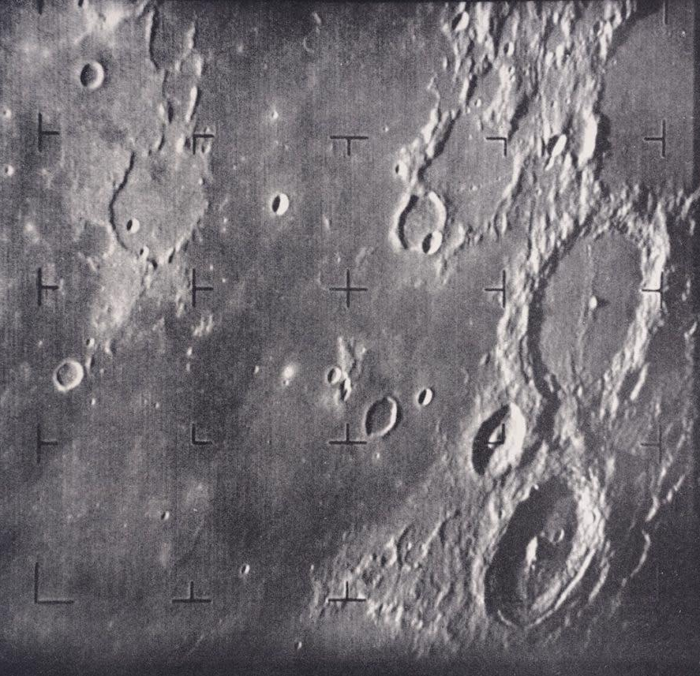
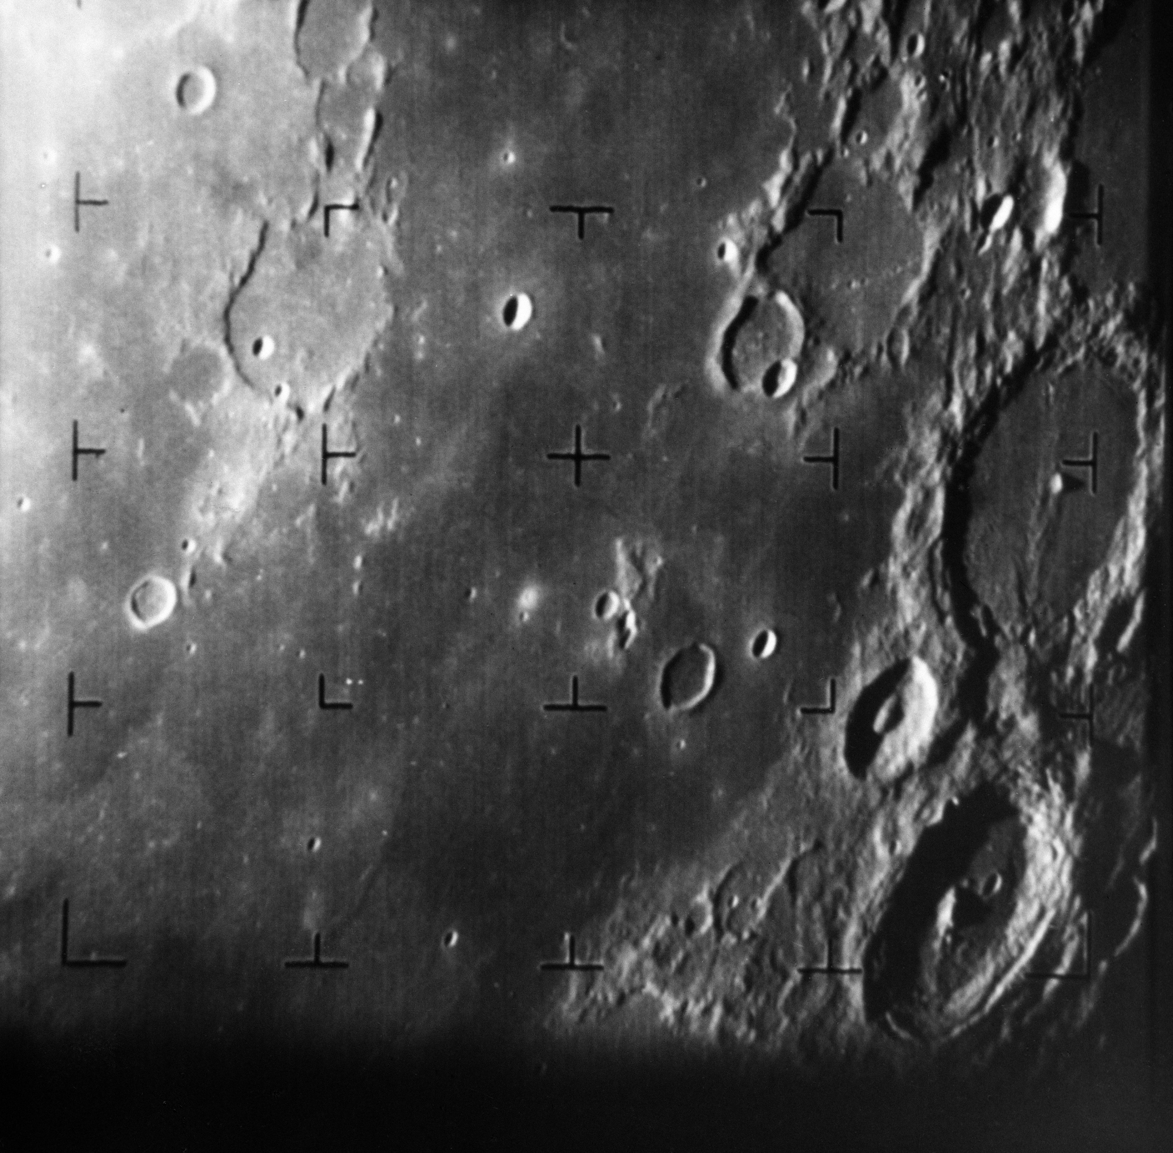
Origins of Digital Image Processing:
The development of digital image processing can be traced back to the 1920s, when images were transmitted electronically over long distances.
Key Milestones & Early Applications:
Period | Development | Example/Application
1920s | Early electronic image transmission | Images transmitted through telegraph systems
1950s–60s | Computers introduced for image processing | Image enhancement and analysis
1960s | Space exploration | NASA spacecraft images of the Moon
1970s | Medical imaging | X-ray and CT image analysis
1970s–80s | Remote sensing | Satellite and aerial photographs
1980s–90s | Industrial & defense applications | Inspection and aerial surveillance
2000s–Present | AI & deep learning | Face recognition, object detection
Table 1: Milestones and applications
In 1964, NASA's Ranger 7 spacecraft transmitted close-up images of the Moon. Digital processing was used to improve the transmitted images and extract useful details from them.
Fig 3: NASA image
Fig 4: NASA image

Slide 3
Fundamental steps in Digital Image Processing:
1. Image Acquisition
Capturing an image using a camera, scanner, satellite sensor, etc.
Includes sampling and quantization to convert the image into digital form.
2. Image Enhancement
Improves the visual appearance of an image.
Examples: contrast enhancement, sharpening, brightness adjustment.
3. Image Restoration
Recovers an image degraded by noise, blur, or other distortions.
Uses mathematical models of the degradation.
4. Color Image Processing
Processes and analyzes information related to image color.
Examples: RGB, HSV, and color enhancement.
Outputs are Images
Color Image Processing
Wavelets
Compression
Morphological Image Processing
Image Restoration
Segmentation
Knowledge Base
Image Enhancement
Outputs are Attributes associated with Images
Feature Extraction
Image Acquisition
Image Pattern Classification
Fig 5: Fundamental steps in DIP

Slide 4
5. Wavelets and Multiresolution Processing
Represents an image at different scales or resolutions.
Useful for image compression, analysis, and feature extraction.
6. Image Compression
Reduces the amount of data required to store or transmit an image.
Examples: JPEG and PNG.
7. Morphological Processing
Analyzes and modifies the shape and structure of objects in an image.
Common operations: erosion, dilation, opening, and closing.
8. Image Segmentation
Divides an image into meaningful regions or objects.
Example: separating a tumor from surrounding tissue.
9. Representation and Description
Represents segmented objects in a suitable form and describes their characteristics.
Features can include shape, boundary, area, texture, and color.
10. Object Recognition
Assigns labels or identifies objects based on their extracted features.
Example: recognizing a face, vehicle, or character.
11. Knowledge Base
Contains prior information about the problem or image. Example: knowing the expected size, shape, or location of an object.
For example:
Medical Image ->Tumor Detection
Original MRI
Wavelets: Analyze image at multiple scales
Compression: Reduce unnecessary data
Morphology: Clean and refine structure
Segmentation: Separate tumor region
Features: Shapes, size, Texture
Recognition: Tumor Identified
Knowledge Base: Provides prior knowledge about expected tumor characteristics

Slide 5
Visual perception – How human eyes see color and light compared to digital sensors
Visual Perception: From Light to Color
What is visual perception?
Visual perception is the process of detecting light and interpreting its intensity, wavelength, and spatial information to form an image
Human Vision
Light enters the eye and is focused on the retina.
Rods detect light intensity, especially in low light.
Cones detect different wavelength ranges and enable color vision.
The brain processes these signals to create visual perception.
Digital Sensor
Camera lens focuses light onto an image sensor.
Sensor elements convert light into electrical signals.
Color filters separate wavelength information, commonly R, G and B.
Signals are converted into digital pixel values.
LIGHT FROM OBJECT
HUMAN EYE
CAMERA SENSOR
Retina
Photodiodes
Brain
Processor
PERCEPTION
DIGITAL IMAGE

Slide 6
How Color is Detected: Human Eye vs Digital Sensor
Human eye
Human color perception is based mainly on the responses of three types of cone cells:
Receptor | Sensitivity | Role
S-cones | Short wavelengths | Blue/violet region
M-cones | Medium wavelengths | Green region
L-cones | Long wavelengths | Yellow/red region
Their responses overlap, and the brain combines their signals to perceive color.
Digital sensor
A digital camera generally uses color filter arrays (CFA) over sensor elements.
A common arrangement is the Bayer pattern:
R | G | R | G
G | B | G | B
R | G | R | G
G | B | G | B
R, G and B filters allow different wavelength ranges to reach different sensor elements.
Each sensor element measures light intensity, not “color” directly.
The camera processor combines the measurements to estimate the color of each pixel.
This process is followed by operations such as demosaicing, white balance, and color correction.

Slide 7
Human Vision vs Digital Sensor: Key Differences
Feature | Human Visual System | Digital Imaging System
Light receiver | Retina | CMOS/CCD sensor
Light receptors | Rods and cones | Photodiodes / sensor pixels
Color sensing | S, M, L cone responses | RGB or other color filters
Brightness | Neural response to light intensity | Measured electrical signal
Processing | Retina + visual cortex + brain | Image signal processor + algorithms
Color adaptation | Biological adaptation and contextual perception | White balance and color correction
Output | Perceived scene | Numerical pixel values
Dynamic response | Adapts to changing illumination | Limited by sensor and processing
Color reproduction | Context-dependent perception | Depends on sensor, filters, calibration and algorithms
Representation | Neural signals | Digital values, e.g. 0–255 per channel
Table 2: Key Difference
Why are they not exactly the same?
Human vision adapts to lighting and uses context to interpret colors. Digital sensors measure light and use processing algorithms such as white balance to reproduce colors.

Slide 9
https://photographyicon.com/color-perception-explained-how-our-eyes-and-cameras-interpret-colors-differently/

