Slide 1


Introduction To
Digital Image Fundamentals
Seminar Presentation

Slide 2
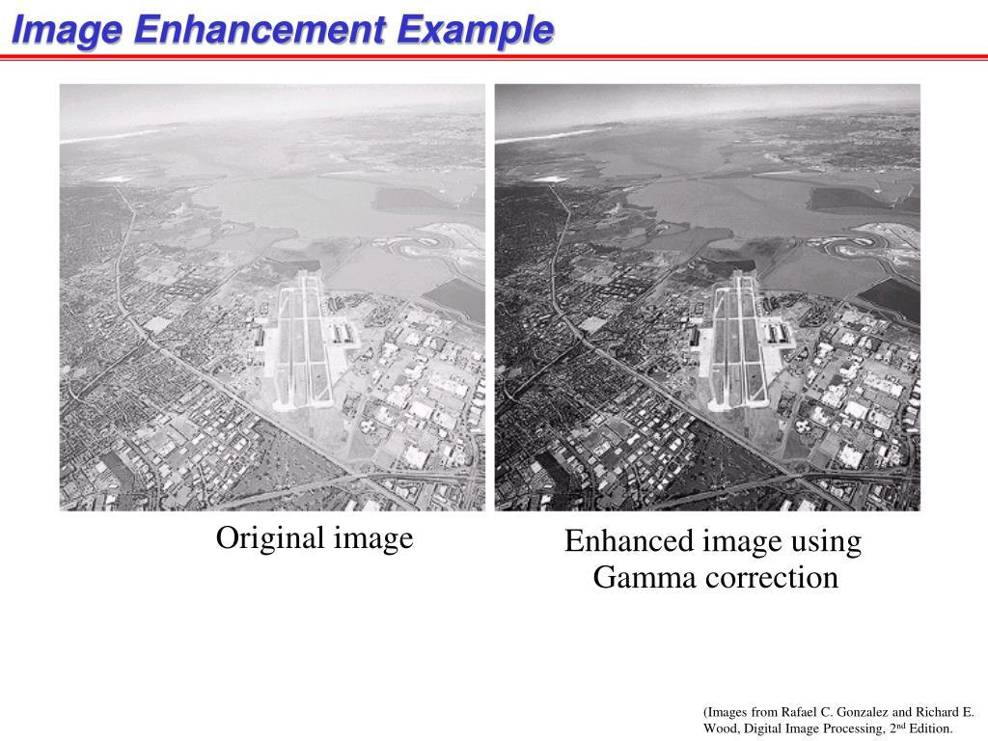
What is digital image processing?
Definition:
Digital Image Processing (DIP) is the use of computer algorithms and mathematical techniques to process, analyze, and improve digital images.
In simple words:
Digital Image Processing means using a computer to manipulate an image so that we can improve it, extract useful information from it, or understand its contents.
A digital image is represented as a matrix of pixels, where each pixel contains numerical information about brightness or color.
Simple Example
Suppose we have a dark photograph:
Original image → Image Processing → Brighter, clearer image
Why Do We Process Images?
Improve Image Quality: Remove noise, blur, and poor lighting.
Extract Information: Detect objects, edges, shapes, and patterns.
Automate Tasks: Enable systems to recognize faces, read documents, or detect diseases.
Fig 1: Original image
Fig 2: Enhanced image using Gamma correction

Slide 3
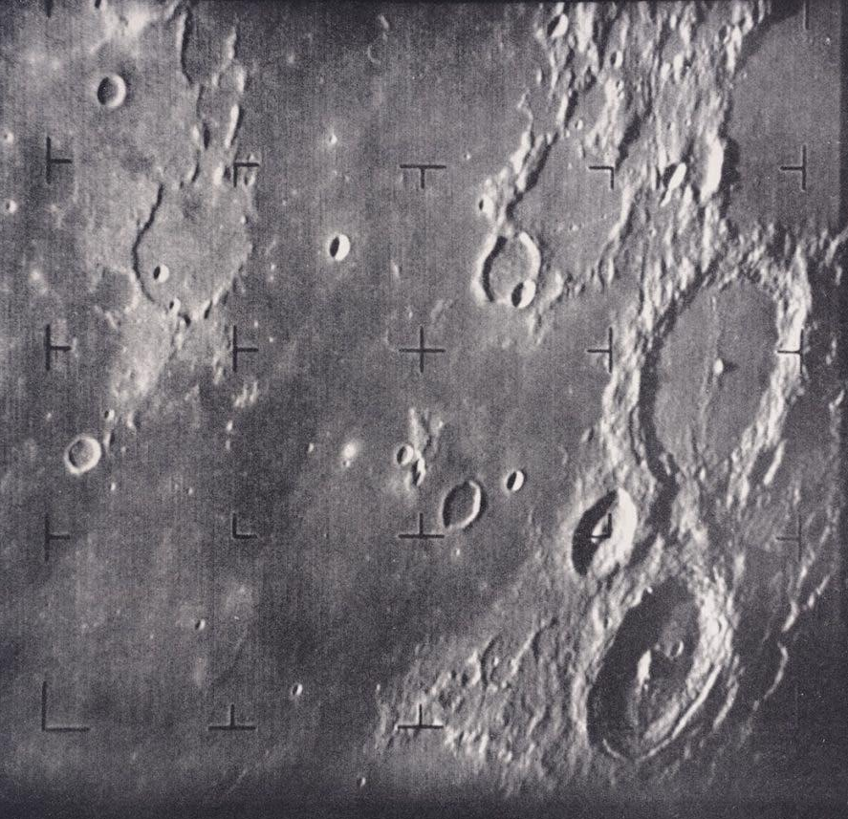
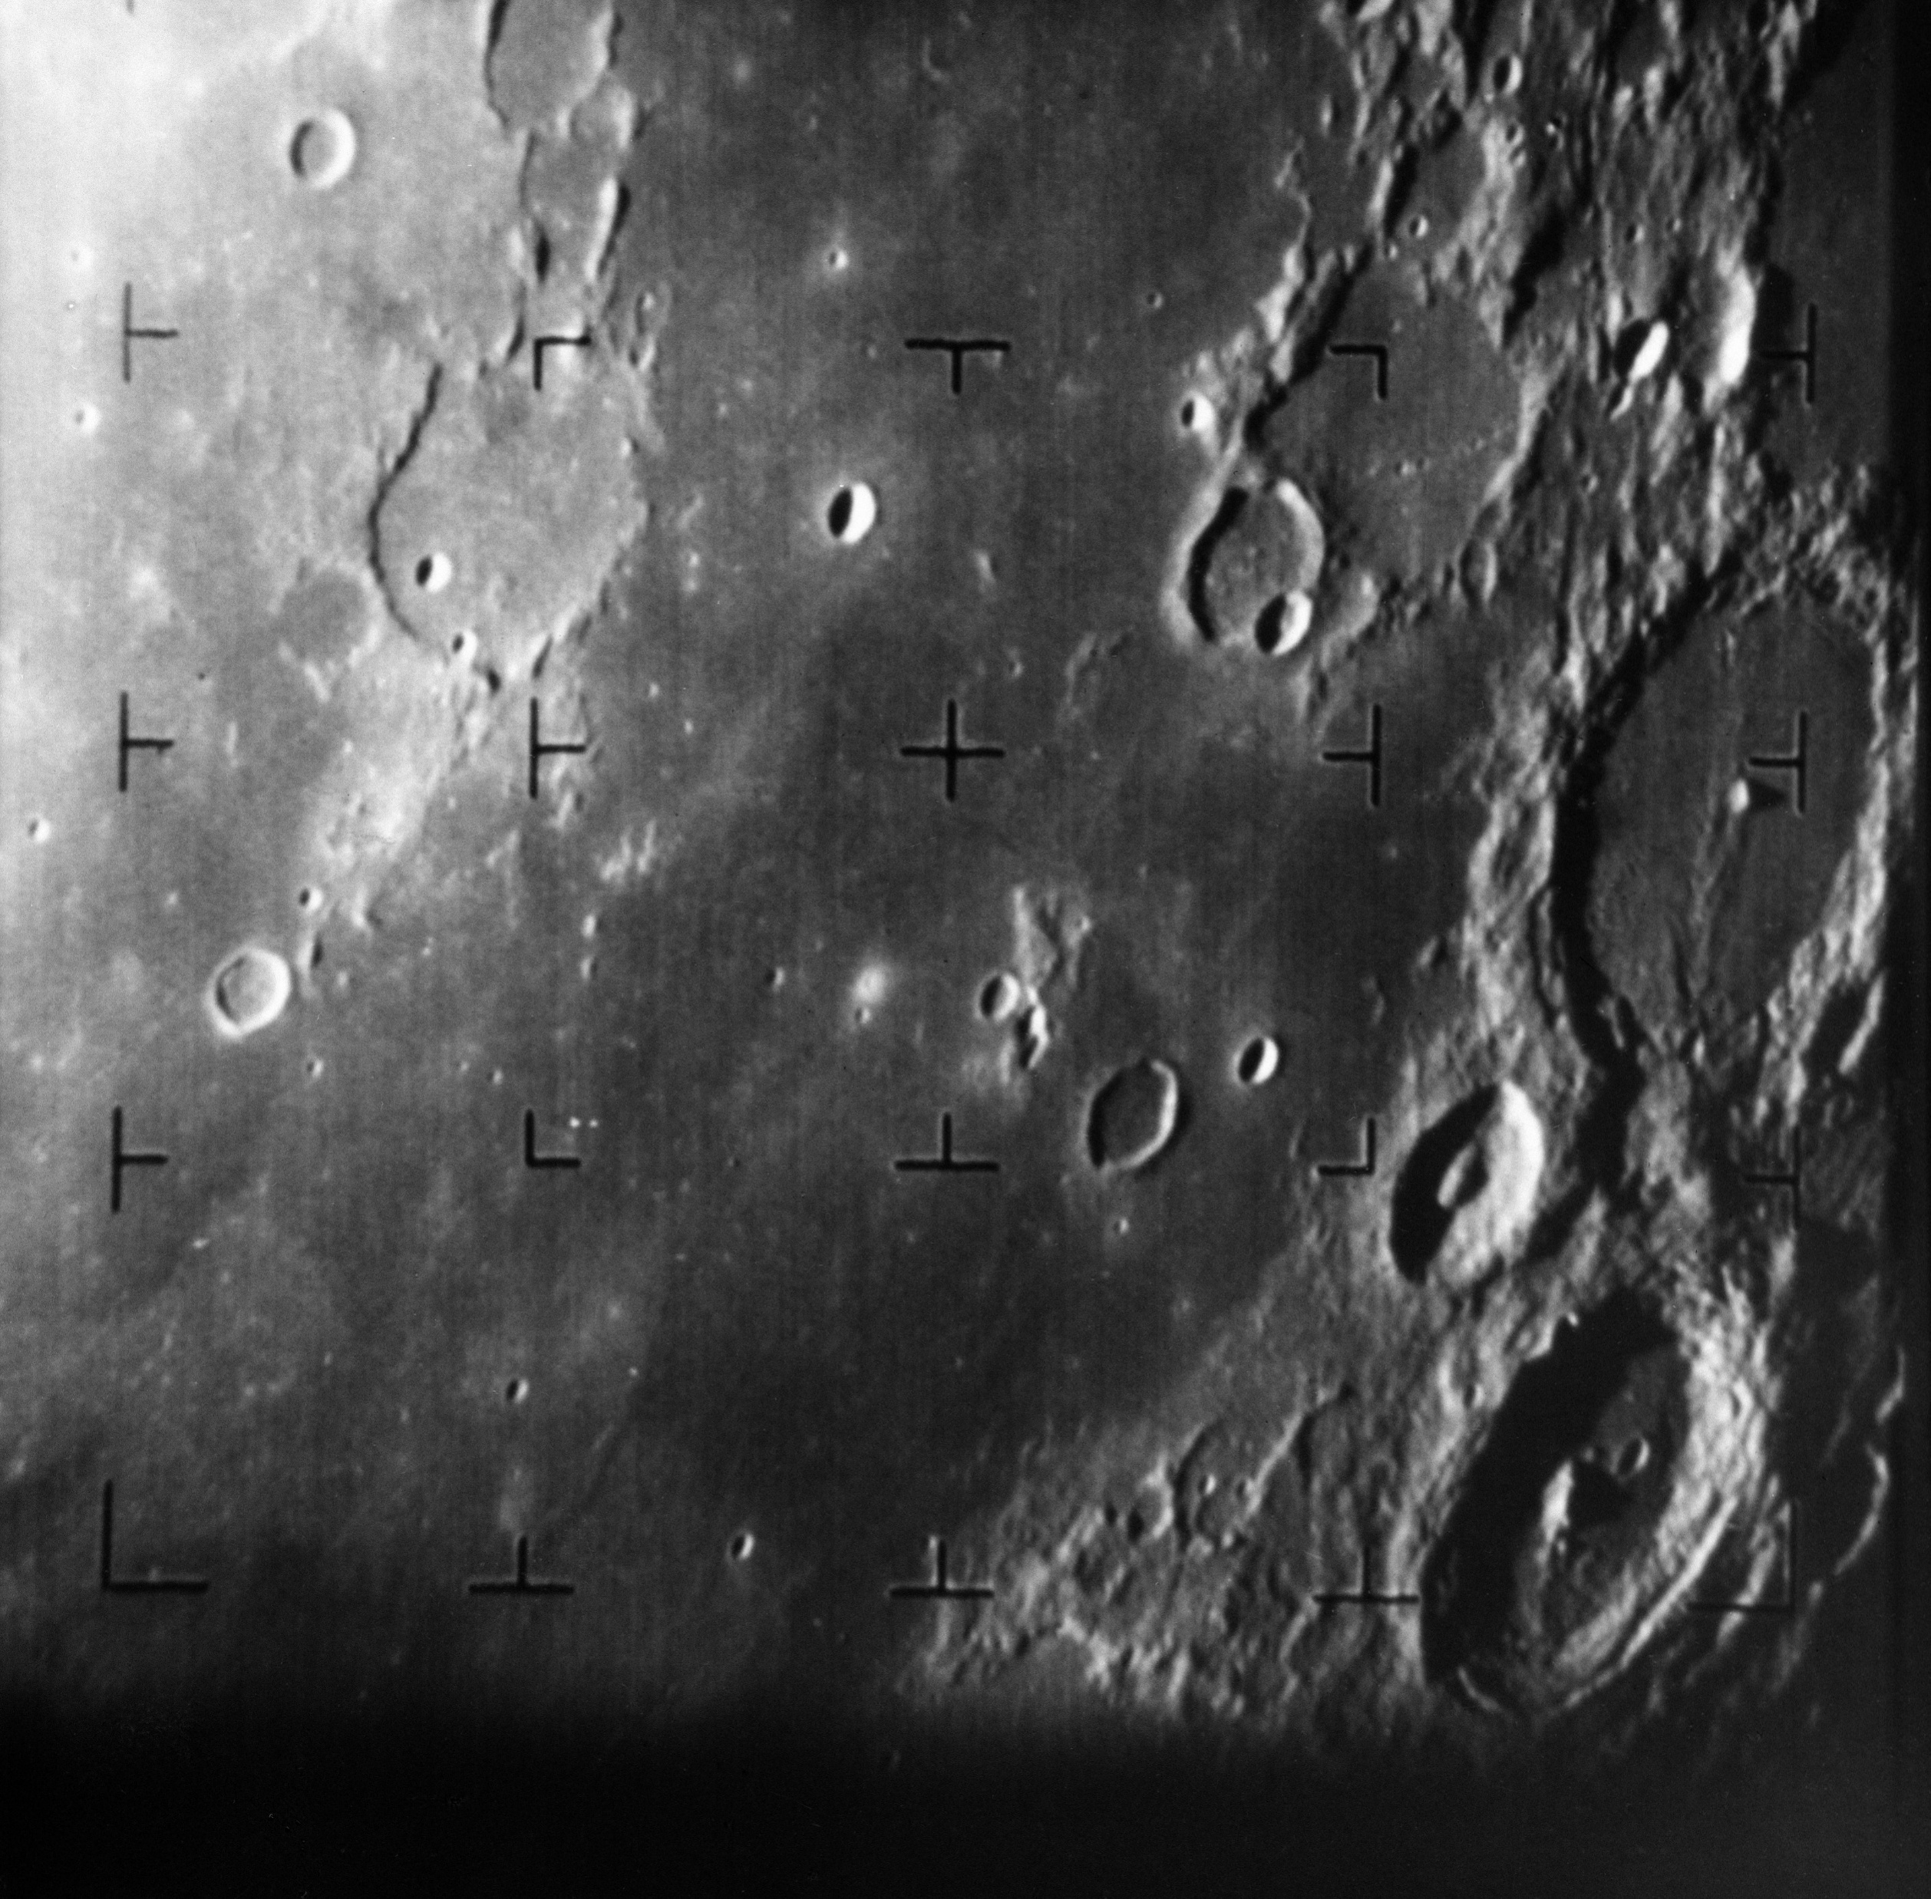
Origins of Digital Image Processing:
The development of digital image processing can be traced back to the 1920s, when images were transmitted electronically over long distances.
Key Milestones & Early Applications:
Period | Development | Example/Application
1920s | Early electronic image transmission | Images transmitted through telegraph systems
1950s–60s | Computers introduced for image processing | Image enhancement and analysis
1960s | Space exploration | NASA spacecraft images of the Moon
1970s | Medical imaging | X-ray and CT image analysis
1970s–80s | Remote sensing | Satellite and aerial photographs
1980s–90s | Industrial & defense applications | Inspection and aerial surveillance
2000s–Present | AI & deep learning | Face recognition, object detection
Table 1: Milestones and applications
In 1964, NASA's Ranger 7 spacecraft transmitted close-up images of the Moon. Digital processing was used to improve the transmitted images and extract useful details from them.
Fig 3: NASA image
Fig 4: NASA image

Slide 4
Fundamental steps in Digital Image Processing:
1. Image Acquisition
Capturing an image using a camera, scanner, satellite sensor, etc.
Includes sampling and quantization to convert the image into digital form.
2. Image Enhancement
Improves the visual appearance of an image.
Examples: contrast enhancement, sharpening, brightness adjustment.
3. Image Restoration
Recovers an image degraded by noise, blur, or other distortions.
Uses mathematical models of the degradation.
4. Color Image Processing
Processes and analyzes information related to image color.
Examples: RGB, HSV, and color enhancement.
Outputs are Images
Color Image Processing
Wavelets
Compression
Morphological Image Processing
Image Restoration
Segmentation
Knowledge Base
Image Enhancement
Outputs are Attributes associated with Images
Feature Extraction
Image Acquisition
Image Pattern Classification
Fig 5: Fundamental steps in DIP

Slide 5
5. Wavelets and Multiresolution Processing
Represents an image at different scales or resolutions.
Useful for image compression, analysis, and feature extraction.
6. Image Compression
Reduces the amount of data required to store or transmit an image.
Examples: JPEG and PNG.
7. Morphological Processing
Analyzes and modifies the shape and structure of objects in an image.
Common operations: erosion, dilation, opening, and closing.
8. Image Segmentation
Divides an image into meaningful regions or objects.
Example: separating a tumor from surrounding tissue.
9. Representation and Description
Represents segmented objects in a suitable form and describes their characteristics.
Features can include shape, boundary, area, texture, and color.
10. Object Recognition
Assigns labels or identifies objects based on their extracted features.
Example: recognizing a face, vehicle, or character.
11. Knowledge Base
Contains prior information about the problem or image. Example: knowing the expected size, shape, or location of an object.
For example:
Medical Image ->Tumor Detection
Original MRI
Wavelets: Analyze image at multiple scales
Compression: Reduce unnecessary data
Morphology: Clean and refine structure
Segmentation: Separate tumor region
Features: Shapes, size, Texture
Recognition: Tumor Identified
Knowledge Base: Provides prior knowledge about expected tumor characteristics

Slide 6
Visual perception – How human eyes see color and light compared to digital sensors
Visual Perception: From Light to Color
What is visual perception?
Visual perception is the process of detecting light and interpreting its intensity, wavelength, and spatial information to form an image
Human Vision
Light enters the eye and is focused on the retina.
Rods detect light intensity, especially in low light.
Cones detect different wavelength ranges and enable color vision.
The brain processes these signals to create visual perception.
Digital Sensor
Camera lens focuses light onto an image sensor.
Sensor elements convert light into electrical signals.
Color filters separate wavelength information, commonly R, G and B.
Signals are converted into digital pixel values.
LIGHT FROM OBJECT
HUMAN EYE
CAMERA SENSOR
Retina
Photodiodes
Brain
Processor
PERCEPTION
DIGITAL IMAGE

Slide 7
How Color is Detected: Human Eye vs Digital Sensor
Human eye
Human color perception is based mainly on the responses of three types of cone cells:
Receptor | Sensitivity | Role
S-cones | Short wavelengths | Blue/violet region
M-cones | Medium wavelengths | Green region
L-cones | Long wavelengths | Yellow/red region
Their responses overlap, and the brain combines their signals to perceive color.
Digital sensor
A digital camera generally uses color filter arrays (CFA) over sensor elements.
A common arrangement is the Bayer pattern:
R | G | R | G
G | B | G | B
R | G | R | G
G | B | G | B
R, G and B filters allow different wavelength ranges to reach different sensor elements.
Each sensor element measures light intensity, not “color” directly.
The camera processor combines the measurements to estimate the color of each pixel.
This process is followed by operations such as demosaicing, white balance, and color correction.

Slide 8
Human Vision vs Digital Sensor: Key Differences
Feature | Human Visual System | Digital Imaging System
Light receiver | Retina | CMOS/CCD sensor
Light receptors | Rods and cones | Photodiodes / sensor pixels
Color sensing | S, M, L cone responses | RGB or other color filters
Brightness | Neural response to light intensity | Measured electrical signal
Processing | Retina + visual cortex + brain | Image signal processor + algorithms
Color adaptation | Biological adaptation and contextual perception | White balance and color correction
Output | Perceived scene | Numerical pixel values
Dynamic response | Adapts to changing illumination | Limited by sensor and processing
Color reproduction | Context-dependent perception | Depends on sensor, filters, calibration and algorithms
Representation | Neural signals | Digital values, e.g. 0–255 per channel
Table 2: Key Difference
Why are they not exactly the same?
Human vision adapts to lighting and uses context to interpret colors. Digital sensors measure light and use processing algorithms such as white balance to reproduce colors.

Slide 9

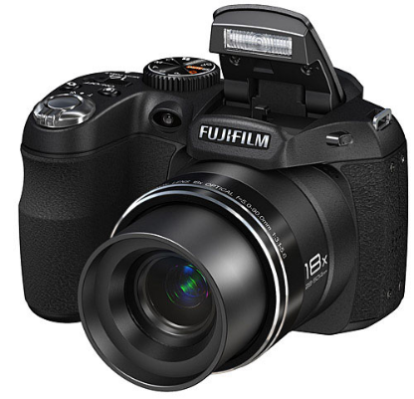
Image Acquisition Fundamentals
Definition:
Image sensing detects information that constitutes an image using specialized physical sensors.
In simple words:
•
It converts continuous physical phenomena (like reflected light) into an analog electrical signal.
•
The process requires an illumination source, object reflection or absorption, and a sensing mechanism.
Sensor Material:
The most common sensor material used for capturing light is the silicon photodiode.
Fig 1: Light entering a camera lens

Slide 10
Sensor Arrangements
Images can be acquired using different sensor configurations depending on the application:
1. Single Sensor
Generates 2D images by mechanical scanning in both x and y directions. It is highly precise but generally a slower method.
2. Line Sensor
Senses a full strip in one direction while mechanical motion operates in the perpendicular direction (e.g., flatbed scanners).
3. Sensor Array
A 2D arrangement that captures the entire image area at once, eliminating the need for complex mechanical motion.

Slide 11
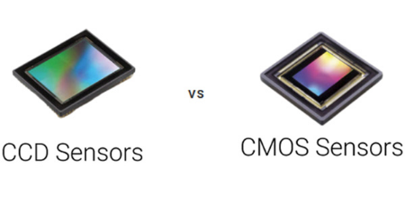
2D Sensor Arrays (Cameras)
How they work:
•
Sensor arrays eliminate the need for mechanical motion to capture a dynamic 2D scene.
•
Common technologies include CCD (Charge-Coupled Device) and CMOS arrays found in digital cameras.
Signal Generation:
•
Each array element responds to incident light by accumulating an electrical charge proportional to the energy.
Fig 2: 2D Sensor Array Chip
•
The array acts as the focal plane, generating a continuous analog voltage output for the entire scene.

Slide 12
The Need for Digitization
To process images on a computer, the analog signal from sensors must be digitized in two ways:
Spatial Digitization (Sampling)
The output of a sensor array is spatially continuous. We must convert this continuous physical plane into a discrete grid structure suitable for computer processing and storage.
Amplitude Digitization (Quantization)
The voltage values representing brightness are analog and continuous. These continuous waveforms must be mathematically mapped to discrete, finite digital steps.

Slide 13
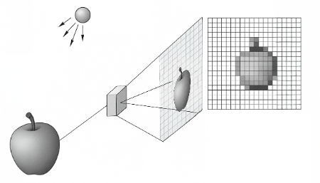
Sampling: Defining the Pixels
Process:
•
Sampling involves discretizing the spatial coordinates (x, y) of the continuous image scene.
•
It transforms a continuous visual field into a grid of discrete picture elements, known as "pixels".
Impact on Quality:
•
The density of this grid determines the image's overall spatial resolution and level of detail.
Fig 3: Continuous image mapped to pixel grid
•
Higher sampling rates capture finer variations but significantly increase file size and required storage.

Slide 14
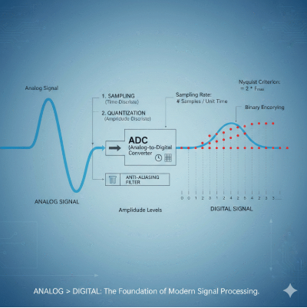
Quantization: Assigning Values
Process:
•
Quantization converts continuous amplitude (voltage) from each pixel into a discrete digital value.
•
Each pixel's intensity is mapped to the nearest integer within a defined scale (e.g., 0 to 255 for 8-bit).
Impact on Quality:
•
This critical step establishes the grayscale depth or color resolution of the final digital image.
•
Using limited quantization levels can cause visible artifacts, such as false contouring or banding.
Fig 4: Mapping analog wave to discrete values

Slide 15

The Image Processing Pipeline
Continuous Scene
↓
Sensor Array
↓
Analog Signal
↓
Sampling & Quantization
↓
Digital Pixels

Slide 16

Image Sources
https://www.picturecorrect.com/fujifilm-finepix-s4000-s3200-and-s2950/fujifilm-s2950/
Source: www.picturecorrect.com
https://www.teledynevisionsolutions.com/globalassets/tvs/learn/dalsa/ccd-vs-cmos/thumb-screenshot-2023-10-24-104441.jpg
Source: www.teledynevisionsolutions.com
https://sigmoidal.ai/wp-content/uploads/2025/06/Sampling-and-Quantization-1.png
Source: sigmoidal.ai
https://zeroinstrument.com/wp-content/uploads/2026/02/Understanding-Sampling-and-Signal-Conversion-From-Analog-to-Digital-768x768.png
Source: zeroinstrument.com

Slide 17




Image Sources
https://www.picturecorrect.com/fujifilm-finepix-s4000-s3200-and-s2950/fujifilm-s2950/
Source: www.picturecorrect.com
https://www.teledynevisionsolutions.com/globalassets/tvs/learn/dalsa/ccd-vs-cmos/thumb-screenshot-2023-10-24-104441.jpg
Source: www.teledynevisionsolutions.com
https://sigmoidal.ai/wp-content/uploads/2025/06/Sampling-and-Quantization-1.png
Source: sigmoidal.ai
https://zeroinstrument.com/wp-content/uploads/2026/02/Understanding-Sampling-and-Signal-Conversion-From-Analog-to-Digital-768x768.png
Source: zeroinstrument.com

Slide 18
Pixel Relationships – Neighbors, Connectivity, Paths, and Distance Measures
Definition:
An image is modeled as a discrete function f(x,y) sampled on an integer grid ℤ². Each coordinate is a sensor element; each value is a quantized brightness.
In Simple Words:
Continuous space (ℝ²) has no built-in “next to.” Digital grids need explicit, combinatorial rules for which pixels count as neighbors — and how far apart two pixels really are.
Why This Matters
Edge tracing, region segmentation, morphological filtering, and distance transforms all rest on how a pixel relates to its spatial neighbors.
Get the rules wrong and: filters leak through corners, connected-component labeling fragments one object into many, contour tracing loops forever, and distance maps come out distorted.
NW
N
NE
W
p(x,y)
E
SW
S
SE
This Seminar Is Built Around Four Pillars:
Fig 1: The eight neighbors of pixel p(x,y) on the grid
4-neighbors: N, S, E, W • Diagonal neighbors: NE, NW, SE, SW
1. Neighbors
2. Connectivity
3. Paths
4. Distance Measures

Slide 19
Spatial Neighborhood Geometry on the Pixel Grid
Formal Definitions
N₄(p) = the 4 orthogonal neighbors at unit distance:
{ (x+1,y), (x−1,y), (x,y+1), (x,y−1) }
N_{D}(p) = the 4 diagonal (corner) neighbors, √2 away:
{ (x+1,y+1), (x+1,y−1), (x−1,y+1), (x−1,y−1) }
N₈(p) = the union of both sets:
N₈(p) = N₄(p) ∪ Nᴰ(p)
Conceptual Translation
Every pixel sits on a uniform square grid. It communicates with 4 compass neighbors (N, S, E, W) and 4 diagonal corner neighbors (NE, NW, SE, SW); together these form the 8-neighborhood.
(x−1,y−1)
(x,y−1)
(x+1,y−1)
(x−1,y)
p(x,y)
(x+1,y)
(x−1,y+1)
(x,y+1)
(x+1,y+1)
Fig 2: Spatial coordinate layout of pixel neighborhoods

Slide 20
Boundary Truncation and Image Border Conditions
For an M×N image with row indices x ∈ [0, M−1] and column indices y ∈ [0, N−1], pixels on the perimeter cannot support a complete neighborhood — if (x±1, y±1) falls outside that range, the point is undefined.
Pixel Location | Valid N₄(p) | Valid Nᴰ(p) | Valid N₈(p) | Example
Interior element | 4 | 4 | 8 | All coordinates remain inside the array bounds
Edge (non-corner) | 3 | 2 | 5 | At x = 0, the coordinate (x−1, y) is undefined
Corner element | 2 | 1 | 3 | At (0,0), only (0,1), (1,0), and (1,1) exist
Boundary Extension Strategies
Constant zero-padding — clamp any out-of-range coordinate to zero.
Border replication — repeat the nearest boundary value.
Periodic extension — wrap around the opposite edge (toroidal).
Symmetric reflection — mirror values back across the boundary.

Slide 21
Adjacency Criteria and Mixed (m-) Connectivity
Three Adjacency Classes
(Let V be the set of intensity values used to define similarity, e.g. V = {1} for binary images.)
4-Adjacency: p and q are 4-adjacent if q ∈ N₄(p) and both values lie in V.
8-Adjacency: p and q are 8-adjacent if q ∈ N₈(p) and both values lie in V.
m-Adjacency: p and q are m-adjacent if (1) q ∈ N₄(p), or (2) q ∈ Nᴰ(p) and N₄(p) ∩ N₄(q) contains no pixel with a value in V.
Why m-Adjacency?
Plain 8-adjacency lets two pixels connect two ways at once — directly across a shared corner, and indirectly through a shared orthogonal neighbor. m-adjacency keeps only one route, removing the ambiguous loop.
Worked Example
0
1 (q)
1 (s)
0
1 (p)
0
0
0
1
3×3 binary patch, V = {1}
p(1,1) and q(0,1) are 4-adjacent — both values are in V.
p and its diagonal neighbor s(0,2) share orthogonal neighbor r=(0,1), which holds a 1.
Under 8-connectivity, p–s connect both directly (diagonal) and via p→q→s — an ambiguous closed loop.
Under m-connectivity, the diagonal link p–s is dropped; only the path p→q→s remains.

Slide 22
The Digital Jordan Curve Paradox
Rosenfeld's Connectivity Paradox
In continuous ℝ², the Jordan Curve Theorem says a simple closed curve always separates the plane into a bounded interior and an unbounded exterior. Applying one connectivity rule uniformly to both foreground and background on a discrete grid breaks this property.
Uniform 8-Connectivity (Diagonal Leakage) | Uniform 4-Connectivity (Background Split)
An 8-connected foreground curve forms a closed loop, but an 8-connected background can step diagonally through the same corner gap — interior and exterior merge. | A 4-connected foreground curve encloses an interior pixel, but the surrounding 4-connected background cannot cross the object's corners — it splits into disconnected pieces.
Failure: the boundary no longer separates interior from exterior. | Failure: one closed object appears to create several background regions.
The Fix — Dual Connectivity
Pair opposite rules on foreground and background: (k, k̄) ∈ {(4,8), (8,4)}. A 4-connected boundary is paired with an 8-connected background, or vice-versa.
Alternatively, apply m-connectivity to both sets — it removes the intersecting diagonal paths directly.

Slide 23
Digital Paths, Connected Components, and Two-Pass Labeling
A digital path from p to q is a sequence of distinct, pairwise-adjacent pixels; paths are classified as 4-, 8-, or m-paths depending on the adjacency rule enforced.
Two pixels in a set S are connected if a path between them lies entirely inside S. All pixels connected to p form one connected component of S.
Processing Stage | What Happens
Pass 1: Scan & Label | Raster-scan each foreground pixel. If its causal (already-visited) neighbors carry different labels, assign the minimum of them and record the labels as equivalent.
Resolve | Merge every recorded equivalence using a union-find (disjoint-set) structure, so each label chain reduces to one root label.
Pass 2: Remap | Replace each pixel's provisional label with its final resolved root label, producing the finished component map.
Suzuki–Abe Border Following
Rather than labeling dense interiors, this algorithm scans line by line and, on each unvisited 0→1 (outer) or 1→0 (hole) transition, walks the boundary contour back to its start — directly producing a hierarchy of nested outer and hole boundaries, with no separate fill step.

Slide 24
Distance Metrics: Euclidean, City-Block, and Chessboard
Three Coordinate Distance Metrics
Euclidean D_{e}(p,q) = √[(x−s)²+(y−t)²]
True straight-line distance. The locus Dₑ ≤ r is a circular disk. Rotationally invariant, but needs a square root.
City-Block D₄(p,q) = |x−s| + |y−t|
Distance restricted to 4-neighbor steps. The locus D₄ ≤ r is a diamond (a square rotated 45°).
Chessboard D₈(p,q) = max(|x−s|, |y−t|)
All 8 neighbor steps cost the same unit. The locus D₈ ≤ r is an axis-aligned square.
Unit Contours (r = 1)
·
1
·
1
1
1
1
1
1
1
1
1
·
1
·
1
1
1
City-Block D₄: diamond
Chessboard D₈: square
Euclidean grows a circle from p — the closest thing to “true” distance, but costly to compute.
City-Block only credits orthogonal steps, so its unit disk is a diamond.
Chessboard credits diagonal steps equally, so its unit disk is a full square.

Slide 25
Chamfer Approximation and the Non-Metric Mixed Distance
Chamfer Distance Transform
Exact Euclidean distance needs floating-point square roots across every pixel. Borgefors approximated it with small integer kernels — e.g. the 3-4 mask and the larger 5-7-11 mask.
Computed in two raster passes: a forward pass (top-left → bottom-right) and a backward pass (bottom-right → top-left), each propagating the minimum local distance to the nearest background pixel.
Metric Space Axioms
Non-negativity: D(p,q) ≥ 0
Identity: D(p,q) = 0 ⇔ p = q
Symmetry: D(p,q) = D(q,p)
Triangle inequality: D(p,z) ≤ D(p,q) + D(q,z)
Dₘ Can Break the Triangle Inequality
Four active pixels (value 1, V = {1}):
p(0,0), q(1,1) — diagonal neighbors
r(0,1) — the shared orthogonal neighbor of p and q
z(1,2) — an orthogonal neighbor of q
Since r = 1 ∈ V, m-connectivity blocks the direct diagonal p–q; the path must detour: p → r → q, so Dₘ(p,q) = 2.
Dₘ(q,z) = 1 directly, so Dₘ(p,q) + Dₘ(q,z) = 3.
But a direct route from p to z can be shorter than 3 — because Dₘ depends on neighboring pixel values, not coordinates alone, it does not satisfy the triangle inequality and is not a true metric.

Slide 26
From Theory to Practice: Two Production Pipelines
The same neighborhood, adjacency, and distance rules power very different production vision systems:
Stage | Histopathology Cell Segmentation | Semiconductor Defect Inspection
Binarization | Otsu thresholding isolates cellular regions from brightfield scans. | Otsu / contrast thresholding isolates conductive circuit traces.
Distance Transform | Borgefors 3-4 Chamfer map; cell centers form local intensity maxima. | Borgefors 5-7-11 Chamfer map (≈ 2% max error) encodes distance from trace edges.
Structure / Segmentation | Marker-controlled watershed with (8,4) dual connectivity separates touching cells. | m-connectivity thinning extracts a single-pixel-wide medial-axis skeleton.
Description / Output | Suzuki–Abe border following + two-pass CCL → labeled, classified cells. | N₈ neighbor-count audit → flags open-circuit breaks and short-circuit bridges.

Slide 27
Summary and References
Key Takeaways — One Idea Per Pillar
1. Neighbors: Discrete grids don't inherit continuous geometry automatically — N₄, Nᴰ, and N₈ give every pixel an explicit, chosen set of neighbors.
2. Connectivity: Dual connectivity, (4,8) or (8,4), preserves the digital Jordan Curve Theorem; m-connectivity removes redundant diagonal paths within a single set.
3. Paths: Sequences of pairwise-adjacent pixels define connected components; two-pass labeling with union-find turns that idea into a fast, production-ready algorithm.
4. Distance Measures: Euclidean, City-Block, and Chessboard metrics — and their integer Chamfer approximations — make distance transforms fast enough for real pipelines, from pathology slides to semiconductor wafers.
References
Failure of the Jordan Curve Theorem in Digital Topology — Rosenfeld's connectivity paradox and dual connectivity.
Borgefors, G. — “Digital Distance Geometry: A Survey,” Sadhana, Indian Academy of Sciences.
Suzuki, S. & Abe, K. — “Topological Structural Analysis of Digitized Binary Images by Border Following.”
“Connected-Component Labeling,” Wikipedia — two-pass algorithm and union-find equivalence resolution.

