Slide 1


Introduction To
Digital Image Fundamentals
Seminar Presentation

Slide 2
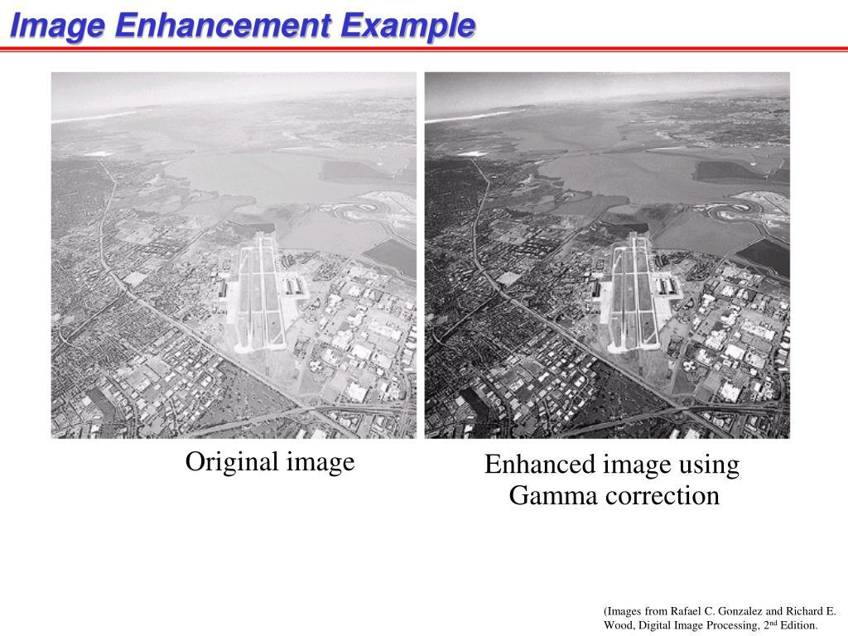
What is digital image processing?
Definition:
DIP uses computer algorithms to process, analyze, and improve digital images.
In simple words:
• Use a computer to improve an image, extract information, or understand its contents.
• A digital image is a matrix of pixels containing brightness or color values.
Simple Example
Dark photograph → Image Processing → Brighter, clearer image
Why Do We Process Images?
• Improve quality: remove noise, blur, and poor lighting.
• Extract information and automate tasks: detect objects, edges, patterns, and recognize faces.
Fig 1: Original image
Fig 2: Enhanced image using Gamma correction

Slide 3
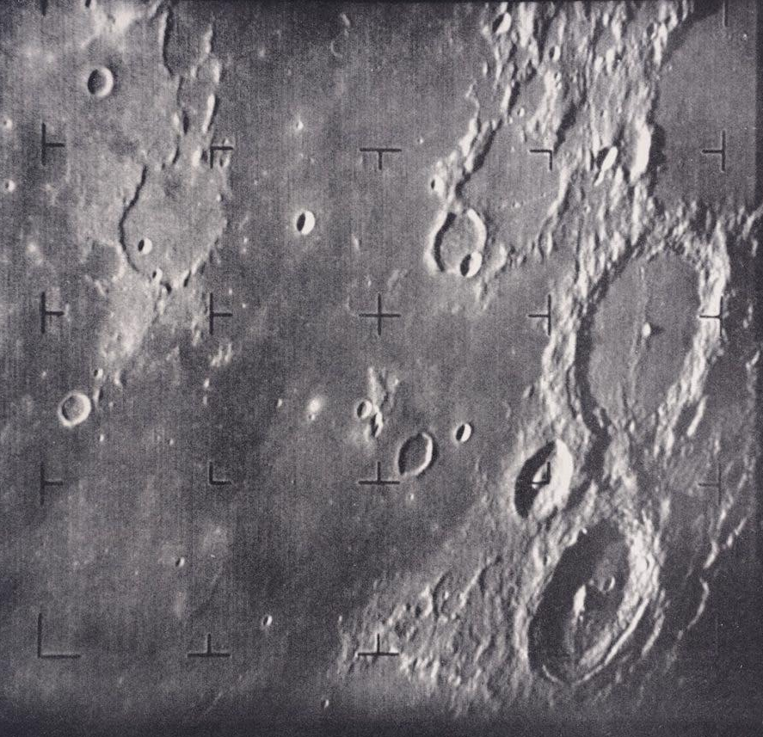
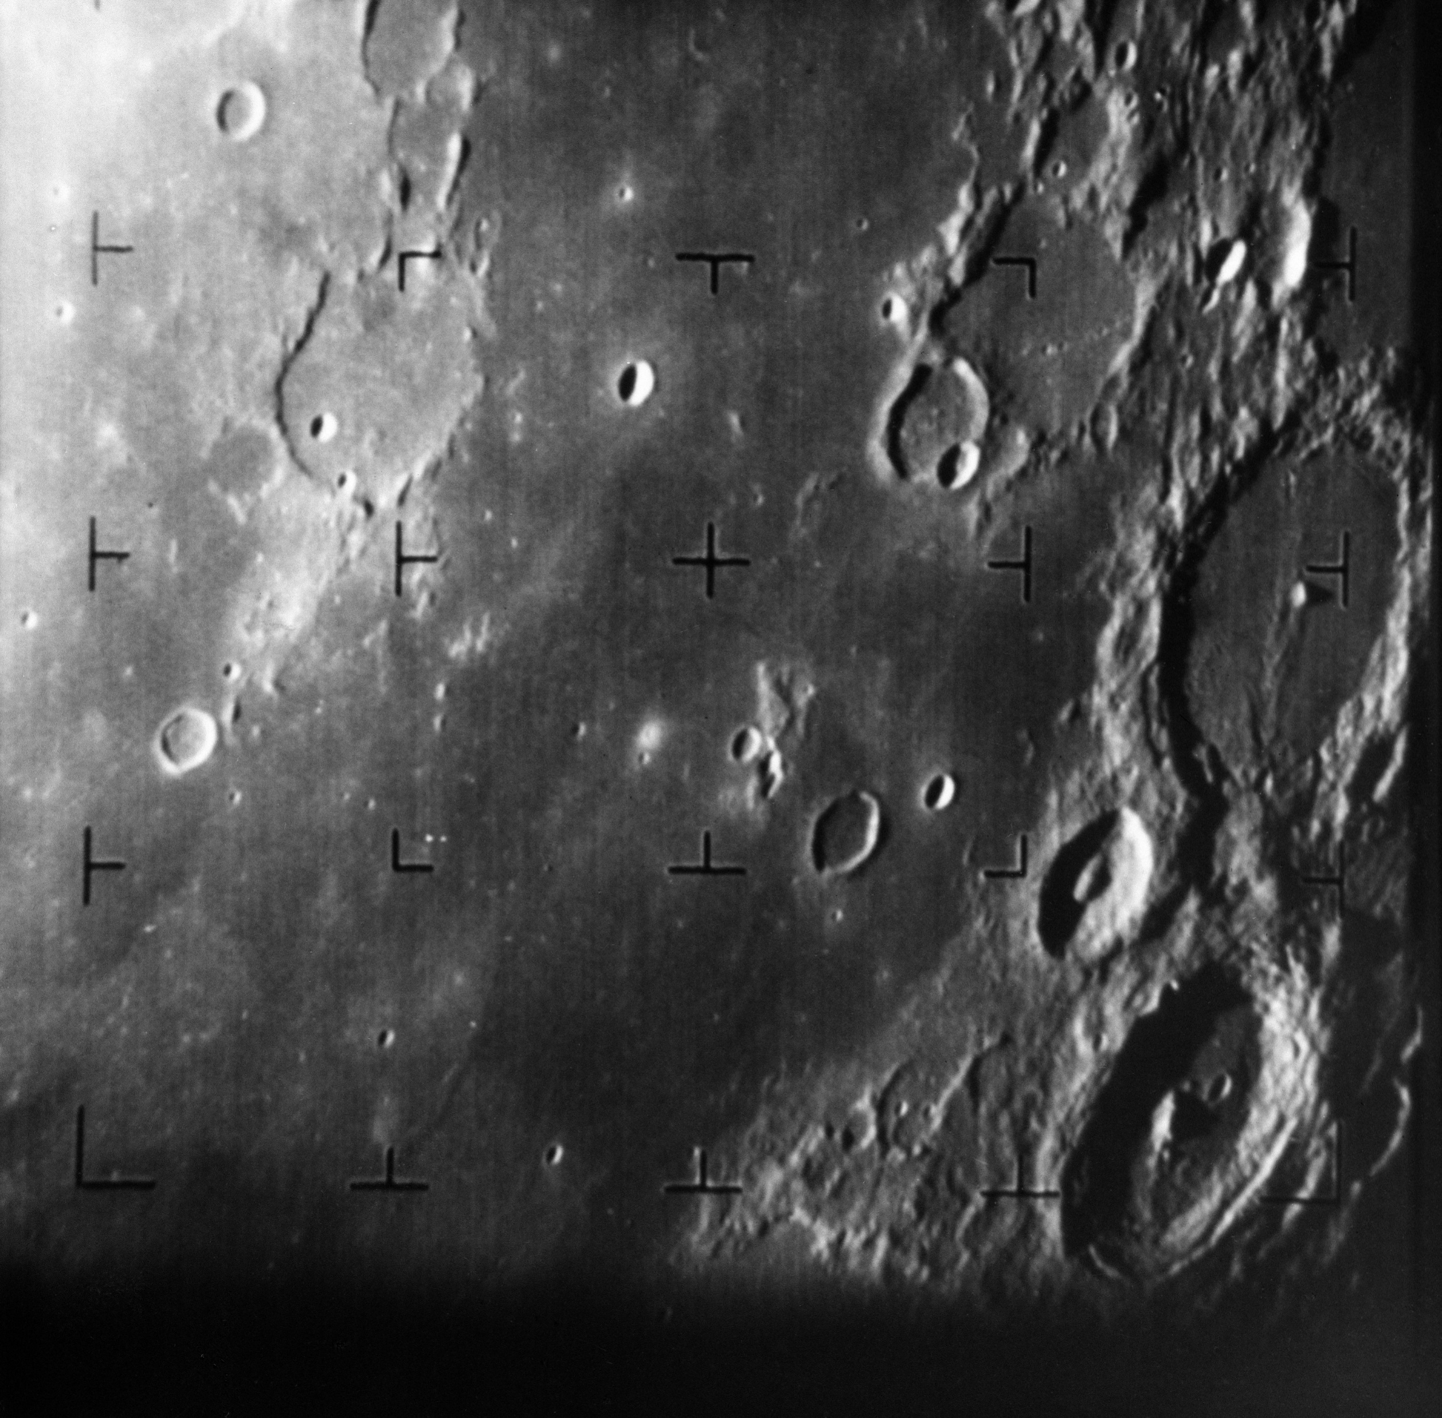
Key Milestones & Early Applications
Origins of Digital Image Processing:
The field traces back to the 1920s, when images were transmitted electronically over long distances.
Period | Development | Example/Application
1920s | Early electronic image transmission | Images transmitted through telegraph systems
1950s–60s | Computers introduced for image processing | Image enhancement and analysis
1960s | Space exploration | NASA spacecraft images of the Moon
1970s | Medical imaging | X-ray and CT image analysis
1970s–80s | Remote sensing | Satellite and aerial photographs
1980s–90s | Industrial & defense applications | Inspection and aerial surveillance
2000s–Present | AI & deep learning | Face recognition, object detection
Table 1: Milestones and applications
In 1964, NASA's Ranger 7 transmitted close-up Moon images. Digital processing improved the images and revealed useful details.
Fig 3: NASA image
Fig 4: NASA image

Slide 4
Fundamental Steps in DIP
1. Image Acquisition
• Capture an image using a camera, scanner, or satellite sensor.
• Includes sampling and quantization.
2. Image Enhancement
• Improves visual appearance: contrast, sharpness, and brightness.
3. Image Restoration
• Recovers images degraded by noise, blur, or distortion.
4. Color Image Processing
• Processes color information such as RGB and HSV.
Outputs are Images
Color
Wavelets
Compress
Morph.
Restore
Segment
Knowledge Base
Enhance
Outputs are Attributes associated with Images
Features
Acquire
Classify
Fig 5: Fundamental steps in DIP

Slide 5
5. Wavelets and Multiresolution Processing
Represents an image at different scales or resolutions.
Useful for image compression, analysis, and feature extraction.
6. Image Compression
Reduces the amount of data required to store or transmit an image.
Examples: JPEG and PNG.
7. Morphological Processing
Analyzes and modifies the shape and structure of objects in an image.
Common operations: erosion, dilation, opening, and closing.
8. Image Segmentation
Divides an image into meaningful regions or objects.
Example: separating a tumor from surrounding tissue.
9. Representation and Description
Represents segmented objects in a suitable form and describes their characteristics.
Features can include shape, boundary, area, texture, and color.
10. Object Recognition
Assigns labels or identifies objects based on their extracted features.
Example: recognizing a face, vehicle, or character.
11. Knowledge Base
Contains prior information about the problem or image. Example: knowing the expected size, shape, or location of an object.
For example:
Medical Image ->Tumor Detection
Original MRI
Wavelets: Analyze image at multiple scales
Compression: Reduce unnecessary data
Morphology: Clean and refine structure
Segmentation: Separate tumor region
Features: Shapes, size, Texture
Recognition: Tumor Identified
Knowledge Base: Provides prior knowledge about expected tumor characteristics

Slide 6
Visual Perception: Human Eye vs Digital Sensor
Visual Perception: From Light to Color
What is visual perception?
It detects light intensity, wavelength, and spatial information to form an image.
Human Vision
– Light enters the eye and is focused on the retina.
– Rods detect intensity; cones enable color vision.
– The brain combines these signals into visual perception.
Digital Sensor
– A camera lens focuses light onto the sensor.
– Sensor elements convert light into electrical signals.
– Color filters separate wavelength information (R, G, B).
– Signals become digital pixel values.
LIGHT FROM OBJECT
HUMAN EYE
CAMERA SENSOR
Retina
Photodiode
Brain
Processor
PERCEPTION
DIGITAL IMAGE

Slide 7
How Color is Detected: Human Eye vs Digital Sensor
Human eye
Receptor | Sensitivity | Role
S-cones | Short wavelengths | Blue/violet region
M-cones | Medium wavelengths | Green region
L-cones | Long wavelengths | Yellow/red region
Their responses overlap; the brain combines the signals to perceive color.
Digital sensor
A digital camera uses a color filter array (CFA), commonly the Bayer pattern.
R | G | R | G
G | B | G | B
R | G | R | G
G | B | G | B
– R, G and B filters pass different wavelength ranges to sensor elements.
– Each sensor element measures light intensity, not color directly.
– The processor estimates pixel color; demosaicing and color correction follow.

Slide 8
Human Vision vs Digital Sensor: Key Differences
Feature | Human Visual System | Digital Imaging System
Light receiver | Retina | CMOS/CCD sensor
Light receptors | Rods and cones | Photodiodes / sensor pixels
Color sensing | S, M, L cone responses | RGB or other color filters
Brightness | Neural response to light intensity | Measured electrical signal
Processing | Retina + visual cortex + brain | Image signal processor + algorithms
Color adaptation | Biological adaptation and contextual perception | White balance and color correction
Output | Perceived scene | Numerical pixel values
Dynamic response | Adapts to changing illumination | Limited by sensor and processing
Color reproduction | Context-dependent perception | Depends on sensor, filters, calibration and algorithms
Representation | Neural signals | Digital values, e.g. 0–255 per channel
Table 2: Key Difference
Why are they not exactly the same?
Human vision adapts to lighting and uses context to interpret colors. Digital sensors measure light and use processing algorithms such as white balance to reproduce colors.

Slide 9

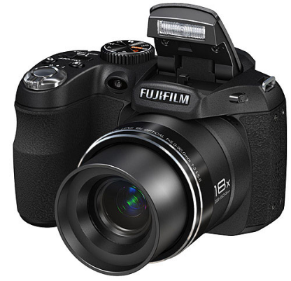
Image Acquisition Fundamentals
Definition:
Image sensing captures scene information using physical sensors.
In simple words:
•
It converts reflected light into an analog electrical signal.
The process needs illumination, reflected light, and a sensing mechanism.
•
Sensor Material:
Silicon photodiodes are commonly used to capture light.
Fig 1: Light entering a camera lens

Slide 10
Sensor Arrangements
Images can be acquired using different sensor configurations depending on the application:
1. Single Sensor
Generates 2D images by mechanical scanning in both x and y directions. It is highly precise but generally a slower method.
2. Line Sensor
Senses a full strip in one direction while mechanical motion operates in the perpendicular direction (e.g., flatbed scanners).
3. Sensor Array
A 2D arrangement that captures the entire image area at once, eliminating the need for complex mechanical motion.

Slide 11
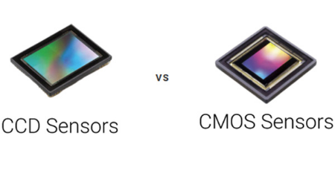
2D Sensor Arrays (Cameras)
How they work:
•
– Sensor arrays capture a dynamic 2D scene without mechanical motion.
•
– CCD and CMOS are common sensor technologies used in digital cameras.
Signal Generation:
•
– Each element converts incident light into charge proportional to energy.
– The array forms the focal plane and produces an analog signal.
Fig 2: 2D Sensor Array Chip
•

Slide 12
The Need for Digitization
To process images on a computer, the analog signal from sensors must be digitized in two ways:
Spatial Digitization (Sampling)
The output of a sensor array is spatially continuous. We must convert this continuous physical plane into a discrete grid structure suitable for computer processing and storage.
Amplitude Digitization (Quantization)
The voltage values representing brightness are analog and continuous. These continuous waveforms must be mathematically mapped to discrete, finite digital steps.

Slide 13
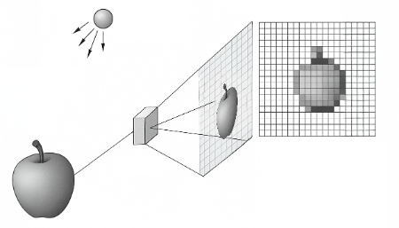
Sampling: Defining the Pixels
Process:
•
– Discretizes the spatial coordinates (x, y) of the image.
•
– Converts the continuous visual field into a grid of pixels.
Impact on Quality:
•
– Grid density controls spatial resolution and detail.
Fig 3: Continuous image mapped to pixel grid
•
– Higher sampling captures finer detail but increases storage.

Slide 14
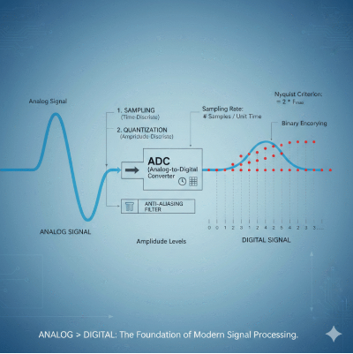
Quantization: Assigning Values
Process:
•
– Converts continuous pixel amplitude (voltage) to digital values.
•
– Maps each intensity to the nearest level, e.g. 0–255 for 8-bit.
Impact on Quality:
•
– Determines grayscale depth or color resolution.
•
– Too few levels can cause false contouring or banding.
Fig 4: Mapping analog wave to discrete values

Slide 15

The Image Processing Pipeline
Continuous Scene
↓
Sensor Array
↓
Analog Signal
↓
Sampling & Quantization
↓
Digital Pixels

Slide 16

Image Sources
https://www.picturecorrect.com/fujifilm-finepix-s4000-s3200-and-s2950/fujifilm-s2950/
Source: www.picturecorrect.com
https://www.teledynevisionsolutions.com/globalassets/tvs/learn/dalsa/ccd-vs-cmos/thumb-screenshot-2023-10-24-104441.jpg
Source: www.teledynevisionsolutions.com
https://sigmoidal.ai/wp-content/uploads/2025/06/Sampling-and-Quantization-1.png
Source: sigmoidal.ai
https://zeroinstrument.com/wp-content/uploads/2026/02/Understanding-Sampling-and-Signal-Conversion-From-Analog-to-Digital-768x768.png
Source: zeroinstrument.com

Slide 17




Image Sources
https://www.picturecorrect.com/fujifilm-finepix-s4000-s3200-and-s2950/fujifilm-s2950/
Source: www.picturecorrect.com
https://www.teledynevisionsolutions.com/globalassets/tvs/learn/dalsa/ccd-vs-cmos/thumb-screenshot-2023-10-24-104441.jpg
Source: www.teledynevisionsolutions.com
https://sigmoidal.ai/wp-content/uploads/2025/06/Sampling-and-Quantization-1.png
Source: sigmoidal.ai
https://zeroinstrument.com/wp-content/uploads/2026/02/Understanding-Sampling-and-Signal-Conversion-From-Analog-to-Digital-768x768.png
Source: zeroinstrument.com

Slide 18
Pixel Relationships: Neighbors, Connectivity & Distance
Definition:
An image is a discrete function f(x,y) on an integer grid. Each coordinate is a sensor element; each value is a quantized brightness.
In Simple Words:
– Digital grids need explicit rules for which pixels count as neighbors.
Why This Matters
– Neighbor rules affect edge tracing, segmentation, morphology, and distance transforms.
– Wrong rules can cause diagonal leakage, broken components, or distorted distances.
NW
N
NE
W
p(x,y)
E
SW
S
SE
1. Neighbors
2. Connectivity
3. Paths
4. Distance Measures
Fig 1: The eight neighbors of pixel p(x,y) on the grid
4-neighbors: N, S, E, W • Diagonal neighbors: NE, NW, SE, SW

Slide 19
Spatial Neighborhood Geometry on the Pixel Grid
Formal Definitions
N₄(p) = the 4 orthogonal neighbors at unit distance:
{ (x+1,y), (x−1,y), (x,y+1), (x,y−1) }
N_{D}(p) = the 4 diagonal (corner) neighbors, √2 away:
{ (x+1,y+1), (x+1,y−1), (x−1,y+1), (x−1,y−1) }
N₈(p) = the union of both sets:
N₈(p) = N₄(p) ∪ Nᴰ(p)
Conceptual Translation
Every pixel sits on a uniform square grid. It communicates with 4 compass neighbors (N, S, E, W) and 4 diagonal corner neighbors (NE, NW, SE, SW); together these form the 8-neighborhood.
(x−1,y−1)
(x,y−1)
(x+1,y−1)
(x−1,y)
p(x,y)
(x+1,y)
(x−1,y+1)
(x,y+1)
(x+1,y+1)
Fig 2: Spatial coordinate layout of pixel neighborhoods

Slide 20
Boundary Truncation and Image Border Conditions
For an M×N image with row indices x ∈ [0, M−1] and column indices y ∈ [0, N−1], pixels on the perimeter cannot support a complete neighborhood — if (x±1, y±1) falls outside that range, the point is undefined.
Pixel Location | Valid N₄(p) | Valid Nᴰ(p) | Valid N₈(p) | Example
Interior element | 4 | 4 | 8 | All coordinates remain inside the array bounds
Edge (non-corner) | 3 | 2 | 5 | At x = 0, the coordinate (x−1, y) is undefined
Corner element | 2 | 1 | 3 | At (0,0), only (0,1), (1,0), and (1,1) exist
Boundary Extension Strategies
Constant zero-padding — clamp any out-of-range coordinate to zero.
Border replication — repeat the nearest boundary value.
Periodic extension — wrap around the opposite edge (toroidal).
Symmetric reflection — mirror values back across the boundary.

Slide 21
Adjacency Criteria and Mixed (m-) Connectivity
Three Adjacency Classes
(Let V be the intensity values defining similarity, e.g. V={1}.)
– 4-adjacency: q ∈ N₄(p) and both values lie in V.
– 8-adjacency: q ∈ N₈(p) and both values lie in V.
– m-adjacency: q is 4-adjacent, or diagonal with no shared 4-neighbor in V.
Why m-Adjacency?
– 8-adjacency can create two routes around a corner. m-adjacency keeps one route and removes the ambiguity.
Worked Example
0
1 (q)
1 (s)
0
1 (p)
0
0
0
1
3×3 binary patch, V = {1}
– p(1,1) and q(0,1) are 4-adjacent.
– p and diagonal s(0,2) share r(0,1)=1.
– 8-connectivity creates two routes: direct p–s and p→q→s.
– m-connectivity removes the diagonal link; only p→q→s remains.

Slide 22
The Digital Jordan Curve Paradox
Rosenfeld's Connectivity Paradox
In continuous ℝ², the Jordan Curve Theorem says a simple closed curve always separates the plane into a bounded interior and an unbounded exterior. Applying one connectivity rule uniformly to both foreground and background on a discrete grid breaks this property.
Uniform 8-Connectivity (Diagonal Leakage) | Uniform 4-Connectivity (Background Split)
An 8-connected foreground curve forms a closed loop, but an 8-connected background can step diagonally through the same corner gap — interior and exterior merge. | A 4-connected foreground curve encloses an interior pixel, but the surrounding 4-connected background cannot cross the object's corners — it splits into disconnected pieces.
Failure: the boundary no longer separates interior from exterior. | Failure: one closed object appears to create several background regions.
The Fix — Dual Connectivity
Pair opposite rules on foreground and background: (k, k̄) ∈ {(4,8), (8,4)}. A 4-connected boundary is paired with an 8-connected background, or vice-versa.
Alternatively, apply m-connectivity to both sets — it removes the intersecting diagonal paths directly.

Slide 23
Digital Paths, Connected Components, and Two-Pass Labeling
A digital path from p to q is a sequence of distinct, pairwise-adjacent pixels; paths are classified as 4-, 8-, or m-paths depending on the adjacency rule enforced.
Two pixels in a set S are connected if a path between them lies entirely inside S. All pixels connected to p form one connected component of S.
Processing Stage | What Happens
Pass 1: Scan & Label | Raster-scan each foreground pixel. If its causal (already-visited) neighbors carry different labels, assign the minimum of them and record the labels as equivalent.
Resolve | Merge every recorded equivalence using a union-find (disjoint-set) structure, so each label chain reduces to one root label.
Pass 2: Remap | Replace each pixel's provisional label with its final resolved root label, producing the finished component map.
Suzuki–Abe Border Following
Rather than labeling dense interiors, this algorithm scans line by line and, on each unvisited 0→1 (outer) or 1→0 (hole) transition, walks the boundary contour back to its start — directly producing a hierarchy of nested outer and hole boundaries, with no separate fill step.

Slide 24
Distance Metrics: Euclidean, City-Block, and Chessboard
Three Coordinate Distance Metrics
Euclidean D_{e}(p,q) = √[(x−s)²+(y−t)²]
True straight-line distance. The locus Dₑ ≤ r is a circular disk. Rotationally invariant, but needs a square root.
City-Block D₄(p,q) = |x−s| + |y−t|
Distance restricted to 4-neighbor steps. The locus D₄ ≤ r is a diamond (a square rotated 45°).
Chessboard D₈(p,q) = max(|x−s|, |y−t|)
All 8 neighbor steps cost the same unit. The locus D₈ ≤ r is an axis-aligned square.
Unit Contours (r = 1)
·
1
·
1
1
1
1
1
1
1
1
1
·
1
·
1
1
1
City-Block D₄: diamond
Chessboard D₈: square
– Euclidean grows a circle — closest to true distance, but needs a square root.
– City-Block uses orthogonal steps; its unit disk is a diamond.
– Chessboard counts diagonal steps equally; its unit disk is a square.

Slide 25
Chamfer Approximation and the Non-Metric Mixed Distance
Chamfer Distance Transform
Exact Euclidean distance needs floating-point square roots across every pixel. Borgefors approximated it with small integer kernels — e.g. the 3-4 mask and the larger 5-7-11 mask.
Computed in two raster passes: a forward pass (top-left → bottom-right) and a backward pass (bottom-right → top-left), each propagating the minimum local distance to the nearest background pixel.
Metric Space Axioms
Non-negativity: D(p,q) ≥ 0
Identity: D(p,q) = 0 ⇔ p = q
Symmetry: D(p,q) = D(q,p)
Triangle inequality: D(p,z) ≤ D(p,q) + D(q,z)
Dₘ Can Break the Triangle Inequality
Four active pixels (value 1, V = {1}):
p(0,0), q(1,1) — diagonal neighbors
r(0,1) — the shared orthogonal neighbor of p and q
z(1,2) — an orthogonal neighbor of q
Since r = 1 ∈ V, m-connectivity blocks the direct diagonal p–q; the path must detour: p → r → q, so Dₘ(p,q) = 2.
Dₘ(q,z) = 1 directly, so Dₘ(p,q) + Dₘ(q,z) = 3.
But a direct route from p to z can be shorter than 3 — because Dₘ depends on neighboring pixel values, not coordinates alone, it does not satisfy the triangle inequality and is not a true metric.

Slide 26
From Theory to Practice: Two Production Pipelines
The same neighborhood, adjacency, and distance rules power very different production vision systems:
Stage | Histopathology Cell Segmentation | Semiconductor Defect Inspection
Binarization | Otsu thresholding isolates cellular regions from brightfield scans. | Otsu / contrast thresholding isolates conductive circuit traces.
Distance Transform | Borgefors 3-4 Chamfer map; cell centers form local intensity maxima. | Borgefors 5-7-11 Chamfer map (≈ 2% max error) encodes distance from trace edges.
Structure / Segmentation | Marker-controlled watershed with (8,4) dual connectivity separates touching cells. | m-connectivity thinning extracts a single-pixel-wide medial-axis skeleton.
Description / Output | Suzuki–Abe border following + two-pass CCL → labeled, classified cells. | N₈ neighbor-count audit → flags open-circuit breaks and short-circuit bridges.

Slide 27
Summary and References
Key Takeaways — One Idea Per Pillar
1. Neighbors: Discrete grids don't inherit continuous geometry automatically — N₄, Nᴰ, and N₈ give every pixel an explicit, chosen set of neighbors.
2. Connectivity: Dual connectivity, (4,8) or (8,4), preserves the digital Jordan Curve Theorem; m-connectivity removes redundant diagonal paths within a single set.
3. Paths: Sequences of pairwise-adjacent pixels define connected components; two-pass labeling with union-find turns that idea into a fast, production-ready algorithm.
4. Distance Measures: Euclidean, City-Block, and Chessboard metrics — and their integer Chamfer approximations — make distance transforms fast enough for real pipelines, from pathology slides to semiconductor wafers.
References
Failure of the Jordan Curve Theorem in Digital Topology — Rosenfeld's connectivity paradox and dual connectivity.
Borgefors, G. — “Digital Distance Geometry: A Survey,” Sadhana, Indian Academy of Sciences.
Suzuki, S. & Abe, K. — “Topological Structural Analysis of Digitized Binary Images by Border Following.”
“Connected-Component Labeling,” Wikipedia — two-pass algorithm and union-find equivalence resolution.

