Slide 1
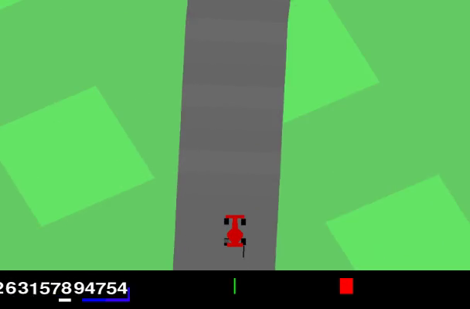
Sample-Efficient PPO for
CarRacing-v3 Using Road-Mask Ray Features
Joe / Student ID: 1103820
500k
929.7
614.1
Compact HSV road-mask ray features + PPO MlpPolicy
training budget
best raw reward
RANDOM10 mean
Promising sample efficiency, but not uniformly robust.
Joe / 1103820
01
Notes:
Open with the core project idea and the three headline numbers.
Emphasize that the conservative conclusion is intentional.

Slide 2
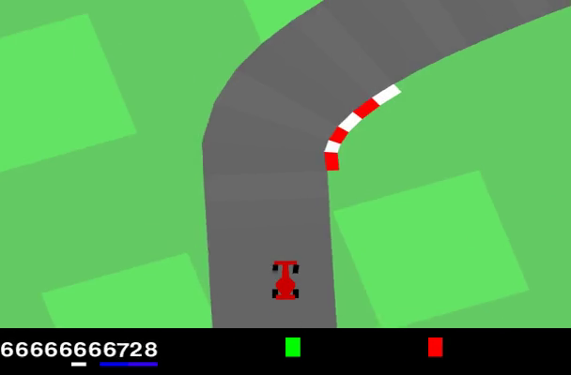
CARRACING-V3
Problem and Motivation
- Observation: 96 x 96 RGB frame
- Action: continuous steering, gas, brake
- Raw-pixel PPO must learn vision and control together
- Limited Colab/course budget motivates compact features
Goal: reduce perception burden without changing PPO itself.
Joe / 1103820
02
Notes:
Explain the benchmark and why raw images are expensive under a course budget.

Slide 3
SCOPE
Research Question and Contribution
Can deterministic road-mask ray features make PPO more sample-efficient under limited training?
- Reproducible wrapper: RGB -> HSV mask -> 9 rays
- 14D base observation stacked to 56D
- Stable-Baselines3 PPO with MlpPolicy
- Evaluation from saved artifacts, not hidden notebook state
- Conservative claim: promising, not fully robust
Joe / 1103820
03
Notes:
State exactly what is contributed and what is not claimed.

Slide 4
CONTEXT ONLY
Related Work / Baseline Context
Topic
Role in this project
PPO
standard continuous-control learner
Stable-Baselines3
implementation, MlpPolicy, artifact reload
CnnPolicy vs MlpPolicy
image policy vs engineered vector policy
RL Zoo
CnnPolicy/image/4e6 timestep configuration context
HSV masking
deterministic road-mask preprocessing
RL Zoo was not re-run; it is not a beaten baseline.
Joe / 1103820
04
Notes:
Make the baseline context clear and avoid overstating comparison.

Slide 5
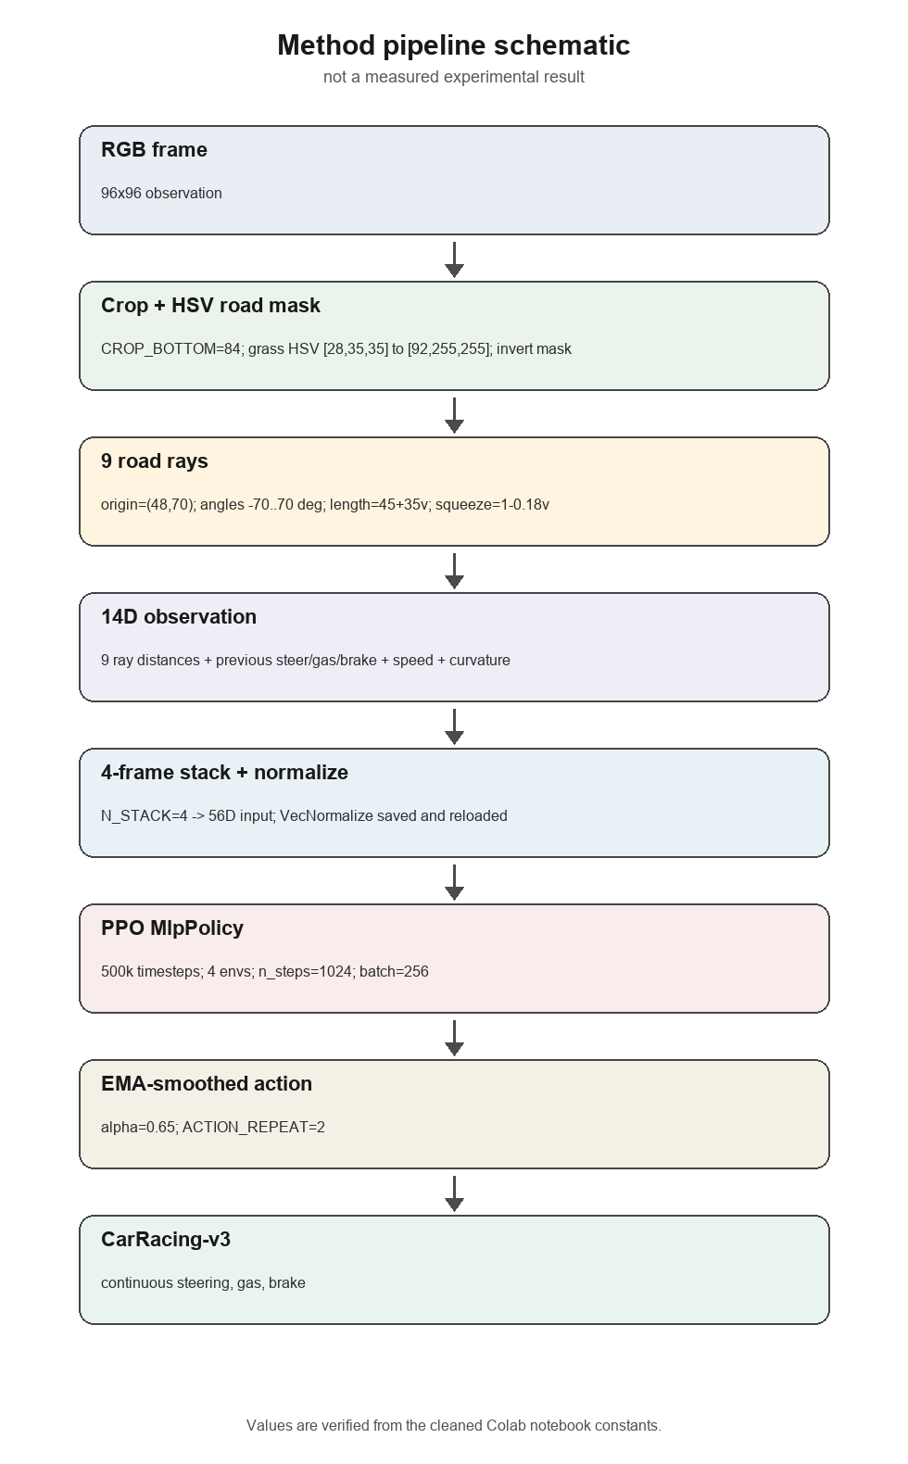
WRAPPER DESIGN
Method Pipeline
Schematic of implemented wrapper; not a measured experimental result.
Joe / 1103820
05
Notes:
Walk left to right through preprocessing, feature stack, PPO, and smoothed action.

Slide 6
INTERPRETABLE INPUT
Ray Feature Design
- Crop dashboard: CROP_BOTTOM = 84
- HSV grass mask: [28,35,35] to [92,255,255]
- Road mask: invert grass-like pixels
- Ray origin: (48, 70)
- 9 angles: -70 to 70 degrees
- Dynamic length: 45 + 35v
- Angle squeeze: 1 - 0.18v
14D = 9 rays + 3 previous controls + speed + curvature
Joe / 1103820
06
Notes:
Explain why the vector is interpretable and why it can train faster than raw pixels.

Slide 7
500K TIMESTEP RUN
PPO Training Setup
Setting
Value
Reward shaping
Algorithm
SB3 PPO
Training aid only; raw reward is the final reporting metric.
Policy
MlpPolicy
Network
256 x 256 MLP
Parallel envs
4
PPO unchanged
n_steps / batch
1024 / 256
The contribution is the deterministic wrapper and evaluation package.
gamma / GAE lambda
0.99 / 0.95
Entropy coef.
0.01
Action handling
EMA alpha 0.65; repeat 2
Joe / 1103820
07
Notes:
Keep this slide factual; do not imply a new PPO algorithm.

Slide 8
ARTIFACT-BASED EVIDENCE
Evaluation Protocol
Item
Protocol
Reload
saved PPO model + VecNormalize
COMPARE5
42, 123, 777, 999, 2026
RANDOM10
deterministic seeds from master seed 42
Metrics
raw reward, shaped reward, frames, termination label
Evidence
CSV tables and charts are quantitative; videos are qualitative
Raw reward is the headline metric.
Joe / 1103820
08
Notes:
Stress that the final evaluation reloads saved artifacts and is not a live-notebook claim.

Slide 9
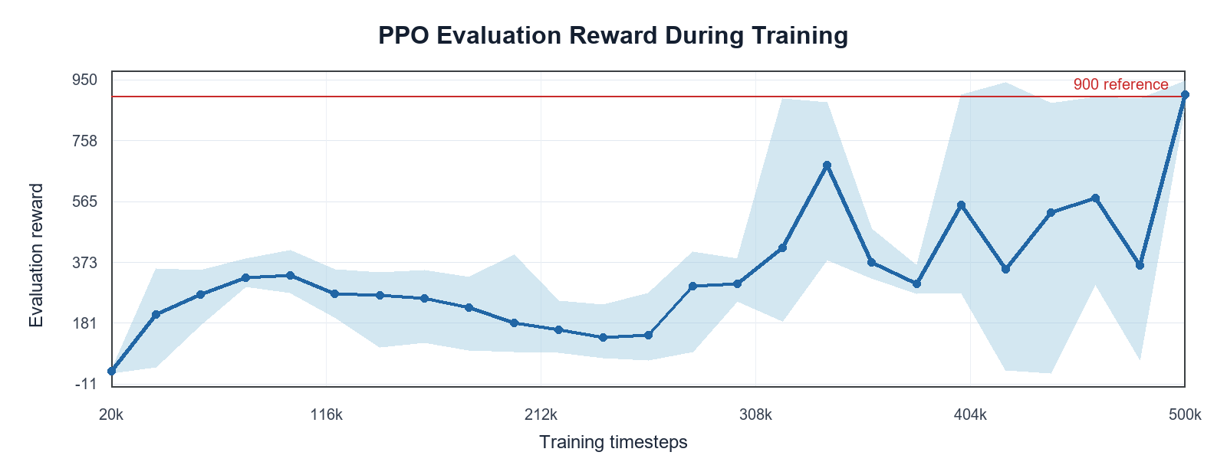
DIAGNOSTIC EVIDENCE
Training Curve
Learning improves late in training, but reward remains noisy. Final judgment comes from multi-seed evaluation.
Joe / 1103820
09
Notes:
Do not over-interpret the curve; it is diagnostic, not the final benchmark.

Slide 10
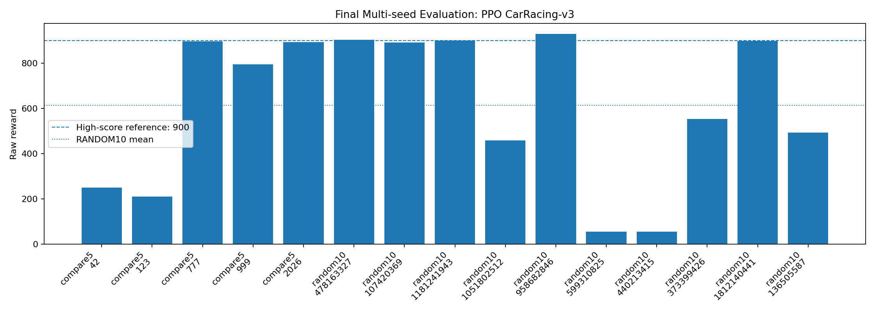
MULTI-SEED RESULTS
Final Reward Distribution
929.7
614.1
55-56
best raw reward
RANDOM10 mean
failure seeds
Joe / 1103820
10
Notes:
Highlight both the strong seeds and the low-reward failures.

Slide 11
TABLES SUMMARIZED FOR PRESENTATION
Seed-Level Evidence
Split
Mean
Std.
Min
Max
- Strong seeds: 958682846 reaches 929.7
- Success seed 2026 reaches 893.33
- Failure seeds: 599310825 = 55.51, 440213415 = 56.17
- High variance prevents a solved/robust claim
COMPARE5
609.1
348.2
210.8
896.0
RANDOM10
614.1
347.8
55.5
929.7
The best episode and the failure seeds both matter.
Joe / 1103820
11
Notes:
Use this slide to explain why the conclusion is balanced.

Slide 12
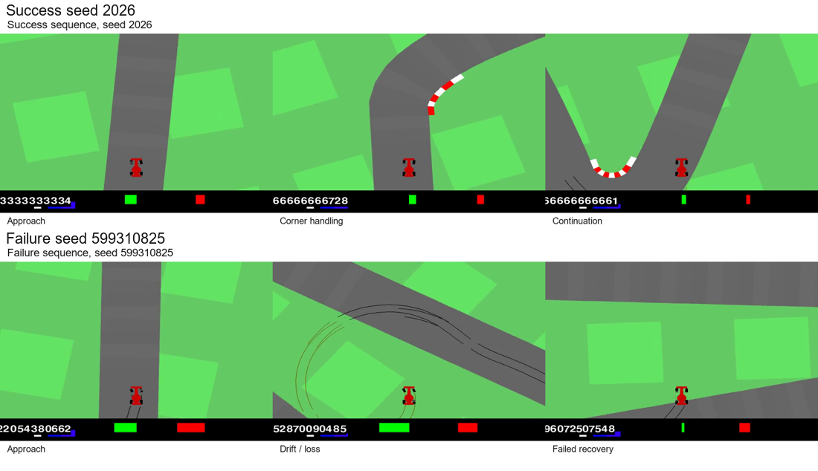
VIDEO EVIDENCE
Qualitative Success and Failure
Qualitative only; CSV tables remain the quantitative evidence.
Joe / 1103820
12
Notes:
Point out the success strip first, then the drift and failed recovery strip.

Slide 13
CONSERVATIVE INTERPRETATION
Limitations and Future Work
- Missing matched RL Zoo CnnPolicy baseline
- HSV thresholds may not transfer under visual changes
- Local rays are weak after off-road drift
- Action smoothing can delay emergency correction
- Only one final training run; no training-seed statistics
- Future ablations: no smoothing, fixed rays, no curvature, no shaping
Future work is not reported as completed work.
Joe / 1103820
13
Notes:
Frame limitations as credibility, not weakness.

Slide 14
FINAL TAKEAWAY
Conclusion and Reproducibility
Road-mask ray features can produce high-reward episodes with 500k PPO timesteps.
- Best raw reward: 929.7
- RANDOM10 mean: 614.1 with high variance
- Not uniformly robust; low-reward seeds remain
- Package includes notebook, report source, figures, tables, slides, and artifacts
GitHub: https://github.com/UltraLamb/CarRacingV3-PPO-RayFeatures
Joe / 1103820
14
Notes:
Close by repeating the balanced conclusion and pointing to the reproducibility package.

