Slide 1
Sample-Efficient PPO for
CarRacing-v3
500k
training timesteps
Road-mask ray features + PPO MlpPolicy
929.7
Joe / Student ID: 1103820
best raw reward
614.1
RANDOM10 mean
Joe / 1103820 1

Slide 2
CarRacing-v3 PPO Final Project
Research Question and Contribution
- Can compact road-mask ray features make PPO learn CarRacing-v3 faster than raw-pixel learning?
- Contribution: replace image input with interpretable 56D stacked features.
- Claim: promising sample efficiency, not a fully robust controller.
56D
PPO input
Joe / 1103820 2

Slide 3
CarRacing-v3 PPO Final Project
Introduction: Pixel-Based Continuous Control
- CarRacing-v3 provides a 96x96 RGB observation.
- The agent controls steering, gas, and brake continuously.
- Raw-pixel PPO must learn vision and control together.
- Random tracks make a single successful episode insufficient.
Joe / 1103820 3

Slide 4
CarRacing-v3 PPO Final Project
Related Work and Baseline Context
- PPO uses a clipped objective to avoid overly large policy updates.
- Stable-Baselines3 separates CnnPolicy for images and MlpPolicy for vectors.
- RL Zoo uses CnnPolicy and 4e6 timesteps for CarRacing PPO.
- RL Zoo is configuration context only because it was not re-run here.
Joe / 1103820 4

Slide 5
CarRacing-v3 PPO Final Project
Proposed Method Overview
RGB
HSV
9 rays
14D
56D
PPO
>
>
>
>
>
frame
mask
distance
state
stack
MLP
- PPO is unchanged.
- The wrapper changes what the policy observes and how actions are smoothed.
- Final evaluation reloads saved model and VecNormalize artifacts.
Joe / 1103820 5

Slide 6
CarRacing-v3 PPO Final Project
Ray Feature Design
- HSV threshold detects grass-like pixels; inversion approximates road.
- Nine rays span the visible left, center, and right road regions.
- Speed-adaptive ray length gives earlier boundary information.
- Curvature comes from left-right ray imbalance.
o_t = [9 ray distances,
previous controls,
speed, curvature]
4-frame stack -> 56D
Joe / 1103820 6

Slide 7
CarRacing-v3 PPO Final Project
PPO Setup and Reward Shaping
- MlpPolicy with 256 x 256 network.
- 4 parallel environments, n_steps=1024, batch_size=256.
- Learning rate decays from 3e-4 to 1e-5.
- Reward shaping guides training; raw reward is used for final reporting.
- Action smoothing reduces jitter but may slow recovery.
Joe / 1103820 7

Slide 8
CarRacing-v3 PPO Final Project
Experimental Setup
- Training budget: 500,000 timesteps.
- Environment: Gymnasium CarRacing-v3.
- No external dataset; tracks are simulator-generated.
- Model and VecNormalize statistics are saved as paired artifacts.
- Evaluation reloads artifacts from disk to avoid hidden notebook state.
Joe / 1103820 8

Slide 9
CarRacing-v3 PPO Final Project
Evaluation Protocol
- COMPARE5: fixed seeds 42, 123, 777, 999, 2026.
- RANDOM10: deterministic random seeds.
- Report raw reward, shaped reward, frames, done reason, and control statistics.
- First-frame hashes confirm seed diversity.
- Qualitative videos illustrate behavior but do not replace CSV evidence.
Joe / 1103820 9

Slide 10
CarRacing-v3 PPO Final Project
Quantitative Results
609.1
614.1
929.7
COMPARE5 mean
RANDOM10 mean
best raw reward
- Several seeds reach near-900 or 900+.
- Two RANDOM10 seeds fail near 55-56.
- The mean hides a success/failure mixture, so seed-level tables matter.
Joe / 1103820 10

Slide 11
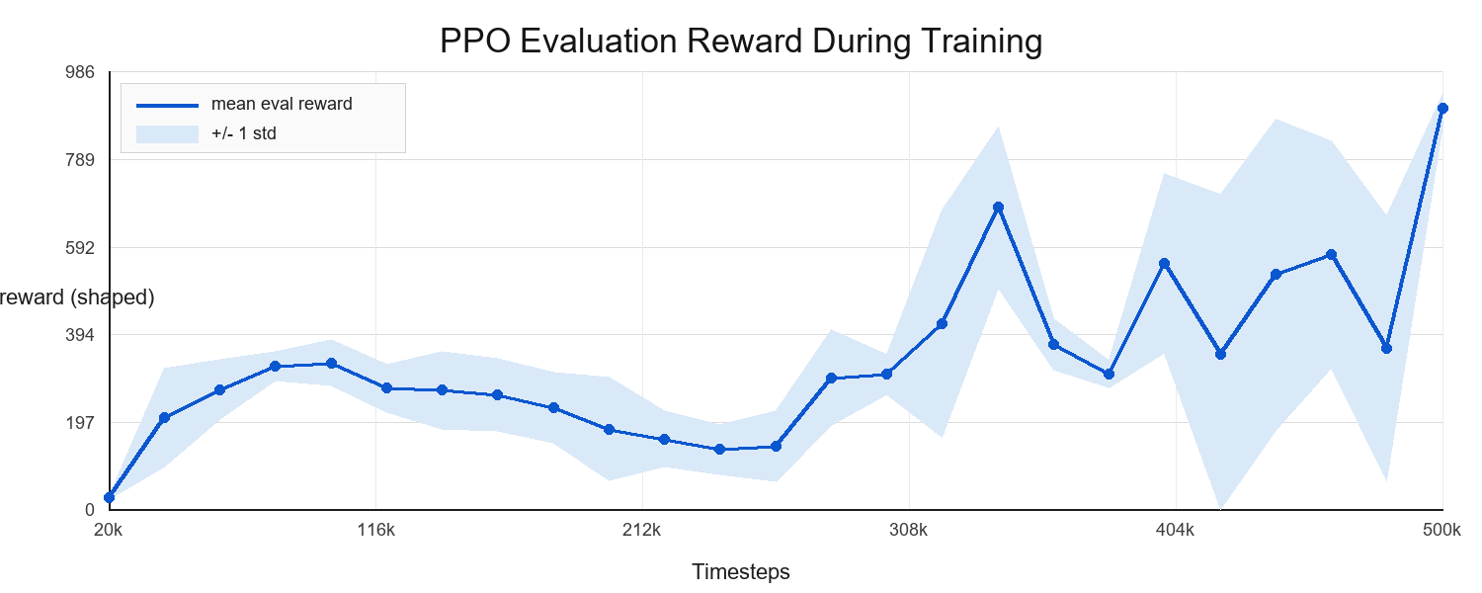
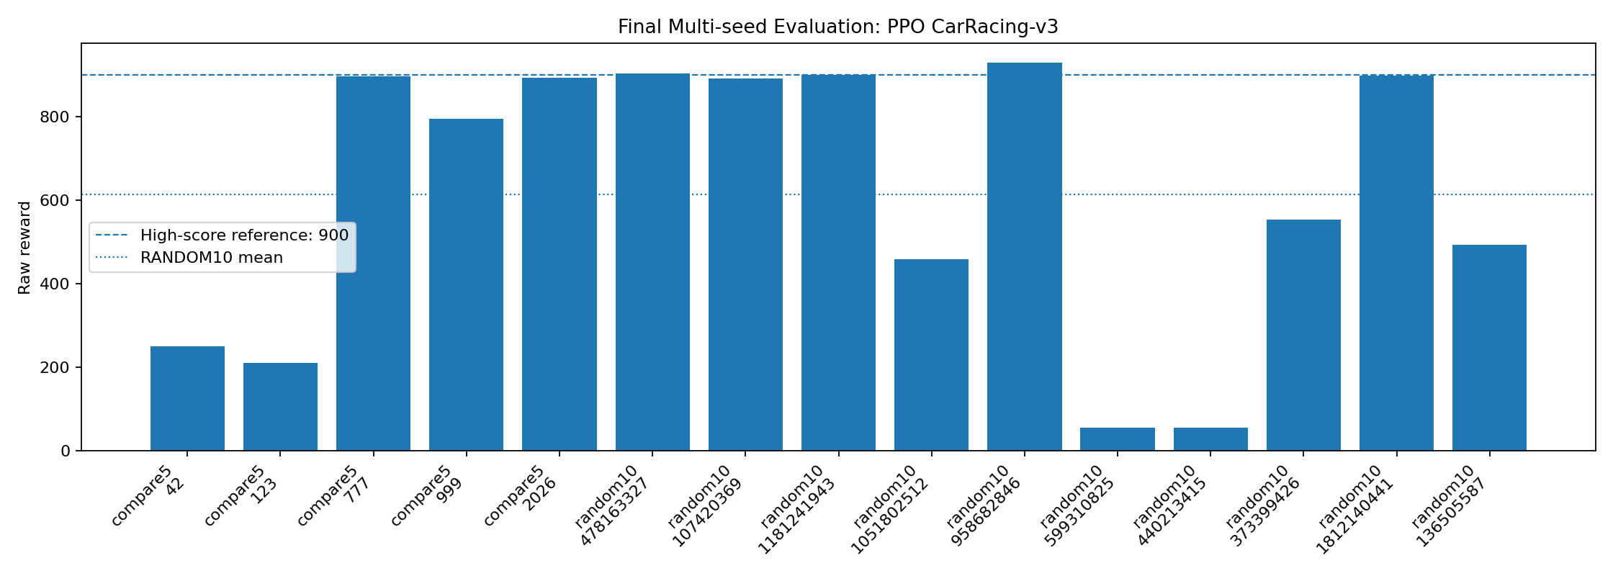
CarRacing-v3 PPO Final Project
Training Curve and Reward Distribution
- Training improves but remains variable.
- Final chart shows high-score and failure groups clearly.
- This supports a conservative sample-efficiency claim.
Joe / 1103820 11

Slide 12
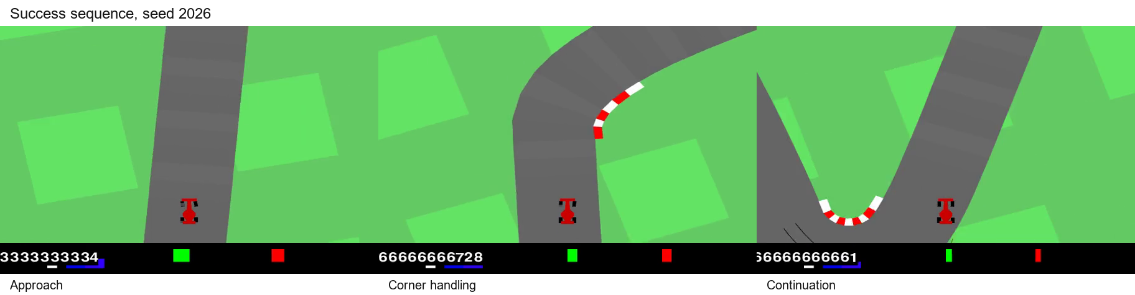
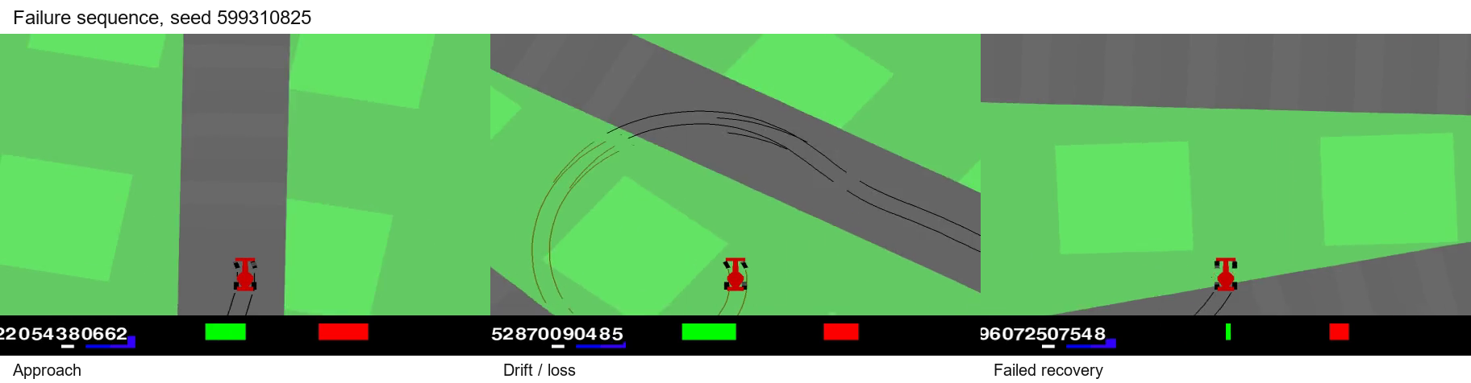
CarRacing-v3 PPO Final Project
Qualitative Success and Failure Cases
- Success, seed 2026: the car approaches a curve, stays on road, and continues.
- Failure, seed 599310825: the car drifts away from the useful local ray view and cannot recover.
- These strips explain behavior; the CSV tables remain the evidence.
Joe / 1103820 12

Slide 13
CarRacing-v3 PPO Final Project
Reproducibility Package
- Clean Colab notebook with cleared outputs.
- Report PDF plus Overleaf-ready IEEE LaTeX source.
- CSV result tables and regenerated figures.
- Artifact zip with model, VecNormalize, metadata, and videos.
- Chinese guide explains course upload and GitHub upload.
Joe / 1103820 13

Slide 14
CarRacing-v3 PPO Final Project
Conclusion and Limitations
- Road-mask ray features can produce high-reward CarRacing episodes with 500k timesteps.
- Failure seeds remain, so robustness is incomplete.
- RL Zoo is context only, not a directly beaten baseline.
- Future work: matched baseline run and component ablations.
Final claim: promising representation, not a fully solved controller.
Joe / 1103820 14

