Slide 1
FINAL SUBMISSION
Image Processing Project
Feature-Based Image Processing and Reinforcement Learning for CarRacing-v3
Main contribution: image-processing-derived compact visual feature representation
Downstream evaluation: PPO and SAC on Gymnasium CarRacing-v3
Final package
Report, slides, notebooks, logs, figures, tables, and demo videos. V2 is final-facing; V1 is archived history.
Image Processing Project | Joe / 1103820

Slide 2
GOAL
Problem and project goal
Problem
Goal
Raw RGB driving observations mix visual interpretation and control. Training an end-to-end image policy is costly for a course-scale notebook workflow.
Extract compact road geometry from images, then test whether standard PPO/SAC policies can use those features to drive.
The project is evaluated with reinforcement learning, but the contribution is the visual feature pipeline.
Image Processing Project | Joe / 1103820

Slide 3
MOTIVATION
Why image processing?
Compact state
Inspectable features
Course-scale evidence
A small feature vector is easier to train on than a 96 x 96 x 3 image tensor.
Road mask, ray distances, and radar-style summaries can be checked directly.
The package can explain the visual representation without claiming a new RL algorithm.
Design tradeoff: hand-engineered features improve interpretability and speed, but can fail when the mask or local geometry is misleading.
Image Processing Project | Joe / 1103820

Slide 4
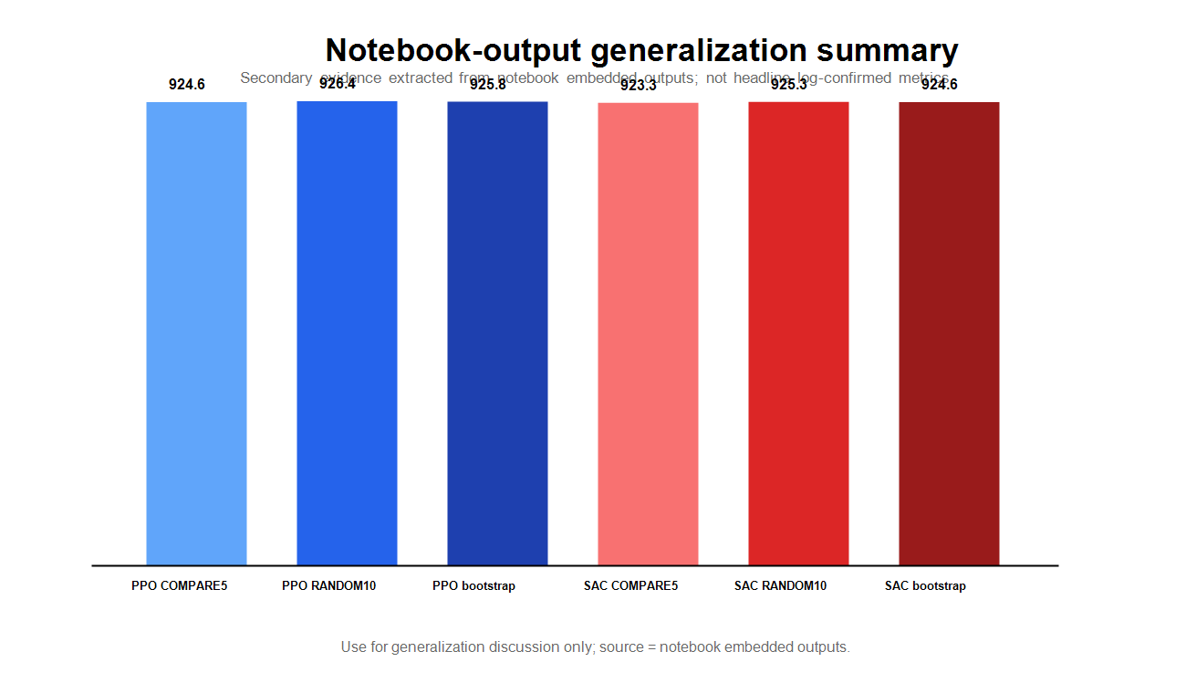
TASK
CarRacing-v3 environment
- Observation: rendered RGB frame
- Action: continuous steering, gas, brake
- Tracks: randomized across seeds
- Evaluation: saved logs, CSV tables, notebooks, and visual demos
The final claim is about a tested evidence package, not a solved environment.
Image Processing Project | Joe / 1103820

Slide 5
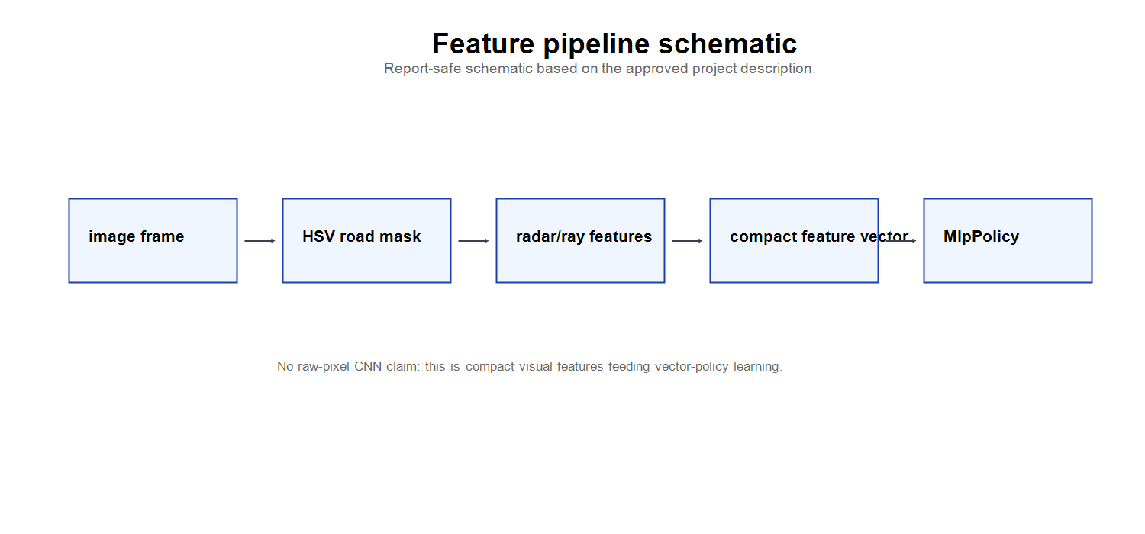
METHOD
Image processing pipeline
RGB frame -> crop/preprocess -> HSV road mask -> ray/radar features -> stacked observation -> PPO/SAC policy
The policy sees compact geometry, not raw pixels.
Image Processing Project | Joe / 1103820

Slide 6
FEATURE DESIGN
Compact feature representation
Road mask
Ray/radar cues
Stacked observation
HSV-based preprocessing separates road-like structure from background regions.
Forward-biased distances summarize local drivable geometry.
Short-term context is carried through stacked compact features.
The representation is deliberately inspectable: failures can be related back to mask quality, local geometry, and recovery context.
Image Processing Project | Joe / 1103820

Slide 7
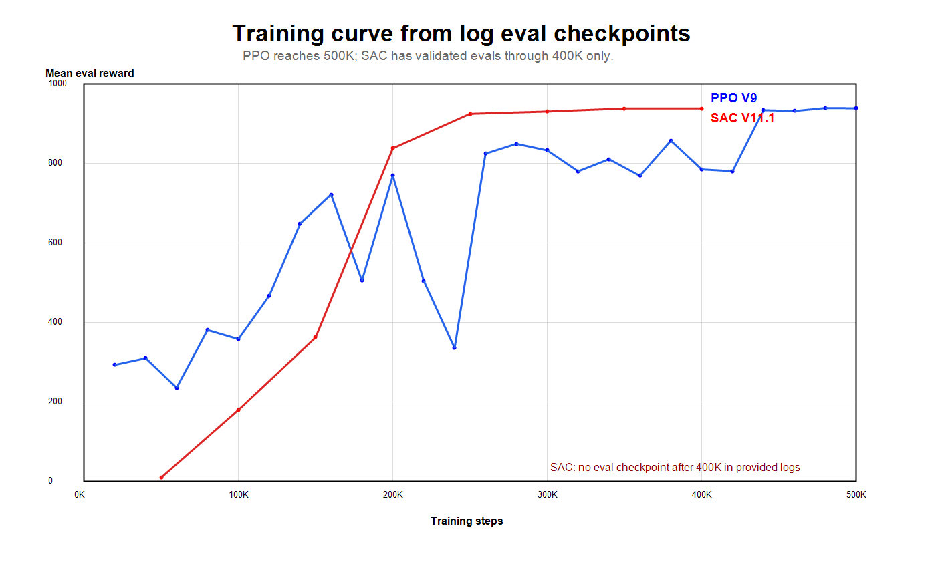
RESULT
PPO baseline (V9)
- Completed 500K baseline
- Final eval @500K: 938.87 +/- 7.86
- Best parsed eval: 939.53 +/- 4.09 @ 480,000
- Last observed step: 501,760
Evidence source: V2 result summary, PPO log, and CSV checkpoint table.
Image Processing Project | Joe / 1103820

Slide 8
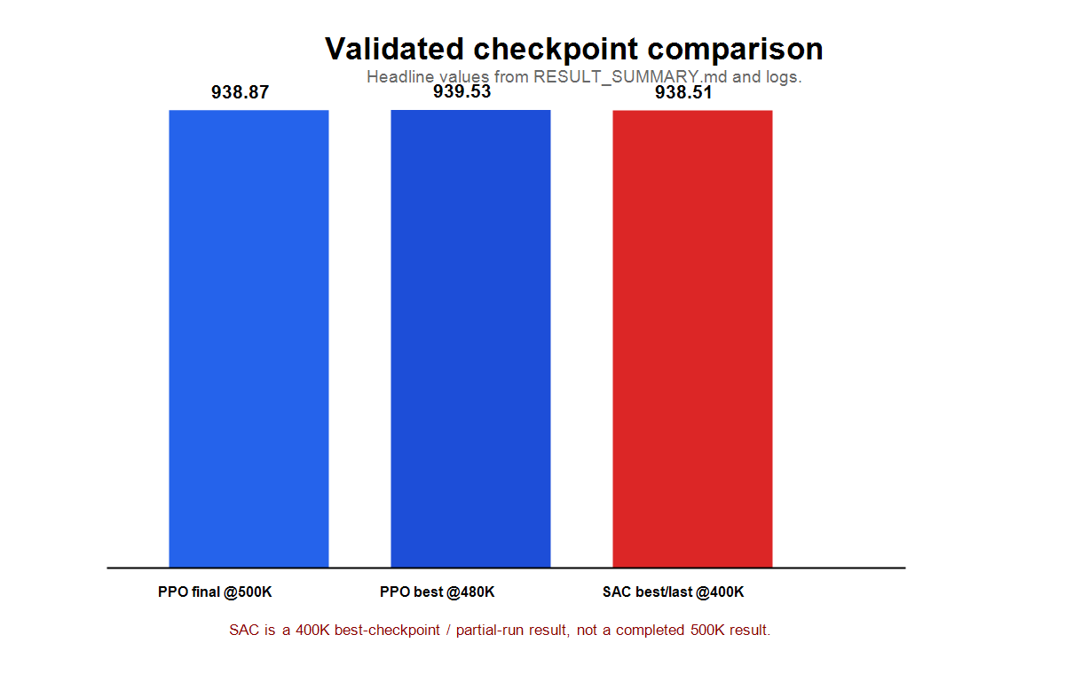
RESULT
SAC fast-result branch (V11.1)
- Partial 400K best-checkpoint / fast-result branch
- Validated eval @400K: 938.51 +/- 4.88
- Last observed step: 418,697
- No validated eval checkpoint after 400K
SAC is not claimed to complete 500K, beat PPO, or provide a compute-equivalent comparison.
Image Processing Project | Joe / 1103820

Slide 9
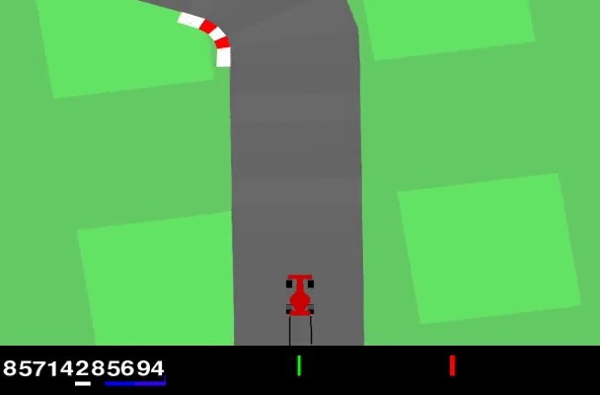
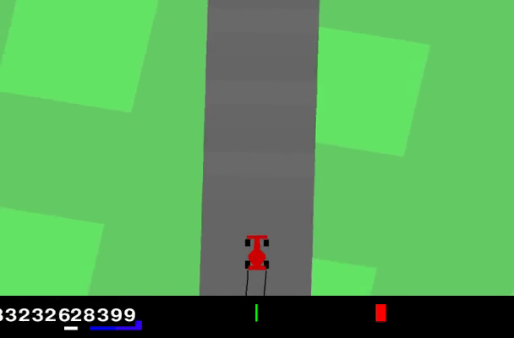
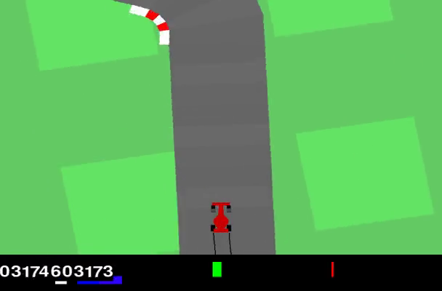
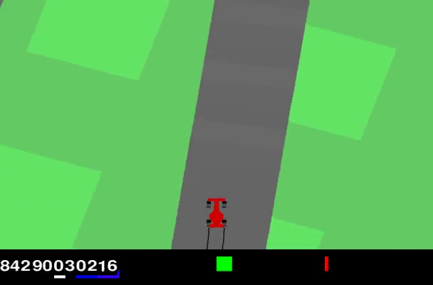
VISUAL EVIDENCE
Demo videos and qualitative results
PPO higher-reward demo
PPO lower-reward demo
SAC higher-reward demo
SAC lower-reward demo
Videos are qualitative evidence extracted from notebook outputs. Quantitative claims come from logs and tables.
See: media/videos/ and media/video_manifest.csv
Image Processing Project | Joe / 1103820

Slide 10
BOUNDARY
Limitations
- SAC is a partial 400K checkpoint branch, not a completed 500K run.
- PPO and SAC are not compute-equivalent.
- No raw image-input CNN policy was trained in this V2 package.
- HSV-style preprocessing can be sensitive to visual changes.
- CarRacing-v3 is not claimed solved.
Image Processing Project | Joe / 1103820

Slide 11
PACKAGE
Reproducibility and GitHub structure
Final V2 folder
Evidence
versions/2026-06-24-ppo-sac-feature-release/
logs/, tables/, notebooks/, figures/, media/videos/
Final materials
report/Image_Processing_Project_V2_IEEE_Report.*
slides/Image_Processing_Project_Final_Presentation.*
The repository should be manually renamed to Image-Processing-Project before sharing the final link.
Image Processing Project | Joe / 1103820

Slide 12
TAKEAWAY
Conclusion and GitHub link
Image processing is the main contribution: compact road-mask and ray/radar features turn RGB frames into an interpretable policy input.
PPO baseline (V9): completed 500K, 938.87 +/- 7.86 @ 500,000
SAC fast-result branch (V11.1): partial 400K checkpoint, 938.51 +/- 4.88 @ 400,000
Final official repository after manual rename:
https://github.com/UltraLamb/Image-Processing-Project
Current repository before rename: https://github.com/UltraLamb/CarRacingV3-PPO-RayFeatures
Image Processing Project | Joe / 1103820

