Slide 1
IMAGE PROCESSING · FINAL PROJECT
Image Processing Project
Feature-Based Image Processing and Reinforcement Learning for CarRacing-v3
Joe · Student ID 1103820
16-D base observation
PPO 938.87 @ 500K
SAC 938.51 @ 400K

Slide 2
MOTIVATION
From raw pixels to a compact, inspectable representation
THE PROBLEM
THIS PROJECT
Training a policy directly on the 96×96×3 pixel frame couples perception and control. It is sample-hungry, opaque, and expensive to debug on a course budget.
Move perception into a deterministic image-processing wrapper. Off-the-shelf PPO and SAC then learn only control on a compact 16-D feature vector.
27,648 pixels → 16 values
Each frame becomes a vector an MLP can act on — four frames stack to 64-D.

Slide 3
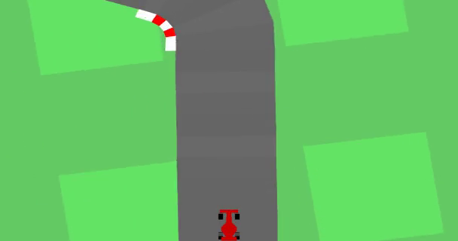
ENVIRONMENT
Gymnasium CarRacing-v3
96×96 RGB frame — top-down view around the car.
Continuous action [steer ∈ −1…1, gas, brake].
Reward = progress along the track; penalties off-track.
Randomized tracks each episode → must generalize, not memorize.
Top-down rendered driving frame (road, grass, car).

Slide 4
WHY IMAGE-PROCESSING FEATURES
Two ways to drive from vision
A
End-to-end pixels (CNN)
B
Feature-based (this work)
• Learns perception and control jointly.
• General, but sample-hungry.
• Opaque and hard to debug.
• Heavy compute footprint.
• Deterministic CV → compact geometry.
• Sample-efficient and inspectable.
• MLP-sized policy input (16-D / 64-D).
• Every stage is auditable.
No raw-pixel CNN policy is trained here — the contribution is the perception layer, not a new learner.

Slide 5
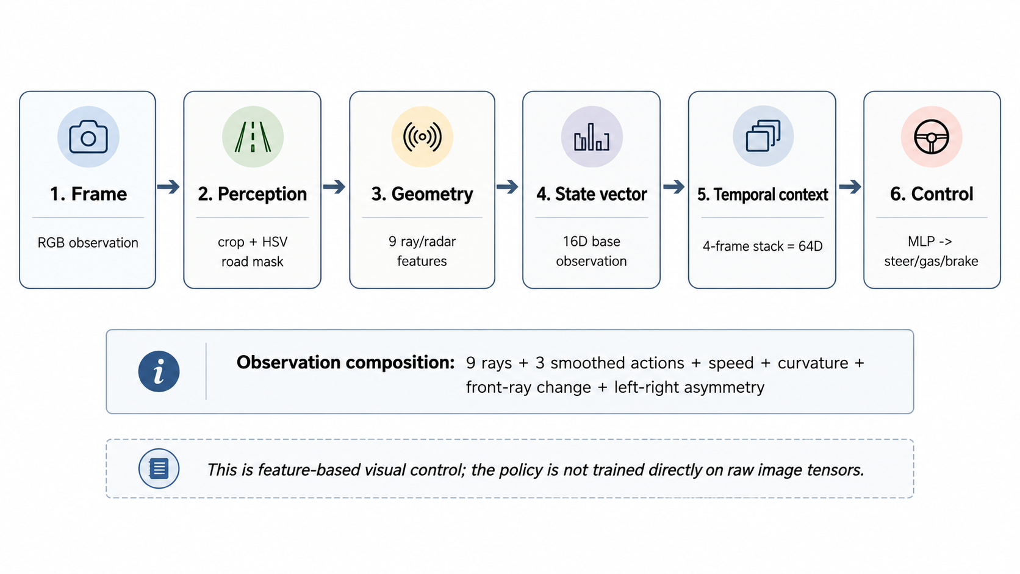
CONTRIBUTION · PIPELINE
The image-processing pipeline

Slide 6
PIPELINE · STEPS 1–2
HSV road-mask extraction
1
Crop + RGB→HSV
Keep the driving region; HSV separates color from brightness.
HSV GRASS BAND
[28, 35, 35]
– [92, 255, 255]
H ∈ 0–179, S,V ∈ 0–255
2
Threshold grass → complement
Select the green band, invert to get the road.
3
3×3 morphological opening
Erode then dilate — removes speckle and pin-holes.
road = ¬ grass
Selecting the uniform grass and inverting is more stable than thresholding the road directly.
4
Connected components
Keep the road blob at the car; drop stray patches.

Slide 7
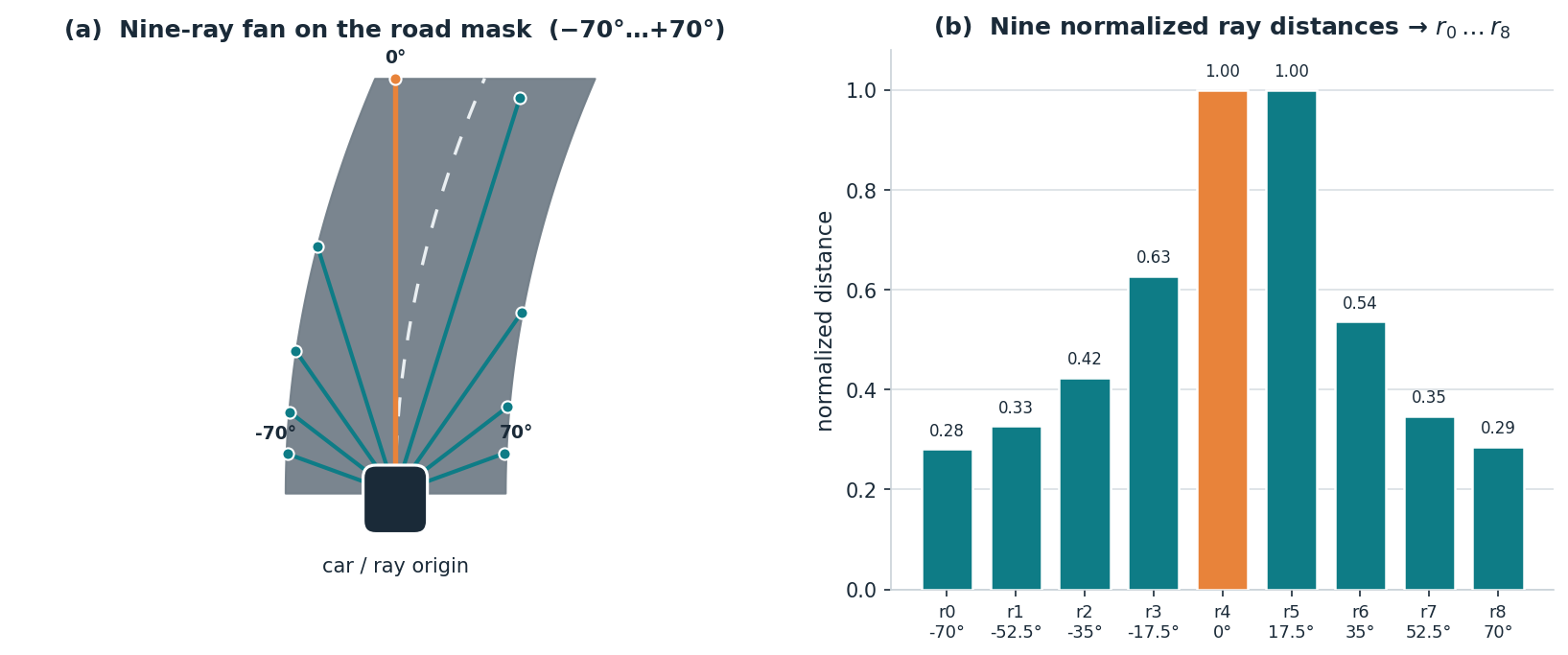
PIPELINE · STEP 3
Ray / radar feature extraction
Nine rays span −70°…+70°, march to the mask boundary, and return normalized distances r₀…r₈ — a compact profile of local road openness.

Slide 8
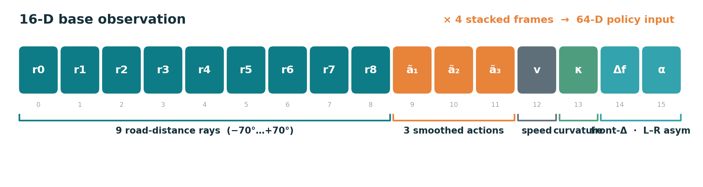
FEATURE REPRESENTATION
16-D base → 64-D stacked observation
16-D = 9 ray distances + 3 smoothed actions + speed + curvature + front-ray change + left–right asymmetry.
Four consecutive observations stack (×4 → 64-D) to capture short-horizon motion. PPO and SAC share this exact stream.

Slide 9
EXPERIMENT DESIGN
One perception layer, two off-the-shelf learners
PPO completed 500K baseline
Shared feature pipeline
16-D base → 64-D stacked observation (held constant)
SAC fast-result branch (400K)
Perception is held constant; only the policy optimizer changes. Any behavioral difference is attributable to the learner, not the representation.
Both are unmodified Stable-Baselines3 algorithms with MLP policies.

Slide 10
RESULT · PPO
PPO completed baseline
VALIDATED @ 500,000 STEPS
✓ Fully completed 500K run (last step 501,760).
✓ ~40 fps · ~3 h 26 m on Colab.
✓ Stabilizes in the low-930s–940s band over final checkpoints.
938.87 ± 7.86
Best parsed 939.53 ± 4.09 @ 480,000
Raw reward (track progress) is the headline metric; shaped reward is a training aid only.

Slide 11
RESULT · SAC
SAC fast-result branch
VALIDATED @ 400,000 STEPS · PARTIAL
• Not a completed 500K run (last step 418,697 ≈ 82%).
• Fast-result branch under Colab runtime limits.
• Not claimed to beat PPO; not compute-equivalent.
938.51 ± 4.88
Best and last eval checkpoint — none after 400K.
Treated strictly as a 400K best-checkpoint result — the conservative reading of the evidence.

Slide 12
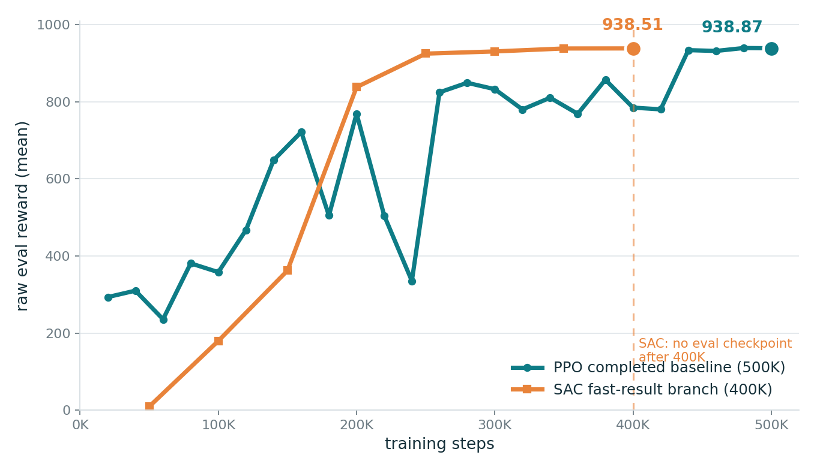
PRIMARY RESULTS
Headline raw-reward comparison
PPO @ 500K
COMPLETED 500K
938.87 ± 7.86
PPO best @ 480K
BEST PARSED
939.53 ± 4.09
SAC @ 400K
PARTIAL 400K
938.51 ± 4.88
Raw reward is the headline metric. PPO and SAC are not a compute-equivalent comparison.
Raw eval reward vs training steps (from log checkpoints).

Slide 13
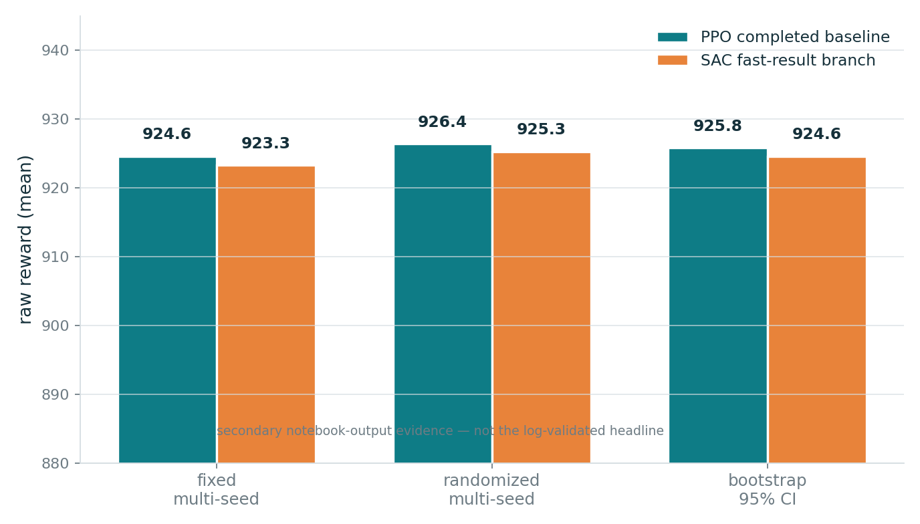
SECONDARY EVIDENCE
Generalization across seed sets
Fixed and randomized multi-seed sets, plus a bootstrap 95% CI.
Both branches land in the mid-920s on held-out seeds — a few points below the best single checkpoints.
Narrow confidence intervals → the mean behavior is stable even as individual seeds vary.
Secondary notebook-output evidence — distinct from the log-validated headline metrics.

Slide 14
HONEST BOUNDARIES
Limitations
!
SAC is partial
!
No pixel baseline
!
Appearance-sensitive
400K best checkpoint — not 500K, not compute-equivalent, not claimed to beat PPO.
No raw-image CNN policy was trained, so there is no head-to-head pixel comparison.
HSV masking can degrade under rendering or track-art changes.
!
Heavy-tailed failures
!
Not “solved”
Reported as multi-seed statistics — never a single best episode.
Qualitative limitation clips
Some high-reward episodes still show unstable recovery, brief off-road drift, or sharp-turn weakness.
CarRacing-v3 is not claimed solved; promising, not uniformly robust.

Slide 15
TAKEAWAYS
A compact visual feature that two RL methods can drive on
1
Perception is the contribution — a deterministic HSV-mask + ray pipeline turns pixels into a 16-D / 64-D feature.
2
Shared, learner-agnostic — PPO (938.87 @500K) and SAC (938.51 @400K) reach the same band on the same features.
3
Honest and reproducible — conservative claims, log-parsed metrics, saved artifacts — no retraining to verify.
Joe · 1103820
GitHub
https://github.com/UltraLamb/Image-Processing-Project

