Slide 1
ST1505
DevOps & AI Automations : Covid, Flu, Cold & Allergy Prediction
Soh Hong Yu | P2100775 | DAAA/FT/2B/01

Slide 2
TABLE OF CONTENTS
01
02
03
04
BACKGROUND
INFORMATION
APPLICATION
DEVOPS
PROCESS
TESTING & ADVANCED

Slide 3
01
BACKGROUND
INFORMATION

Slide 4
COLD, FLU & ALLERGIES
In Singapore, due to our humid environment, many people get cold and flu. In 2021, 588 deaths caused by flu and the cold in Singapore alone. Furthermore, 24% of Singaporeans are allergic to pollen. As the symptoms of all 3 illness are very similar, knowing which one you have is very crucial especially if it is very serious.

Slide 5
COVID-19
During Covid-19, Many Singaporeans despite having a small symptoms like cough and sneezing, they will go to their nearby hospitals and general clinics to check if they have been infected by Covid-19. This increase the workload of the hospitals and general clinics. This prompted the Singaporean Government to launch campaigns to promote and educate citizens on what they can do when they experience symptoms similar to Covid-19.

Slide 6
PROJECT OBJECTIVE
REDUCE WORK
SELF TESTING
Doctors and Nurse will only need to provide the necessary care to the other patients that is suffering a more severe illness
Patients will have a piece of mind and would be educated based. This will also allow them to monitor themselves.

Slide 7

Presenting To You…
Immune is a simple to use application that helps users diagnose what illness does the user have through the present of symptoms. And AI model will be used to predict the illness and from there, the application will advise users on what to do next!

Slide 8

02
Application Demo

Slide 9
03
DevOps Process

Slide 10
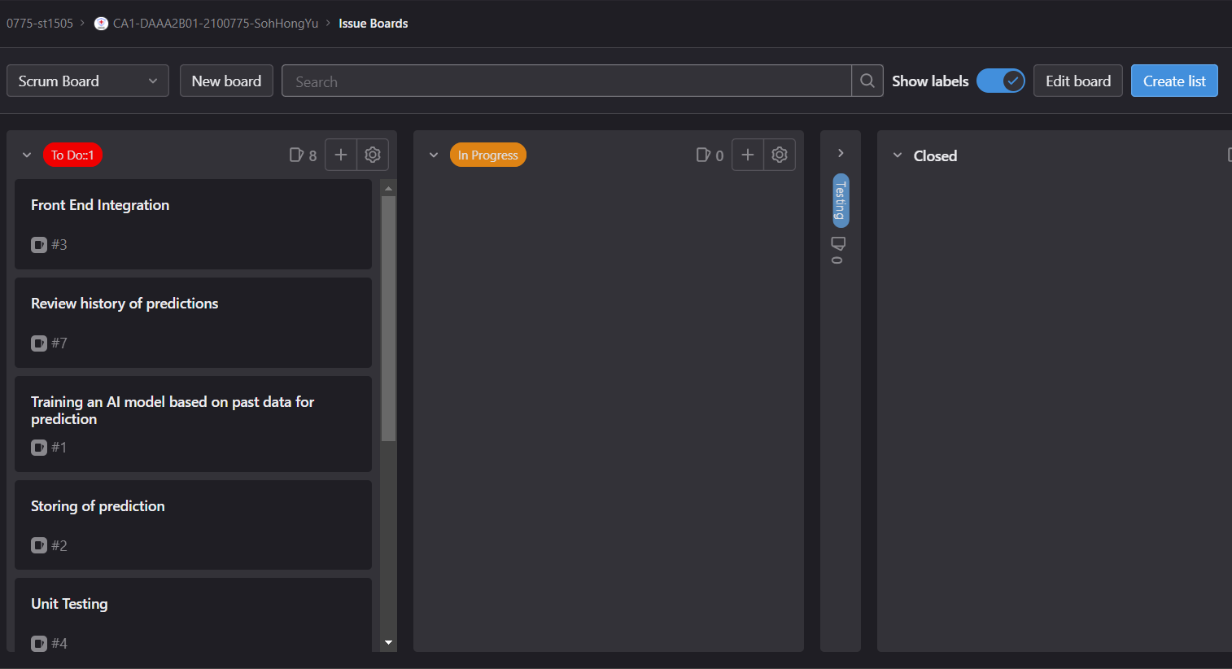
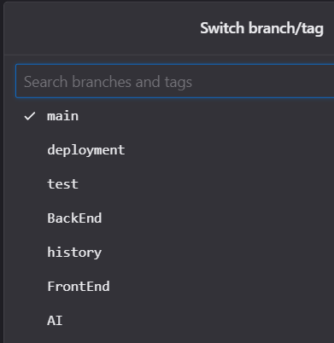
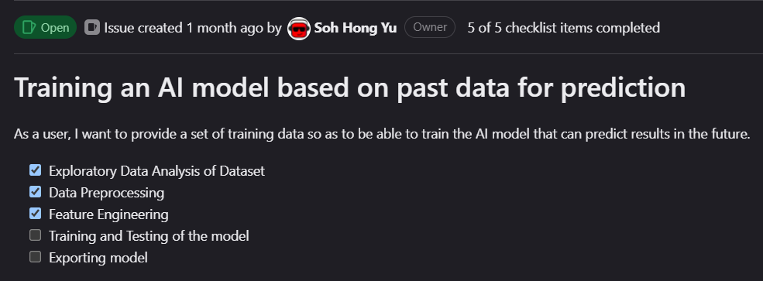
SETTING UP
Before developing the application, we need to do some scrum boarding. This allows us to keep track of our application development. [To Do, In Progress and Testing Labels]
After doing the scrum board, it is time to make branches. This allow us to make changes to the folder in a controlled environment. [No of Branches: 6]

Slide 11
DATASET
COUGH : Boolean value that indicates if coughing is a symptom.
MUSCLE_ACHES : Boolean value that indicates if muscle aches is a symptom.
TIREDNESS : Boolean value that indicates if tiring is a symptom.
SORE_THROAT : Boolean value that indicates if sore throat is a symptom.
RUNNY_NOSE : Boolean value that indicates if running nose is a symptom.
STUFFY_NOSE : Boolean value that indicates if stuffy nose is a symptom.
FEVER : Boolean value that indicates if fever is a symptom.
NAUSEA : Boolean value that indicates if nausea is a symptom.
VOMITING : Boolean value that indicates if vomiting is a symptom.
DIARRHEA : Boolean value that indicates if diarrhea is a symptom.
SHORTNESS_OF_BREATH : Boolean value that indicates if shortness of breath is a symptom.
DIFFICULTY_BREATHING : Boolean value that indicates if difficulty breathing is a symptom.
LOSS_OF_TASTE : Boolean value that indicates if loss of taste is a symptom.
LOSS_OF_SMELL : Boolean value that indicates if loss of smell is a symptom.
ITCHY_NOSE : Boolean value that indicates if itchy nose is a symptom.
ITCHY_EYES : Boolean value that indicates if itchy eyes is a symptom.
ITCHY_MOUTH : Boolean value that indicates if itchy mouth is a symptom.
ITCHY_INNER_EAR : Boolean value that indicates if itchy inner ear is a symptom.
SNEEZING : Boolean value that indicates if sneezing is a symptom.
PINK_EYE : Boolean value that indicates if pink eye is a symptom.
TYPE : Type of illness [flu, cold, allergy & covid].

Slide 12
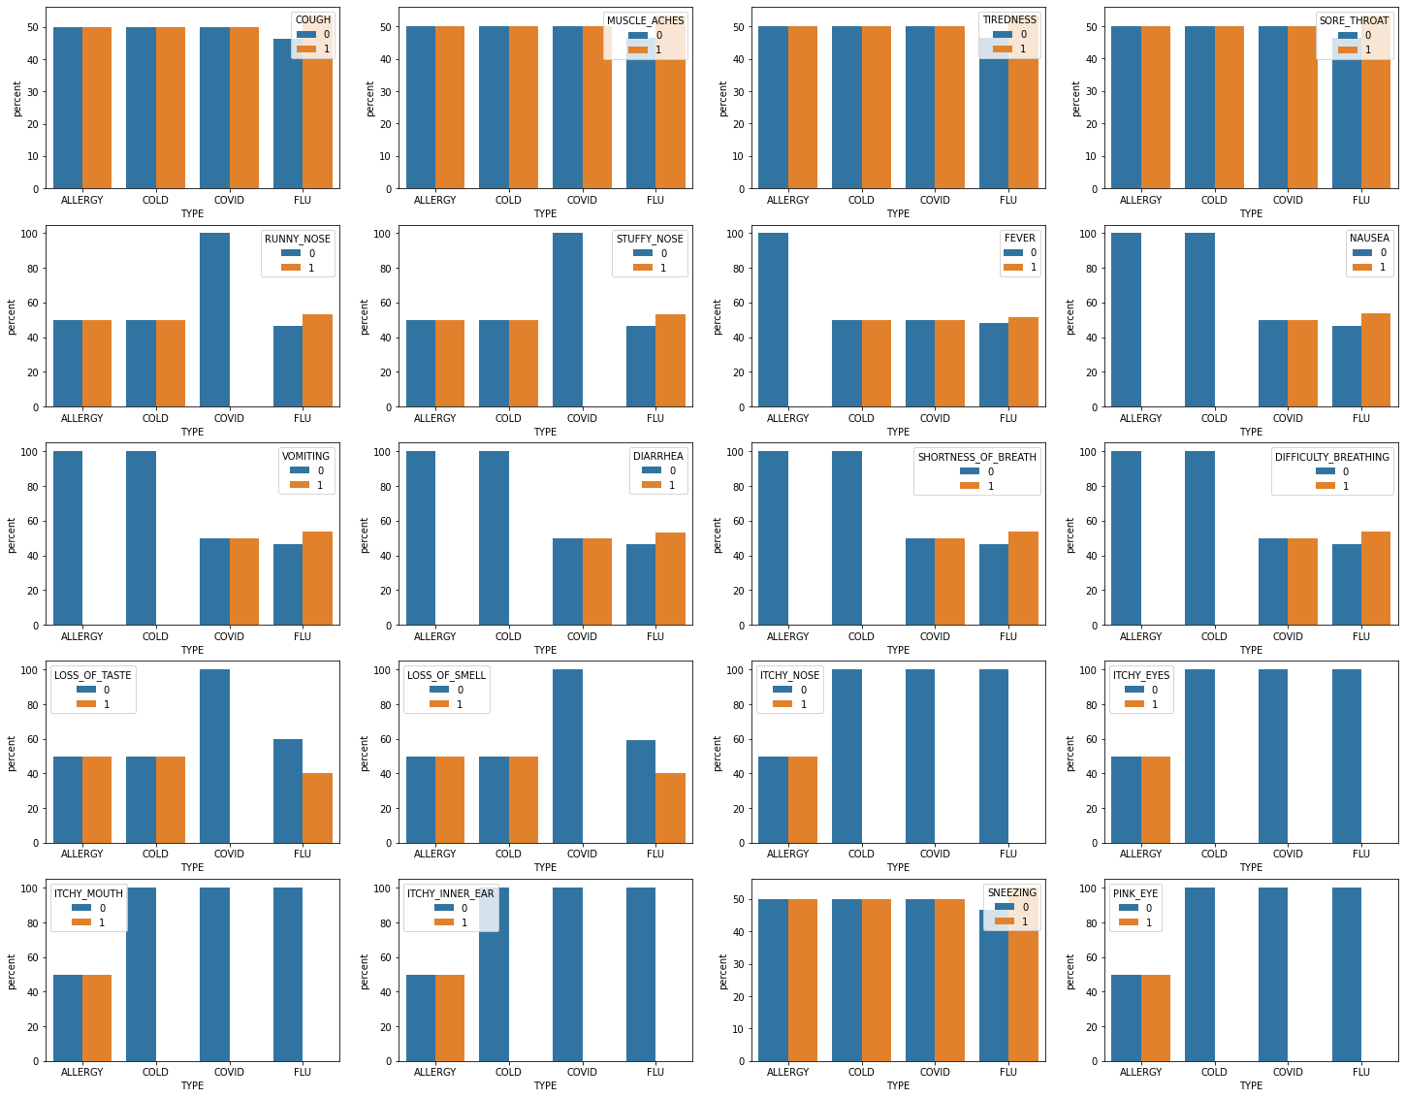
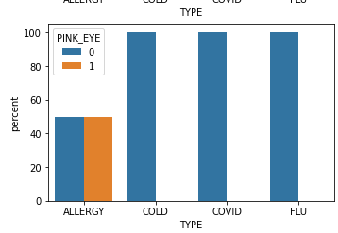
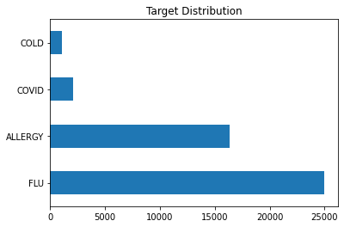
EXPLORATORY DATA ANALYSIS
We can see that the target distribution is not equal and therefore, we will be doing some preprocessing later. We also note that from the graphs [Percentage of symptoms based on TYPE] certain symptoms are key factors. For example, Pink Eye is a key symptom of Allergy. This suggest that a decision tree based model is strong as only certain factors will lead to specific illness

Slide 13
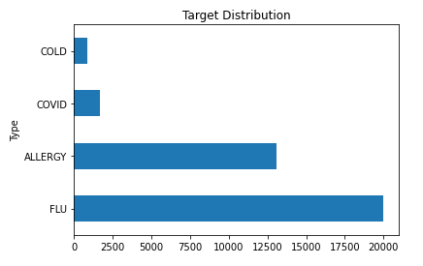


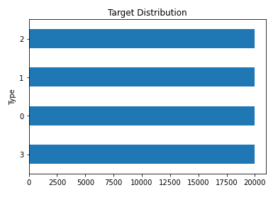
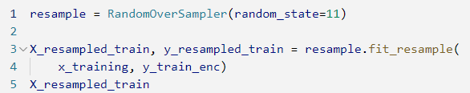
DATA PREPROCESSING
Train - Test Split
Categorical Encoding [Encoding Labels]
Rebalancing of data

Slide 14
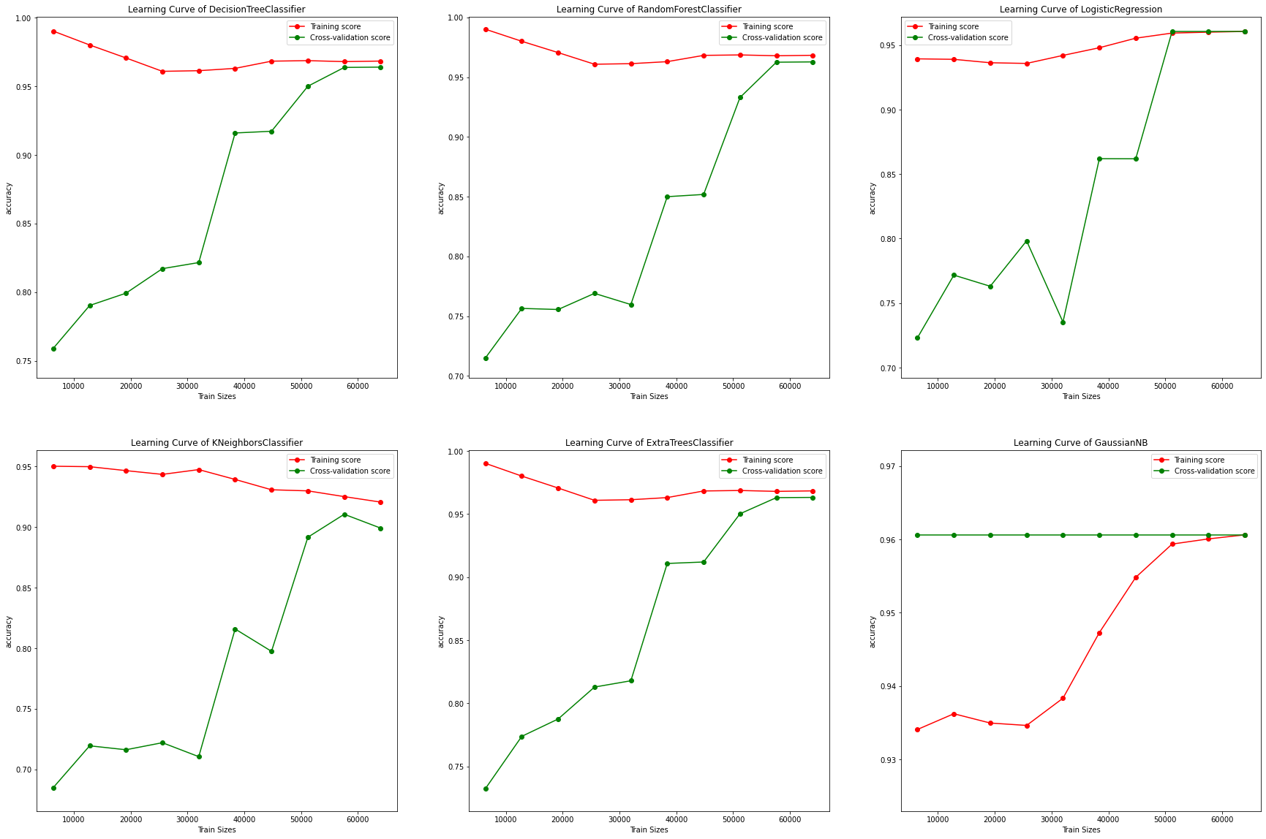
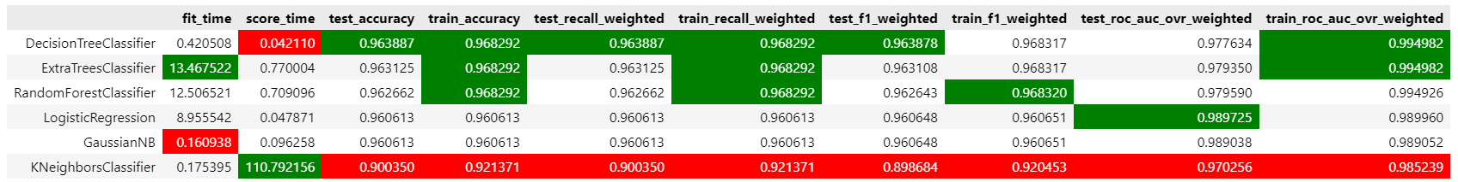
MODELLING
Scoring - Accuracy, Recall, F1 score & ROC_AUC
Models Used:
DummyClassifer [Baseline]
DecisionTreeClassifier
RandomForestClassifier
LogisticRegression
KNeighborsClassifier
ExtraTreesClassifier
GaussianNB
Model using cross_validation performs well at 96.3%. KNN model is the worse as the data is mostly booleans and it is hard to form clusters.

Slide 15
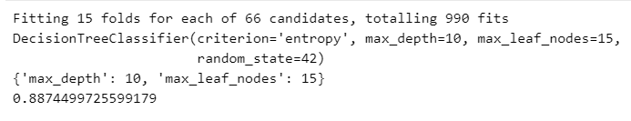
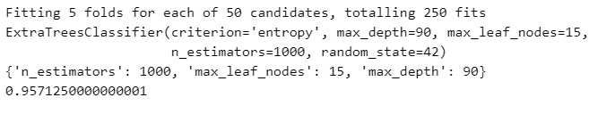
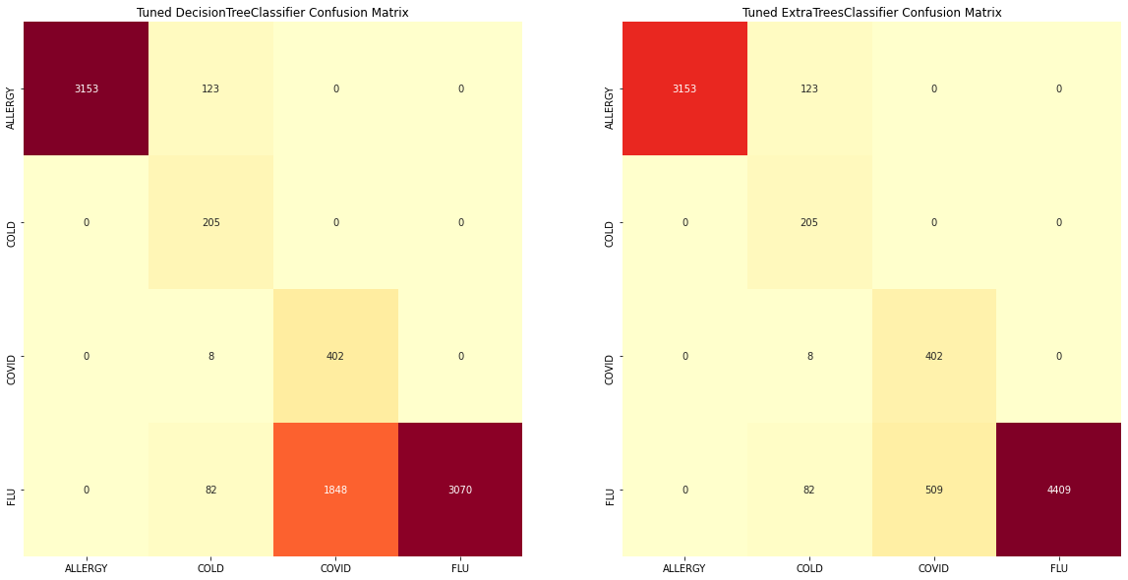
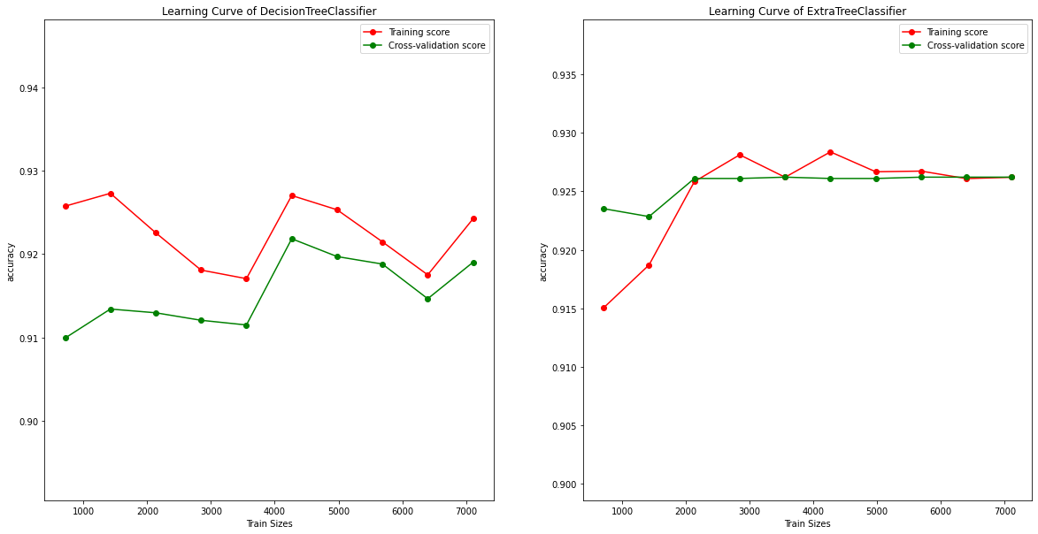
HYPERPARAMETER TUNING
We will be hyperparameter tuning DecisionTreeClassifier and ExtraForestClassifier [Best Models from previous experiment] to see the improvement in the accuracy after tuning. We also will need to tune these models as tree based models like to over fit and therefore we will be cutting the tree and the number of branches it can form to reduce overfitting.

Slide 16
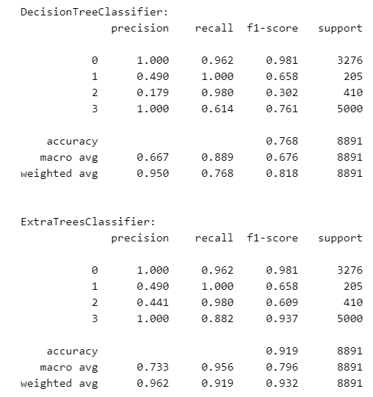
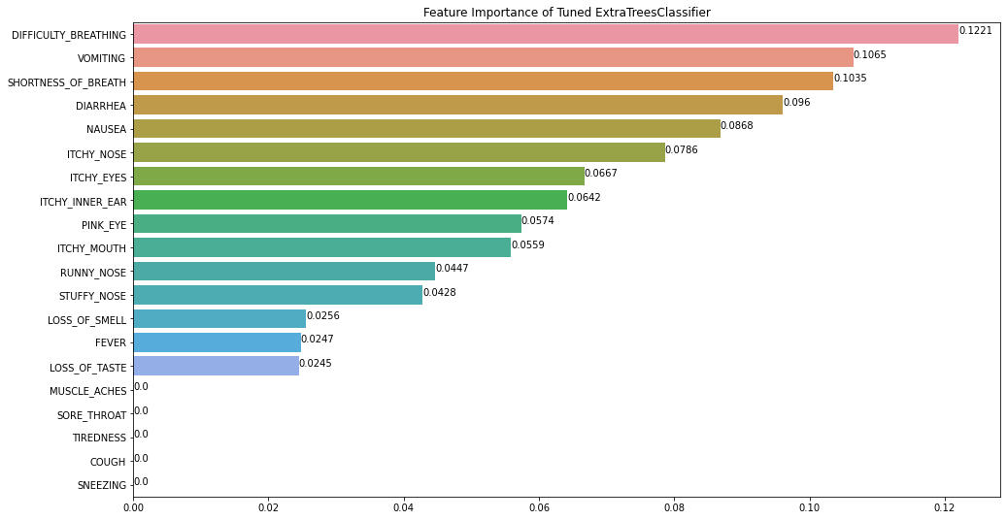
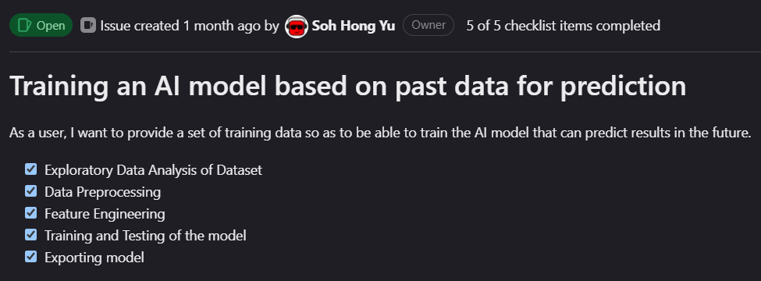
EVALUATE MODEL
From our quick classification report, we can see that ExtraTreesClassifier models are more accurate in predicting whether what type of illness the patient has.

Slide 17
04
TESTING & ADVANCED

Slide 18
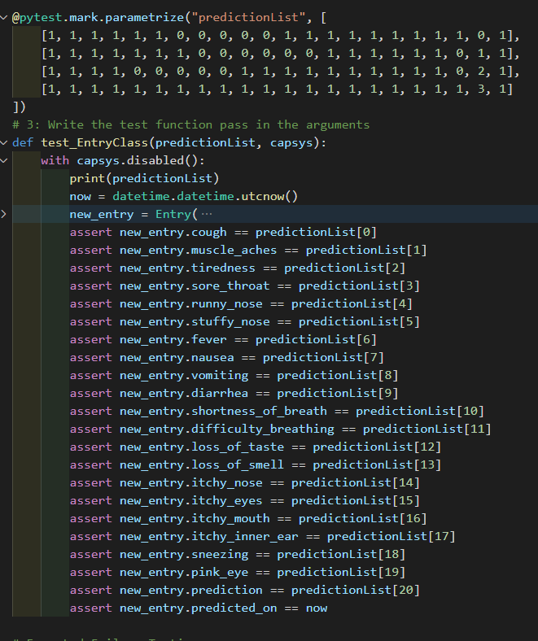
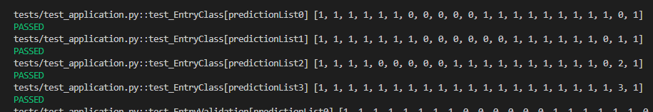
UNEXPECTED FAILURE TESTING
We made an unexpected failure function to test if there is unexpected failures. Looks like after running the FC,

Slide 19
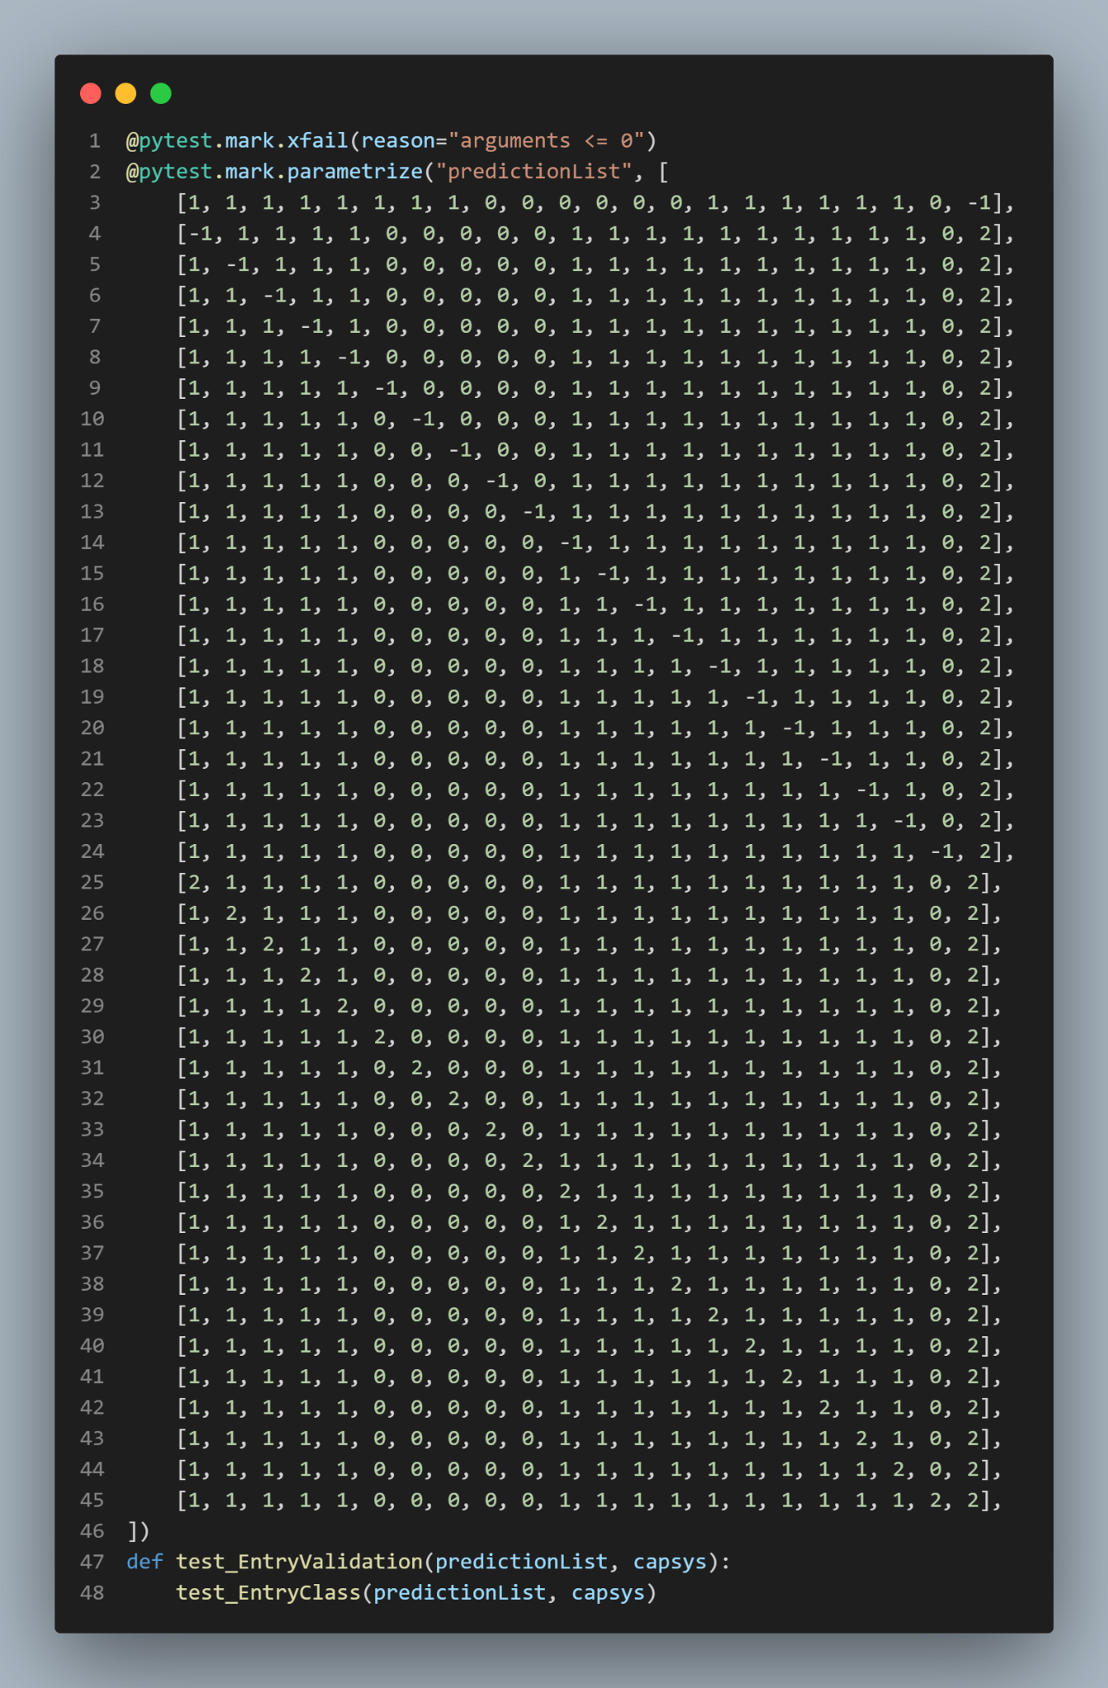
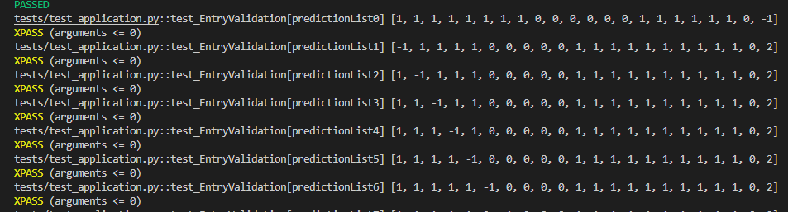
EXPECTED FAILURE TESTING
We will be using the same function as the unexpected failure testing. This allows us to moderate and check for any of the data has any outliers that was not validated.

Slide 20
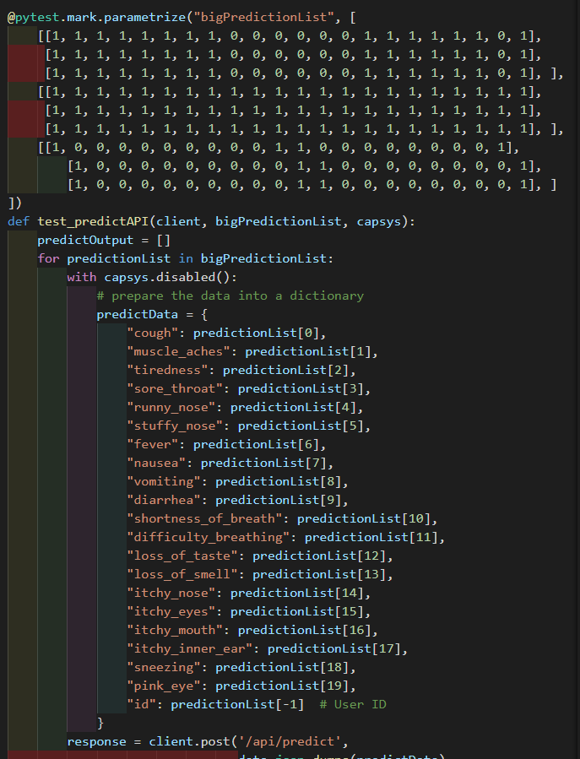

CONSISTENCY TESTING
We group arrays into 3 array of random index. The array in an array will be looped through, then the values are feed into the AI Model to test if the output prediction is consistent.

Slide 21
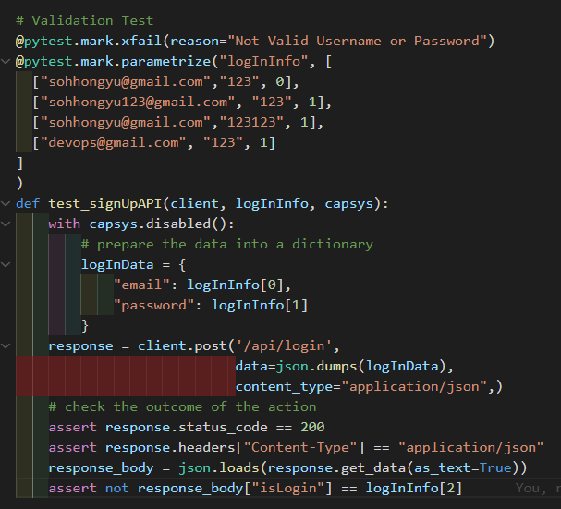

VALIDATION FAILURE TESTING
We check if there is any issue or validation error in the parameter. We also validate and ensure the data is inside of the database beforehand.

Slide 22

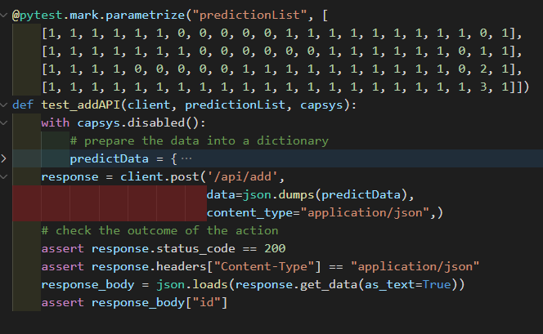
ENDPOINT API TESTING
To add a new endpoint, each columns of the list is used to help make the data. Once the data is done, it will be added into the database.

Slide 23
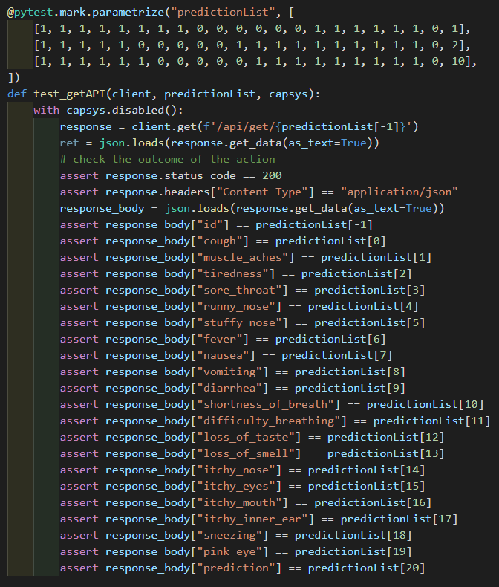


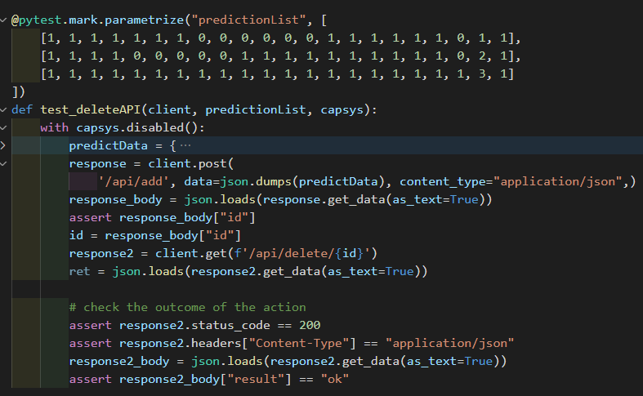
ENDPOINT API TESTING
Created a test case to get endpoint by index. It will take in data from the other columns to ensure all are correct.

Slide 24
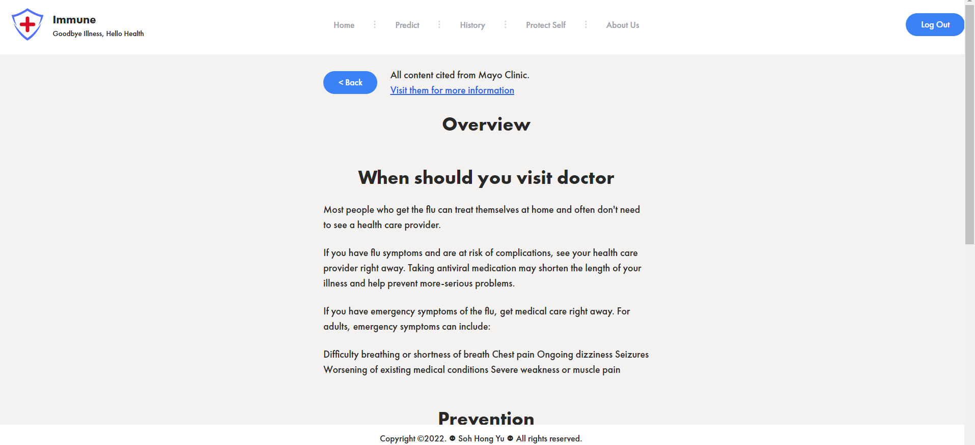
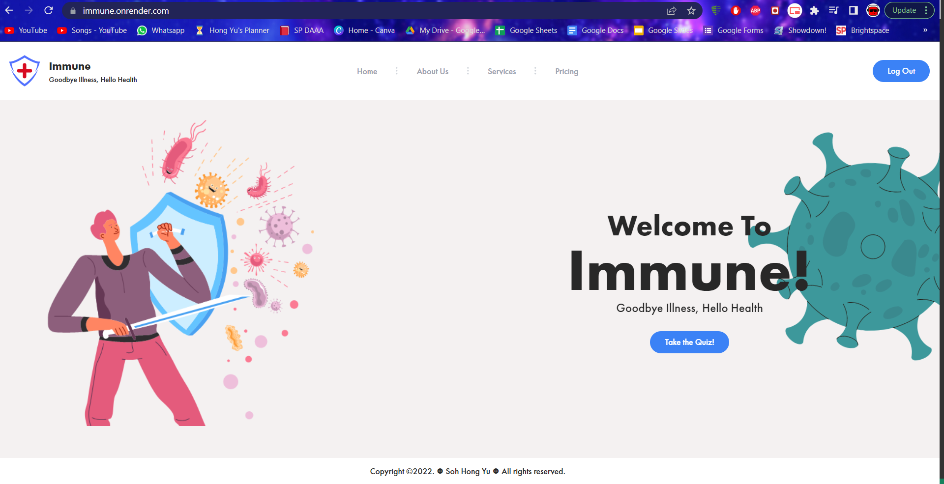
ADVANCED
ADVANCED Add-ons are added to the project.
Website is hosted on Render [immune.onrender.com] using gunicorn
Web scraping is employed to extract text to give users a better understanding of the different illness

Slide 25
REFERENCES
Gov.sg (2020) I am showing respiratory symptoms (like a cough, runny nose or fever), where should I go?, MCI - Gov.SG.
Available at: https://www.gov.sg/article/i-am-showing-respiratory-symptoms-where-should-i-go(Accessed: November 14, 2022).
Teng, A. (2021) Allergy types: Top 12 most common allergies in Singapore, Homage. Available at: https://www.homage.sg/health/allergy-types/ (Accessed: December 2, 2022).
Conway, W. (2021) Covid, flu, cold symptoms, Kaggle.Available at: https://www.kaggle.com/datasets/walterconway/covid-flu-cold-symptoms(Accessed: November 13, 2022).
Anon (2021) 800 deaths a year -- and life carries on normally, TWC2. Available at: https://twc2.org.sg/2021/08/31/800-deaths-a-year-and-life-carries-on-normally/ (Accessed: November 26, 2022).

