Slide 1
What is the learning curve to implementing a just culture?
Presentation by Torren Davis
DevOps Module 9.2
7/14/2024

Slide 2
What is a Just Culture?
Simply put, a Just Culture is technically a culture, but meant to be a figure of speech, bringing about the conversation of justice and judgement within an organization, or just the world in general, and talking about how the workplace can be guided to a more just culture.

Slide 3
What is a Just Culture? (cont.)
“A culture where staff are not punished for actions, omissions, suggestions, or decisions taken by them that are commensurate with their experience and training, but where gross negligence, wilful violations and destructive acts will not be tolerated.” - Regulation (EU) No 376/2014

Slide 4
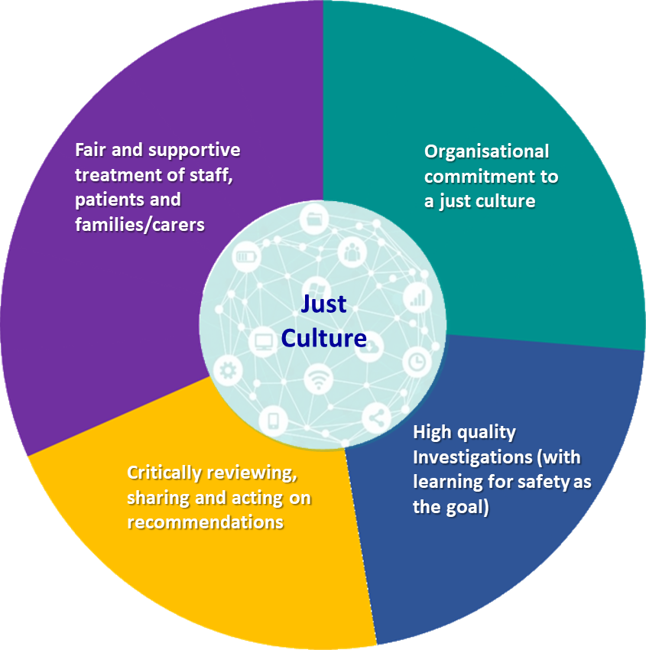

Slide 5
The Learning Curve
To keep it simple, the learning curve of implementing a Just Culture is very high, as such a thing is incredibly difficult due to a large number of different reasons, in the form of barriers.

Slide 6
Barriers
Social Barriers are just one of the barriers that can make reaching a just culture difficult. Everyone is different, from values to beliefs. This means that everyone's sense of justice and fairness are different, with each situation being viewed in a different lense from one another.
Another barrier is Organizational and professional barriers, which come from the fact that every organization is different, from those who work within it, to the how it is ran. Every profession out there has their own views on justice and injustice.

Slide 7
Barriers (cont.)
Historical barriers are another type of barrier that can cause difficulties in reaching a just culture. The past plays a role in how people and organizations view things in the present and future, including justice.
There are many more barriers that can prevent us from reaching the goal of a just culture within organizations.

Slide 8
What can be done?
In order to implement a just culture, the world would have to change the way it currently looks at people, and the systems we have in place. This change has to start somewhere, and likely has to spread to become the norm.

Slide 9
Sources
Stevenshorrock. (2024, May 27). Why is it just so difficult? barriers to “just culture” in the real world. Humanistic Systems. https://humanisticsystems.com/2023/10/18/why-is-it-just-so-difficult-barriers-to-just-culture-in-the-real-world/
What is just culture? changing the way we think about errors to improve patient safety and staff satisfaction. Brigham and Women’s Faulkner Hospital. (n.d.). https://www.brighamandwomensfaulkner.org/about-bwfh/news/what-is-just-culture-changing-the-way-we-think-about-errors-to-improve-patient-safety-and-staff-satisfaction

