Slide 1
Analog Output and FPGA Digital Output
Hsiou-Yuan Liu
April 2013

Slide 2
Overview
This project consists of the control of NI AO boards and FPGA digital output apparatus, and the conversion of the timing description file (config file) designed by MS Chang.
Users can regard the AO and DO subprojects as independent projects, i.e. they work well in the absence of the other. However this situation is not applicable to each of them and timing subproject.

Slide 3
Overview
The naming convention of vi’s:
0_: The .vi contains a complete flow of high end usage. For example, the output of an analogue waveform.
1_: The .vi handles a task, which serves as a building block of the high end usage.
9_: The .vi is optional to the main usage, without which the functionality of the 0_ files are not affected. For instance, the display of the waveform.

Slide 4
Description of the hierarchy
User
3 NI libraries (TimingUtitlity.llb, NI_Analog_Output.llb and FPGA_Digital_Output.llb)
Example timing configuration files (folder TimingData)
Technician
The FPGA Quartus II project (folder MonroeFPGA_DigitalWaveform_Outputing_clock)
The C/C++ project for accessing the timing description file and preparing FPGA commands.

Slide 5
Outline
Analogue output library
Output timings
Force each channel to some voltage
Digital output library
Output timings
Commands
Timing format
Inquiry Information in the .csv file
Converting
Appendix –Technician support

Slide 6
Analogue output library
To use this library, one has to connect the RTSI between the two NI AO boards and the external signals (external clock and trigger) once.
The external clock modules (prefixed ExtClk) are recommended

Slide 7
Output timings
Example: 0_Example.vi in the NI_Analog_Output.llb library.
There is a complete flow generating the analogue waveform through external clock.
By imitating the users can build their own vi.
The two parts need to be carefully set:
Unit conversion for easier control of some channels
External sources

Slide 8
Output timings – Unit conversion
Unit conversion for easier control of some channels
In some cases the control parameters are in the unit different from voltage, e.g. mW for laser power controlled by an AOM.
It is recommended to use a mapping file to map that unit (e.g. mW) to voltage to facilitate the experiments.

Slide 9
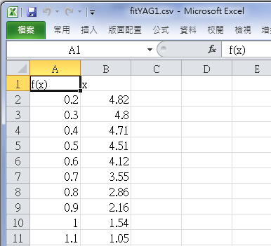
Output timings – Unit conversion
Unit conversion for easier control of some channels (conti.)
The mapping file
In the first row there should be two cells containing f(x) and x. (interchangeable)

Slide 10
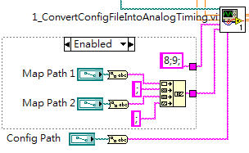
Output timings – Unit conversion
Unit conversion for easier control of some channels (conti.)
In the example, the specified channels are 8 and 9.
The string format is designed as below.
If you don’t want this, replace each of “8;9;” and the concatenated string by a single “;” (see Disabled frame).

Slide 11

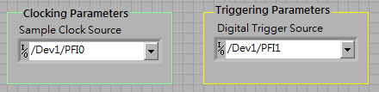
Output timings – External sources
External sources
Software
Hardware
(picture to take)

Slide 12
Force each channel to some voltage
Example: 0_Example_Forced_Volt_Set.vi in the NI_Analog_Output.llb library

Slide 13
Outline
Analogue output library
Output timings
Force each channel to some voltage
Digital output library
Output timings
Commands
Timing format
Inquiry Information in the .csv file
Converting
Appendix –Technician support

Slide 14
Digital output library
To use this library, one has to setup the FPGA for digital waveform through Quartus II once.
If the directory of the file is changed, the file path should be specified again, especially the DLL file!

Slide 15

Output timings
Example: 0_Example.vi in the library FPGA_Digital_Output.llb.
Steps:
Specifying the COM port via which connected to the FPGA.
Specifying AnalogTiming_DigitalTimingAndControl.dll
Specifying the timing description file
Run the program. It will remain in a while-loop
Click Write and Arm to command the device
If you want the timing outputting continuously, click Continuous? and enter a nonzero period(ms).

Slide 16
Commands
Here I provide a herd of commands to control the digital waveform generator.
CmdAmd: Arm the device to listen to the trigger
CmdReset: Reset the device
CmdSetChInitValue: Set the register containing the initial voltage of each channel
CmdSetAllValueToInit: Set the output voltage of each channel to its initial value recorded in the register
CmdSetChValue: Force each channel to the specified value

Slide 17
Outline
Analogue output library
Output timings
Force each channel to some voltage
Digital output library
Output timings
Commands
Timing format
Inquiry Information in the .csv file
Converting
Appendix –Technician support

Slide 18
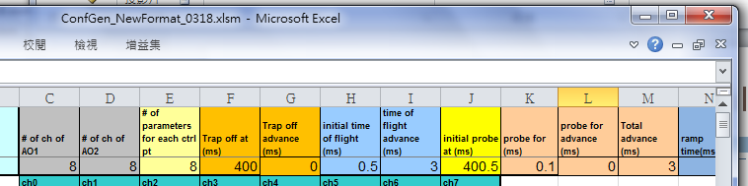
Inquiry Information in the .csv file
There is a row in the .csv file containing the information of some parameters in the config file (refer to the figure)
Inquire the number by sending a string identical to the descriptor of that number
Example: 1_InquiryCsvAttribute.vi in TimingUtility.llb

Slide 19
Converting
Analog:
Standard parameters: Sampling rate, Loop, DLL path, Config File and AO Board x
Channel to map and Mapping Files are for Unit conversion. (click here)
Some programs require the number of sampling points. It can be found in Sampling pts (per channel)
The Drawing Time is for comparison with the LabVIEW converting. (obsolete parameter)

Slide 20
Converting
Digital
Standard parameters: DLL path, open timing file, iLoop, commands
nOffsetTime_us is for the synchronization regarding the AO board.
In addition, the string named “commands” is for sending to the FPGA via RS-232.
Other indicators not connected out are for debugging, which can be safely ignored.

Slide 21
Outline
Analogue output library
Output timings
Force each channel to some voltage
Digital output library
Output timings
Commands
Timing format
Inquiry Information in the .csv file
Converting
Appendix –Technician support

Slide 22
Appendix –Technician support
Quantus II project for FPGA
C/C++ project for DLL
Format of the auto-generated .csv file

Slide 23
Quantus II project for FPGA
Loading the program to the FPGA
[advanced] Modifying the number of pulses for each channel, as well as the number of channels

Slide 24
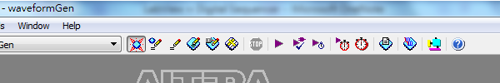
Quantus II project for FPGA
Loading the program to the FPGA
In the folder MonroeFPGA_DigitalWaveform_...
Double click waveformGen.qpf
If you do not modify the Quartus II project, it should be compiled. You then proceed to the next step. Otherwise compile the project through clicking

Slide 25
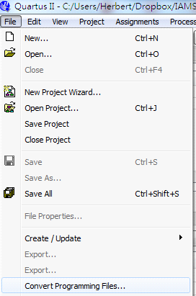
Quantus II project for FPGA
Loading the program to the FPGA (conti.)
Open the “Convert Programming Files” window

Slide 26
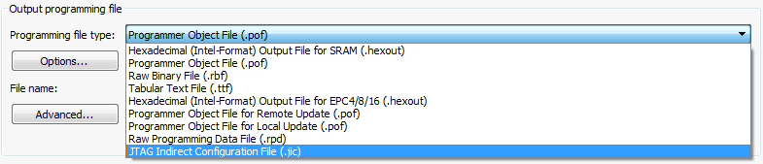

Quantus II project for FPGA
Loading the program to the FPGA (conti.)
Select the Programming file type to JTAG Indirect Configuration (.jic) file.
Configuration device selected to EPCS4

Slide 27
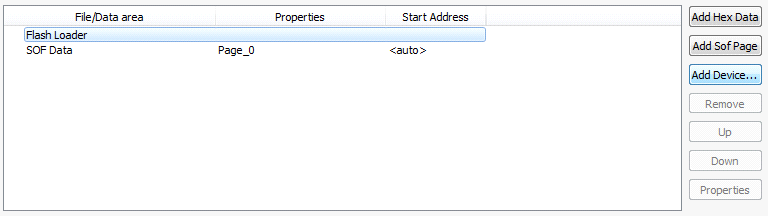
Quantus II project for FPGA
Loading the program to the FPGA (conti.)
left click Flash Loader item; then left click Add Device

Slide 28
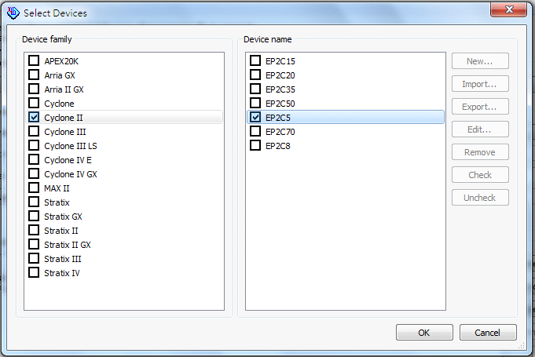
Quantus II project for FPGA
Loading the program to the FPGA (conti.)
select the check boxes as those in the figure

Slide 29
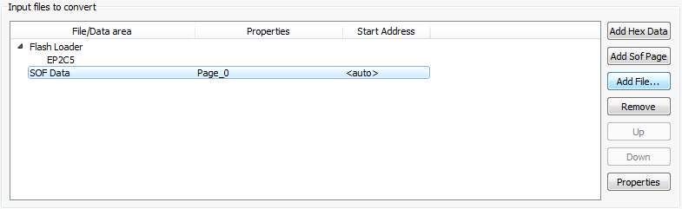
Quantus II project for FPGA
Loading the program to the FPGA (conti.)
Left click SOF Data item, and then left click Add File

Slide 30
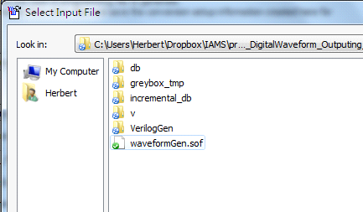
Quantus II project for FPGA
Loading the program to the FPGA (conti.)
Select the sof file

Slide 31
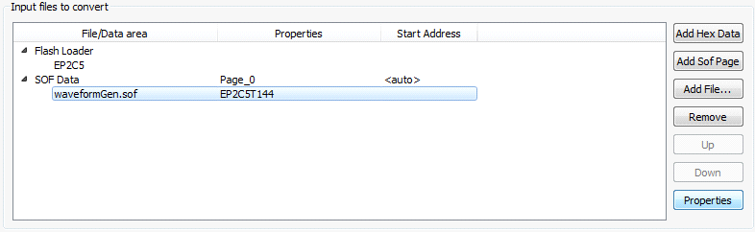
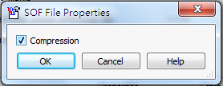
Quantus II project for FPGA
Loading the program to the FPGA (conti.)
Left click waveformGen.sof item; left click Properties.
mark the Compression box (if there is any problem regarding auto-loading, ignore steps 10&11 and redo)

Slide 32
Quantus II project for FPGA
Loading the program to the FPGA (conti.)
It now should look like this (figure in next slide). Then click Generate button.

Slide 33
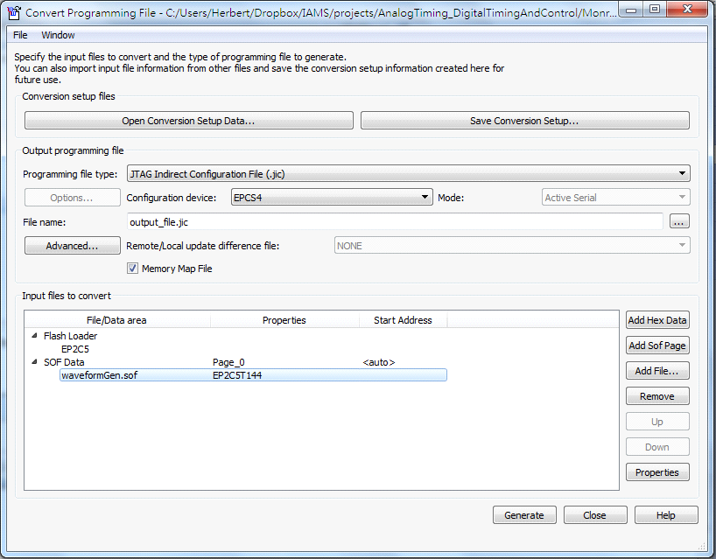

Slide 34

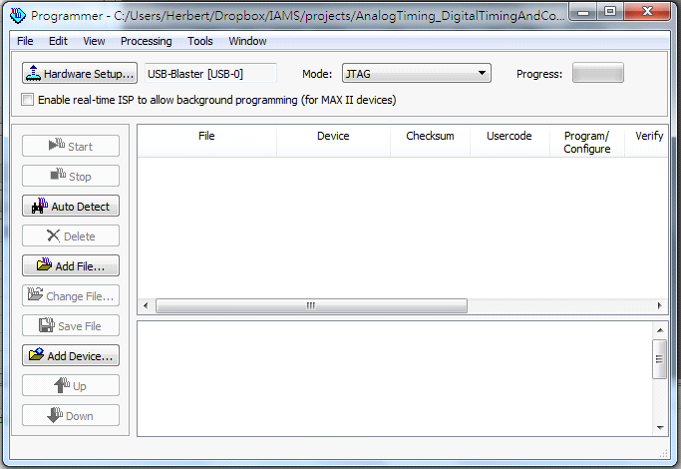
Quantus II project for FPGA
Loading the program to the FPGA (conti.)
open the Programmer window
Clean up the content of right-hand side table

Slide 35
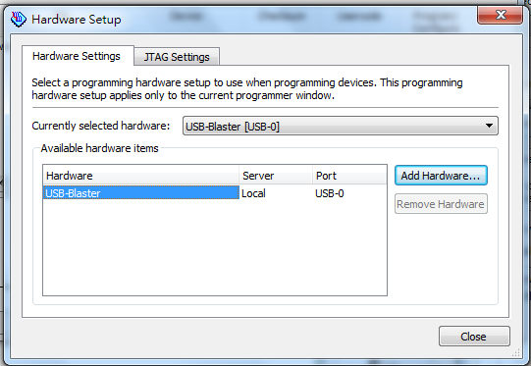
Quantus II project for FPGA
Loading the program to the FPGA (conti.)
Connect the blaster and the click “Hardware Setup.”
Click USB-Blaster and then click Close

Slide 36
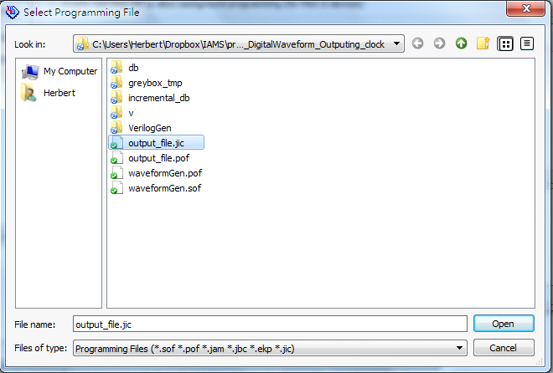
Quantus II project for FPGA
Loading the program to the FPGA (conti.)
Click “Add File” and choose the only jic file.

Slide 37
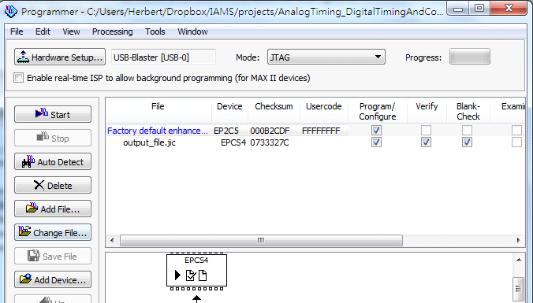
Quantus II project for FPGA
Loading the program to the FPGA (conti.)
mark the checkboxes as those in the figure; click Start.

Slide 38
Quantus II project for FPGA
Loading the program to the FPGA (conti.)
Finally, you have to turn off the FPGA and then turn it on again. The program written onto the EPROM through .jic will be loaded to the FPGA automatically every time you turn on the FPGA.

Slide 39
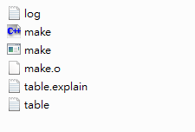
Quantus II project for FPGA
[advanced] Modifying the number of pulses for each channel, as well as the number of channels
In folder MonroeFPGA_DigitalWaveform_... and its subforder VerilogGen.
Open table.txt
Folder VerilogGen:

Slide 40
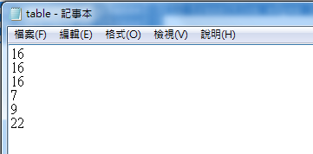
Quantus II project for FPGA
[advanced] Modifying the number of pulses for each channel, as well as the number of channels
Specify the number of pulses for each channel. The number of channels is equal to how many numbers you specify in table.txt If you enter the numbers as the figure, it turns out to be: 0th channel with 16 impulses(32 transition edge), 1st with 16, 2nd with 16, 3rd with 8, 4th with 16, 5th with 32.

Slide 41
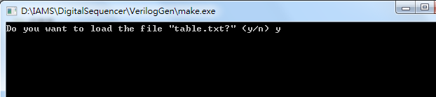
Quantus II project for FPGA
[advanced] Modifying the number of pulses for each channel, as well as the number of channels
After entering the numbers, run make.exe. Entering y for the execution.
Folder VerilogGen:

Slide 42
Quantus II project for FPGA
[advanced] Modifying the number of pulses for each channel, as well as the number of channels
Then repeat the procedure “Loading the program to the FPGA,” making sure to compile in the step 3. of that procedure.

Slide 43
Appendix –Technician support
Quantus II project for FPGA
C/C++ project for DLL
Format of the auto-generated .csv file

Slide 44
C/C++ project for DLL
This project is for reading/converting data from the .csv file and controlling the FPGA.
Recommend to install Code::Blocks
Files are contained in folder DLL_make
Double click timing_dll.cbp, you will see the figure in next slide.

Slide 45
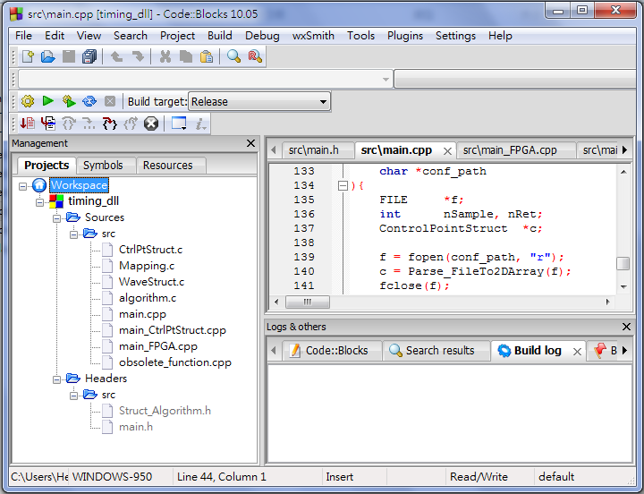
C/C++ project for DLL

Slide 46
C/C++ project for DLL
The digital command functions are put in main.cpp
Description of each file
main.h the functions exported for usage are declared here
Struct_Algorithm.h declares the enums, structures and the functions in CtrlPtStruct.c, WaveStruct.c, Algorithm.c and Mapping.c
CtrlPtStruct.c defines the methods of structure ControlPointStruct

Slide 47
C/C++ project for DLL
Description of each file (conti.)
WaveStruct.c defines the methods of structure WaveformStruct
algorithm.c defines the csv-parsing function, the function finding the maximum number of samples and the function converting the timing into waveform for all channels.
Mapping.c defines the map-parsing function and the function mapping the original waveform to a new one. The latter looks up the map with linear interpolation.

Slide 48
C/C++ project for DLL
Description of each file (conti.)
main.cpp defines the interface function for analogue waveform generation
main_FPGA.cpp defines the interface function for digital waveform generation and functions commanding FPGA.
main_CtrlPtStruct.cpp defines the exported utility functions of structure ControlPointStruct

Slide 49
C/C++ project for DLL
The number of fields of a control point should be 8
If you change it, you have to modify Parse_FileTo2DArray() and Build_OneChannel() in algorithm.c, as well as enum AttrType{} in Struct_Algorithm.h
It is STRONGLY RECOMMENDED to avoid changing the number of fields.

Slide 50
C/C++ project for DLL
If you want to add a new shape, modify enum VariationShape{} in Struct_Algorithm.h and add a new case in Build_OneChannel() in algorithm.c according to your design.
If necessary, you can add multiple parameters as I did for sinusoidal in Parse_FileTo2DArray() in algorithm.c (search “if(s == eShapeSine)” for that portion)

Slide 51
C/C++ project for DLL
For FPGA, all functions are in main_FPGA.cpp
Modify this part according to the modification of MonroeFPGA_DigitalWaveform_Outputing_clock\v\ RS232_CONTROL.v

Slide 52
C/C++ project for DLL
Utility functions defined in main_CtrlPtStruct.cpp are exported for the user to use ControlPointStruct from outside the DLL
In addition to the above usage, the function inquiring the value of the parameter in the .csv is also defined here.

Slide 53
Appendix –Technician support
Quantus II project for FPGA
C/C++ project for DLL
Format of the auto-generated .csv file

Slide 54
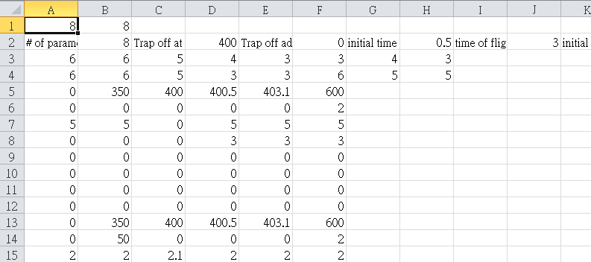
Format of the auto-generated .csv file
Each integer defines the number of channels on an AO board (e.g. board 1 has 8 and board 2 has 8)
The number of the integers here defines the number of boards. (e.g. 2 integers so there are 2 boards)

Slide 55
Format of the auto-generated .csv file
Odd columns are the names, while the even columns are the values of parameters.

Slide 56
Format of the auto-generated .csv file
Numbers of control points of channels on each boards. Two lines for two boards.

Slide 57
Format of the auto-generated .csv file
Data of control points. A channel is defined every 8 lines.

