Slide 1








Slide 2




Synthetic Spin-orbit coupling
Real Spin-orbit coupling
Atomic spin
Atomic spatial motion
Electronic spin
Electronic orbit

Slide 3

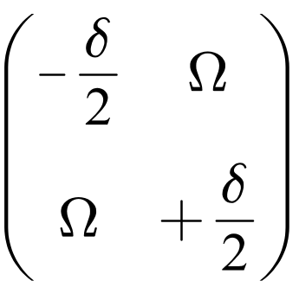

Landau Zener问题

Slide 4







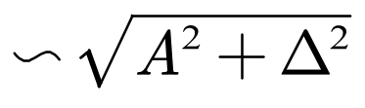

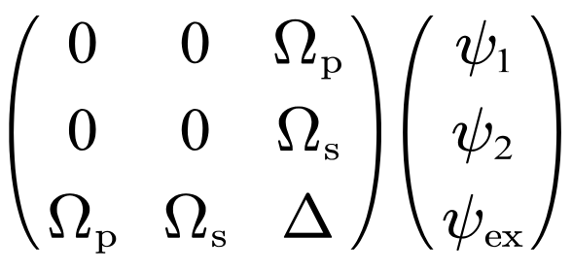



STIRAP
pump
stoke
0
Final
initial

Slide 5

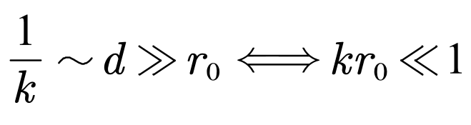
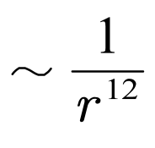

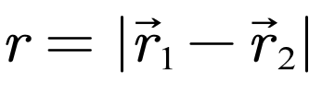

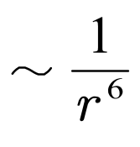

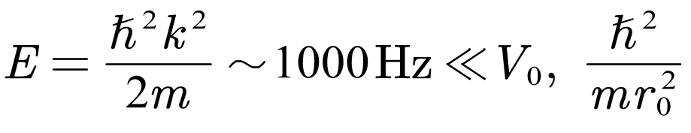
Dilute
Quantum

Slide 7
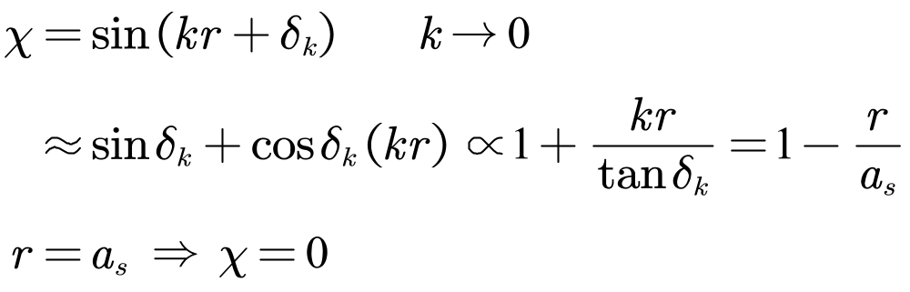

Slide 8
















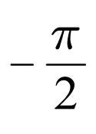


Square well
Low energy
universality
attractive
repulsive
Bound state
universality
散射长度变大，相互作用变强
Scattering resonance

Slide 9


Slide 10


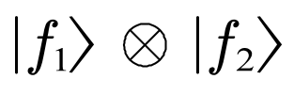
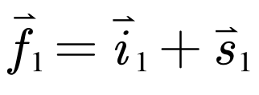
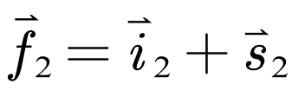






Slide 11
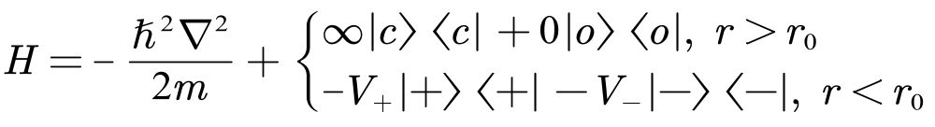
Simplified Model
V₋
V₊

