Slide 1

2018
Software Management Examination Report
Zhao Liang, Hou Zhiwen, Li Bichun, Zhu Ruian, Tan Yang
Examination Report
Sunstate Equipment June 24, 2018
.

Slide 2

I.Objectives of the Project
目录
CONTENTS
II. Expected results of the Project
III. Project Implementation & Management Plan
VI. Budget
IV. Financial Plan

Slide 3
I.Objectives of the Project

Slide 4
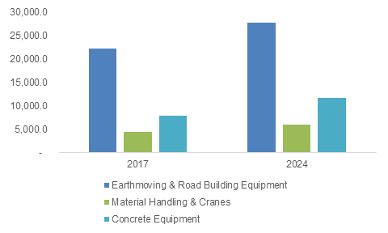
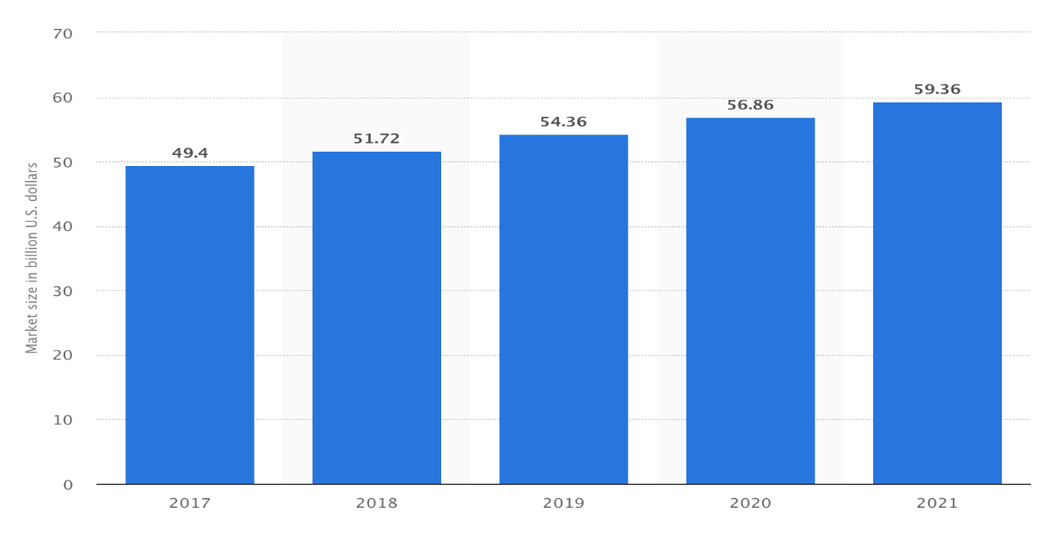
Development objectives
U.S. Construction Equipment Rental Market, By Product, 2017 & 2024 (USD Million), Global Market Insights
U.S. equipment rental market size from 2017 to 2021 (in billion U.S. dollars), Statista

Slide 5
Immediate objectives
The project aims to adapt new technology, including real time information system, to replace the traditional manual operations with a web-based system with a database. This will make it easier and more effective to create customer information, update equipment inventory data assign jobs to trucks/drivers and update job statuses. It will help the company make more profit and customers rent equipment more easily.
Now, the company has four depots in the market area, and each truck will start and return to the depot where it belongs to. In future, the company will extend its business to the whole USA or to some foreign countries.
For the experience, it can be applied to the resembling sectors such as taxi dispatching, in-town delivery, etc. to realize a real-time and highly available web system.

Slide 6
Expected results of the Project

Slide 7
Expected Results of Project
A complete web-based dispatching system which meets the requirement of conducting the dispatching operations more effectively.
Successful transition from manual operations to the new software and database.
Robustness and fault tolerance of the system and timely arrangement of maintenance.
Overall results
Unintended effects
Experimental technology may cause unexpected errors and failures.
If there exists asymmetric information between the actual need and the project, the company may spend a lot for reconstruction of the software.
Accidents due to the errors of the system and some legal issues.
Market analysis
In 2006, Sunstate ranked at No.14 in the US equipment rental market while in 2016 it ranked at No.7, with rental volume of $500 million, according to The RER 100: Top Rental Equipment Companies of 2016.
The project will produce approximately another 67% increase of the income through the planned activities and budget, according to McKinsey.

Slide 8
Project Implementation & Management Plan

Slide 9
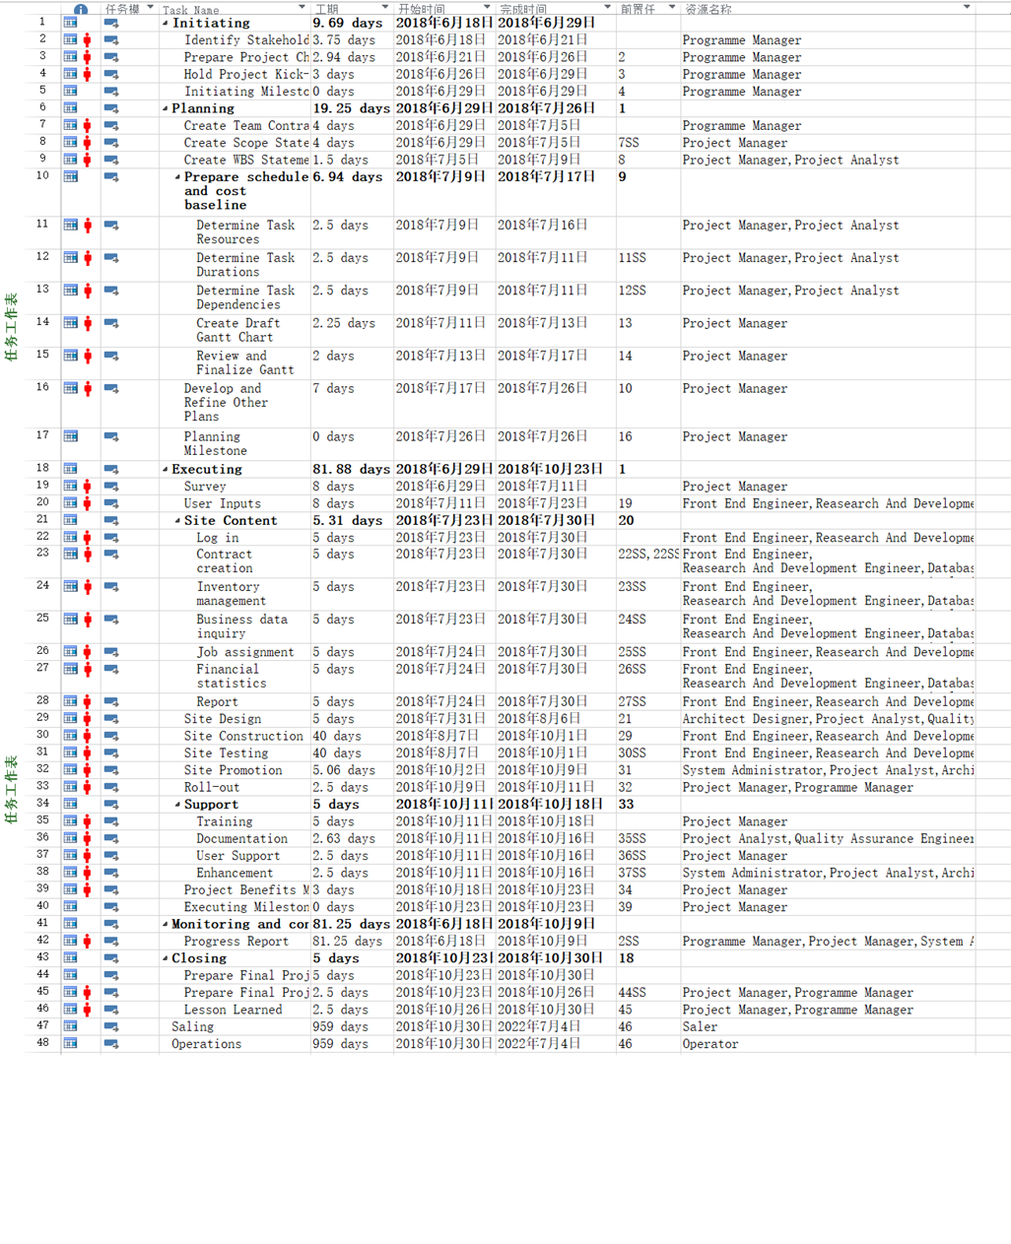
Sunstate_schedule
1
Initiating
It is the preparatory work before the project starts, mainly by the programme manager.
Planning
Prepare the project implementation plan and alternative plan, the main person in charge are project manager and project analysis
2
3
Executing
According to the plan, the project and coding are mainly completed by front end engineer, research and development, database engineer and system administrator
4
Monitoring and controlling
Test and monitor project quality throughout project development, the main person in charge is quality assurance engineer
5
Closing
Finish project. the main person in charge are project manager and programme manager

Slide 10
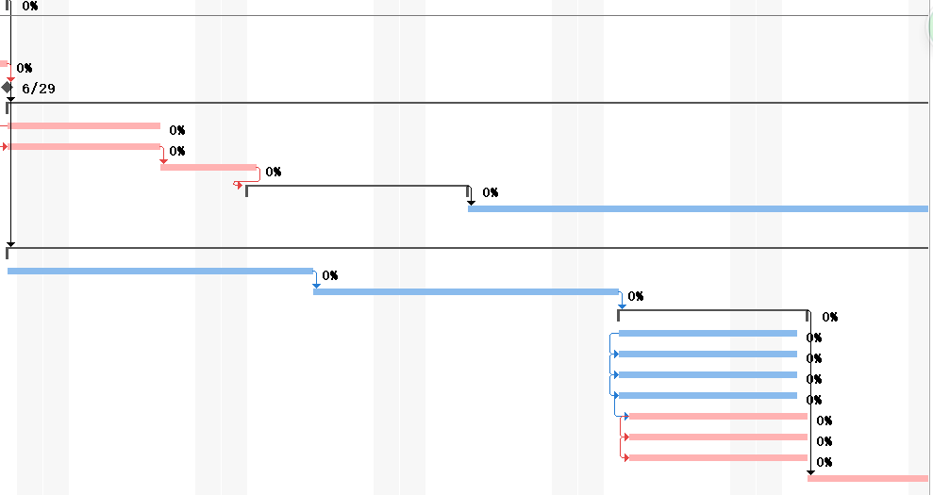
Gantt chart
Note
This is a part of Gantt Chart, which shows the order and duration of a particular project by means of activity lists and timescale.
To see the detail, please check the attached file sunstate_schedule.mpp.

Slide 11
Project Beneficiaries
counter person
registered customer
For end user, the project should ensure the usability of the client/browser side.The system should be convenient enough for their daily work.
The system should allow registered customers to quiry about the contract information in recent years.
financial manager/general manager
administrator
The system should be equiped with comprehensive operating and backstage management interfaces for administrator.
The system should allow financial managers to obtain financial data from the new system, including rent income and related costs, especially labor costs, traffic costs, warehousing costs, and at the departmental level or contract level.
At the same time, the general manager can obtain reports on transactions, revenues, costs and net income from different warehouses every week.

Slide 12
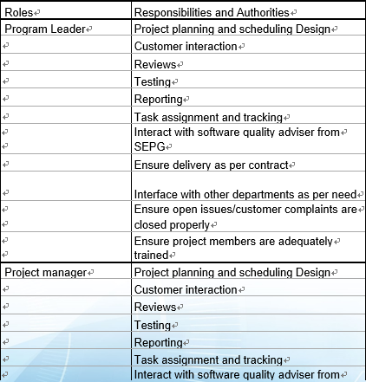
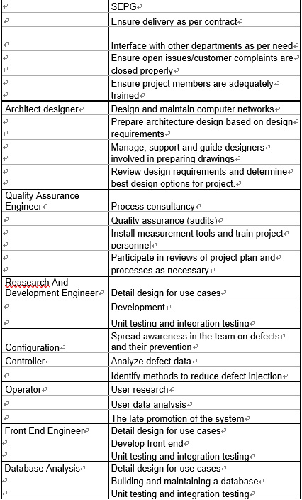
Implementing team management of project

Slide 13
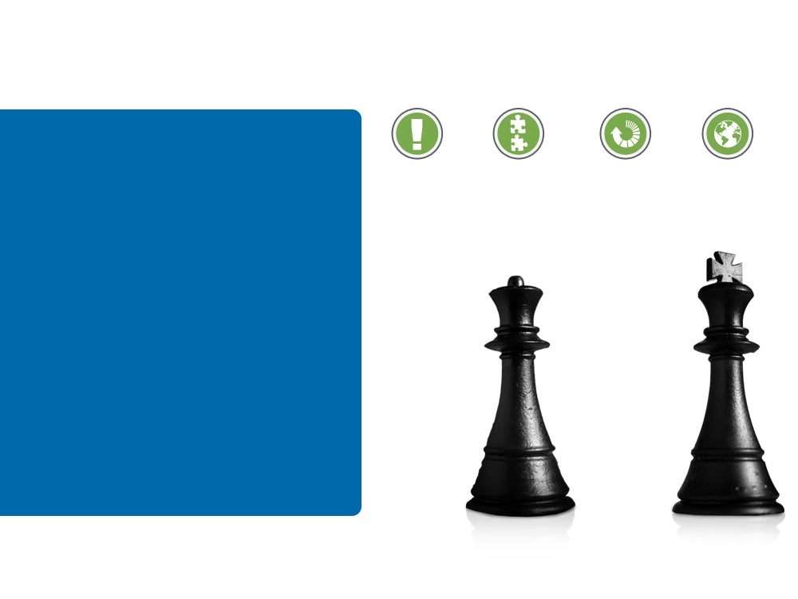
Project monitoring
SQA plan & management
The quality manager is responsible for the project's Software Quality Assurance(SQA), according to the quality management plan. Considering that the testing part is sub-contracted to the third-party team, the SQA manager should be specifically concerned about the testing.
Routine Meeting
The team would have a routine meeting weekly, where each department report their works and process during the week. The project manager should review and confirm whether each department is processing as scheduled.

Slide 14
Budget

Slide 15
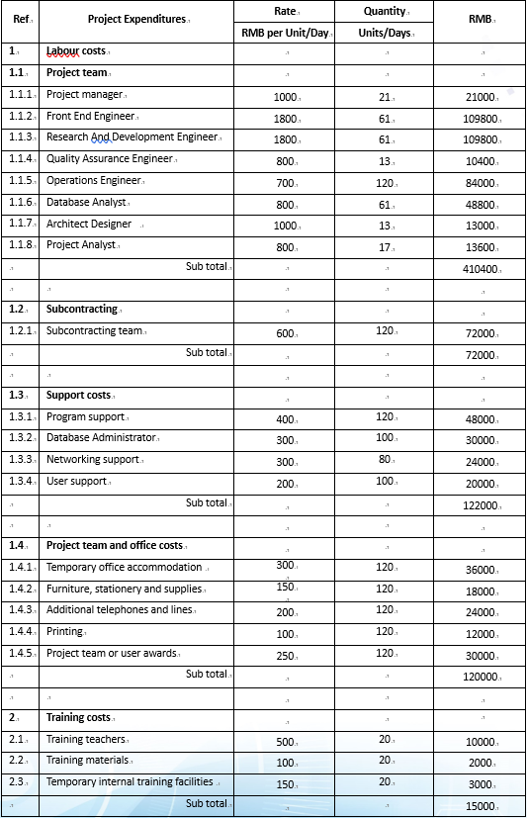
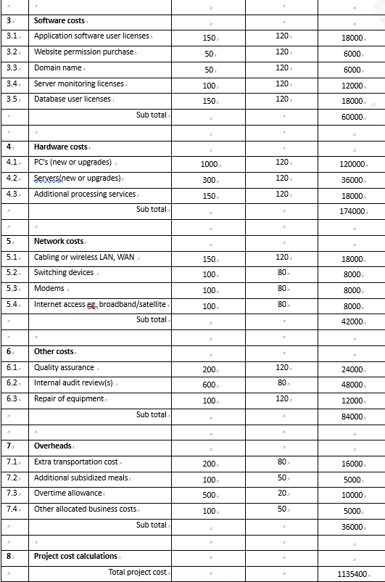
Budget

Slide 16
Financial Plan

Slide 17
Financial Plan
❖Major Assumptions
The financial plan is based on important assumptions. The key underlying assumptions are:
‣We assume around 20% increasing in our revenue according to the average of IT.
‣We assume the increase in sales will not bring about changes in human cost.
‣We assume the fixed assets depreciation period is 4 years.
‣We assume the bank loan is 500,000. The loan interest rate of 4.90%, 24 months to pay off the loan, which is matching principal and interest loans.
‣Management salaries rose by 15% per year.

Slide 18
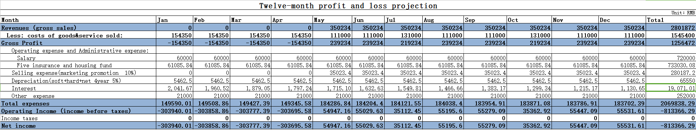
12-month Profit And Loss Projection
❖Major Assumptions
Note:
・The development cycle is four months
・Revenues include reduced human costs and increased sales and phone costs
・costs of goods sold：Labour costs + Subcontracting + Project team and office costs + training
・costs of service sold:operating and maintenance people、counter people、dispatcher salary + water and electric + extra transportation cost + modify costs
・salary:customer service + manager + sellers
・Five insurance and housing fund:operating and maintenance people + counter people + dispatcher + customer service + manager + sellers
・Selling expense: 10% Revenues
・Depreciation = 276000 ☓ (1 - 5% ) / 4/ 12 = 5462.5
・Other expense :Additional subsidized meals + Overtime allowance + Other allocated business costs

Slide 19
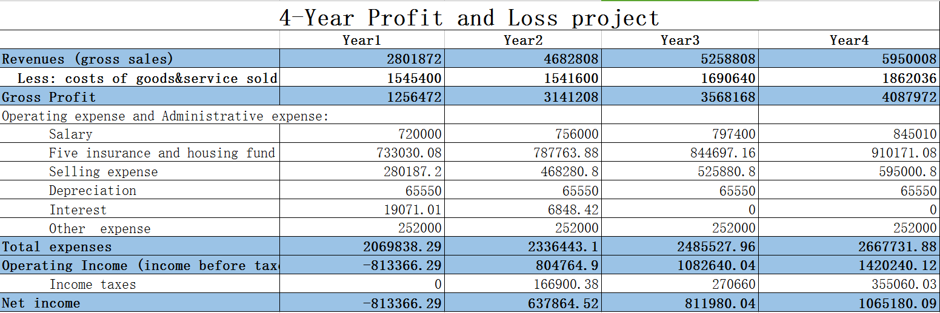
4-year Profit and loss project

Slide 20
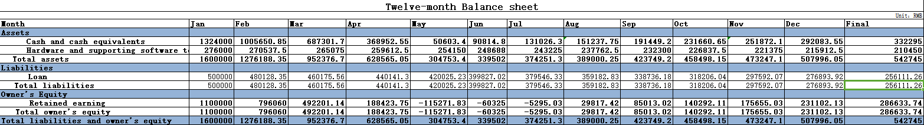
12-month Balance Sheet
❖Major Assumptions
Note:
・1. the project is a project developed by sunstate's software department. The initial capital is approved by the company's finance department based on the project cost estimate, which amounts to 110000 yuan.
・2. Balance sheet represents the status of the software department at the beginning of each month. An additional form will be added at the end of each year to indicate the final state of the project team.
・3. the monthly salary, including staff salaries and the cost of goods sold, is deducted from the cash owned by the Department.
・4. Loan in the begining is 500000.
・5. Software Product's value depend on it's developing cost. It will be appended in cash after four years.

Slide 21
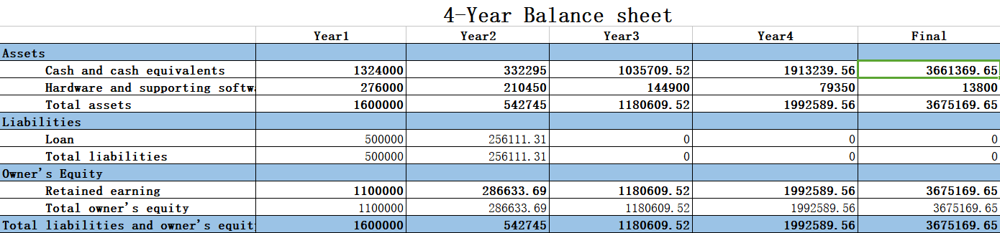
4-year Balance Sheet
Note:
Balance sheet represents the status of the software department at the beginning of each year. An additional form will be added at the end of forth year to indicate the final state of the project team.

Slide 22
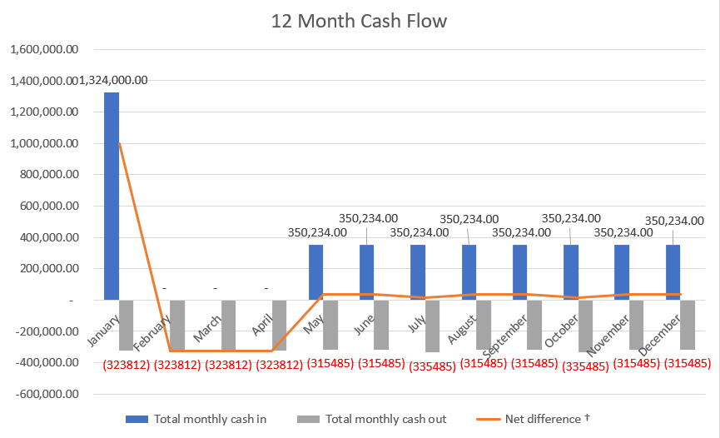
Projected Cash Flow

Slide 23
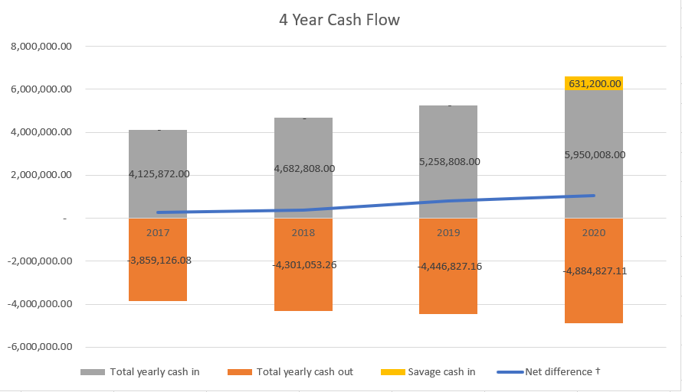
Projected Cash Flow
Projected Cash Flow work sheet will show in excel

Slide 24
Break-even Analysis
break-even cart（First year）
Fixed cost | amont
Development Cost | 617400
Operating expense and Administrative expense:
Salary | 720000
Five insurance and housing fund | 733030.08
Selling expense | 350234
Depreciation | 65550
Loan interest | 19071
Other expense | 252000
Total fixed cost | 2757285.08
Variable Costs per Unit of Production | 1412000
Selling Price Per Unit of Production | 4202808
note:
公式：BEP = TFC/(SUP - VCUP)
BEP = 收支平衡点（Break-even Point）
总备注：计算的是软件开发完成后的BEP，所以VCUP，SUP，以及TFC中的一部分值和损益表中不同，因为损益表的第一年是包含4个月软件开发的，没有收入。选取的时间点是第五个月，比如一年的单位产品价格等于第五个月的单位产品价格乘以12，TFC中的一些项也是同理，TFC的项大部分值都和损益表中一年的总和一致，不同的在下面有说明。有一些值会按规律变化，比如单位变动成本，比如利息，不是单纯乘以12，但是一年的总值是可以计算的，然后以年为单位算出BEP
TFC = 总固定成本（Total Fixed Costs） The selling expense is different form the value in profit projection because the 4 month selling expense（advertising expense）during development is 0,after development it's value won't be 0
VCUP = 单位变动成本（Variable Costs per Unit of Production） The cost of service of a year after the software is developed，
SUP = 单位产品价格（Selling Price Per Unit of Production）The revenues of a year after the software is developed
TFC=2757285.08
VCUP=111000*8 + 131000*4 = 1412000
SUP=350234*12=4202808
BEP=TFC/（SUP-VCUP）=2757285.08/（4202808-1412000）=0.988 year

Slide 26
2018
THANK YOU VERY MUCH

