Slide 1
JAVA PROJECT PRESENTATION [Library Seat Reservation System]
B.Tech 3rd Semester
[Anand Prem - 23SCSE1011859]
[Advika Srivastava - 23SCSE1012346]
[Date - 24 Oct. 2024]
SUBMITTED TO :
Mr. Chandra Bhushan Kumar Yadav

Slide 2
Introduction
Problem Statement:
In many libraries, seat reservation is still managed manually, leading to inefficiencies and inconvenience for both library staff and patrons. The lack of a streamlined, digital system for reserving library seats results in several issues:
Inefficient Seat Utilization: Without a proper tracking system, seats may remain underutilized or overbooked.
Time-Consuming Processes: Both users and library staff spend unnecessary time managing and coordinating seat reservations.
Inaccurate Availability Information: Users may not have real-time information on seat availability, leading to frustration and wasted trips.
Limited Accessibility: Manual reservation systems often lack the flexibility needed for users to make or modify reservations remotely.

Slide 3
Introduction
Objective:
The objective of the Library Seat Reservation System is to provide an efficient and userfriendly web application where
users can reserve library seats online . The system aims to streamline the reservation process, improve user experience,and enhance library resource management by allowing both users and administrators to perform essential functions related to seat reservations.

Slide 4
Project Background
Overview: The Library Seat Reservation System is a web application designed to simplify the process of reserving library seats. Developed using Java, MySQL, basic HTML, and Maven within IntelliJ IDEA Community Edition, this system caters to both users and administrators.
User Features:
Seat Availability Check: Users can view and select available seats.
Reservation: Reserve seats for specific hours.
Check-In/Check-Out: Manage reservations effectively.
Admin Features:
Reservation Management: View and manage all reservations.
Seat Maintenance: Cancel reservations for damaged seats.
User Management: Add new users to the system.

Slide 5
Project Scope
Technology Used:
Backend:
Java: The primary programming language for building the backend logic.
Servlets & JSP: For handling HTTP requests and responses.
JDBC: For connecting and interacting with the MySQL database.
Database:
MySQL: The database management system for storing user information, seat details, and reservations.
Frontend:
HTML: For basic web design and structure.
CSS: For styling the HTML pages.
JavaScript: For interactive elements and validation.
Development Environment:
IntelliJ IDEA Community Edition: The integrated development environment (IDE) used for coding, testing, and debugging the application.
Maven: For project management and dependency handling.
Version Control :
Git & Github

Slide 6
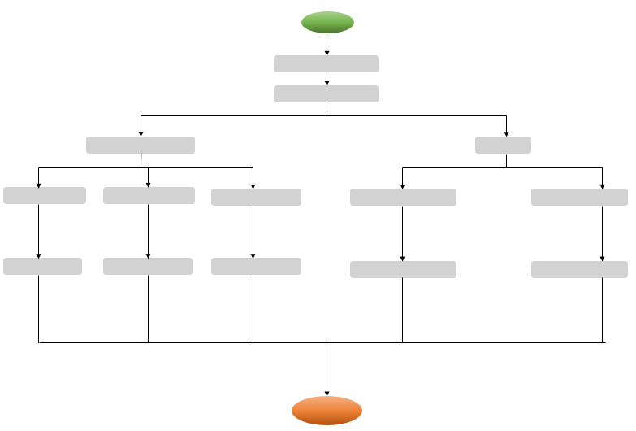
FLOW-CHART
START
USER - LOGIN
USER VALIDATION
NO
IF ADMIN
YES
IF USER
ADMIN DASHBOARD
USER DASHBOARD
MANAGE USER
MANAGE SEATS
RESERVATIONS
SEAT RESERVATION
RECORDS
ADD/DELETE
CHECK/MARK SEAT
VEIW DATABASE
MAKE / REMOVE
CHECK IN /OUT
EXIT

Slide 7
Key Java Concepts Used
OOPs Concepts:
Classes
Objects
Inheritance
Polymorphism
Exception Handling:
Database Connection Errors
Input Validation
Null Pointer Exceptions

Slide 8
Future Enhancements
The Library Seat Reservation System has significant potential for future enhancements to improve user experience and operational efficiency.Here are some key areas of expansion :
1. Mobile Application Development
2. Real-Time Seat Monitoring
3. QR Code Check-In/Check-Out
4. Integration with Campus Systems

Slide 9
THANK
YOU
PRESENTED BY
ANAND & ADVIKA

