Slide 1
DevOps Build
Purpose
The main purpose of the DevOps build is to configure, monitor, distributed builds, manage users and send reports for organizational projects. One project can have multiple build configuration, DevOps build have the functionalities to monitor, to build, to publish and to release the project builds.

Slide 2
Definition
Admin:-
Admin is responsible for registering with the tool and creating a profile with the company name.
Manage user regarding roles, permission, Organization etc
Manage application regarding configuration/settings, theme, email notification
Admin has full access rights to check app logs and reports.

Slide 3
Definition
Release Manager
Release managers can create projects and server configuration of the organization.
Release managers can create another release manager or normal user of the organization.
The Release manager has access of all support ticket and credential/secrets of the organization.
Release managers can get email notification regarding all build of the organization.

Slide 4
Definition
User
User can edit his details.
User can able to build the project and publish the project for a specific server.
User can get only email notification for specific build which created by him/her.
User can able to download a build file, a published and a released file.

Slide 5
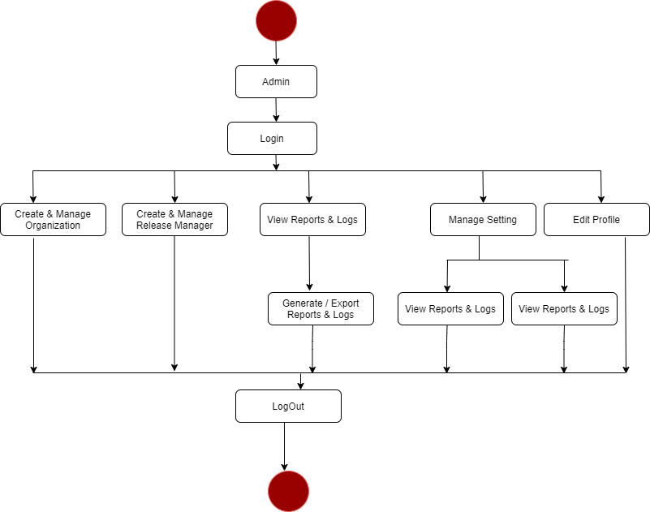
Activity Diagram :-(Admin)

Slide 6
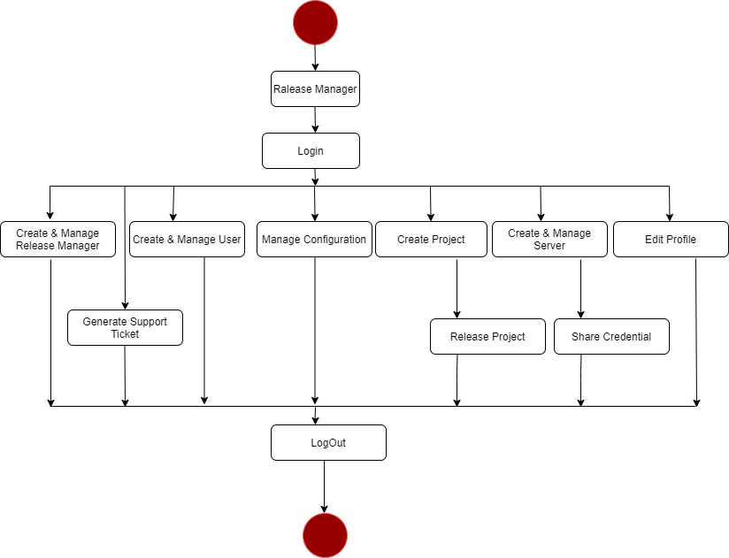
Activity Diagram :-(Release Manager)

Slide 7
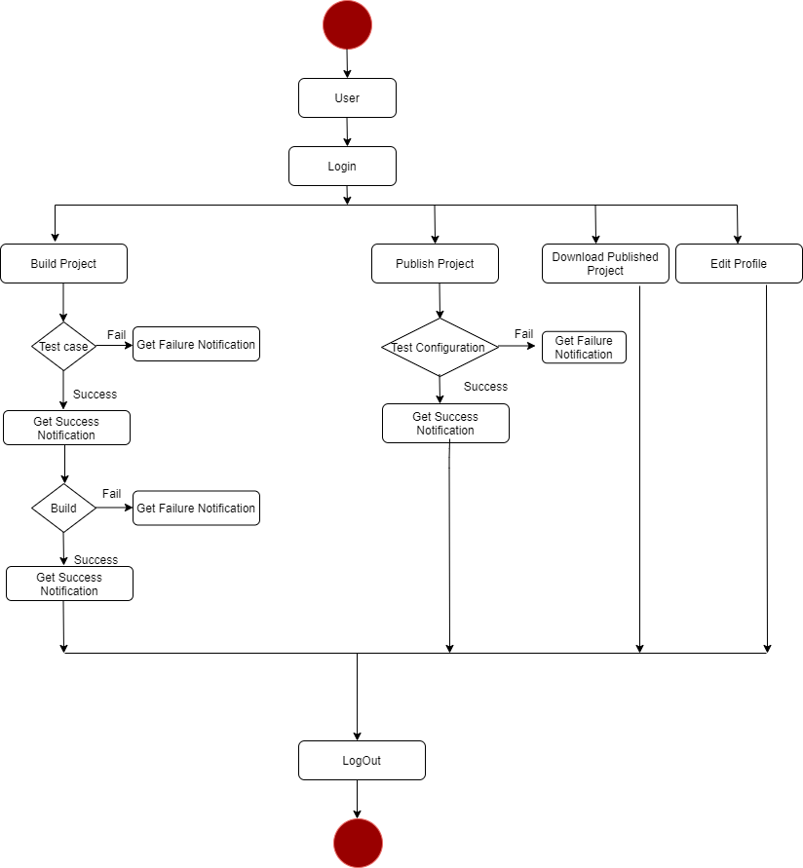
Activity Diagram :-(Users)

Slide 8
Thank You

