Slide 1
Tetris-like Game Project-2 uluç furkan vardar 041501029

Slide 2
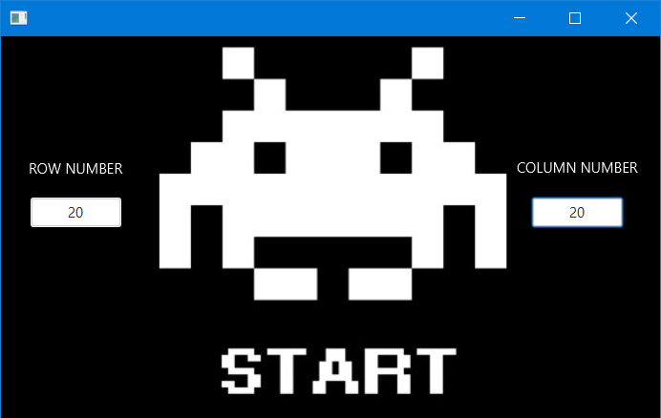
İnterface Design
Opening page is like this.
User can enter the values of the Row and Column.
After enter Values, user click «START» page is changing.

Slide 3
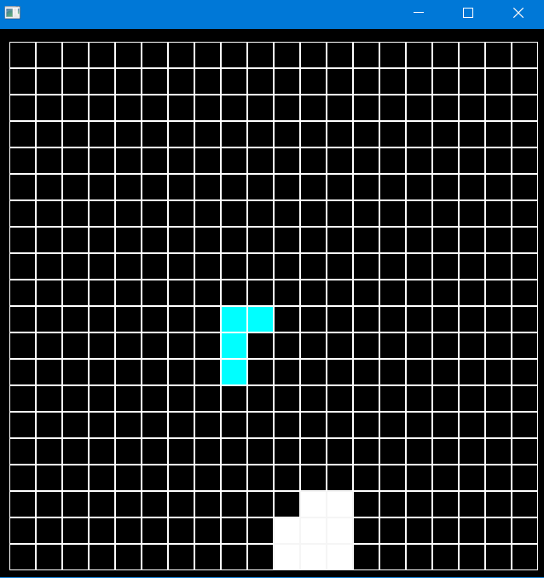
After «start» click
Tetris starts as you set up.
Every shape has different color
After shape down changes it’s color to white

Slide 4







Shapes Implementation
3x2 3x2 3x2 3x2 4x1 2x2 2x3
(Yellow regtangels are emty parts of matrices.)
Every shape has diffrent size and also map is a matrix. So evey motion of an object is controled if next motion is over laped or not.
Rotation function is also reverse every matrix counter clockwise to 90 degree.

Slide 5
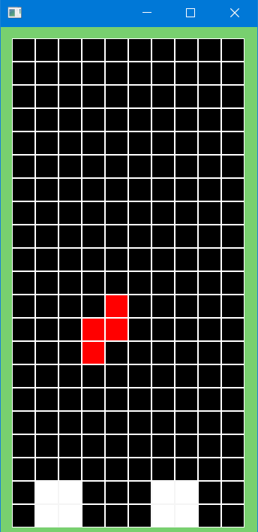
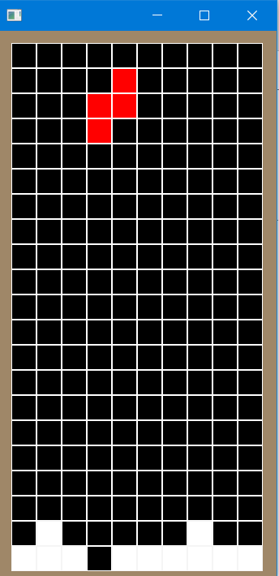
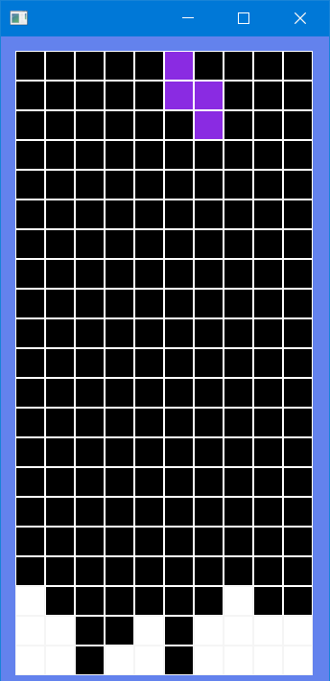
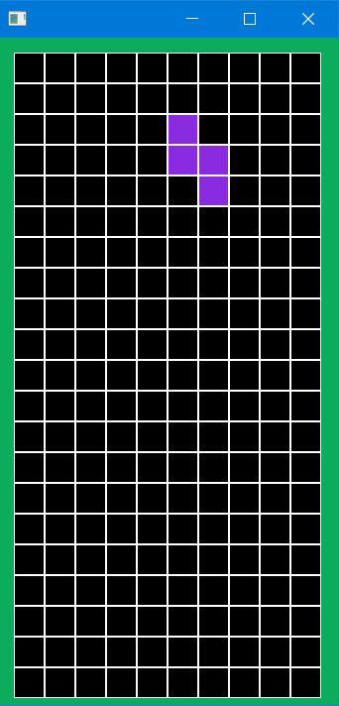
UnFair mode
*Stop game *Move shape UP *Add pixels *Delete pixels

Slide 6
Thank you for listening

