Slide 1
Uzbek Word Game Modeling using Character-level N-gram and Statistics

Slide 2
Content
Terminology
Introduction
Problem Statement
Methodology
Data Preparation
Statistics
Restrictions
Approaches
Results
Conclusion
Appendix

Slide 3
Terminology
Word game
Character Level N-gram
Letter frequency
Positional Letter Frequency
Digraph Letters
Cross-Validation
Standard deviation

Slide 4
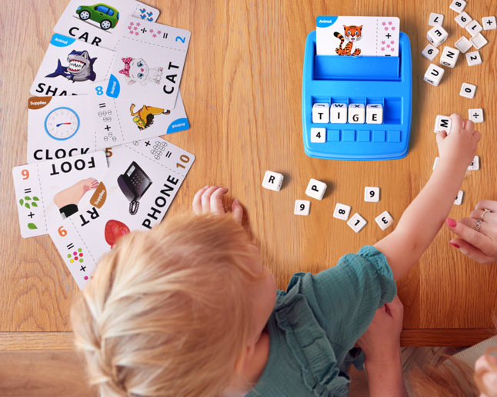
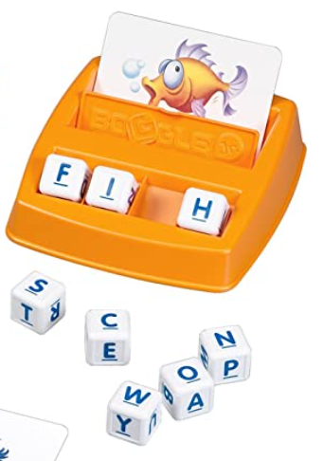
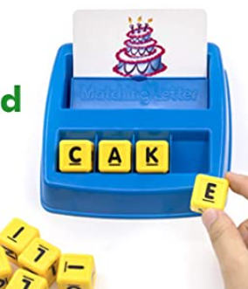
Introduction
The word game modeling is identifying a set of letters to implement in a matching letter game toy. The game consists of a predefined number of cubes with a letter on every six sides, and word cards to form those words using a combination of cubes.
It is specially designed for a different level of difficulty that is customized for 3-12 years old.
This matching letter game is very suitable for early childhood education and entertainment. It can improve children’s learning enlightenment ability, word formation ability, and early vocabulary recognition ability.
Most of them consisted of 8 to 16 letter cubes with options forming up to 64 words from given word flashcards and the length of the words are in 3-4 letters.

Slide 5
Problem statement
The task is to suggest a set of letters to be described in cubes for the matching letter game. There are six sides of a
cube, and a letter will be placed on each side of it. Before the design, a game needs to identify the count of cubes. We planned the count of cubes for cases of five, six, seven and eight, it is made up of a small number of cubes, and there will be three-letter, four-letter and five-letter words.
The result of the proposed methods should provide the opportunity to make as many words as possible from the words in the selected dataset. The number of cubes should be fewer.
Performing evaluation of the model accuracy on selected datasets (Uzbek and English) in the cases of 7-8 cubes. Both datasets included 3-5 letter words.

Slide 6
Methodology
Our proposed approach consists of two methods that include the following steps:
Data preparation,
Statistics,
Methods and
Fine-tuning.
The dataset for training was generated and normalized for game modeling stages.
The frequency of letters in the dataset has been studied, analyzed of the pattern of the occurrence of vowels and consonants in the words and character-level B-gram language for words.
To increase the efficiency of the model, fine-tuning replacements of letters in a cube are carried out.

Slide 7
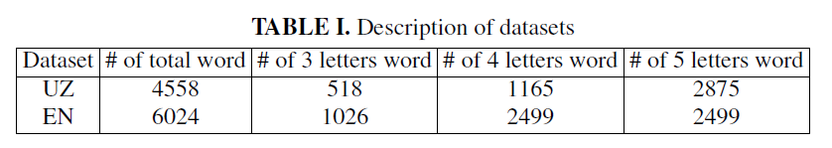
Data Preparation
Uzbek language words are extracted from the Madvaliyev and Begmatov dictionary book.
In the Uzbek language digraph with diacritical signs, taking into the availability of letters, we will make several changes. g’, o’ denotes ¯g, ¯o. With these changes, we replace the digraph with one character, which is considered two characters in a word, and it helps to correctly calculate letter frequency.
Digraph letters, ch and sh, is divided to s and h, two independent letters, while c is not a letter for the Uzbek alphabet.
Uzbek alphabet has the character that is called a phonetic glottal stop (native: Tutuq belgisi), and although it is not a real letter. In our dataset, the words with this character consist of too few counts (18 words), therefore we omitted these words while filtering words as the dataset.
After these normalizations, left 7948 words within length 3-5 characters. This list of words was filtered by a
native Uzbek speaker. Purpose of the filtering is removing very rare words and an unfamiliar words to child.
To check the accuracy of our model in other language, English dataset was obtained from ESL Forums online web page (https://eslforums.com) that designed for young children to learn English language. It is contain list of common words that have 3-5 letters in English.

Slide 8
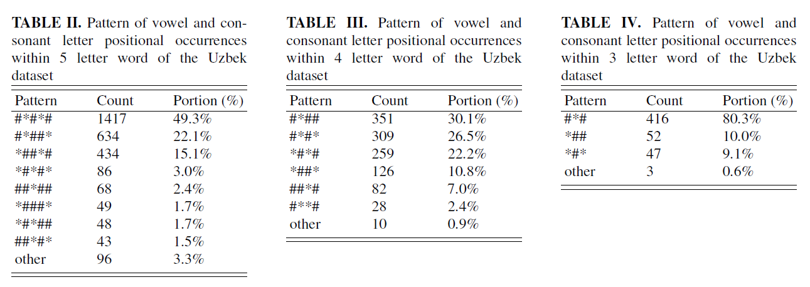
Statistics (Vowel Patterns)

Slide 9
Statistics (UZ: LF, N-gram)
{'a': 2316, 'o': 1368, 'i': 1368, 'r': 989, 'l': 838, 't': 828, 's': 819, 'u': 790, 'n': 711, 'm': 605, 'q': 587, 'k': 566, 'y': 509, 'b': 493, 'h': 487, 'e': 418, 'z': 400, 'd': 394, 'v': 348, 'ō': 328, 'f': 233, 'p': 232, 'g': 212, 'j': 198, 'ḡ': 181, 'x': 164, 'c': 92}
{'ar': 217, 'la': 202, 'ta': 172, 'ra': 167, 'an': 166, 'ir': 162, 'sh': 162, 'al': 159, 'ma': 157, 'on': 148, 'or': 131, 'in': 127, 'il': 127, 'li': 126, 'ur': 123, 'ha': 122, 'na': 120, 'ka': 119, 'ay': 119, 'oq': 116, 'qa': 115, 'as': 114, 'sa': 113, 'ak': 109, 'da': 109, 'at': 108, 'ro': 105, 'ol': 103, 'am': 102, 'ov': 102, 'ti': 96, 'si': 95, 'to': 94, 'yo': 93, 'ch': 92, 'is': 92, 'lo': 92, 'ri': 91, 'im': 90, 'iq': 90, 'za': 87, 'tu': 84, 'mo': 83, 'ba': 83, 'qi': 83, 'uv': 80, 'iy': 80, 'ot': 79, 'bo': 78, 'so': 78, 'hi': 77, 'ki': 73, 'no': 70, 'mi': 69, 'ul': 68, 'ab': 68, 'it': 67, 'os': 67, 'om': 66, 'yi': 66, 'be': 66, 'ya': 65, 'bi': 64, 'iz': 64, 'az': 63, 'er': 63, 'va': 62, 'oy': 62, 'ad': 61, 'ik': 61, 'av': 60, 'oz': 60, 'vo': 60, 'us': 60, 'un': 59, 'su': 59, 'ga': 59, 'di': 59, 'ja': 57, 'ob': 56, 'qo': 56, 'bu': 55, 'yu': 54, 'do': 53, 'ho': 53, 'fa': 53, 'zo': 53, 'uz': 52, 'od': 52, 'qu': 51, 'el': 51, 'ōr': 51, 'aq': 49, 'pa': 49, 'um': 48, 'ḡi': 47, 'po': 47, 'af': 46, 'aj': 46, 'ng': 46, 'ji': 45, 'ḡa': 45, 'ut': 44, 'ni': 44, 'ah': 43, 'zi': 43, 'st': 41, 'tō': 40, 'ko': 40, 'uy': 40, 'ru': 39, 'ku': 39, 'xa': 38}
{ind: 113}
['a', 'i', 'o’] (Vowels that LF Value >=5%)

Slide 10
Statistics (EN: LF, N-gram)
{'e': 2160, 'a': 1892, 's': 1731, 'o': 1506, 'r': 1247, 't': 1129, 'l': 1114, 'i': 1104, 'd': 932, 'n': 873, 'c': 822, 'u': 753, 'b': 716, 'p': 671, 'm': 594, 'h': 544, 'g': 508, 'f': 462, 'y': 436, 'k': 398, 'w': 358, 'v': 217, 'x': 105, 'z': 88, 'j': 82, 'q': 22}
{'ar': 222, 'es': 213, 'er': 188, 'in': 186, 're': 177, 'al': 163, 'le': 160, 'ra': 156, 'ed': 156, 'ea': 156, 'an': 149, 'la': 149, 'co': 148, 'de': 136, 'ro': 135, 'as': 135, 'or': 135, 'te': 134, 'at': 132, 'ee': 130, 'on': 129, 'ca': 129, 'lo': 126, 'st': 125, 'se': 122, 'ch': 122, 'ts': 120, 'ri': 116, 'en': 114, 'el': 113, 'oo': 111, 'am': 109, 'bo': 109, 'il': 105, 'pe': 104, 'ba': 102, 'do': 102, 've': 101, 'be': 99, 'll': 99, 'ur': 97, 'ne': 97, 'it': 97, 'ad': 96, 'ot': 95, 'ol': 94, 'me': 92, 'ho': 90, 'li': 88, 'ai': 87, 'he': 86, 'ow': 85, 'to': 85, 'ha': 85, 'ta': 84, 'ma': 82, 'un': 82, 'id': 80, 'ke': 79, 'et': 79, 'os': 79, 'sh': 79, 'ic': 79, 'po': 77, 'ap': 77, 'ns': 76, 'ac': 76, 'bu': 76, 'th': 74, 'di': 74, 'pa': 73, 'ck': 73, 'us': 73, 'fa': 71, 'ou': 71, 'ge': 70, 'cr': 69, 'is': 69, 'op': 68, 'mo': 67, 'ng': 65, 'ds': 65, 'fe': 64, 'fi': 64, 'ps': 64, 'ut': 64, 'da': 63, 'ce': 62, 'ls': 62, 'nd': 62, 'wa': 62, 'hi': 62, 'nt': 62,…}
ind: 236
['e', 'a', 'o', 'i'] (Vowels that LF Value >=5%)

Slide 11
Restrictions
All letters from the alphabet of the language must take a place in the set of cubes. Since the game is designed to improve the work of letters in young children, when they play with cubes during the game, they will get acquainted with all the letters in the alphabet of the language.
A letter can not be placed two times or more on a single cube. During the matching letters of the word, a player can use only one side of a cube while forming a word, according to this fact when a letter is placed more than one time on the cube it is ineffective. According to placing different letters, we should make as many words as possible.
The count of vowel letters for each cube is two (or three, depending on the method). This restriction provides an almost equal number of vowel letters for different cubes.

Slide 12
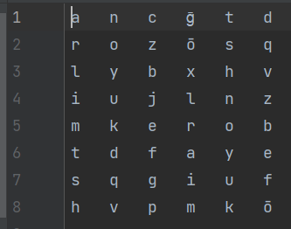
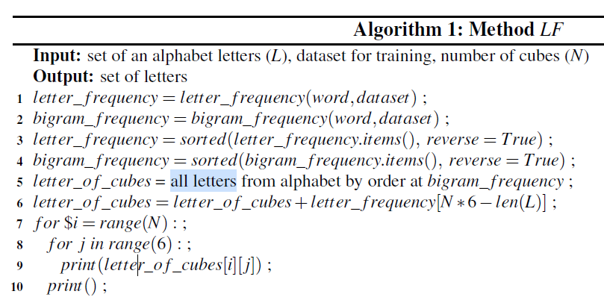
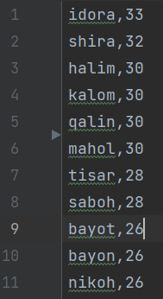
Approach I

Slide 13
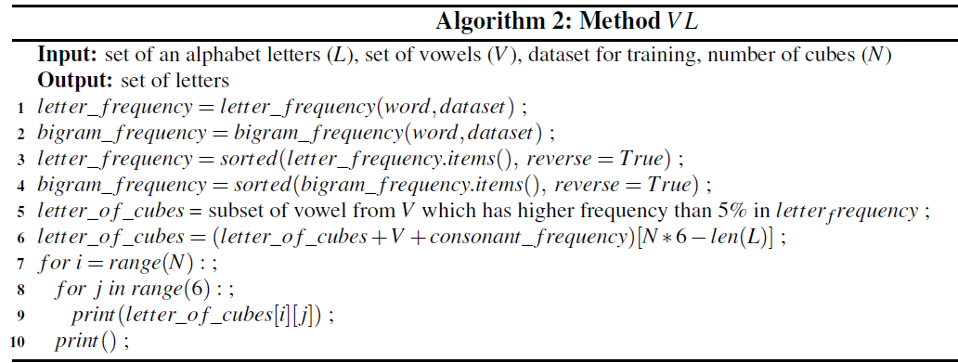
Approach II

Slide 14
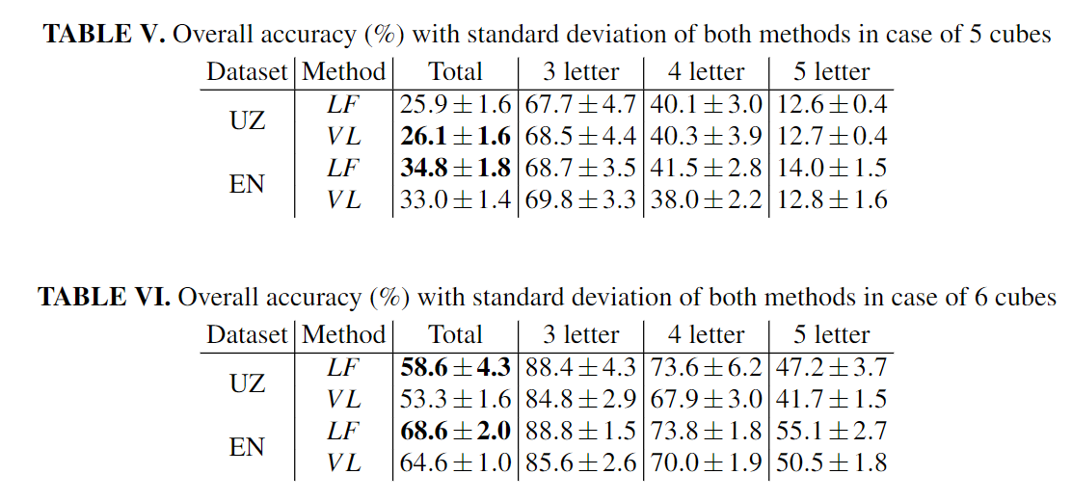
Results

Slide 15
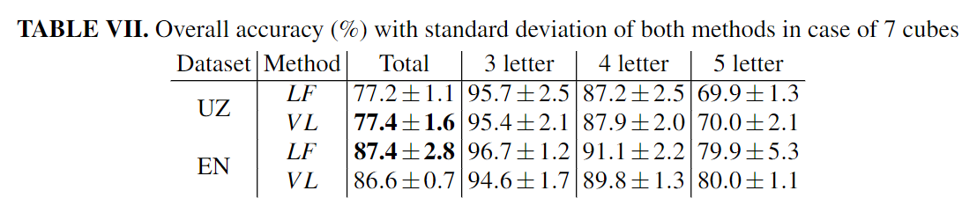
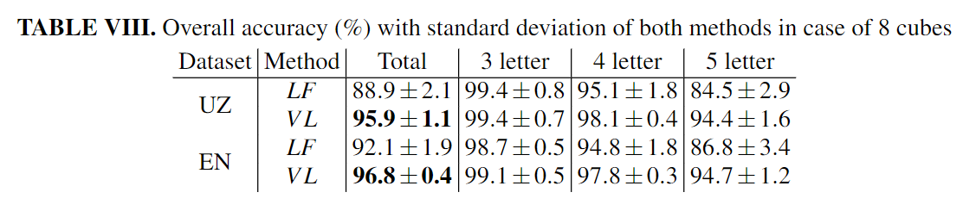
Results

Slide 16
Comparision with the Approaches
 |  | Jami | 3 ta harfli | 4 harfli | 5 harfli
uz | app1 | 28.9 | 55.6 | 35.7 | 21.3
 | app2 | 71.6 | 95.6 | 82.6 | 62.8
en | app1 | 18.5 | 39.5 | 19.5 | 8.9
 | app2 | 76.6 | 87.9 | 82.0 | 66.6
Approach1 – Xarflar to’plamidan tasodifiy tanlab olingan holda yasaladi.
Approach2 – Kubiklar yasash uchun yetarlicha bo’lgan xarflar to’plamidan tasodifiy tanlab olingan element kubik yasashda qatnashadi va to’plamdan o’chiriladi.
For 8 cubes case

Slide 17
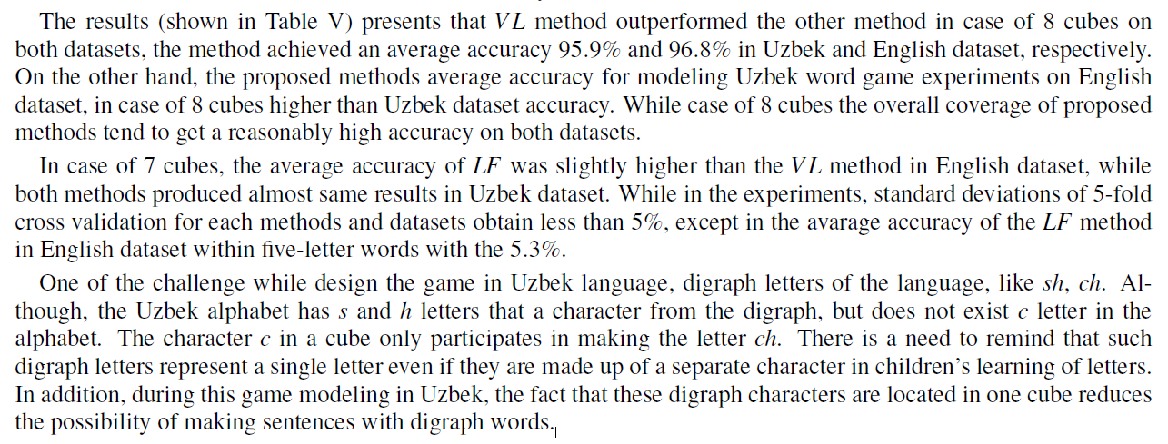
Results explain

Slide 18
Conclusion
A matching letter game is essential tools for child to improve their letter recognition and vocabulary as well as orthography.
Proposed methods to modeling a cubic oriented word game. The datasets within 3-5 letter words in the Uzbek language was created and filtered according to the rules of a game.
Positional letter distribution by a vowel and consonant level statistics analyzed and presented in a pattern view.
Proposed 2 methods, based on Letter Frequency (LF) and Vowel Priority (VL) methods.
As a evaluation of the methods, the experiments performed in Uzbek and English word datasets by 5-fold cross-validation.
Among the methods VL method outperformed in case of 8 cubes, with the average accuracy of the model was 95.9% and 96.8%, respectively, in Uzbek and English dataset.
The model intends use in a design a matching letter game in a other different languages by provide its’ alphabet and words list as a training dataset.

Slide 19
Appendix
https://github.com/UlugbekSalaev/LetterCubicGame

