Slide 1

Fastag Fraud Detection
By Ulviyya Ismayilzada

Slide 2

Our Target
This project focuses on leveraging machine learning classification techniques to develop an effective fraud detection system for Fastag transactions. The dataset comprises key features such as transaction details, vehicle information, geographical location, and transaction amounts. The goal is to create a robust model that can accurately identify instances of fraudulent activity, ensuring the integrity and security of Fastag transactions.

Slide 3
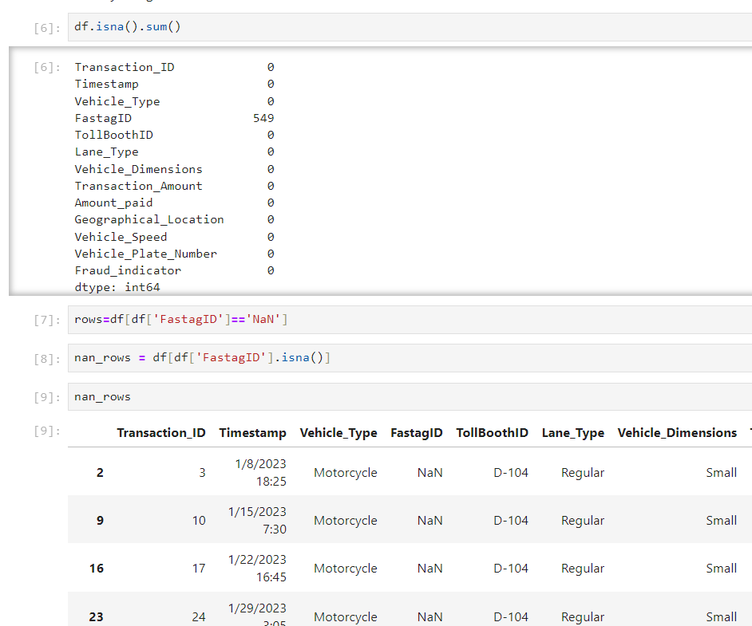
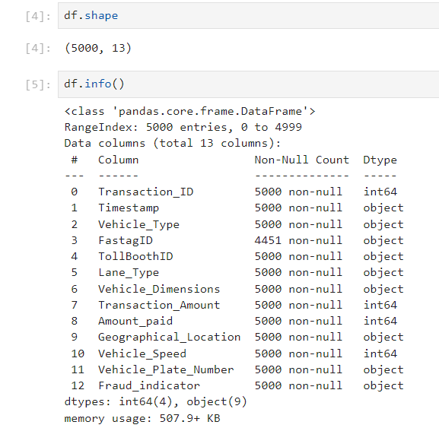
EDA Firstly, we explored the dataset to understand the distribution of features and the prevalence of fraud indicators. The dataset contains 5000 rows and 13 columns. NAN values were only present in the 'fastagid' column, and we checked whether these NAN values held any meaningful significance for the dataset

Slide 4
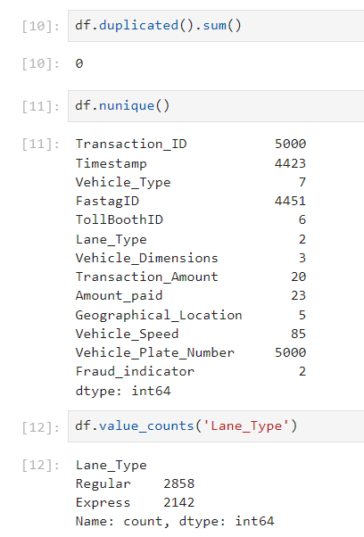
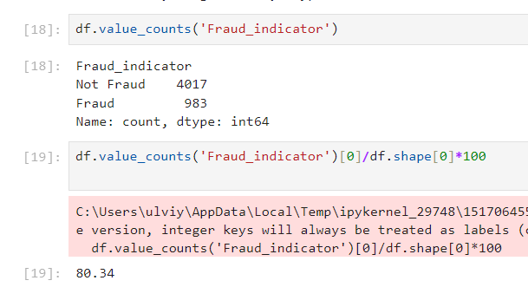
EDA There were no duplicated rows in our dataset. Additionally, we checked the value counts of features for insights. We discovered an imbalance in our target variable, with one class comprising over 80% of the data.

Slide 5
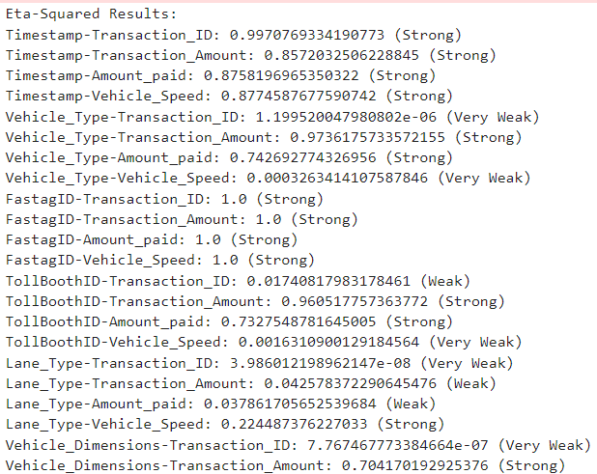
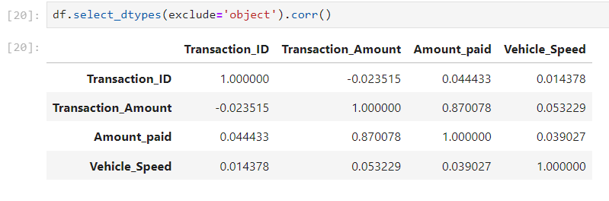
EDA Correlation between features were defined

Slide 6
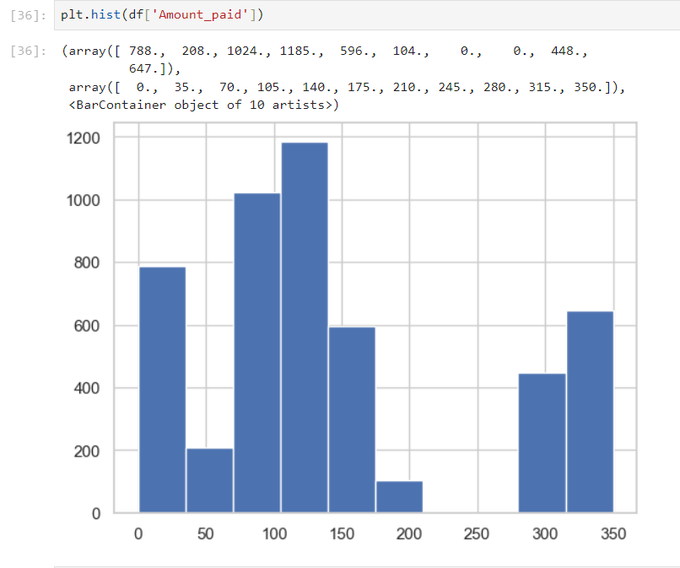
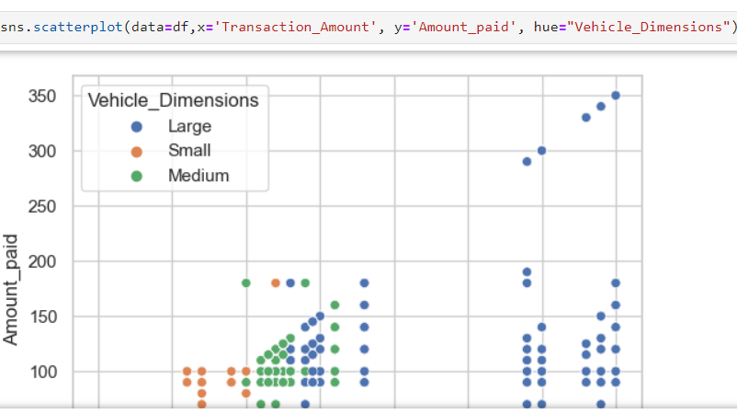
EDA Distribution of some features, relations between features were checked by using different visualizations

Slide 7
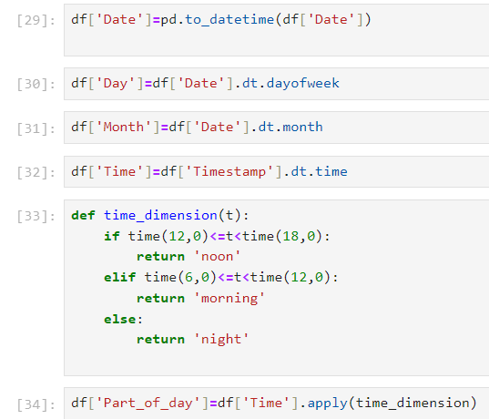
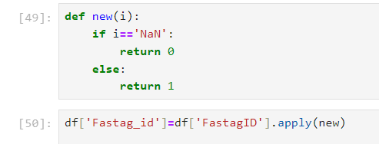
Feature Engineering
Within this stage some new features such as date, day, month, fastag, part of day were created from existed features, some features found less insightful and dropped

Slide 8
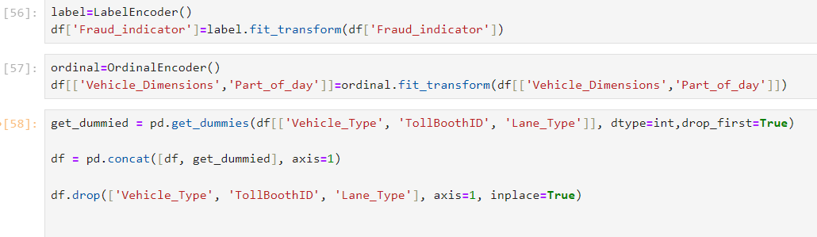
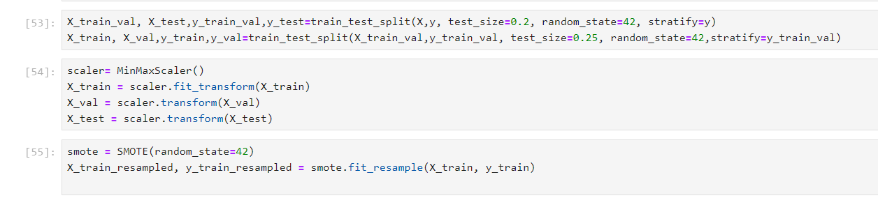
Data Preprocessing
In this stage, missing values were checked, data was scaled using the Min-Max scaler, and categorical features were encoded appropriately. For avoiding overfitting model validating with validation data. Furthermore, the imbalance in the target variable was addressed using the Synthetic Minority Oversampling Technique (SMOTE)

Slide 9

Model development
As we know ,we need to predict there is fraud or not we had classification problem. So, we built a machine learning classification model to predict and detect Fastag transaction fraud. Random Forest and Decision tree classification models were used. To achieve better results, GridSearchCV was employed for hyperparameter tuning. Additionally, to ensure there was no overfitting, the model's performance was evaluated using cross validation .

Slide 10
Evaluation metrics
Accuracy is the ratio of correctly predicted instances to the total instances.
Precision, also known as positive predictive value, measures the ratio of correctly predicted positive observations to the total predicted positives.
Recall, also known as sensitivity or true positive rate, measures the ratio of correctly predicted positive observations to all the observations in the actual class.
F1 Score is the weighted average of Precision and Recall. It tries to find the balance between precision and recall.
Roc-Auc score demonstrates how well model distinguishes classes

Slide 11
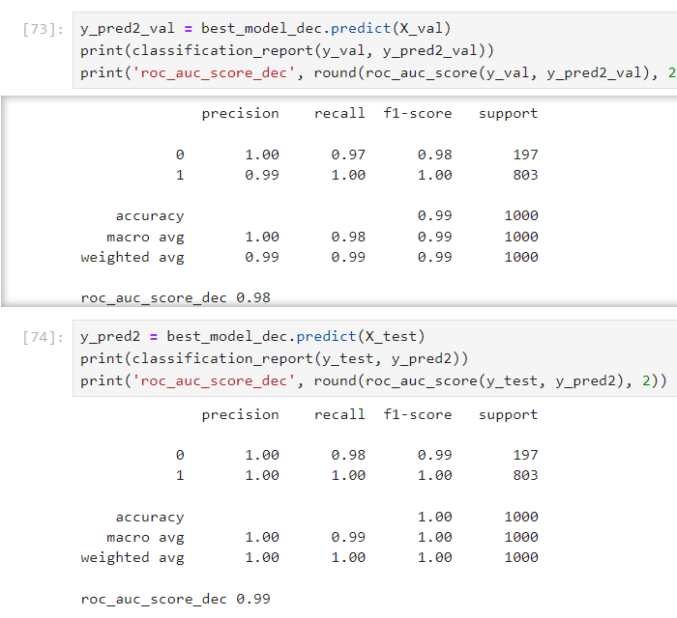
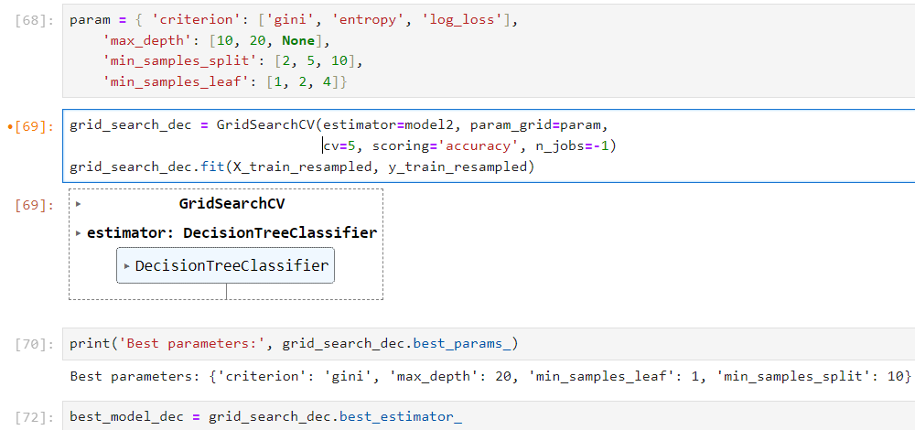
Model evaluation
The model achieved a ROC-AUC score of 99%, indicating that it effectively distinguishes between the target classes. Moreover, metrics such as accuracy, precision, and recall support the model's superior performance.

Slide 12
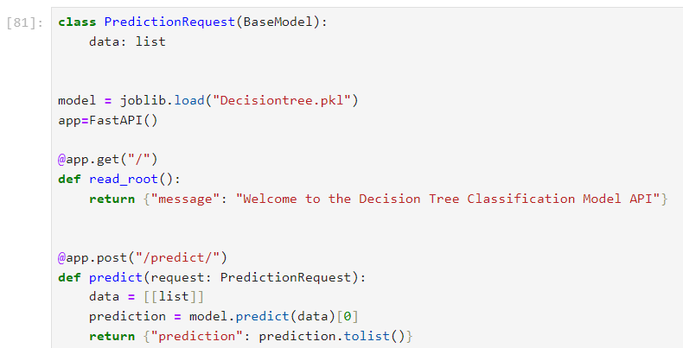
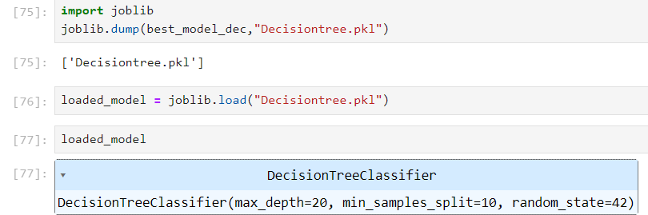
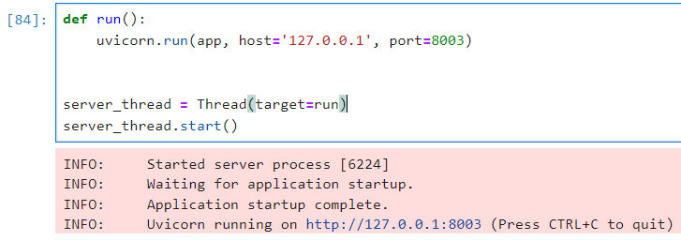
Model Deployment
Well performed model saved and deployed

Slide 13

Conclusion
After working on our dataset, we have developed a model that performs well. Our model effectively identifies fraud, making it a scalable and efficient Fastag fraud detection system. This system helps minimize financial losses and ensures the security of digital toll transactions.

