Slide 1
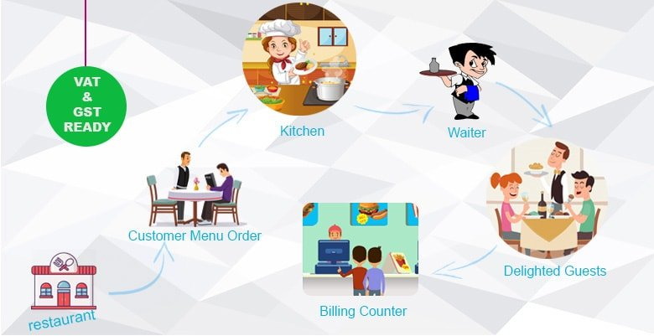

UML CLASS
DIAGRAMM

Slide 2
RESTAURANT
*
Restaurant
Human Manager
# name
# address
Table Manager
Food Category
Customer

Slide 3
Human Manager
Human Manager
Manager
<Abstract>
Person
<Abstract>
<Enum>
Staff
Cooker
1
Foods Name
# id : number
# name : string
-salary: number
specialization
Samlor korkor
Nom banh chok
Bai sach chrouk
Prahok ktis
# age : number
*
# phone : number
Waiter
category
1
gender
1
<Enum>
Staff Category
Cashier
<Enum>
Gender
COOKER
DISHWASHER
CASHIER
WAITER
MALE
FEMALE

Slide 4
Table Manager
Table Manager
*
Table
+ id
+ numberOfCustomers
+ numberAllTables:[]
*
Chair
0/1
Customer
+ id
+ name: string
+ numberAllChairs:[]

Slide 5
Food Category
Food Category
Samlor korkor
Coffee
*
*
<Abstract>
<Abstract>
Food
drink
+ name: string
+ price: number
+ categories: [] = []
+ name : string
+ price : number
+ categories: [] = []
Kare
Tea
Tong Yam
Coca Cola
Chha Kdav
PepSi

Slide 6
Customer
Customer
*
selects
Payment
pays
<Abstract>
Food Menu
Customer
- name: string
- cardID: number
+ name: string
+ price: number
Order
+ name: string
+ orderNumer: number
Food
Drink

