Slide 1

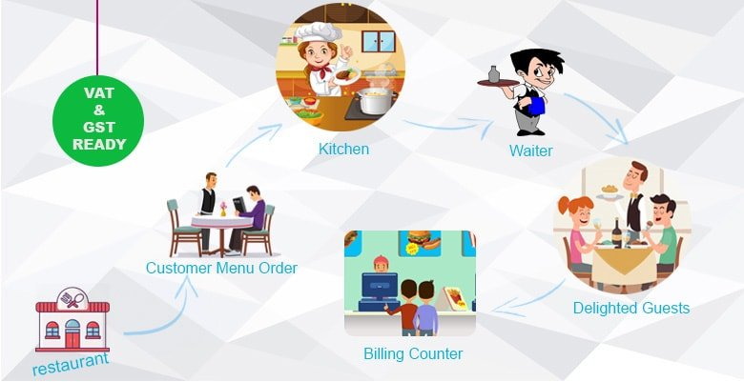

UML CLASS
DIAGRAMM

Slide 2
C
O
N
T E N T
1
WHAT CAN OUR SYSTEM CAN DO
2
UML CALSS DIAGRAM
3
HOW TO CODE
4
WHAT DID I HAVE LEARN

Slide 3

1. WHAT OUR SYSTEM CAN DO
Know the position of all of the staff in the restaurant
Manager tables & chairs there are free or busy in the restaurant
Check whether customers sit or not to sit at the table
Get the total price of the customer pay somethings
Know about for payment of the money(ABA, WING…)

Slide 4

2. UML CALSS DIAGRAM

Slide 5
RESTAURANT
*
Restaurant
Human Manager
# name
# address
Table Manager
Food Manager
Customer Manager

Slide 6
HUMAN MANAGER
Human Manager
Manager
<Abstract>
Person
*
<Abstract>
Staff
Cooker
# id : number
# name : string
-salary: number
# age : number
# phone : number
Waiter
category
1
gender
1
<Enum>
Staff Category
Cashier
<Enum>
Gender
COOKER
DISHWASHER
CASHIER
WAITER
MALE
FEMALE

Slide 7
TABLE MANAGER
Table Manager
*
Table
+ id
+ numberOfCustomers
+ numberAllTables:[]
*
Chair
0/1
Customer
+ id
+ name: string
+ numberAllChairs:[]

Slide 8
FOOD MANAGER
Food Manager
*
Food Categories
*
*
Food
drink
+ name: string
+ price: number
+ categories: [] = []
+ name : string
+ price : number
+ categories: [] = []

Slide 9
CUSTOMER MANAGER
Customer Manager
*
Payment
Customer
Menu Order
- name: string
- cardID: number
# name: string
# price: number
Cashier
Food
Drink
- name: string
- accontID: number

Slide 10
4. What we have learned from this project?
Soft skill
Hard skill
- communication
- Abstract class
- Critical thinking
- Inheritance
- Problem solving
- Enum
- Find solution
- Analysis
- Decision

Slide 11
Do you have any question?

Slide 12





Thank you !
www.passerellesnumeriques.org

