Slide 1
Implementation
Pre-processing
Train Model
Evaluate Model
Predict Example Sentences

Slide 2
Implementation of Pre-Processing
VNC-Tokens (Use as an index to extract sentences from BNC-Corpus)
BNC-Corpus (Corpus contains sentence) XML format
Extract features from obtained sentences

Slide 3
Pre-Processing 1/2

Slide 4
Pre-Processing 2/2
Write into CSV file (Training set)

Slide 5
Implementation of training model
Use words embedding to turn features into vector using three methods
W2V
Skip-thoughts
Split the training data
Train Machine Learning Model

Slide 6
Training Model 1/3
Turn Features in training set from word format into dense vector format (Numerical form)
Why? Because machine learning classifier can under stand only number

Slide 7
Training Model 2/3
Split the training data into Training 80 % and Validation data 20%
Because we will evaluate the performance of our model in the next process

Slide 8
Training Model 3/3
Train the model using 2 techniques:
SVM
Logistics Reg
Then, we can measure the performance of both model and choose the best one in the next step

Slide 9
Implementation of evaluation
Use trained model to predict the test data that we have devided before to get the measurement report
Compare each model performance

Slide 10
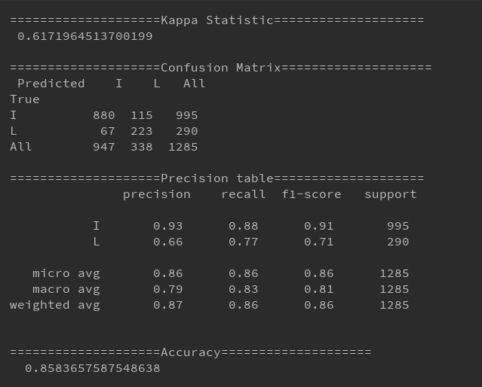
evaluate Model 1/3
SVM performance Logistic Regression performance
vs

Slide 11
evaluate Model 2/2
Compare the performance and pick the best which is word2vec+Logistic Regression model
Name | Accuracy | Kappa Statistic | F-1 score of idiomatic | F-1 score of literal | Avarge F-1 score of 2 class
SVM | 0.852 | 0.548 | 0.91 | 0.64 | 0.775
Logistic Regression | 0.858 | 0.617 | 0.91 | 0.71 | 0.81

Slide 12
Implementation of prediction
Load the example sentence
Get the prediction

Slide 13
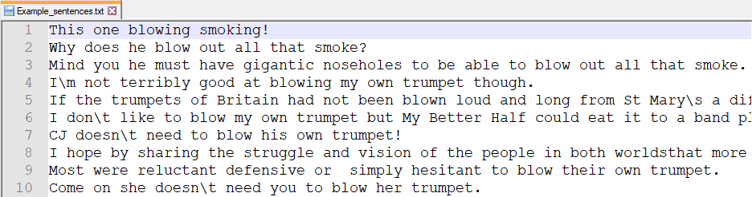
prediction 1/2
System read the input sentence from the Example_sentences.txt

Slide 14
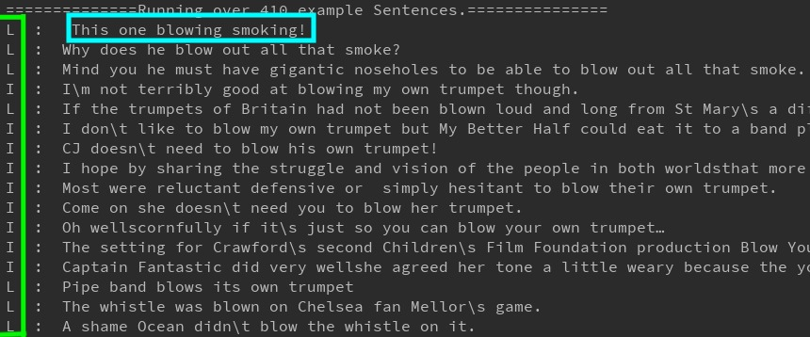
prediction 2/2
Get the prediction
sentence
Class
L: Literal
I: Idiomatic

