Slide 1
Javascript
Loops, Conditional Statements, Functions, Variables, Parameters, Arrays and Associative Arrays

Slide 2
Loops
Loops in javascript allow you to loop over arrays
Two types of Loops
Standard for loop
For each loop

Slide 3

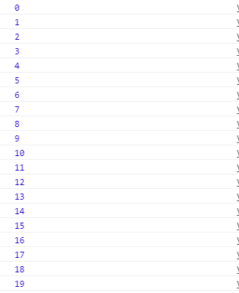
Code example – standard loop
Output:
Code

Slide 4
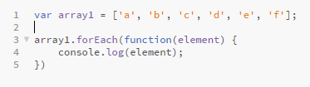
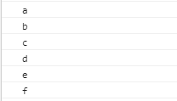
Code Example – For Each Loop
Code
Output:

Slide 5
Conditional Statements
A section of code that will conditionally execute
Keywords: if, else if, else
== does type conversion for you (I.E. it will convert the character ‘1’ to the int 1 if comparing to an integer
=== does NOT do type conversion. (I.E. if you’re comparing the character ‘1’ and the int 1, it will NOT be considered equal, where as with == it would be
!= means not equal, with type conversion
!== means not equal, without type conversion
Other operators include >, >, >=, <=, etc.
You can also check for if a variable has a value by just inputing the variable name with no compare operator. I.E. (if(value) …)

Slide 6
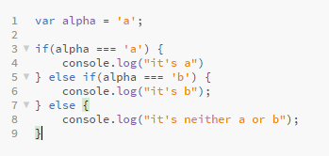
Code Example – conditional Statement
Code
Output:

Slide 7
Functions
Functions are a very important part of Javascript
Not only are they recommended for repeated code, they are also required when executing some of the built in functionality of Javascript.
I.E. with the for each loop, we created a function to run the loop
Because of this, you will see function built “on the fly” as well as declared
Functions can also be declared without using the “function” keyword, using the fat arrow ES6 syntax: () => {}
I.E. (test) => { console.log(test);}

Slide 8
Code Example – “on the fly” function
Code
Output:
Note how a function is created and ran, but is never stored.

Slide 9
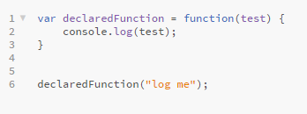
Code Example – Stored function
Code
Output:

Slide 10
Variables
Variables are declared using the keyword “var”
Variables can then be set to anything: functions, strings, characters, integers, etc.
You cannot declare the type of the variable, the type is set by checking the right hand side of the equals operator.

Slide 11
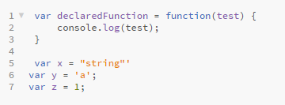
Code Example – Stored function
Code

Slide 12
Parameters
Parameters are variables or hard coded objects that are passed to a function
Parameters are statically typed. Meaning the type will need to be verified before using it as a specific type.
I.E. if you’re expecting a date variable, you must check the variable is a date before calling date functions on it.

Slide 13
Arrays
Arrays allow you to store multiple objects in a single variable
Arrays are setup the same as other variables using the var keyword
The right hand side will need square brackets [] around the data.
Adding to an array can be done in two ways
Using the push method: array.push(obj);
Getting the length of the array and passing it as the index: array[array.length] = obj;

Slide 14

Code Example – Arrays
Code

Slide 15
Associate Array s
In JavaScript you can also create arrays that aren’t indexed in the standard way. This is called an associate array
This stored key value pairs
JavaScript does NOT support named indexes. I.E array[“bob”] = 23
This syntax will turn the array into an object, instead of an array

Slide 16
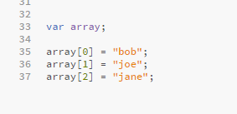
Code Example – Arrays
Code

