Slide 1
AJAX
CIT 261 – Ryan Dockstader

Slide 2
What is AJAX?
AJAX is an acronym for Asynchronous JavaScript and XML
While XML is used in the acronym, and in the object to create an AJAX call, it also allows for JSON
AJAX is the standard way of getting data from a server (on the same domain as the site, or otherwise) without reloading the page

Slide 3
Where is AJAX used
Anywhere that you receive new data/submit data without the page refreshing
Angular, React, Vue.js, etc
Google Docs, Google Drive, Word Online, Etc.

Slide 4
How to make an AJAX Call in Vanilla JS
JavaScript has an object class, called XMLHttpRequest built into the language for making AJAX requests.
https://developer.mozilla.org/en-US/docs/Web/API/XMLHttpRequest
https://www.w3schools.com/xml/ajax_intro.asp

Slide 5
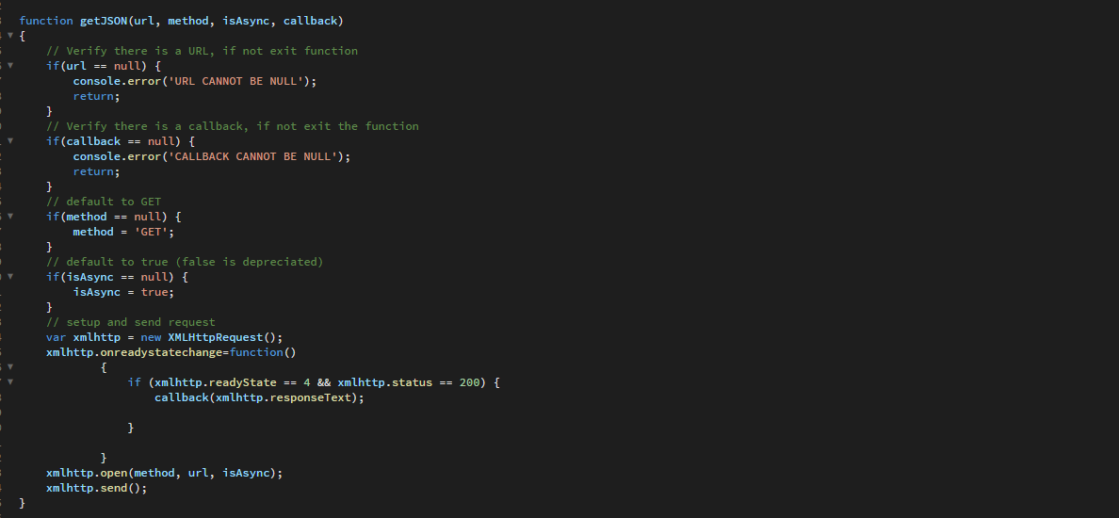
The Code

Slide 6
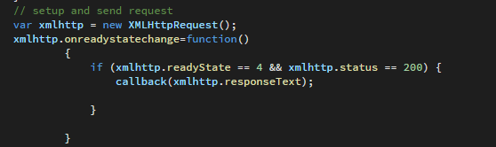
The Code - Breakdown
Setup the XMLHttpRequest Variable
Set the onreadystatechange function
This is called each time the state is changed
When ready state is 4, and status is 200 responseText is the JSON or XML that was pulled back

Slide 7

The Code - Breakdown
The open function prepares the request with the method (GET, POST, PUT, DELETE, etc), the URL, and if it is Async
Synchronous calls are depreciated, so isAsync should always be set to true.
Send makes the request.

Slide 8
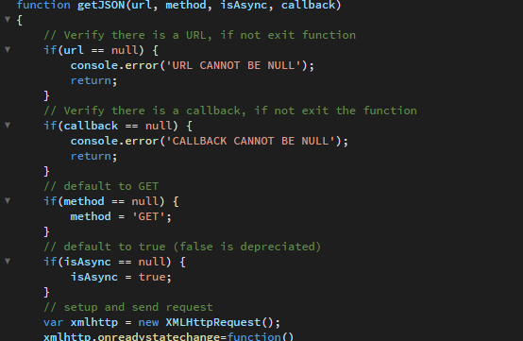
The Code - Extras
All this code is to just make life a little easier.

