Slide 1

SPAMBASE
Ulysse BERTHET
Tristan DARRIGOL

Slide 2
The dataset
Origin : archive.ics.uci.edu/ml/datasets/Spambase
Task : Classification : Spam / Non Spam
Number of instances : 4601
Attributes : 57 floats, 1 class

Slide 3
Attributs
48 continuous real [0,100] attributes of type word_freq_WORD in %
6 continuous real [0,100] attributes of type char_freq_CHAR in %
3 continuous real [1,...] attribute :
- Average length of uninterrupted sequences of capital letters
- Length of longest uninterrupted sequence of capital letters
- Total number of capital letters in the e-mail
1 nominal {0,1} class attribute of type spam :
For words in :
For char in :
1 = Spam
0 = Non Spam
['make', 'address', 'all', '3d', 'our', 'over', 'remove', 'internet', 'order', 'mail', 'receive', 'will', 'people', 'report', 'addresses', 'free', 'business', 'email', 'you', 'credit', 'your', 'font', '000', 'money', 'hp', 'hpl', 'george', '650', 'lab', 'labs', 'telnet', '857', 'data', '415', '85', 'technology', '1999', 'parts', 'pm', 'direct', 'cs', 'meeting', 'original', 'project', 're', 'edu', 'table', 'conference’]
[';', '(', '[', '!', '$', ‘#’]

Slide 4
Data exploration
39% of the emails are spams
No outliers or missing values

Slide 5
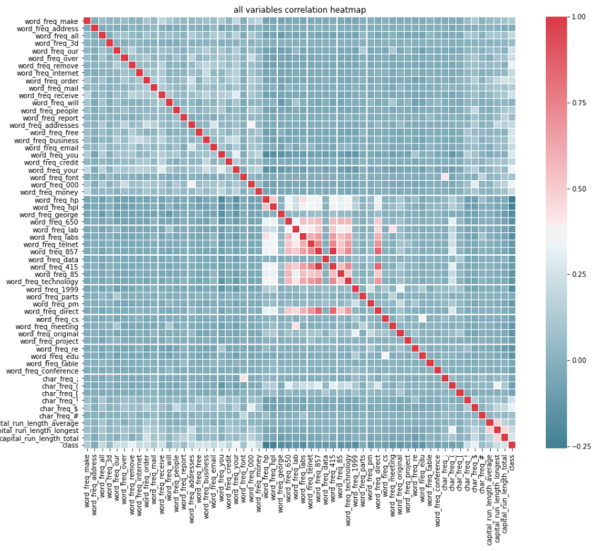
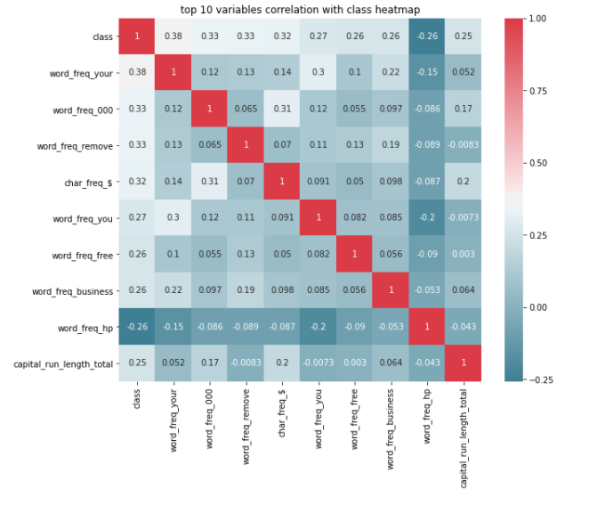
Variables correlation

Slide 6
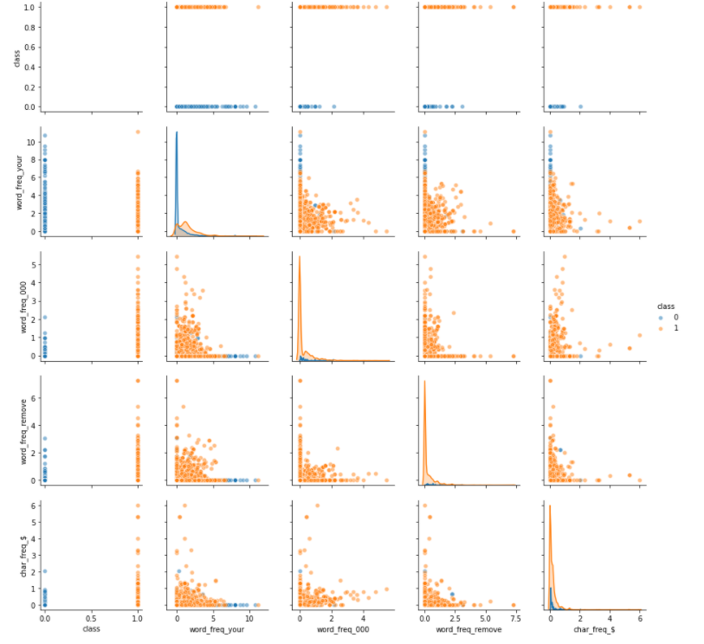
Pair plot Top 4

Slide 7
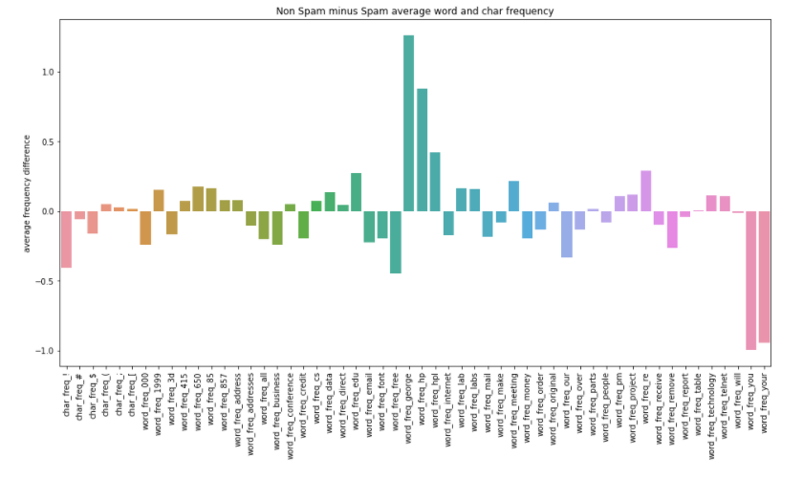
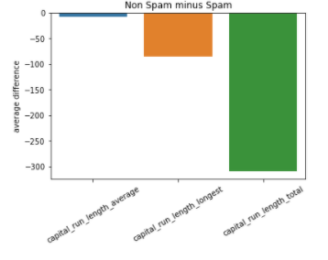
Spam vs non spam average word frequency
Word and Char average frequency difference :
The words "you" and "your" are fare more frequent in spam emails than in non spam.
The words "george" and "hp" are fare more frequent in non spam emails than in spam.
Interpretation : spamer don't know your name and call you "you" instead of your name (George ?)
Capital average difference:
Capital letters are far more used in spam emails

Slide 8
Email to vector converter
Raw email :
«You have won 1 MILLION $, please send you ADDRESS !! »
To test raw emails with our model
Takes a raw email (string) in input
Calculates the word and char frequencies using regex
Calculates the variables about capital letters using regex
Output a vector that can be interpreted by our model
Email vectoriser
Vectorized email :
[0.0, 11.11111111111111, 0.0, 0.0, 0.0, 0.0, 0.0, 0.0, 0.0, 0.0, 0.0, 0.0, 0.0, 0.0, 0.0, 0.0, 0.0, 0.0, 22.22222222222222, 0.0, 0.0, 0.0, 0.0, 0.0, 0.0, 0.0, 0.0, 0.0, 0.0, 0.0, 0.0, 0.0, 0.0, 0.0, 0.0, 0.0, 0.0, 0.0, 0.0, 0.0, 0.0, 0.0, 0.0, 0.0, 11.11111111111111, 0.0, 0.0, 0.0, 0.0, 0.0, 0.0, 22.22222222222222, 11.11111111111111, 0.0, 5.333333333333333, 11, 16]
Classifier model
Classiffied email :
[1] : Spam

Slide 9
API :
Input :
Request to the api must have the following Json format :
For vectorized data :
data = [1,[X1,X2,...] = [1,[[x1i]*57,[x2i]*57,...]
data = [0,["raw email text 1","raw email text 2",... ]]
data[0]=0 if it is a list of raw emails, data[0]=1 if it is a list of vector compatible with the model
Output :
The api will return data in the following format :
[p1,p2,...]
with pn the prediction for the n th element
with every xni corresponding to a columns of Xn
For raw email data :
data[0] is a flag to know if the data is a row emails or a vector :

