Slide 1

SPAMBASE
Ulysse BERTHET
Tristan DARRIGOL

Slide 2
The dataset
Origin : archive.ics.uci.edu/ml/datasets/Spambase
Task : Classification : Spam / Non Spam
Number of instances : 4601
Attributes : 57 floats, 1 class

Slide 3
Attributs
48 continuous real [0,100] attributes of type word_freq_WORD in %
6 continuous real [0,100] attributes of type char_freq_CHAR in %
3 continuous real [1,...] attribute :
- Average length of uninterrupted sequences of capital letters
- Length of longest uninterrupted sequence of capital letters
- Total number of capital letters in the e-mail
1 nominal {0,1} class attribute of type spam :
For words in :
For char in :
1 = Spam
0 = Non Spam
['make', 'address', 'all', '3d', 'our', 'over', 'remove', 'internet', 'order', 'mail', 'receive', 'will', 'people', 'report', 'addresses', 'free', 'business', 'email', 'you', 'credit', 'your', 'font', '000', 'money', 'hp', 'hpl', 'george', '650', 'lab', 'labs', 'telnet', '857', 'data', '415', '85', 'technology', '1999', 'parts', 'pm', 'direct', 'cs', 'meeting', 'original', 'project', 're', 'edu', 'table', 'conference’]
[';', '(', '[', '!', '$', ‘#’]

Slide 4
Data Informations
39% of the emails are spams
No outliers
No missing values

Slide 5
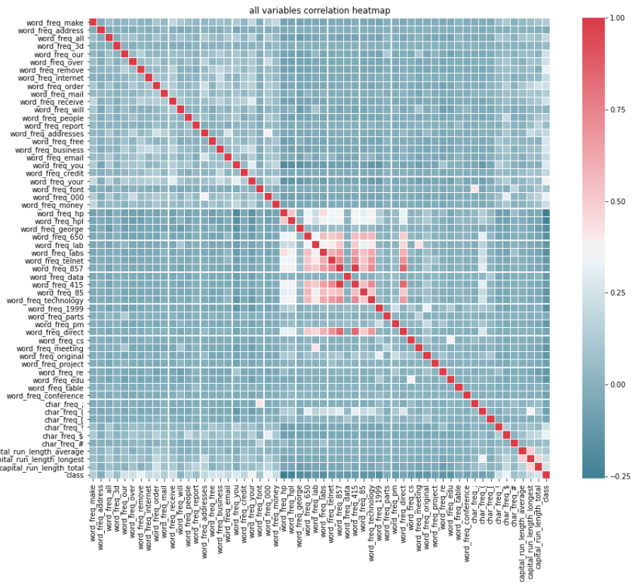
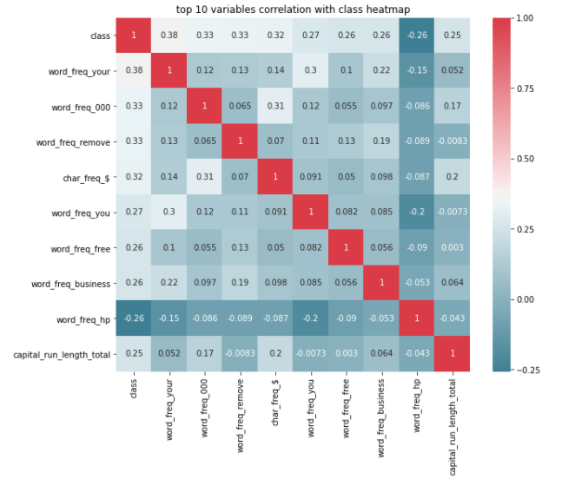
Variables correlation
« your », « 000 », « remove », « $ », « you », « free », « business » and total number of capital letters have the highest positive correlation with the email being a spam
« hp » has the highest correlation with the email not being a spam
Their is no strong correlation between one variable and the email being a spam or not (all <0.38)

Slide 6
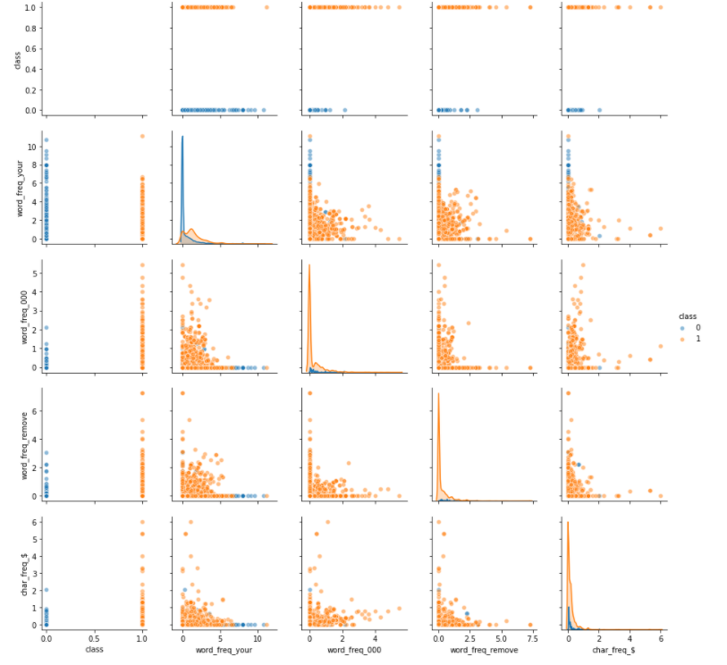
Pair plot Top 4 most correlated variables
“your” is more present in non spam at lower frequency. It often appears once or less. In spam it appears more than once.
“000”, “remove” and “$” appear more in spam at all frequencies.

Slide 7
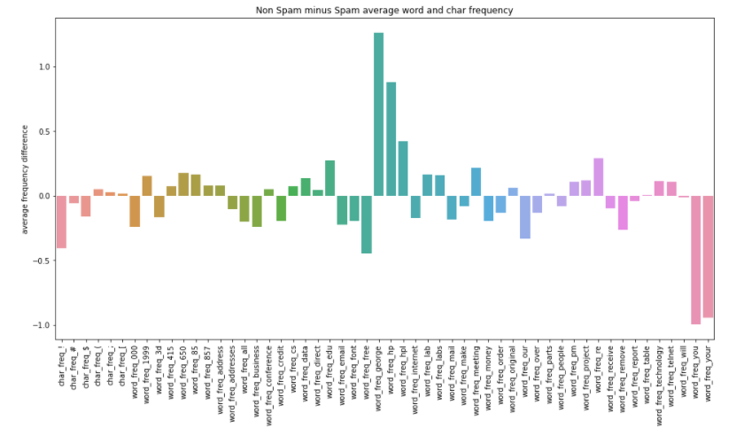
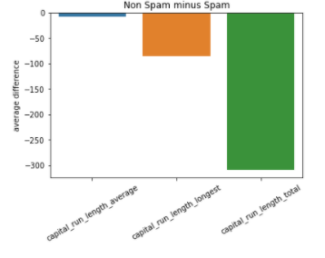
Spam vs non spam average word frequency
Word and Char average frequency difference :
The words "you" and "your" are fare more frequent in spam emails than in non spam.
The words "george" and "hp" are fare more frequent in non spam emails than in spam.
Interpretation : spamer don't know your name and call you "you" instead of your name (George ?)
Capital average difference:
Capital letters are far more used in spam emails

Slide 8
Email to vector converter
Raw email :
«You have won 1 MILLION $, please send you ADDRESS !! »
To test raw emails with our model
Takes a raw email (string) in input
Calculates the word and char frequencies using regex
Calculates the variables about capital letters using regex
Output a vector that can be interpreted by our model
Email vectoriser
Vectorized email :
[0.0, 11.11111111111111, 0.0, 0.0, 0.0, 0.0, 0.0, 0.0, 0.0, 0.0, 0.0, 0.0, 0.0, 0.0, 0.0, 0.0, 0.0, 0.0, 22.22222222222222, 0.0, 0.0, 0.0, 0.0, 0.0, 0.0, 0.0, 0.0, 0.0, 0.0, 0.0, 0.0, 0.0, 0.0, 0.0, 0.0, 0.0, 0.0, 0.0, 0.0, 0.0, 0.0, 0.0, 0.0, 0.0, 11.11111111111111, 0.0, 0.0, 0.0, 0.0, 0.0, 0.0, 22.22222222222222, 11.11111111111111, 0.0, 5.333333333333333, 11, 16]
Classifier model
Classiffied email :
[1] : Spam

Slide 9
API :
Input :
Request to the api must have the following Json format :
data = [1,[X1,X2,...] = [1,[[x1i]*57, [x2i]*57, ... [xni]*57]
data = [0,["raw email text 1", "raw email text 2", ... ]]
data[0]=0 if it is a list of raw emails, data[0]=1 if it is a list of vector compatible with the model
Output :
The api will return data in the following Json format :
[p1,p2,...]
data[0] is a flag to know if the data is a row emails or a vector :
For raw email data :
For vectorized data :
with every xni corresponding to a columns of Xn
with pn the prediction for the n th element
Created using Flask

