Slide 1
MITOSIS Monday, 8:40. Sofie inherits Brouwerij Van Dessel.
Three documents. Three answers.
“Which indexation applies in January?”
Forecast
Final figure
Company agreement
Pro-Pay, 14 Oct
Agoria, 22 Dec
Van Dessel CAO + Teams
2.13%
2.21%
February
Her search finds all three. Nothing tells her which one to trust.
Notes:
Sofie just inherited the Brouwerij Van Dessel portfolio, and the first client question is already waiting: what indexation in January? Her search finds three documents and a Teams message. They say 2.13%, 2.21% and 'February'.

Slide 2
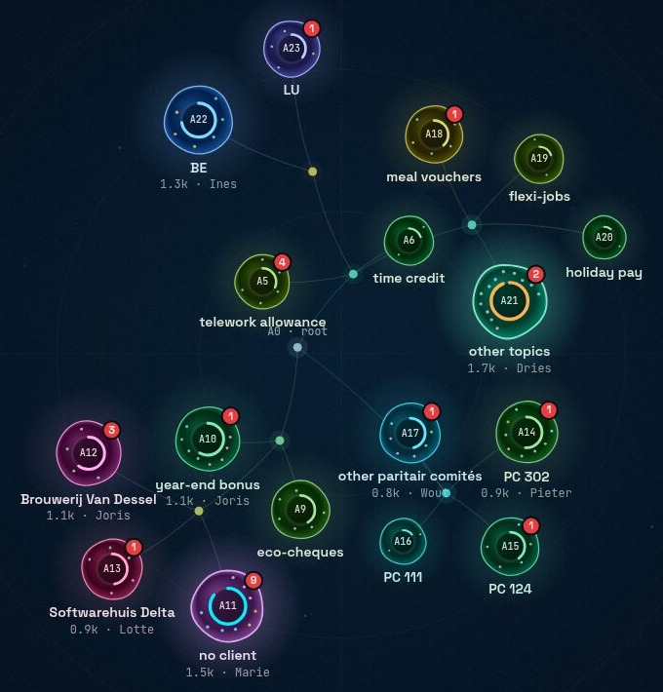
02 THREE WAYS TO HOLD KNOWLEDGE
Dead, connected, alive.
Dead
Connected
Alive
Classic AI search
Knowledge graph
Mitosis
Blends chunks into one confident answer. A forecast looks as relevant as the final figure.
Someone has to draw the map and keep it current. It goes stale the week after.
Divides itself as it reads, and catches the contradiction before anyone asks.
Notes:
Classic AI search retrieves a handful of chunks and blends them into one confident answer: a forecast looks exactly as relevant as the final figure. A knowledge graph connects things, but somebody has to draw that map and keep it current. So we built something that reads everything first. It starts as one agent, and when it knows too much to keep in mind at once, it divides like a cell.

Slide 3
03 HOW IT WORKS
It reads first, so you don’t have to search.
1
3
4
5
2
Read
Divide
Catch
Tell the owner
Verified
every document, chat and ticket
by joint committee, client, country
specialists see their whole domain
Jan settles it in one click
everyone gets the green answer
85% of routing is rules and vector math, no LLM call. Facts are extracted once, when a document arrives.
Notes:
It splits by joint committee, by client and by country, and it writes down why. Nobody drew this map by hand. Each specialist keeps its whole domain in view, so it notices when two sources disagree while it is still reading. Here it's a forecast of 2.13% against the final 2.21%. The swarm sends Jan, who owns PC 200, only the questions he can settle, and shows what they affect: one client config still uses the old number. He confirms it, and from then on everyone gets the verified answer.

Slide 4
04 DOES IT WORK
Tested on 102 documents with planted traps.
Answer accuracy, 18 golden questions
19/21
0
78% vs 61%
contradictions caught
client data leaks
planted in the corpus; plain RAG: 0
access control before retrieval
Mitosis
14/18
0 vs 1
85%
Plain RAG
11/18
prompt-injection leaks
of routing without an LLM call
Mitosis vs plain RAG
rules + local embeddings
Security Signed tokens, role checks on every route, per-client views (no IDOR), injections quarantined, PII redacted at ingest.
Notes:
We tested it on 102 documents with 21 planted contradictions. Mitosis answered 78% of the golden questions correctly, against 61% for a plain chatbot on the same documents. It surfaced 19 of the 21 contradictions before anyone asked. Client data stays with the client: zero leaks. And a document that tries to give the AI instructions gets quarantined; the plain chatbot followed it once. 85% of routing needs no AI call at all.

Slide 5
05 WHY SD WORX, WHY NOW
The trust layer under SD Worx’s agents.
ROLLOUT
SD Worx AI agents
agentic payroll, since June 2026
PC 200 team
one joint committee, one team
Mitosis
All joint committees
which answer to trust, and who owns it
Belgium
27 countries
Documents, Teams, tickets, client configs
every SD Worx payroll desk
the knowledge as it really is
mysdworx
client HR admins, same verified answers
Find it. Understand it. Trust it.
Notes:
In June 2026 SD Worx put its payroll consultants on AI agents that retrieve knowledge. More AI answers means more answers that sound sure and are wrong. We start with one joint committee and one team, PC 200, then all joint committees, then the 27 countries, then client-facing inside mysdworx. SD Worx already has agents that find information. Mitosis is what lets people trust what they find. Find it. Understand it. Trust it.

