Slide 1
P04 - TradeUp
Stock Trading Simulator
M. Umar Zubair
M. Shahmir Qazi
M. Rayyan Khan
M. Ahmad
M. Raiyaan Junaid Hamid

Slide 2
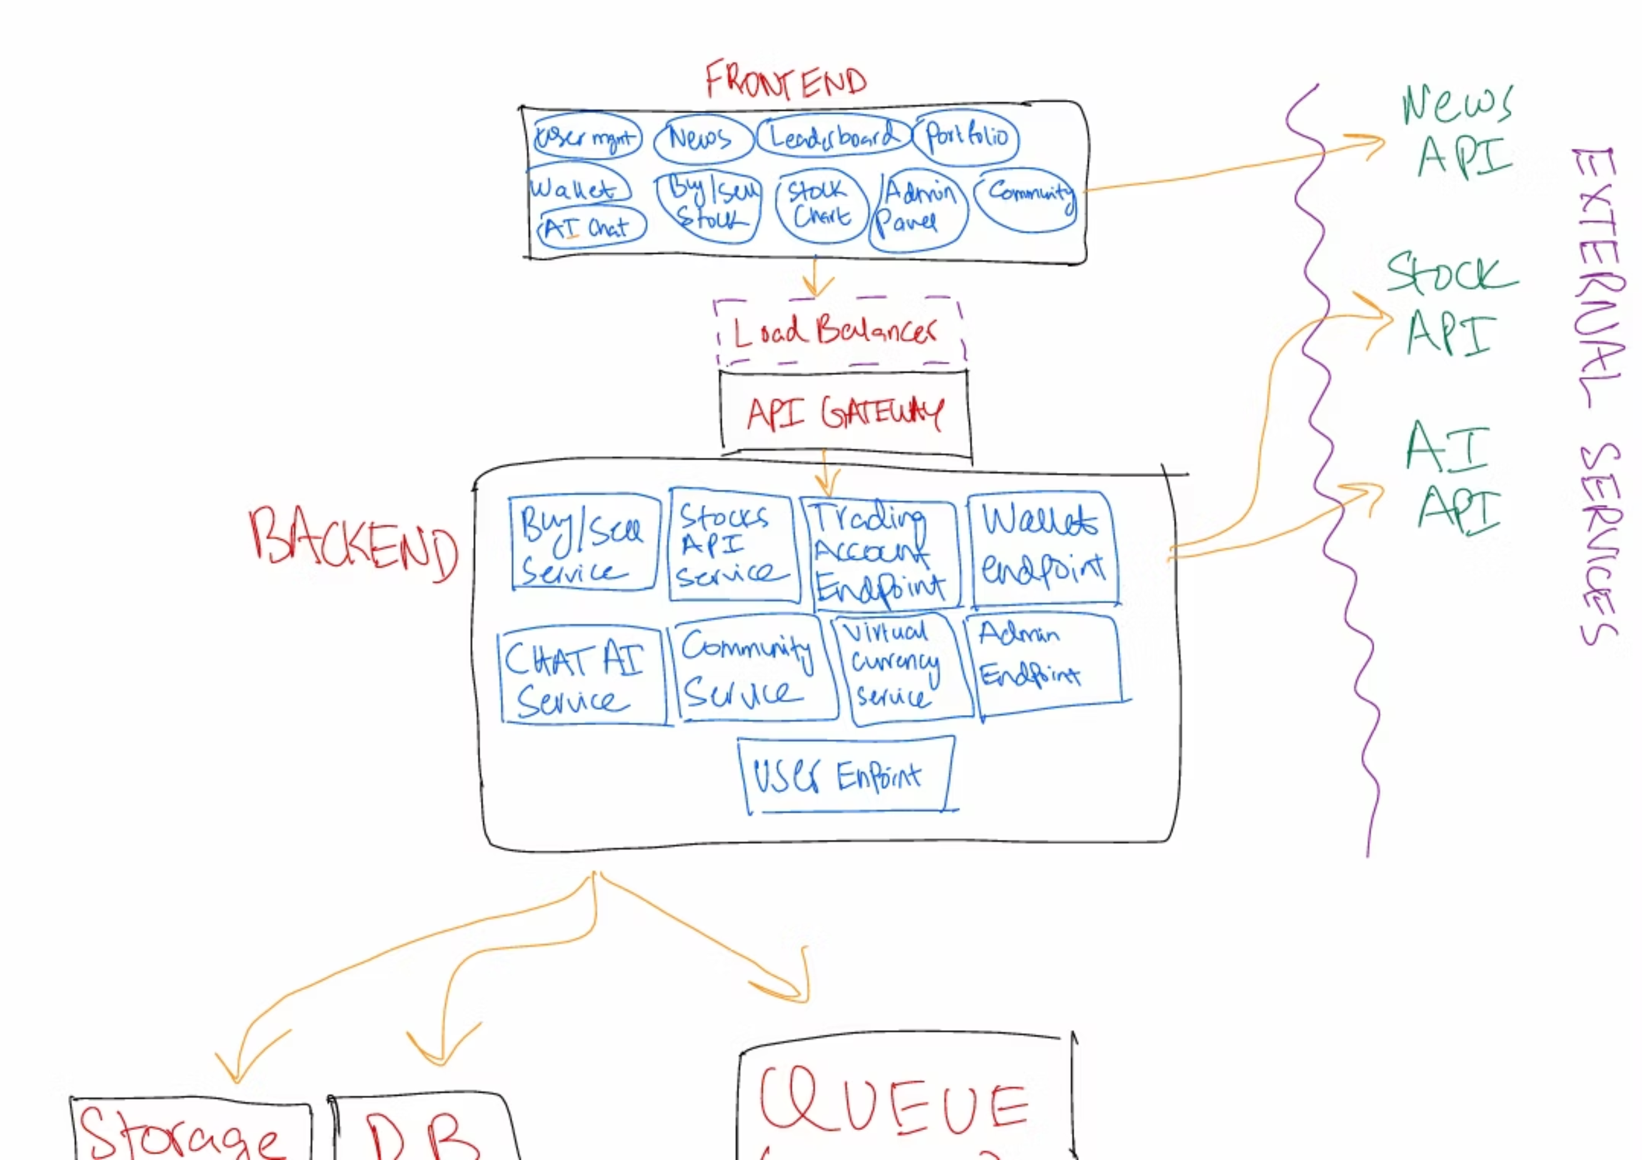

Slide 3
System Architecture
MVC
Frontend:
Candle-Stick/Stocks View
Portfolio View
News Information
The main component that displays information on all stocks in a candlestick view and other details interacts with the buy/sell service in the backend, initiating buy/sell orders, and communicates with the stocks API to retrieve stock information.
Displays users' purchased stocks and favourite stocks, interacting with the database through the backend using basic CRUD operations.
Shows daily important news fetched through the news api. This directly calls the api, but the content is cached in a Redis DB for faster fetch and fewer API calls
Leaderboard View
Community View
Wallet
Tracks and displays top users based on trading performance or achievements.A single user’s rank, score, and performance stats on a leaderboard.
Forums to interact with other users on the app
Allows user to add virtual credits to their trading account/app account through the virtual currency service
Admin View
User Account Management View
Authentication View
A specialized user with elevated privileges to manage users, content, and system functions.
Represents a platform user with personal info, login credentials, subscription type, and activity tracking
Login/Signup System interacts directly with the backend /DB to authenticate the user

Slide 4
Backend:
1
User Service
Manages user registration, authentication, and profiles. Handles account creation, login, password
resets, and subscription upgrades, interacting directly with the database and authentication tokens.
2
Trading Service
Handles virtual trading operations such as executing buy/sell orders, updating balances, and
calculating portfolio performance. Communicates with the Market Data Service and User Service.
3
Market Data Service
Fetches and updates real-time and historical stock data through external APIs. Caches prices and
market info for efficient retrieval by trading-related services.
4
AI & Analytics Service
Provides market insights, trade recommendations, and sentiment analysis based on user behavior and
news data. Integrates with the Chat Service and Market Data Service.

Slide 5
5
Leaderboard Service
Tracks achievements and leaderboards. Updates user rankings and rewards, interacting with the User
and Notification Services.
6
Payment Service
Manages subscription billing, in-app currency purchases, and refunds. Connects securely with third-party
payment gateways and updates user balances.
7
Notification Service
Sends alerts and reminders for trades, portfolio updates, achievements, and system messages. Uses
queues and schedulers for reliable delivery.
8
Chat & Communication Service
Handles user and AI chat sessions, storing message history and conversation state. Integrates with
the AI & Analytics Service for intelligent responses.

Slide 6
Implementation of Non-Functional Requirements in Architecture
Memory Efficiency (Under 4 GB)
Each ECS container has defined memory limits, ensuring the total resource allocation stays below 4 GB.
Aurora Serverless and S3 handle large data offloading from in-memory storage, keeping runtime memory usage minimal.
Redis caching (for stock prices and news data) minimizes repetitive API calls, improving efficiency.
High Availability (99% Uptime, ≤2 Failures/Day)
AWS Route 53 provides DNS-level failover and routing between healthy instances.
ALB + ECS ensures auto-healing and blue-green deployments.
API Gateway and load balancers distribute traffic evenly, preventing bottlenecks.
Aurora Serverless offers automatic failover and scaling, ensuring database continuity.
Recovery time objective (RTO) under 15 minutes achieved using ECS restart policies and CloudWatch alarms for
service failures.
Maintainability & Modularity
Each service (e.g., Buy/Sell Service, Community Service, Chat AI Service) is developed, deployed, and updated independently.
Microservice modularity aligns with clean code principles, reducing coupling and promoting single-responsibility design.
Rolling updates and CI/CD pipelines (e.g., CodePipeline or GitHub Actions) ensure minimal downtime during deployments.

Slide 7



Implementation of Security Features in Architecture
A01:2021 – Broken Access Control
A02:2021 – Cryptographic Failures
A03:2021 – Injection
Risk: SQL/Command injection leading to data corruption.
Risk: Unauthorized access to data or admin actions.
Risk: Data leakage, secrets loss, or MITM attacks.
Mitigation via Architecture: Services use parameterized queries via ORM (e.g., SQLAlchemy, Prisma). API Gateway sanitizes input before routing. Input validation enforced on backend microservices.
Mitigation via Architecture: “Deny by default” access policy implemented via API Gateway & IAM roles. JWT-based authentication on all endpoints ensures only verified access.
Mitigation via Architecture: Secrets Manager stores credentials and API keys securely. All communications over HTTPS/TLS. Aurora encrypts data at rest and in transit.

