Slide 1
Amazon Sales Data Report

Slide 2
Introduction
The analysis delves into Amazon sales data sourced from Kaggle.com, encompassing 3204 rows and 10 columns. The dataset provides insights into various facets of Amazon sales, including order dates, shipping details, product categories, sales figures, and customer demographics. The purpose of this analysis is to uncover trends, patterns, and actionable insights to inform strategic decision-making.

Slide 3
Data Overview
The dataset comprises 3204 rows and 10 columns, capturing individual sales transactions. Key columns include Order_id, Order Date, Ship Date, Email_ID, Geography, Category, Product Name, Sales, Quantity, and Profit.

Slide 4
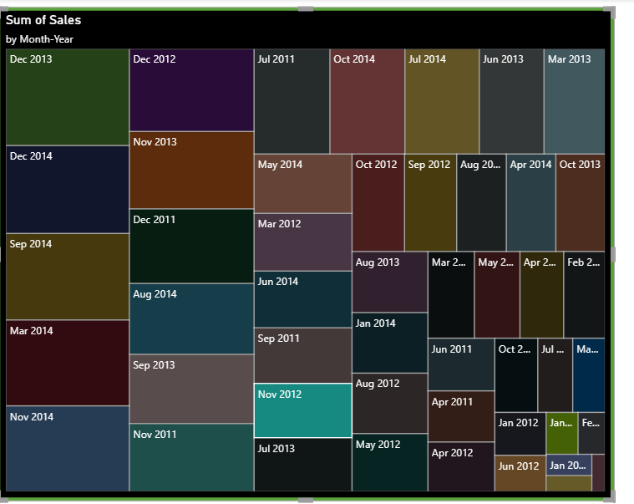
Key Findings and Insights: Sales Trends Over Time:
Analysis of monthly sales trends reveals seasonal variations, with December 2013 recording the highest total sales and February 2011 the lowest

Slide 5
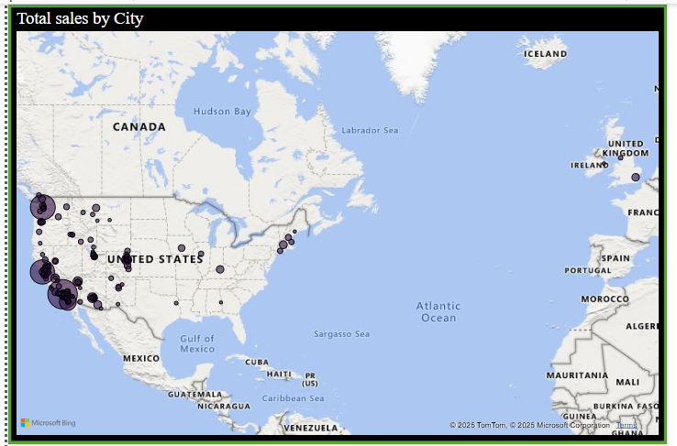
Geographical Analysis:
California leads in total sales, with cities like Los Angeles and San Francisco contributing significantly.

Slide 6
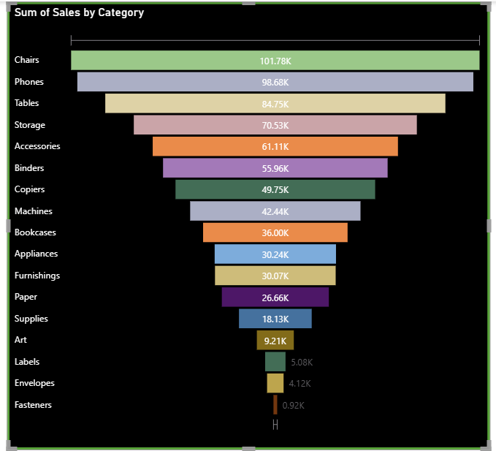
Product Category Analysis:
Chairs emerge as the top-selling category, followed by Phones and Tables and fasteners are low-selling category.

Slide 7
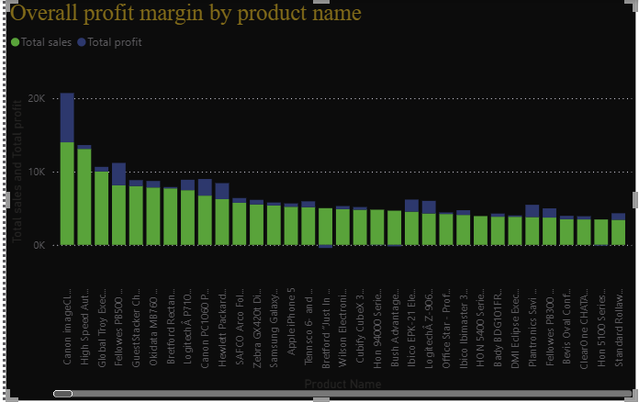
Product Performance:
The Canon image CLASS 2200 Advanced Copier emerges as the top-performing product in terms of total sales and profit.

Slide 8
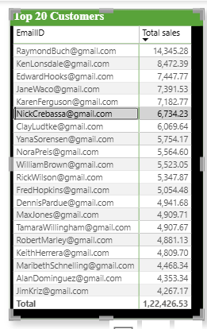
Customer Analysis:
RaymondBuch@gmail.com stands out as a top customer with significant total orders and sales in Washington.

Slide 9
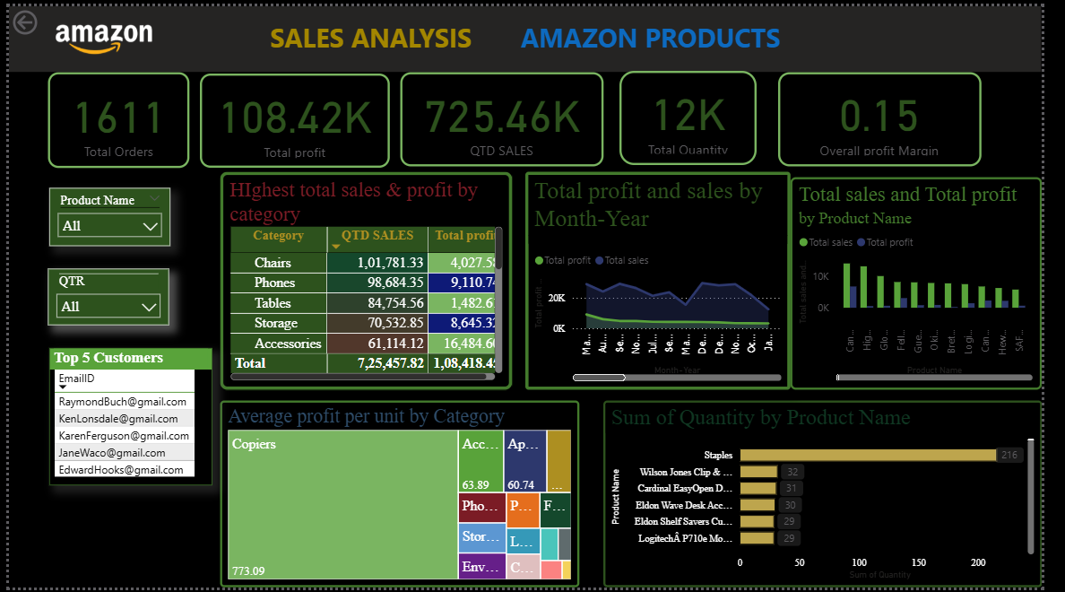
Dashboard

Slide 10
Conclusion:
In conclusion, the analysis of Amazon sales data has provided valuable insights into sales trends, product performance, and customer behavior. By leveraging these insights, Amazon can make informed decisions to optimize its sales strategy, enhance operational efficiency, and drive sustainable growth. As Amazon continues to innovate and evolve, harnessing the power of data-driven insights will be instrumental in shaping its future success and maintaining its position as a leader in the global marketplace

