Slide 1
SAYEH PROCESSOR

Slide 2

Contents
Introduction .
Components and its description
Instruction format
Instruction set
Datapath
Hierarchical Structure
Alu operations
Controller
2

Slide 3
INTRODUCTION
4
The CPU is simple architecture, yet enough hardware (SAYEH) that has been designed for educational and benchmarking purposes.
The simple CPU example discussed here has a register file that is used for data processing instructions.
The CPU has a 16-bit data bus and a 16-bit address bus.
The processor has 8 and 16-bit instructions.

Slide 4
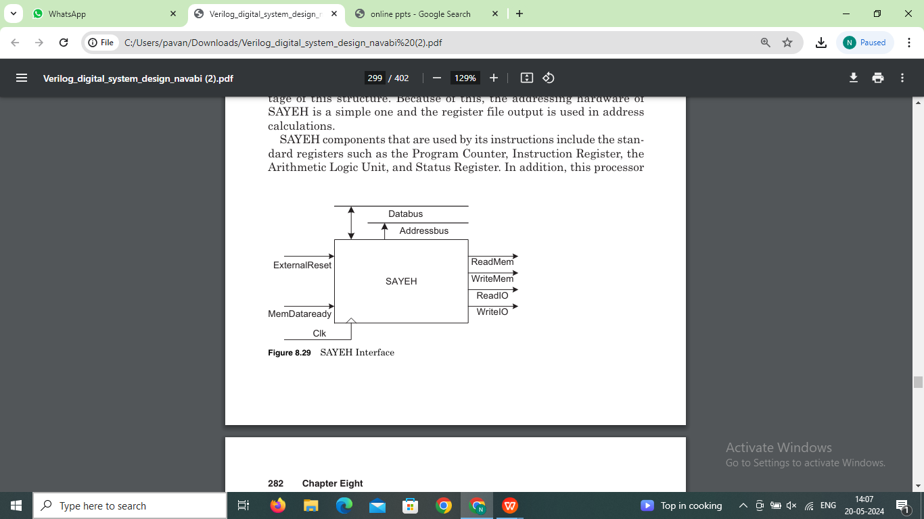
SAYEH Processor Interface Signals are as Follows:
4

Slide 5
CPU Components
SAYEH components that are used by its instructions includes:
Standard Registers
Program Counter
Instruction Register
Arithmetic Logic Unit
Status Register
Window Pointer

Slide 6
Description
CPU components and a brief description of each are shown below:
PC. Program Counter, 16 bits
R0, R1, R2, and R3. General purpose registers part of the register file, 16 bits.
Reg file. The general purpose registers form a window of 4 in a register file of 8 registers
WP. Window Pointer points to the register file to define R0, R1, R2, and R3, 3 bits
IR. Instruction Register that is loaded with a 16-bit, an 8-bit, or two 8-bit instructions, 16 bits
ALU. The ALU that can AND, OR, NOT, Shift, Compare, Add, Subtract, and Multiply its inputs, 16 bit operands
Z flag. Becomes 1 when the ALU output is 0
C flag. Becomes 1 when the ALU has a carry output

Slide 7
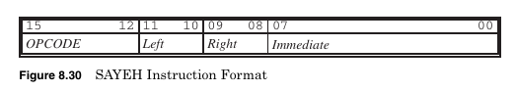
The general format of 8-bit and 16-bit SAYEH instructions is shown below:
SAYEH Instruction Format:
The 16-bit instructions have the Immediate field and the 8-bit instructions do not.
The OPCODE filed is a 4-bit code that specifies the type of instruction.
The Left and Right fields are two bit codes selecting R0 through R3.
Usually, Left is used for destination and Right for source.
The Immediate field is used for immediate data.

Slide 8
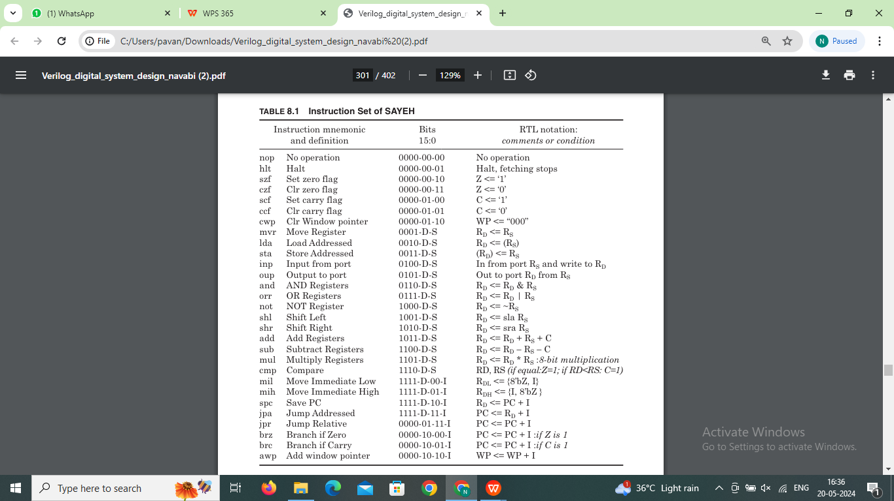
Instruction Set:-
Processor has a total of 29 instructions as shown :

Slide 9
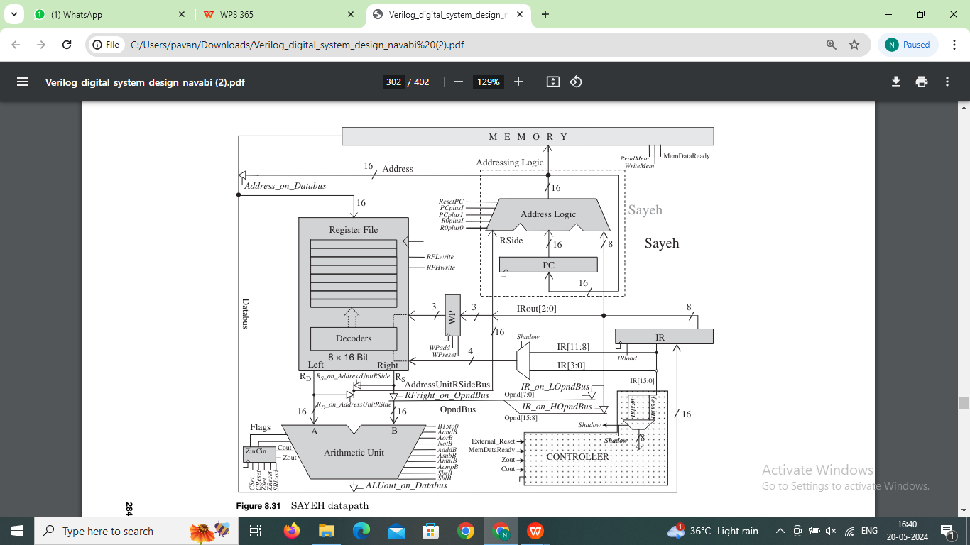
Datapath:
The Datapath of SAYEH is:

Slide 10
Main components and their lower-level structures are listed below:
Addressing Unit
Program counter (PC)
Address Logic
Instruction register (IR)
Window pointer (WP)
Register File
Arithmetic logic unit (ALU)
Flags

Slide 11
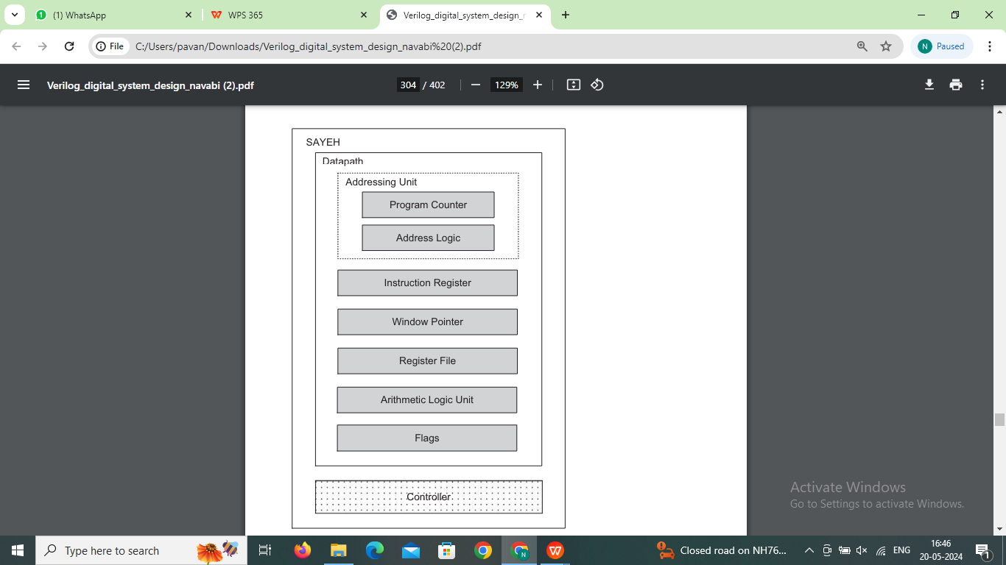
Hierarchical Structure.
Hierarchical structure of SAYEH components:

Slide 12
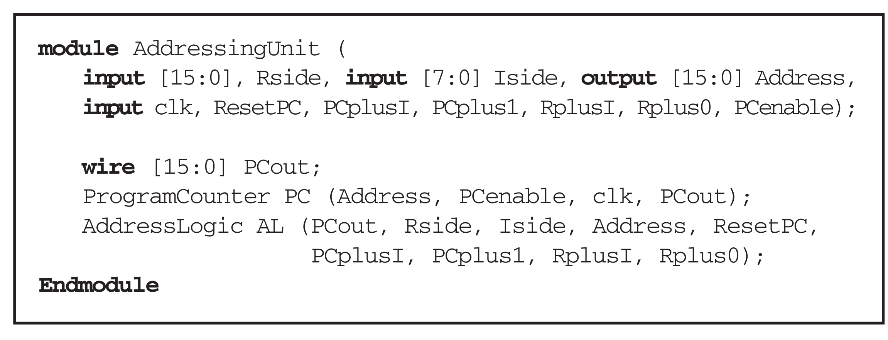
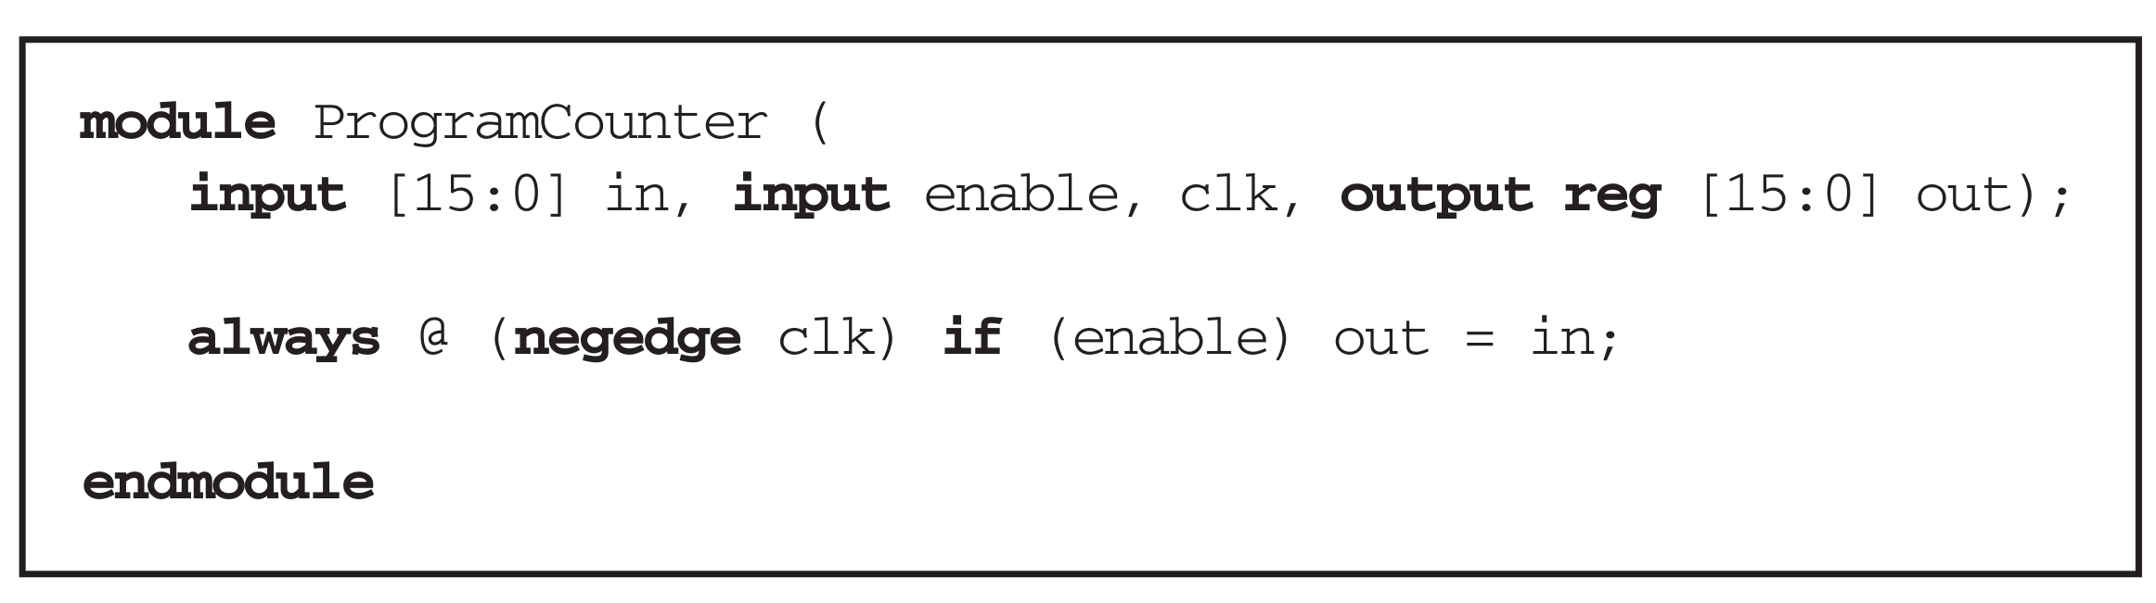
Addressing unit:
As Shown in Hierarchical structure Addressing Unit consists of the PC and Address Logic.

Slide 13
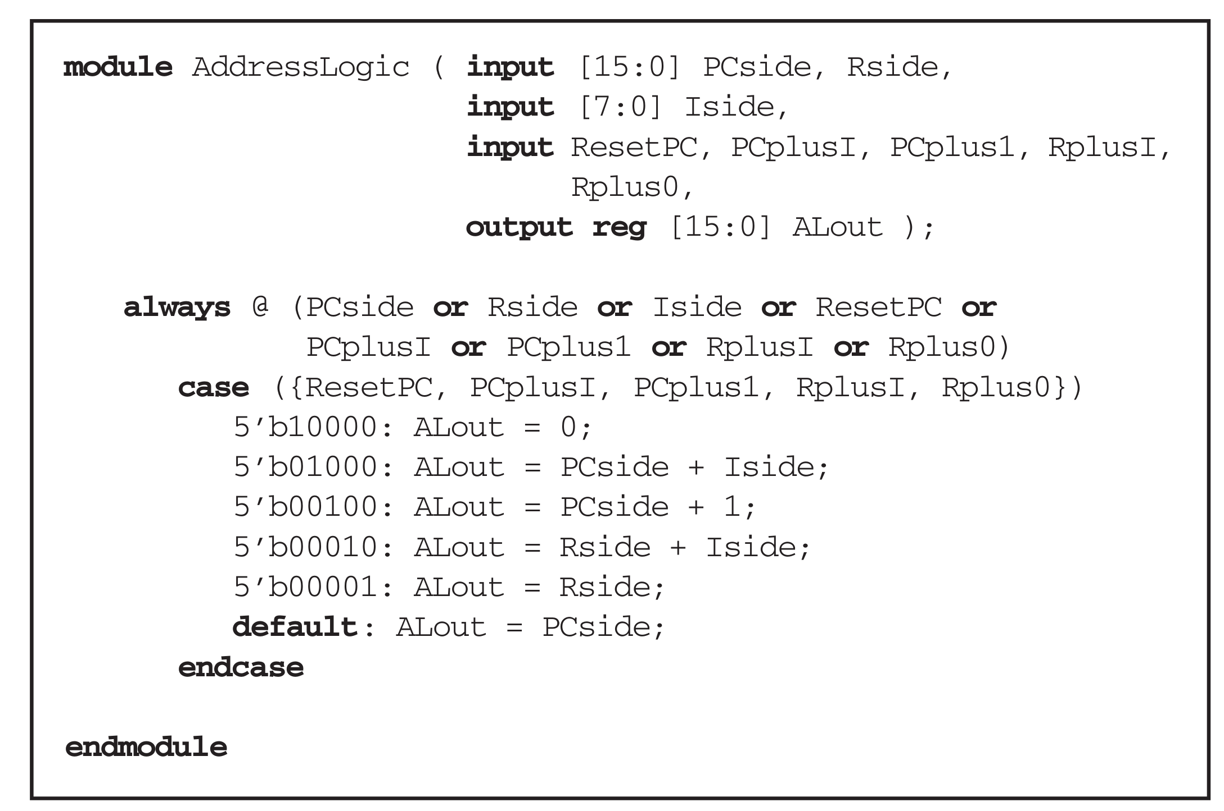

Slide 14
Arthmetic Unit verilog code:
`define B15to0H 10’b1000000000
`define AandBH 10’b0100000000
`define AorBH 10’b0010000000
`define notBH 10’b0001000000
`define shlBH 10’b0000100000
`define shrBH 10’b0000010000
`define AaddBH 10’b0000001000
`define AsubBH 10’b0000000100
`define AmulBH 10’b0000000010
`define AcmpBH 10’b0000000001
module ArithmeticUnit ( A, B,
B15to0, AandB, AorB, notB, shlB, shrB, AaddB, AsubB,
AmulB, AcmpB, aluout, cin, zout, cout);
input [15:0] A, B;
input B15to0, AandB, AorB, notB, shlB, shrB,
AaddB, AsubB, AmulB, AcmpB;
input cin;
output [15:0] aluout;
output zout, cout;
reg [15:0] aluout;
reg zout, cout;

Slide 15
continue...
always @( A or B or B15to0 or AandB or AorB or notB or shlB or
shrB or AaddB or AsubB or AmulB or AcmpB or cin)
begin
zout = 0; cout = 0; aluout = 0;
case ({B15to0, AandB, AorB, notB, shlB,
shrB, AaddB, AsubB, AmulB, AcmpB})
`B15to0H:aluout = B;
`AandBH: aluout = A & B;
`AorBH: aluout = A | B;
`notBH: aluout = ~B;
`shlBH: aluout = {B[15:0], B[0]};
`shrBH: aluout = {B[15], B[15:1]};
`AaddBH: {cout, aluout} = A + B + cin;
`AsubBH: {cout, aluout} = A - B - cin;
`AmulBH: aluout = A[7:0] * B[7:0];
`AcmpBH: begin
aluout = A;
if (A> B) cout = 1; else cout = 0;
if (A==B) zout = 1; else zout = 0;
end
default: aluout = 0;
endcase
if (aluout == 0) zout = 1’b1;
end
endmodule

Slide 16
Registerfile verilog code.
module RegisterFile ( input [15:0] in,
input clk, RFLwrite, RFHwrite,
input [1:0] Laddr, Raddr, input [2:0] Base,
output [15:0] Lout, Rout );
reg [15:0] MemoryFile [0:7];
wire [2:0] Laddress = Base + Laddr;
wire [2:0] Raddress = Base + Raddr;
assign Lout = MemoryFile [Laddress];
assign Rout = MemoryFile [Raddress];
reg [15:0] TempReg;
always @(negedge clk) begin
TempReg = MemoryFile [Laddress];
if (RFLwrite) TempReg [7:0] = in [7:0];
if (RFHwrite) TempReg [15:8] = in [15:8];
MemoryFile [Laddress] = TempReg;
end
endmodule

Slide 17
Instruction register verilog code.
module InstrunctionRegister (in, IRload, clk, out);
input [15:0] in;
input IRload, clk;
output [15:0] out;
reg [15:0] out;
always @(negedge clk)
if (IRload == 1) out <= in;
endmodule

Slide 18
Controller:
Controller ports. The instruction register output, ALU flags, and external control
signals constitute the inputs of the controller.
The outputs of the controller are 36 control signals going to the Data Path.
A Shadow output that indicates that the controller is handling a shadow instrcution.
controller outputs are declared as reg and are assigned values in the combinational always block of the controller module.
Control states. A parameter declaration declares the eight states of the controller.
Eight states are reset,fetch,memread,exc1,exc2,exc1lda,exc2lda,incpc.

Slide 19
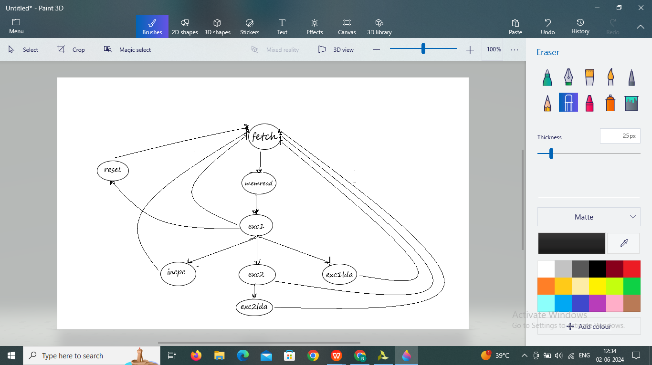
Controlpath.

Slide 20
State reset is the initial state of the machine and its halt state.
In state fetch the machine begins fetching a 16-bit instruction that can include
an 8-bit instruction and a shadow.
State memread is entered while our controller is waiting for Instruction
Execution of instructions is performed in the exec1 state. This state is entered from
the memread state.
The lda instruction is not completed by the exec1 state and requires the additional state of exec1lda to complete its memory read.
States exec2 and exec2lda are like exec1 and exec1lda except that they handle the shadow part of an instruction.
the incpc state increments the program counter.

Slide 21
Instructions and Schematic:
For Testing the Sayeh Processor the instructions we created are as follows:
@0 f60a
@1 210f
@2 fe0b
@3 3c0f
@4 b10f
Lets decode and understand the above instructions. “@0” implies at 0th location of the memory. These instruction are in hexadecimal format will convert into binary so that we can understand them easily. (f60a)₁₆ ➔ (1111-0110-0000-1010)₂ From the Opcode bits we can decode and identify it as the SPC (save PC) instruction. That is in this instruction we are actually adding the immediate data(0a) to the PC register value and storing the address in the R1 register. Likewise we can decode and understand the other instructions also.

Slide 22
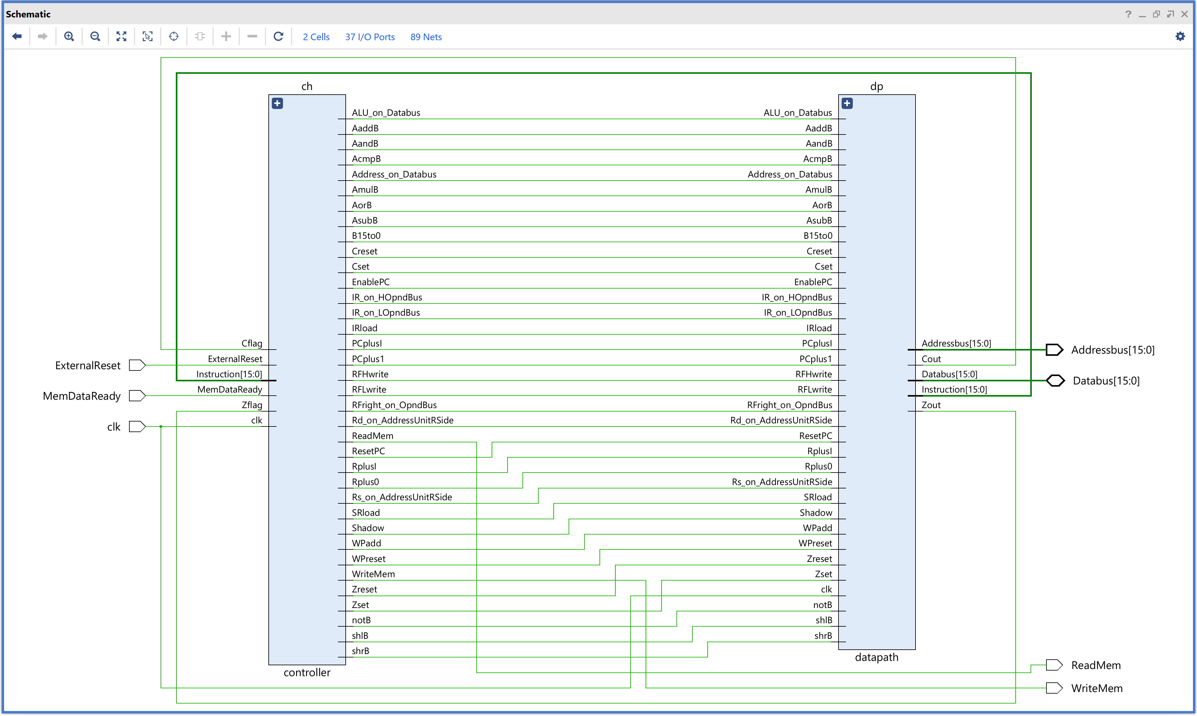
Schematic of Sayeh Processor:

Slide 23
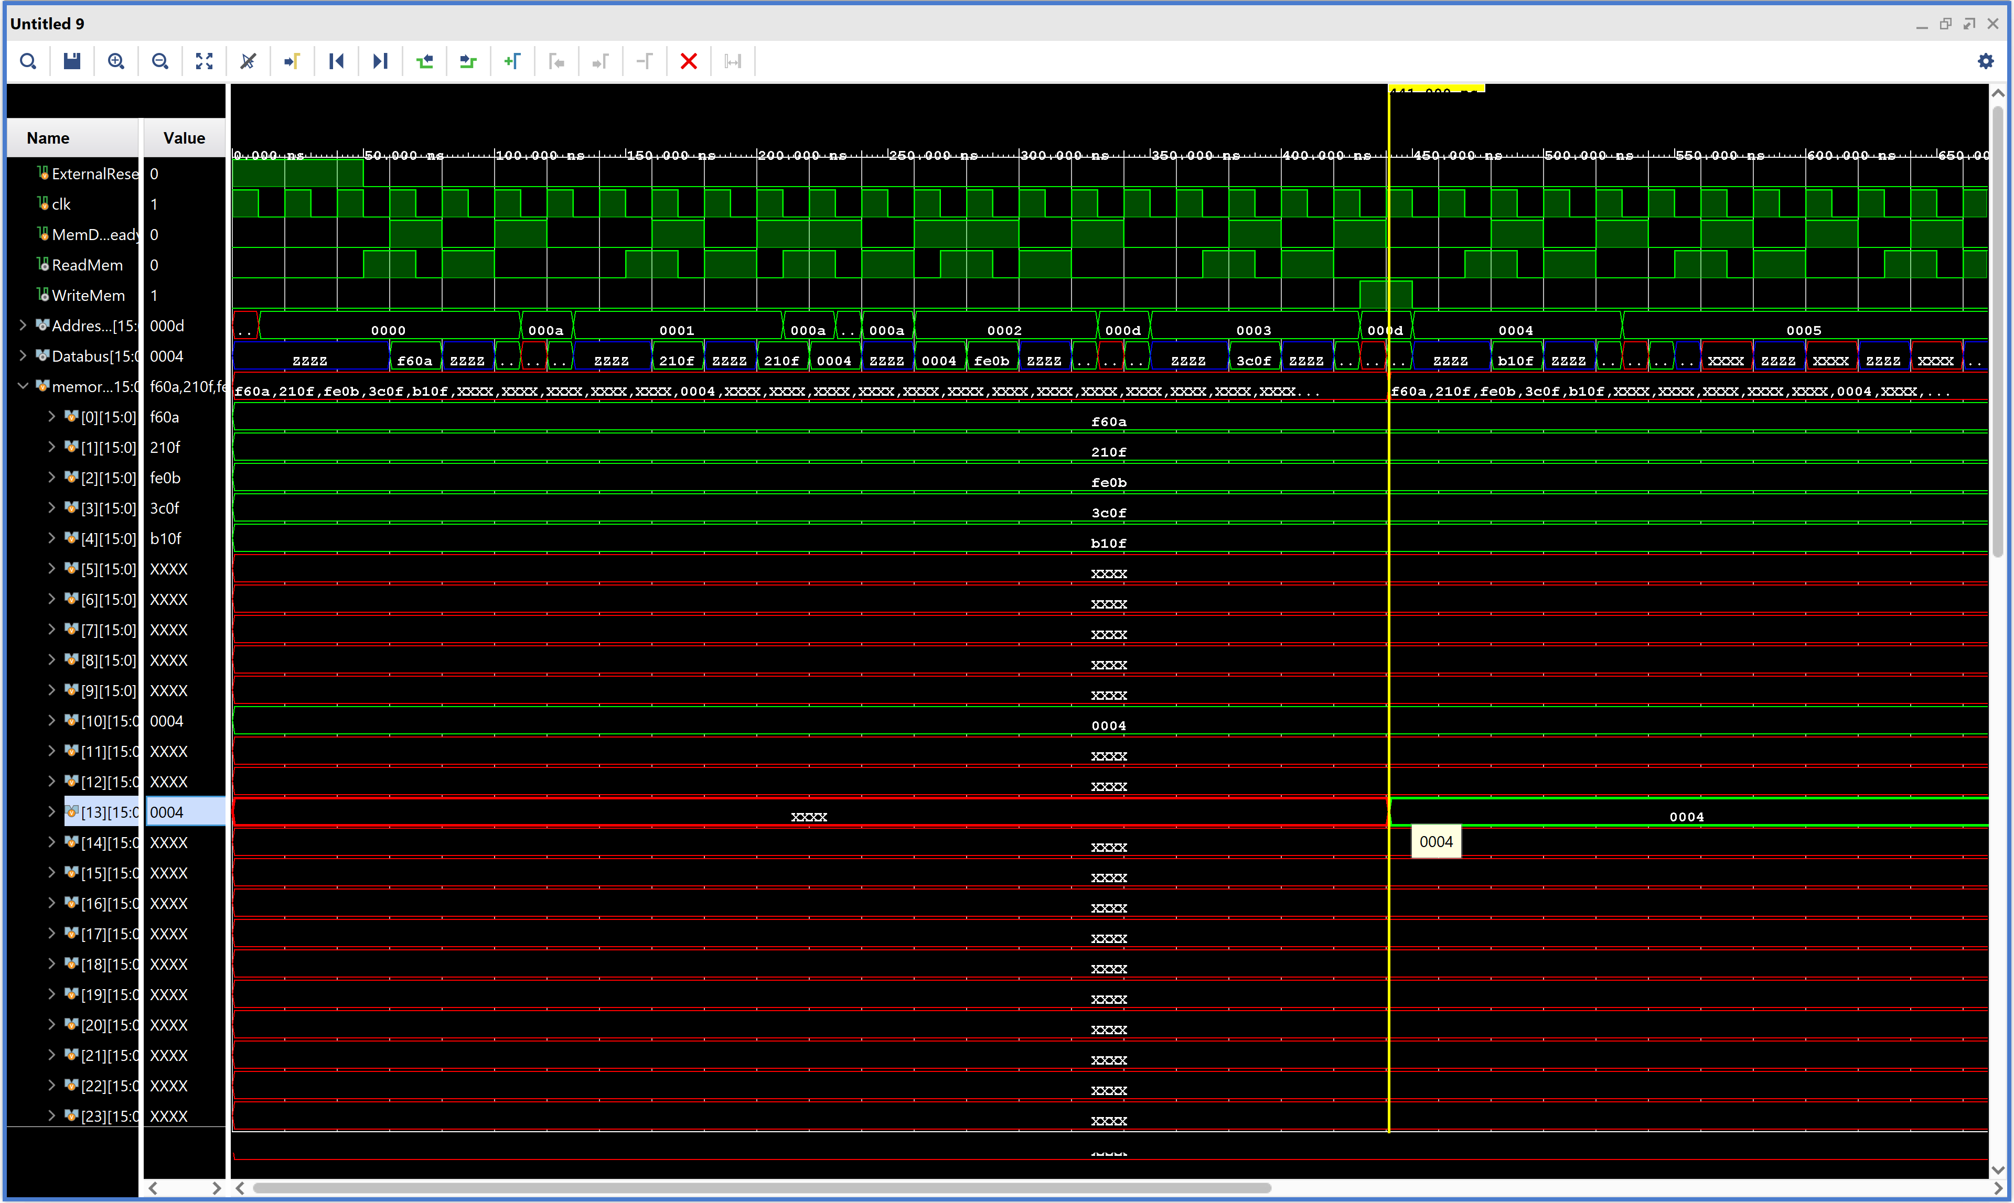
Results :

Slide 24



