Slide 1
IBM University Engagement Project Submission
“Exploring the Power of Agentic AI with IBM Granite and LangFlow”

Slide 2

Project Title – Interview Trainer Agent
Domain of Project – Education and Career Development
Student Name | Recent Passport Photo | Email ID | Mobile number [WhatsApp]
Uma Nakka |  | nakkauma828@gmail.com | 8978206337

Slide 3
Problem Statement – Interview Trainer Agent
The Challenge
Interview preparation remains a significant challenge for students and job seekers due to the lack of structured guidance, personalized learning strategies, and realistic practice opportunities. Candidates often struggle to identify role-specific requirements, assess their preparedness, and improve their interview performance effectively. As a result, many qualified individuals fail to demonstrate their full potential during recruitment processes.
The Objective
Develop an AI-powered Interview Trainer Agent that provides personalized and interactive interview preparation support for students and professionals.
The solution should:
Personalized Learning Roadmaps – Create customized interview preparation plans based on the user's target role, skills, and experience level.
Interview Topic Recommendations – Identify important concepts and topics that require focused revision.
Technical Interview Preparation – Provide domain-specific guidance for Python, Java, Frontend Development, AI, Data Analytics, and Software Engineering roles.
Coding Practice Support – Recommend relevant coding problems, DSA concepts, and technical exercises.
HR & Behavioral Interview Guidance – Assist users in preparing for communication, behavioral, and situational interview questions.
Interactive Mock Interviews – Conduct realistic interview sessions with step-by-step questioning and response evaluation.
Performance Feedback – Analyze responses and provide actionable improvement suggestions.
Career Development Assistance – Offer learning recommendations and interview preparation strategies aligned with career goals.
Context-Aware Guidance – Utilize conversation history to deliver personalized and continuous support.
Domain-Focused Intelligence – Remain dedicated to interview preparation and career-related guidance

Slide 4
Technology Used
• LangFlow – Visual framework used to design and manage the AI agent workflow.
• IBM watsonx.ai – AI platform used to access and deploy foundation models.
• IBM Granite 8B Code Instruct – Foundation model used for generating interview guidance, mock interview questions, and personalized preparation plans.
• Message History Component – Maintains conversation context to provide personalized and continuous support.
• IBM Cloud – Cloud platform used for hosting and managing AI services.
• GitHub – Used for version control, project management, and code repository maintenance.
Tech Stack (Mandatory)
I used:
LangFlow + IBM watsonx.ai + IBM Granite Models

Slide 5
Proposed Solution:
The proposed solution is an AI-powered Interview Trainer Agent designed to support students and job seekers throughout their interview preparation journey. Developed using LangFlow, IBM watsonx.ai, and IBM Granite 8B Code Instruct, the system provides intelligent, personalized, and role-oriented interview guidance.
The agent analyzes user requirements, career objectives, and target job roles to create customized preparation strategies. It assists users by identifying key interview topics, recommending learning paths, providing technical and behavioral interview guidance, and facilitating structured mock interview sessions.
By leveraging contextual memory and conversational intelligence, the system continuously adapts its recommendations based on user interactions and progress. This enables a more personalized and engaging preparation experience compared to traditional learning resources.
The Interview Trainer Agent serves as a virtual career mentor that helps users strengthen technical expertise, enhance communication skills, improve problem-solving abilities, and build confidence for real-world interview scenarios. Through AI-driven guidance and continuous feedback, the platform promotes effective preparation and improved interview readiness.

Slide 6
Langflow component Used -
• Chat Input – Accepts interview-related queries and user responses.
• Message History – Maintains conversation context and enables personalized interview guidance.
• IBM watsonx.ai Component – Connects LangFlow with IBM watsonx.ai foundation models.
• IBM Granite 8B Code Instruct – Generates interview preparation roadmaps, mock interview questions, feedback, and career guidance.
• Prompt Component – Defines the agent’s behavior and restricts it to interview preparation and career-related assistance.
• Chat Output – Displays AI-generated responses and interview guidance to the user.

Slide 7
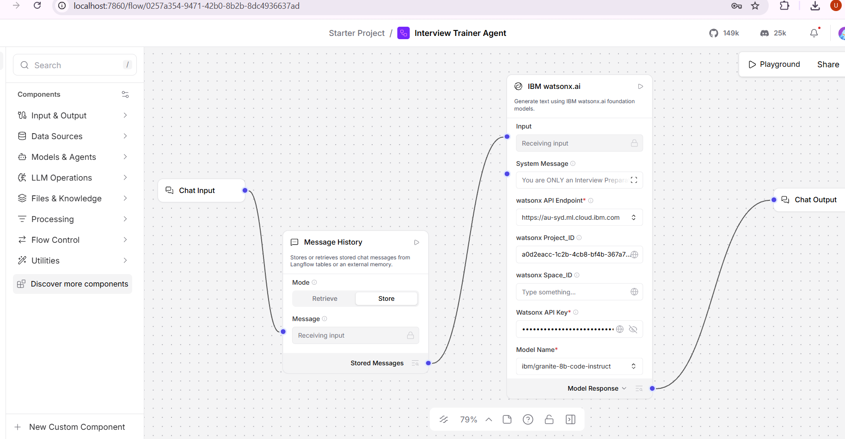
Langflow workflow -

Slide 8
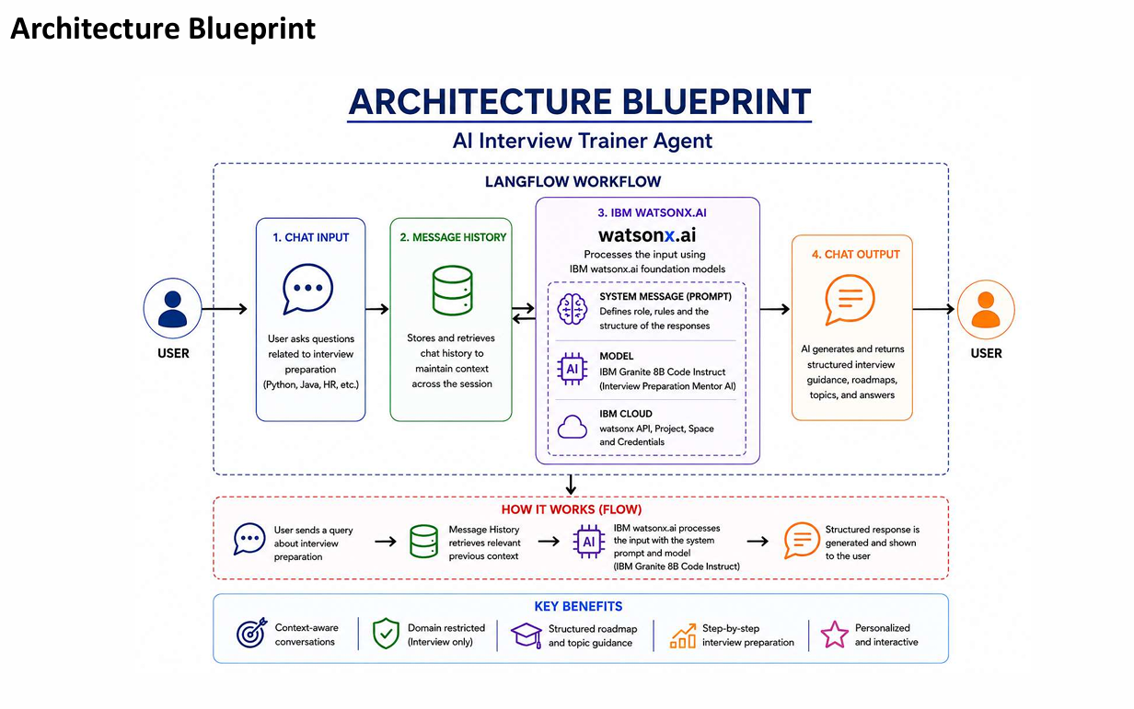
Architecture blueprint

Slide 9

Role of Agentic AI in the solution
Agentic AI serves as the core intelligence of the Interview Trainer Agent, enabling the system to deliver personalized, adaptive, and goal-oriented interview preparation support. Unlike traditional chatbots that provide generic responses, the agent understands user objectives, analyzes preparation requirements, and generates tailored recommendations based on individual needs.
The agent can create customized interview preparation roadmaps, recommend relevant technical and behavioral topics, conduct interactive mock interviews, evaluate user responses, and provide constructive feedback for continuous improvement. By maintaining conversation context and adapting to user progress, the system ensures a personalized and engaging learning experience.
Through intelligent decision-making and contextual understanding, Agentic AI transforms the platform into a virtual interview mentor that helps users strengthen technical knowledge, improve communication skills, build confidence, and enhance overall interview readiness.

Slide 10
Technology Used
• LangFlow – Used to design and orchestrate the Interview Trainer Agent workflow through a visual interface.
• IBM watsonx.ai – Used to access and deploy AI foundation models for intelligent interview assistance.
• IBM Granite 8B Code Instruct – Used for generating interview preparation roadmaps, mock interview questions, answer evaluation, and personalized career guidance.
• Message History Component – Used to maintain conversation context and deliver personalized interview preparation support.
• IBM Cloud – Provides the cloud infrastructure for accessing and managing AI services.
• GitHub – Used for version control, project documentation, and repository management.

Slide 11
Novelty and Uniqueness
• Personalized Interview Coaching – Delivers customized interview preparation strategies based on the user’s target role, skills, and experience level.
• AI-Driven Preparation Roadmaps – Generates structured learning plans to help users prepare efficiently and systematically.
• Interactive Mock Interview Experience – Simulates real interview scenarios and provides meaningful feedback on user responses.
• Context-Aware Guidance – Utilizes conversation history to deliver adaptive and personalized recommendations throughout the preparation journey.
• Comprehensive Interview Support – Assists users in preparing for technical, behavioral, and HR interview rounds within a single platform.
• Continuous Performance Improvement – Identifies areas for improvement and provides targeted suggestions to enhance interview readiness.
• Virtual Interview Mentor – Functions as an intelligent career preparation assistant rather than a traditional question-answer chatbot.
• Powered by IBM Granite Models and watsonx.ai – Leverages advanced AI capabilities to deliver reliable, relevant, and interview-focused guidance.

Slide 12
Git Hub Link
Github Repository:
https://github.com/Uma513/Interview-Trainer-Agent
·
·
·

Slide 13
Future Scope
• AI-Powered Interview Analytics – Provide detailed performance insights, identify improvement areas, and measure interview readiness through intelligent assessment.
• Voice-Based Interview Simulation – Enable real-time interview practice with speech interaction, communication analysis, and confidence evaluation.
• Company and Role-Specific Preparation – Deliver customized interview strategies, question sets, and preparation plans tailored to specific job roles and organizations.
• Intelligent Career Development Assistant – Expand the platform beyond interview preparation by offering skill-gap analysis, learning recommendations, and long-term career guidance.
·
·
·

Slide 14
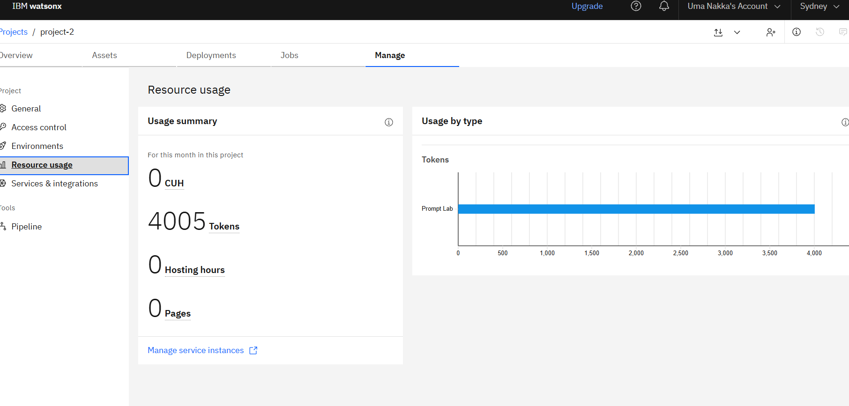
IBM watsonx.ai Usage Evidence
IBM watsonx.ai resource usage dashboard showing token consumption during project testing

Slide 15


