Slide 1
Assumptions of Linear Regression

Slide 2
Linear relationship : between the dependent and the independent variables.
No Multicollinearity The independent variables shouldn’t be correlated
Homoscedasticity : Residuals have constant variance at every level of x.
Normal distribution of error terms
No auto-correlation

Slide 3
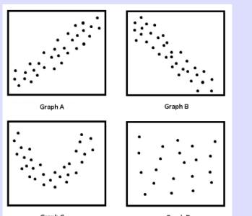
Linear relationship
If violated
Solution : logarithmic, exponential, square root, or reciprocal either to the dependent variable, independent variable, or both.

Slide 4
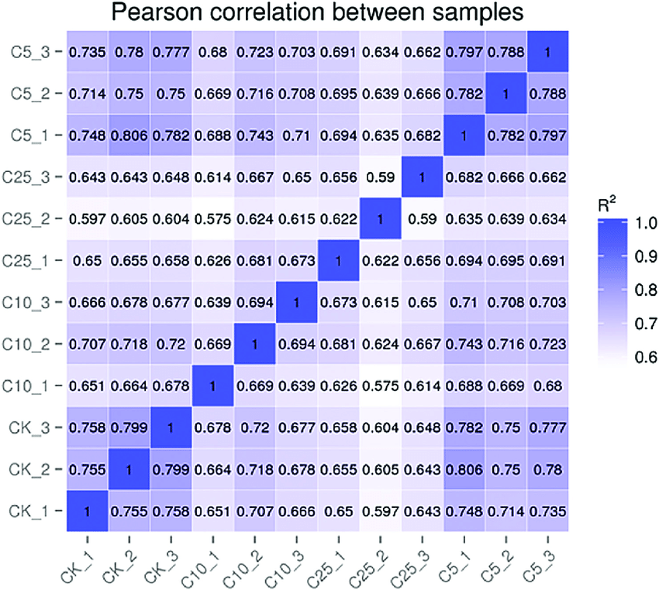
No Multicollinearity
The independent variables shouldn’t be correlated. If multicollinearity exists between the independent variables
Test : VIF
Sol
Reduce the correlation between variables by either transforming or combining the correlated variables.

Slide 5
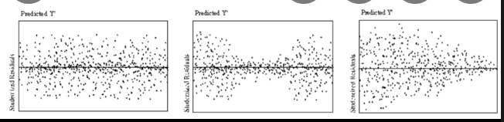
Homoscedasticity
Create a scatter plot that shows residual vs fitted value
violated?
Transform the dependent variable
Redefine the dependent variable
Use weighted regression

Slide 6
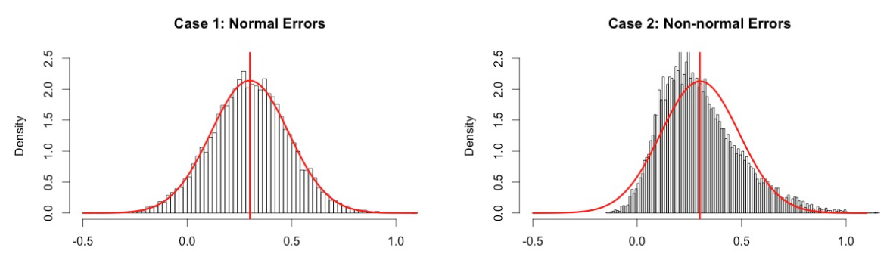
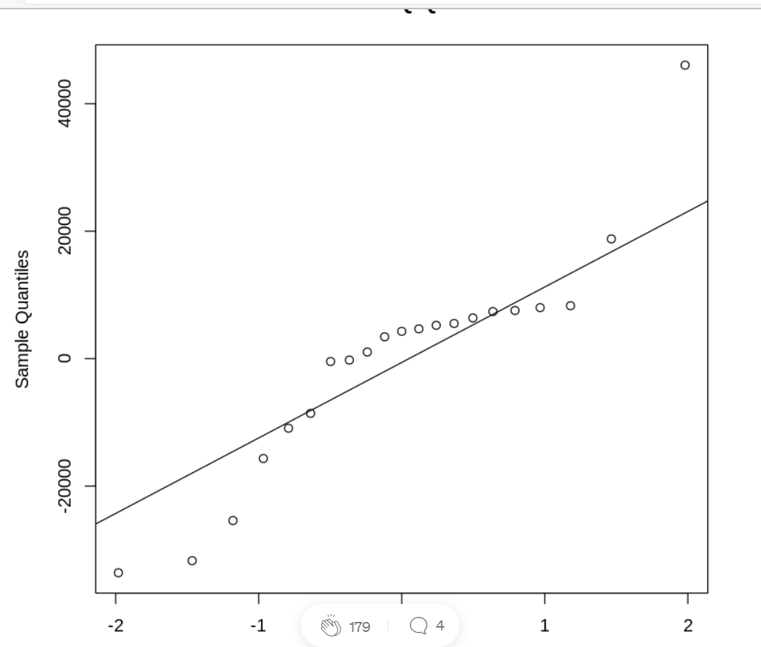
Normal distribution of error terms
Q-Q plots
Scatter plots
violated?
Verify if the outliers have an impact on the distribution.
Apply non-linear transformation in the form of log, square root, or reciprocal to the dependent, independent, or both variables.

Slide 7
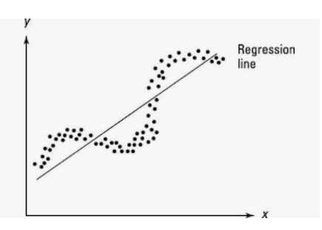
No auto-correlation
The residuals (error terms) are independent of each other. In other words, there is no correlation between the consecutive error terms of the time series data.

Slide 8
If the machine could have predicted the values right every time, confusion matrix would consist of only true positives and true negatives. However, it sometimes gets confused and classifies incorrectly which then results in the creation of false positives and false negatives.

Slide 9
True, False, Positive, Negative
True Positives (TP): The model predicts a customer will take a loan and the customer actually takes a loan.
True Negatives (TN): The model predicts a customer will not take a loan and the customer actually does not take a loan.
False Positives (FP): The model predicts a customer will take a loan, but the customer actually does not take a loan.
False Negatives (FN): The model predicts a customer will not take a loan, but the customer actually takes a loan.

Slide 10
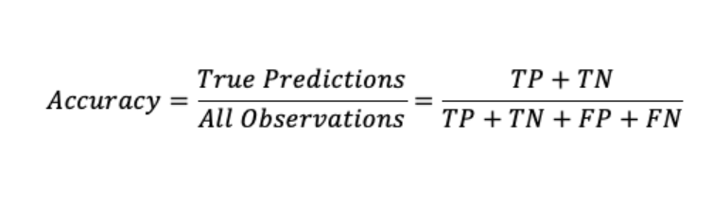
imbalanced it would not be the right metric to check the model performance.

Slide 11
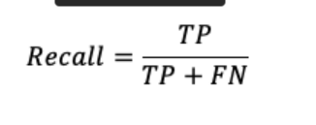
Recall, also known as Sensitivity or True Positive Rate (TPR)
measures of all the actual 1’s how many we predicted 1. It is the ratio of positive instances that are correctly classified as positive.
Recall score of the model is very low 63%, which means the model failed to predict 37 potential customers out of every 100 customers.

Slide 12
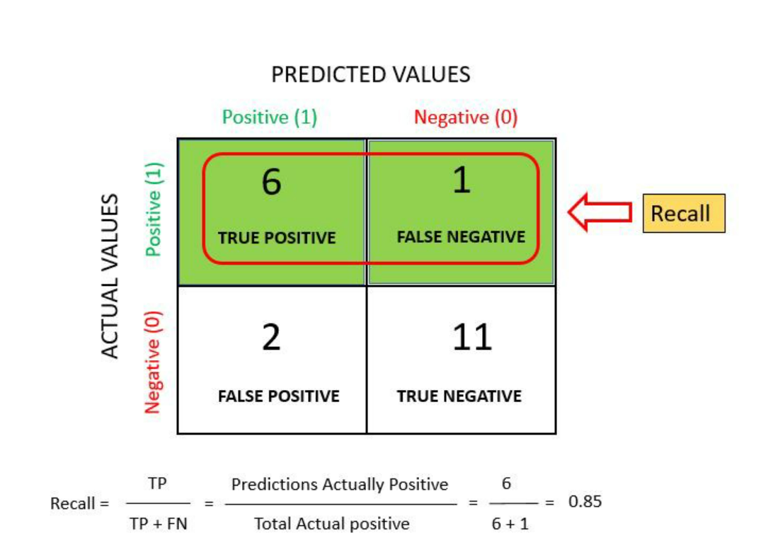

Slide 14
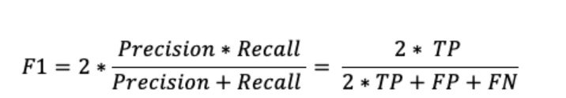
F1 Score
F1 Score is the combination of precision and recall into a single metric, harmonic mean of precision and recall. The classifier only gets a high F1 score if both precision and recall are high.
F1 Score is most useful when you need to take both precision and recall into account.
Depending on the context of your data, you mostly care about precision or recall. Increasing precision reduces recall and increasing recall reduces precision; this is called the precision/recall tradeoff.

Slide 15
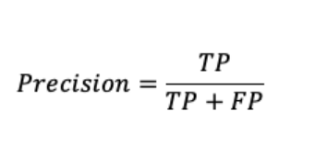
Precision
Precision measures the accuracy of the positive predictions. It calculates of all the 1’s we predicted how many are actually 1. In other words, then it predicts positive result, how often it is correct.
“Precision is a useful metric in cases where False Positive is a higher concern than False Negatives”

Slide 16
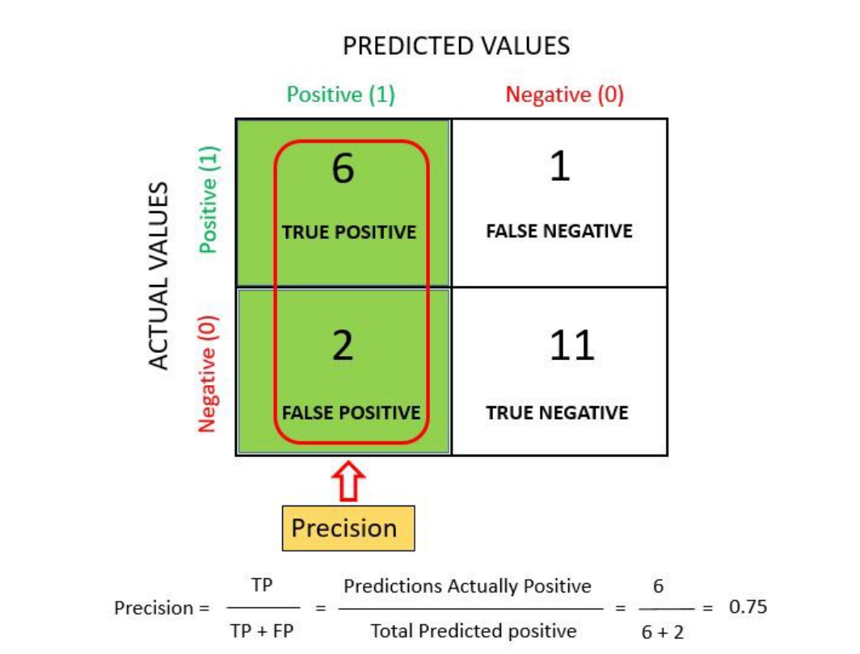

Slide 17
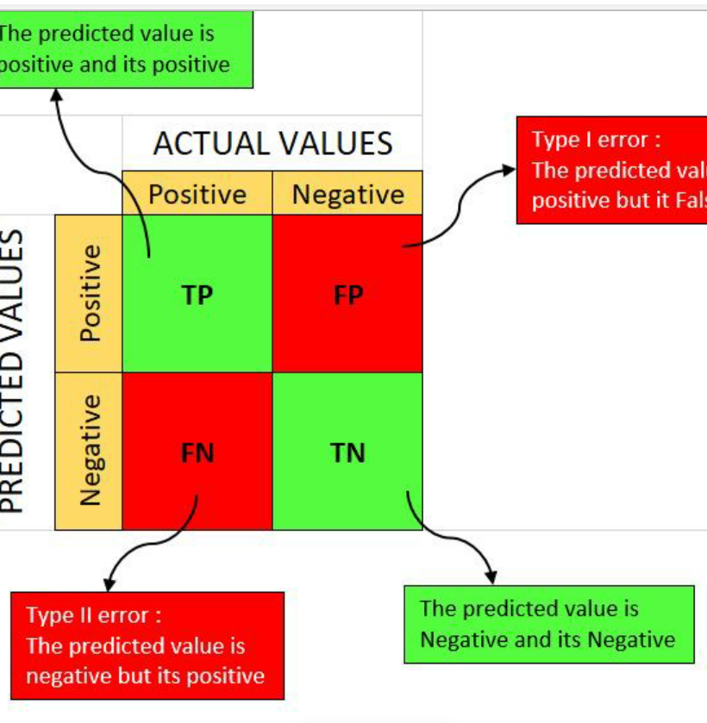
confusion matrix

Slide 18
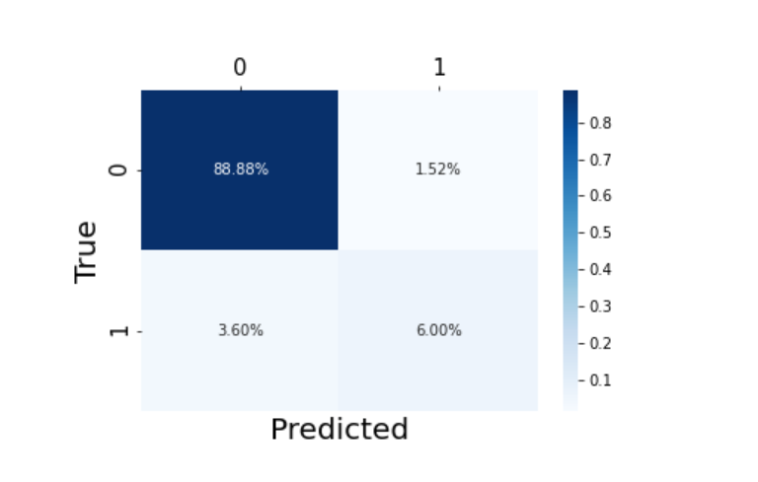

Slide 19
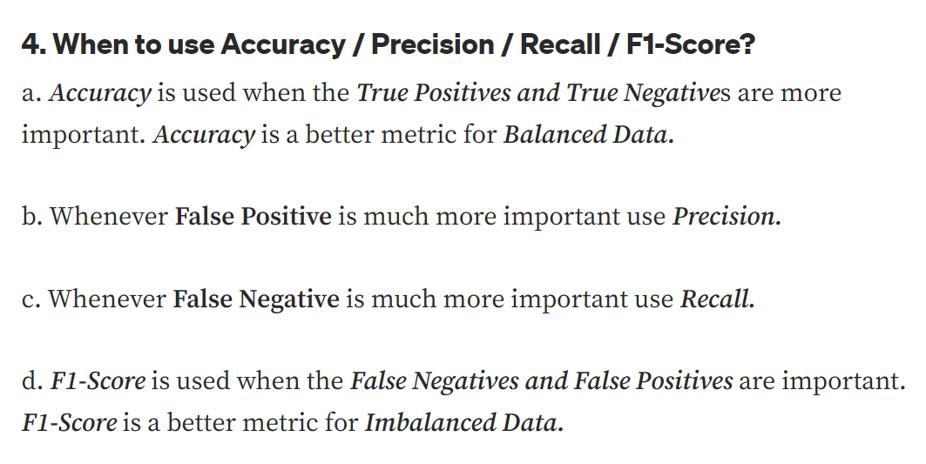

Slide 20
AUC-ROC
Sometimes we need to visualize the performance of the classification model on charts; then, we can use the AUC-ROC curve.
ROC (Receiver Operating Characteristic curve) curve. ROC represents a graph to show the performance of a classification model at different threshold levels. The curve is plotted between two parameters, which are:
True Positive Rate
False Positive Rate

Slide 21
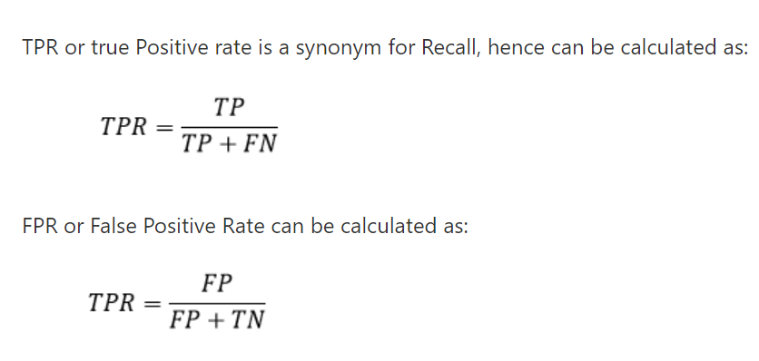
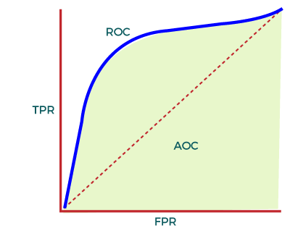
The value of AUC ranges from 0 to 1. It means a model with 100% wrong prediction will have an AUC of 0.0, whereas models with 100% correct predictions will have an AUC of 1.0.

Slide 22
