Slide 1
SUPER MARKET BILLING SYSTEM
-FIELD PROJECT
BY BATCH-06
Submitted by:-
231FA04372
231FA04379
231FA04412
231FA04423

Slide 2
Introduction
Existing Methodology
Literature (Lecturer) Survey
Project Objective
Methodology
Applications

Slide 3
Introduction
The project, titled Supermart Billing System, is a comprehensive web-based application designed to streamline the retail billing process. It integrates multiple functionalities—such as secure user authentication (login, sign-up, and password reset) and a dynamic billing interface—to enhance both operational efficiency and user experience. By leveraging modern web technologies (HTML, CSS, and JavaScript), the system aims to provide a seamless and responsive environment for managing supermarket transactions.

Slide 4
01.
Literature (Lecturer) Survey

Slide 5
SUPER MARKET BILLING SYSTEM
A review of current academic and industry perspectives highlights several key points:
Digital Transformation in Retail: Studies indicate that shifting from manual, desktop-based billing methods to integrated web applications significantly reduces errors and accelerates transaction times.
User Authentication and Security: Research emphasizes the importance of robust user management systems that protect sensitive data while offering a smooth customer experience.

Slide 6
SUPER MARKET BILLING SYSTEM
Responsive and Interactive Interfaces: Insights from educators and industry experts suggest that an intuitive, responsive design is critical for modern applications, ensuring accessibility and ease-of-use.
These findings have influenced the design of the Supermart Billing System, ensuring that the project aligns with contemporary best practices and addresses common pitfalls observed in traditional methodologies.

Slide 7
Existing Methodology

Slide 8
SUPER MARKET BILLING SYSTEM
Fragmented Processes: Many systems use separate modules for user management and billing, leading to disjointed workflows.
Manual Data Handling: Reliance on manual entry increases the likelihood of human error and slows down the overall process.
Limited User Interface: Older systems frequently employ static, non-interactive interfaces that do not cater to the needs of modern users.
The existing approaches, therefore, lack a unified framework that combines secure authentication with efficient billing, a gap that the current project seeks to fill.

Slide 9
SUPER MARKET BILLING SYSTEM
Project Objective

Slide 10
SUPER MARKET BILLING SYSTEM
The primary goal of this project is to develop a secure, user-friendly, and efficient billing system for supermarkets. Key objectives include:
Enhanced Security: Implementing a robust login and registration system that ensures user data protection.
Efficient Transaction Management: Allowing users to add, modify, and remove items with real-time updates.
Integrated Billing Process: Facilitating seamless invoice generation and printing, thus minimizing manual intervention.
Improved User Experience: Creating an interactive and responsive interface that meets modern usability standards.

Slide 11
SUPER MARKET BILLING SYSTEM
Methodology

Slide 12
Requirement Analysis: Identify user needs and define system functionalities (user authentication, item management, billing, etc.). System Design: Develop a modular architecture that separates user management from the billing interface. Create wireframes and prototypes to visualize the user flow. Front-end Development: Utilize HTML, CSS, and JavaScript to build a responsive and visually appealing user interface.

Slide 13
Back-end Integration (if applicable):
Implement server-side logic to handle user data verification, transaction processing, and secure storage. Ensure that data flows seamlessly between the front-end and back-end components.
Testing and Validation: Conduct rigorous testing to verify system reliability, usability, and security.
Perform user acceptance testing (UAT) to gather feedback and refine the interface.

Slide 14
Deployment and Iteration: Launch the application in a controlled environment. Monitor performance and user feedback to make iterative improvements.

Slide 15
Applications
A
B
C
Point of Sale (POS) System
Inventory Management
Customer Management
D
E
F
Barcode Scanning
Sales and Transaction Reports
Security and Fraud Prevention

Slide 16
Here are the key outcomes you can expect from this application:
1.User Authentication Workflow
2. User Registration
3. Supermarket Billing System
4. Modern UI/UX Design
5. Practical Front-End Development Techniques

Slide 17
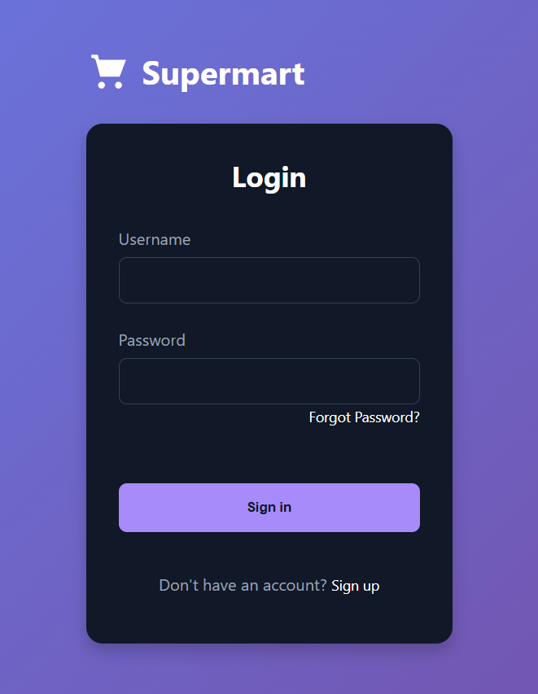
Outcomes:
1. Login Screen
Appearance and Layout:
Form Fields: The login screen displays a clean form with two input fields: one for the username and another for the password.
Navigation Links: Links are provided for “Forgot Password” and “Sign Up,” allowing users to navigate to the password reset or registration screens as needed.
Feedback: Upon entering credentials, if the username is "user123" and the password is "password123," the system provides immediate visual confirmation by redirecting the user to the billing screen.
User Experience: The interface is designed to be straightforward and minimalistic, ensuring users can quickly access the system.

Slide 18
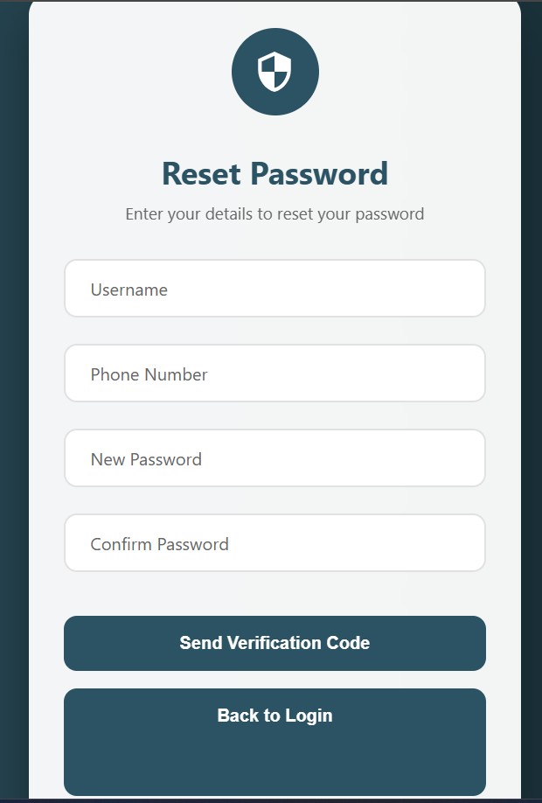
2. Password Reset Screen
Appearance and Layout:
Input Fields: The screen contains input fields for the username and phone number, allowing users to initiate the password reset process.
Process Simulation: A simplified process is implemented where, instead of a real verification code, the system simulates the sending of a code. Users then have an opportunity to enter and confirm a new password.
Navigation: A prominent "Back to Login" button is available, ensuring that users can return to the login screen at any point.
Feedback: The system visually notifies the user when the reset process is initiated (e.g., via messages or alerts), indicating the transition from verification to password change.

Slide 19
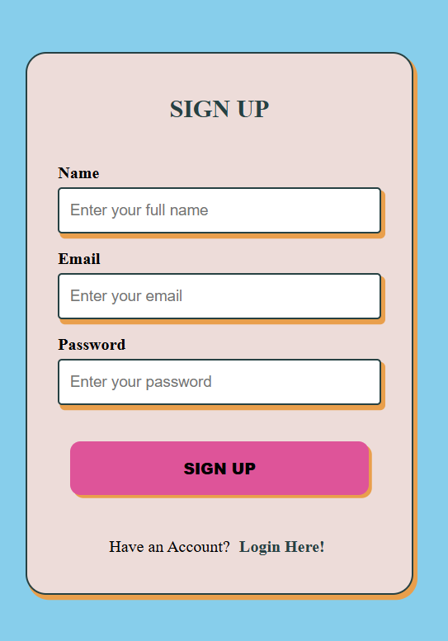
3. Signup Screen
Appearance and Layout:
Registration Form: The signup screen features input fields for the user's name, email, and password, offering a straightforward method to create a new account.
Navigation Link: A link is provided to redirect users back to the login page after registration or if they already have an account.
Visual Design: The design is consistent with the overall theme, providing a clean and modern user interface that encourages user registration.
Feedback: Upon successful signup, the user is expected to be redirected to the login page, confirming the account creation process.

Slide 20
4. Billing Screen
Appearance and Layout:
Dynamic Interface: The billing screen is the core functional page, featuring dynamic elements for adding items to the bill.
Item Entry: Users can enter item details (name, price, quantity, manufacturer, manufacturing and expiry dates) using a structured form. Predefined items help auto-populate the fields, reducing manual entry errors.
Bill Summary: An itemized list is displayed, showing each added item along with its computed total (price multiplied by quantity).

Slide 21
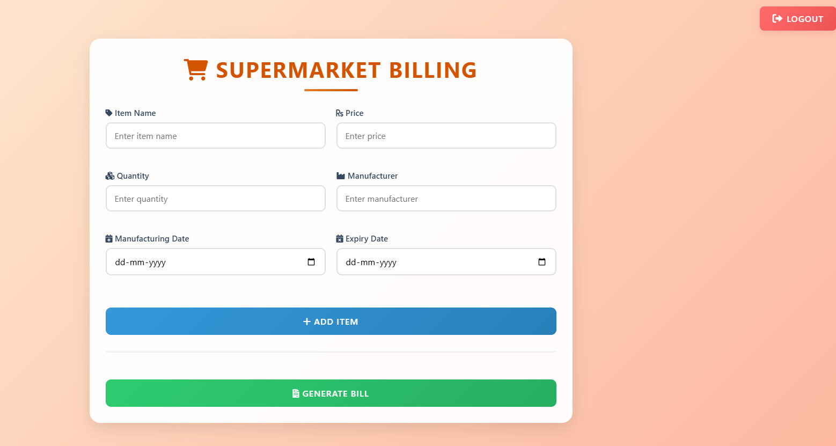

Slide 22
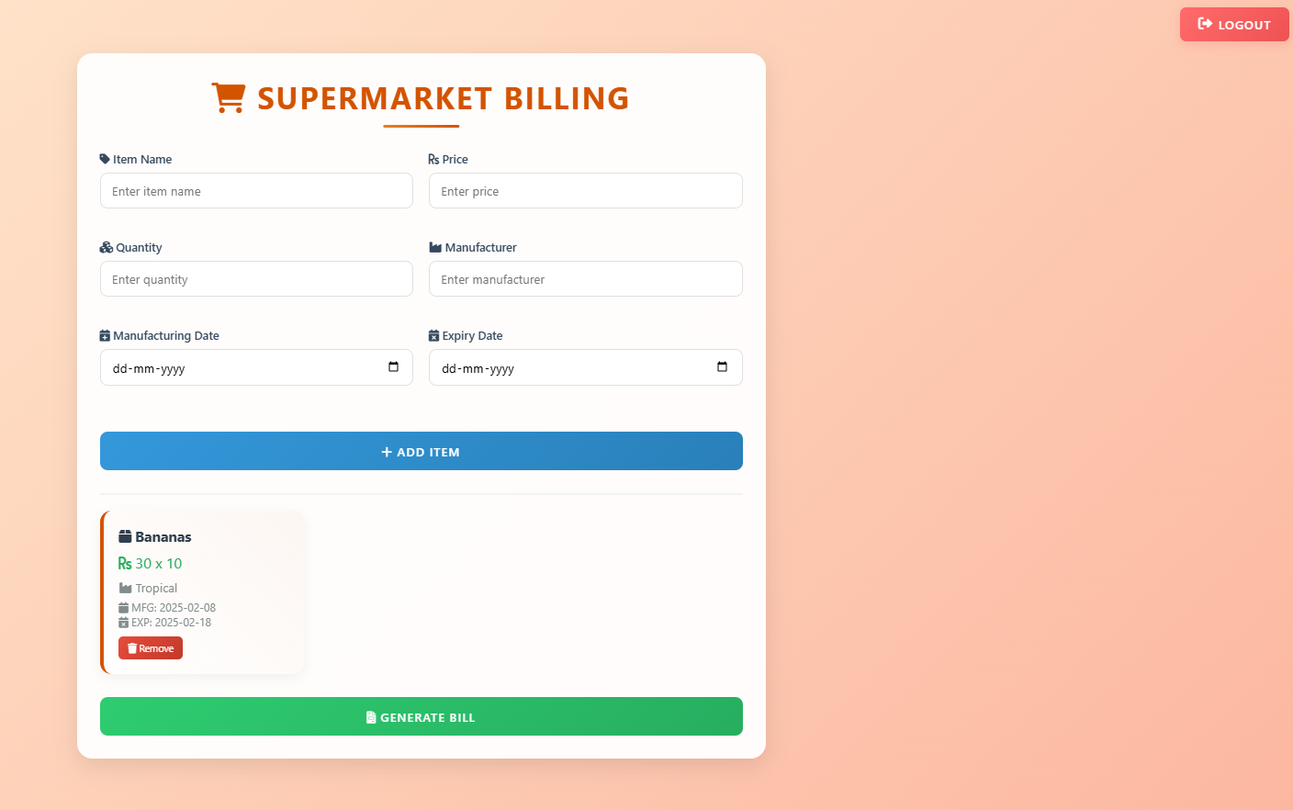
Final Output:

Slide 23
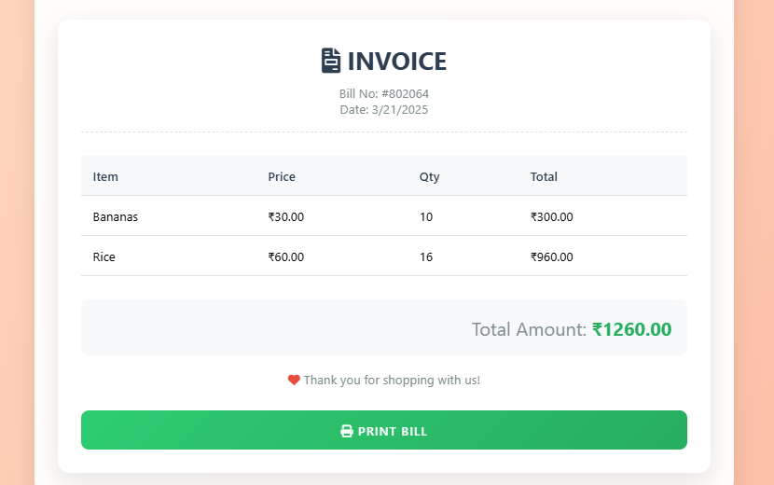

Slide 24
THANK YOU!

