Slide 1
PORTFOLIO CASE STUDY
PeopleOps & Legal Intelligence Hub
A unified semantic data product for HR and Legal — governance, AI/ML, and an ROI-informed roadmap.
Data Product Strategy · Semantic Modeling · AI/ML Product Management · Data Governance
Uma Ramanathan — Product, UX & Data Portfolio
Notes:
Title slide. Frame this as a self-directed case study built to answer the Data & AI PM (HR & Legal) job requirements section by section — same approach as the Ad Copilot deck, applied to an enterprise data-governance-heavy role.

Slide 2
GUIDE
How This Deck Is Organized
Five sections, each answering a specific part of the role — useful to a different reader.
01
The Problem
Hiring Manager, HRBP & Legal stakeholders
Fragmented HR & Legal data, manual reporting
02
The Product & Governance
Data Platform / Engineering, Hiring Manager
One semantic layer, shared lineage & ownership
03
Roadmap
Hiring Manager, Finance / Ops
ROI-informed sequencing of the build
04
AI/ML & Responsible AI
ML / Eng, Hiring Manager
Predictive models with human review lanes
05
Business Case & Delivery
Hiring Manager, cross-functional teams
Metrics that prove value, agile release plan
PeopleOps & Legal Intelligence Hub · Portfolio Case Study
Notes:
This deck is sectioned to match the JD's What You'll Do list. Each row names the reader it's written for — feel free to jump around depending on who's in the room.

Slide 3
01
SECTION 01 · THE PROBLEM
Two Functions, One Shared Pattern
HR and Legal both run on manual, spreadsheet-stitched reporting pulled from systems that were never built to talk to each other — with real governance risk every time that stitching happens by hand.
HR
Legal
Workforce planning is reactive
Contract & compliance risk hides in plain sight
Attrition risk visible only after an exit interview
DEI and workforce reporting rebuilt by hand each cycle
No forward view on skills gaps across teams
Contract bottlenecks surface only when someone asks
Obligations and renewals tracked outside any system
Compliance gaps discovered after the fact, not before
Shared root cause: no single governed source of reference — every report is rebuilt from scratch, with no lineage back to source.
PeopleOps & Legal Intelligence Hub · Portfolio Case Study
Notes:
Two personas, same underlying failure. The point of this slide is to show the pains aren't coincidentally similar — they share one root cause, which is exactly what justifies building one platform instead of two point solutions.

Slide 4
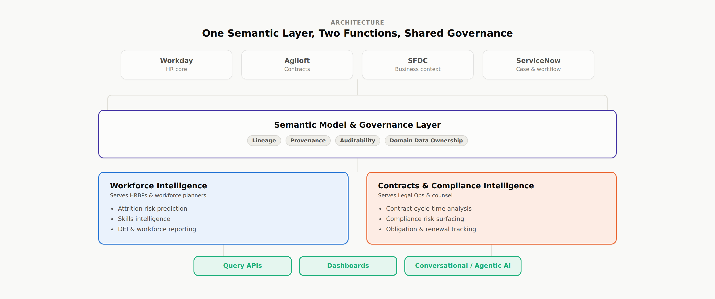
02
SECTION 02 · THE PRODUCT
One Semantic Layer, Two Modules
Rather than two disconnected dashboards, both functions query the same governed model — through APIs, dashboards, and a conversational AI assistant.
PeopleOps & Legal Intelligence Hub · Portfolio Case Study
Notes:
Walk left to right: four source systems feed one semantic model that carries lineage, provenance, auditability and domain ownership rules; that model splits into an HR module and a Legal module, both surfaced through the same APIs, dashboards, and conversational AI layer. The shared middle is the differentiated part — anyone can build a dashboard per function.

Slide 5
02
SECTION 02 · THE PRODUCT
Governance Isn't a Checkbox — It's the Model
Grounded in real data-masking, metadata management, and schema classification work from regulated healthcare and banking environments.
Lineage
Provenance
Every field traceable back to its source system and transformation.
Clear ownership of who changed what, and when.
Auditability
Domain Ownership
Every AI-influenced decision logged and reviewable.
HR owns HR definitions, Legal owns Legal definitions.
Privacy & records compliance: GDPR data-subject rights and records-of-processing obligations are treated as model constraints from day one — not a review step bolted on before launch.
PeopleOps & Legal Intelligence Hub · Portfolio Case Study
Notes:
This is the section closest to real prior experience — data masking and metadata management work translates directly here. If asked to go deeper technically, this is the slide to expand on.

Slide 6
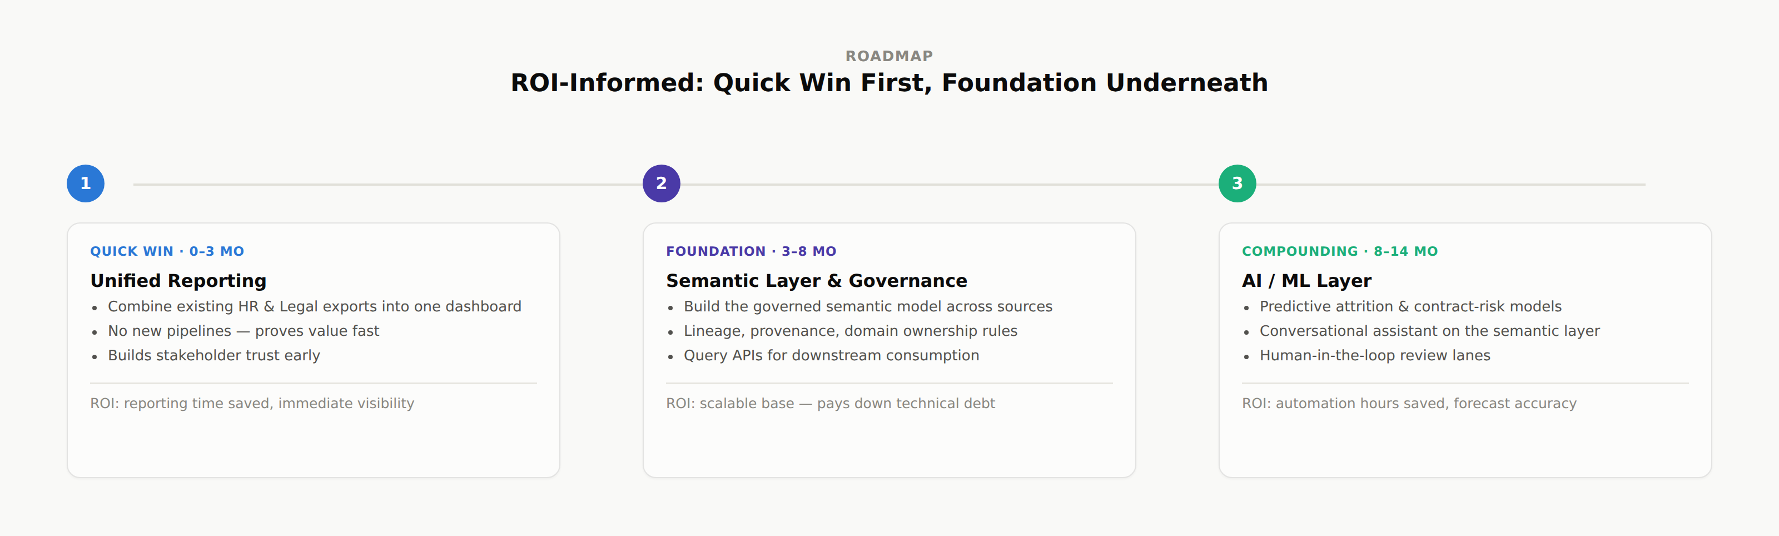
03
SECTION 03 · ROADMAP
ROI-Informed: Quick Win First, Foundation Underneath
Sequencing is deliberate — a fast, low-risk win earns the trust needed to invest in the harder foundational and AI/ML work.
PeopleOps & Legal Intelligence Hub · Portfolio Case Study
Notes:
Phase 1 proves value with zero new pipelines. Phase 2 is the unglamorous but essential foundation — this is the technical-debt-vs-quick-win tradeoff the JD explicitly asks for. Phase 3 is where AI/ML compounds the return on Phase 2's investment.

Slide 7
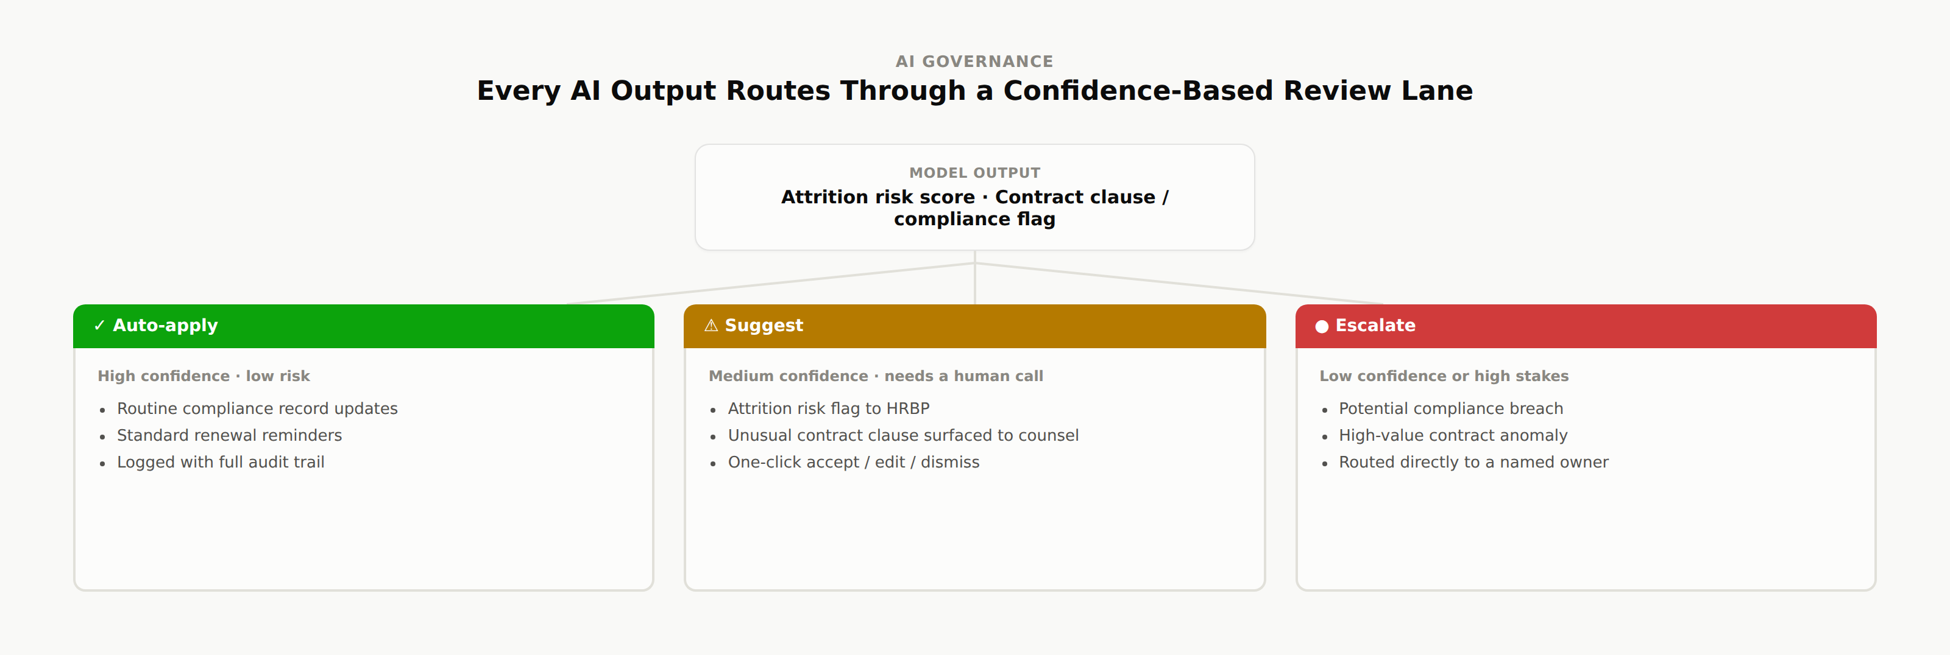
04
SECTION 04 · AI/ML & RESPONSIBLE AI
Every AI Output Earns Trust Before It Acts
An attrition-risk model for HR and a contract/compliance anomaly model for Legal — neither acts unsupervised.
PeopleOps & Legal Intelligence Hub · Portfolio Case Study
Notes:
Low-risk, high-confidence actions move automatically; everything else stays a human decision, with the model doing the flagging, not the deciding. This is the model-governance pattern that makes an AI/ML feature defensible in a regulated function, not just a v1 feature list.

Slide 8
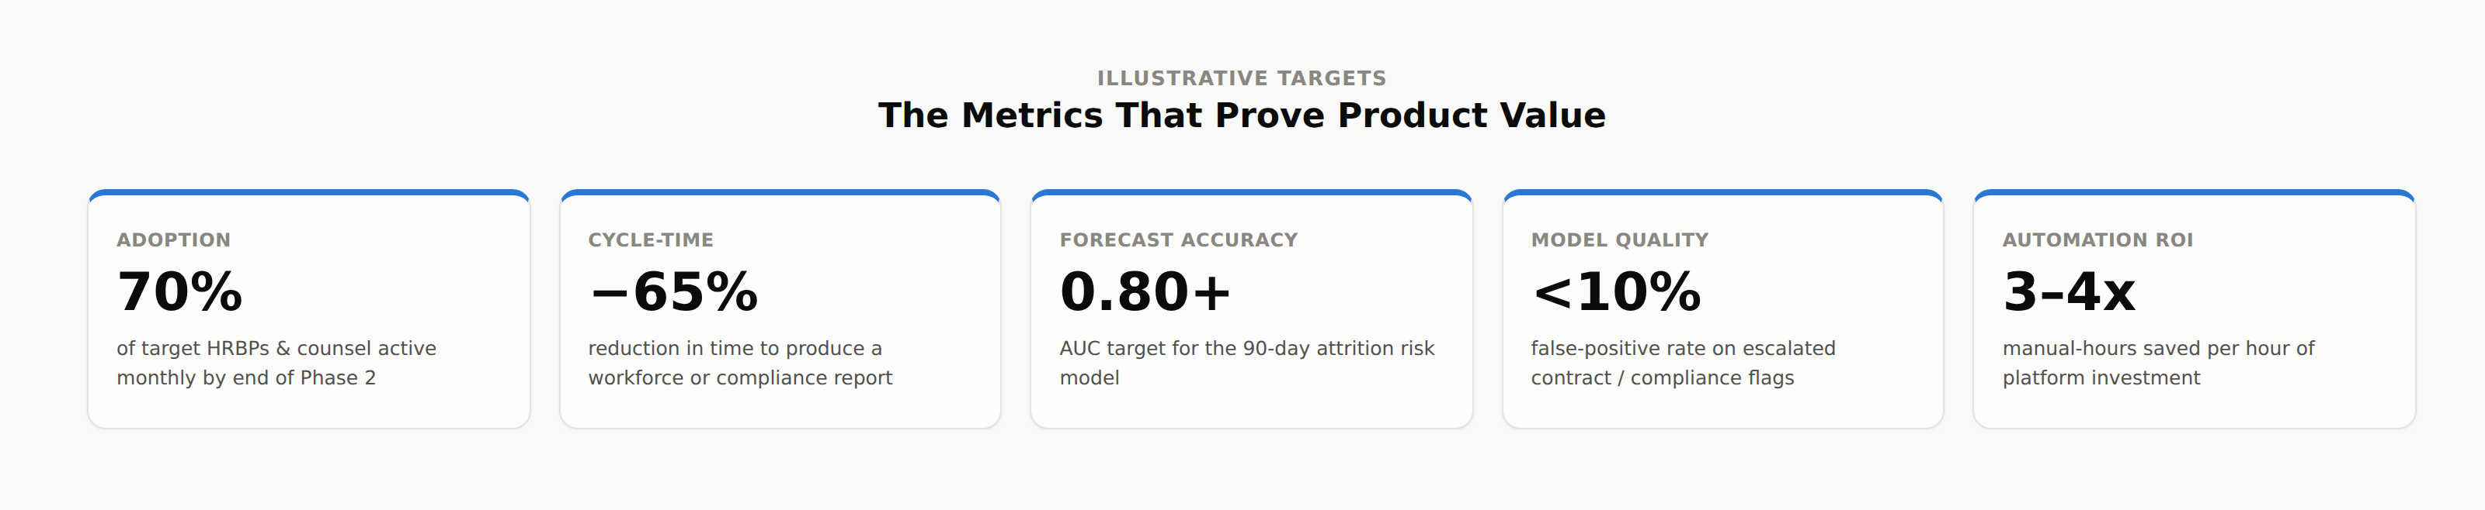
05
SECTION 05 · BUSINESS CASE & DELIVERY
The Metrics That Prove Product Value
Chosen to answer the question every stakeholder actually asks: is this worth what it costs.
Illustrative targets — a real engagement would baseline these against current-state manual reporting.
PeopleOps & Legal Intelligence Hub · Portfolio Case Study
Notes:
Adoption and cycle-time prove near-term value; forecast accuracy and model quality prove the AI layer is trustworthy, not just novel; automation ROI is the number Finance asks for.

Slide 9
05
SECTION 05 · BUSINESS CASE & DELIVERY
Delivery: Framed With Engineering, Not Handed to Them
One backlog shared across data platform, data science, and AI/ML teams — the model only stays trustworthy if product and engineering build it together.
1
2
3
4
Frame
Prototype
Validate
Release
Problem framing & data-feasibility with data engineering
Semantic model + one dashboard, built for UAT
UAT with HRBPs & Legal Ops, data quality & security checks
Phased rollout of APIs, then the AI/ML layer
PeopleOps & Legal Intelligence Hub · Portfolio Case Study
Notes:
Standard agile release cycle, but the point to make out loud is who's in the room at each step — engineering from day one, not after the PRD is 'done'.

Slide 10
CLOSE
What This Project Demonstrates
Translating fragmented stakeholder pain into one governed data product
ROI-informed roadmap sequencing: quick win, foundation, compounding AI value
Semantic modeling & data governance: lineage, provenance, auditability, domain ownership
Shipping an AI/ML product with a human-in-the-loop review model
Business case construction with named, falsifiable success metrics
Cross-functional delivery across data engineering, data science & platform teams
Uma Ramanathan — Product, UX & Data Portfolio · umaramanathan54@gmail.com
Notes:
Close by tying each bullet back to a specific line in the JD's What You'll Bring / What You'll Do sections — this list was written to mirror that language deliberately.

