Slide 1

Smart India Hackathon 2023
-by Codewars

Slide 2
Topics:
Introduction
How AI Can Help
Problem Statement
Benefits of AI-enable Water Well Predictor
Implementation Challenges
Conclusion

Slide 3

Introduction
Traditionally, predicting the behaviour of water wells has been a challenging task, often relying on outdated methods that can lead to inaccurate results. However, with the power of artificial intelligence, we can now achieve greater accuracy and efficiency in this critical area. In this presentation, we will explore how AI-enable water well predictor works and benefits it offers for water resource management.

Slide 4
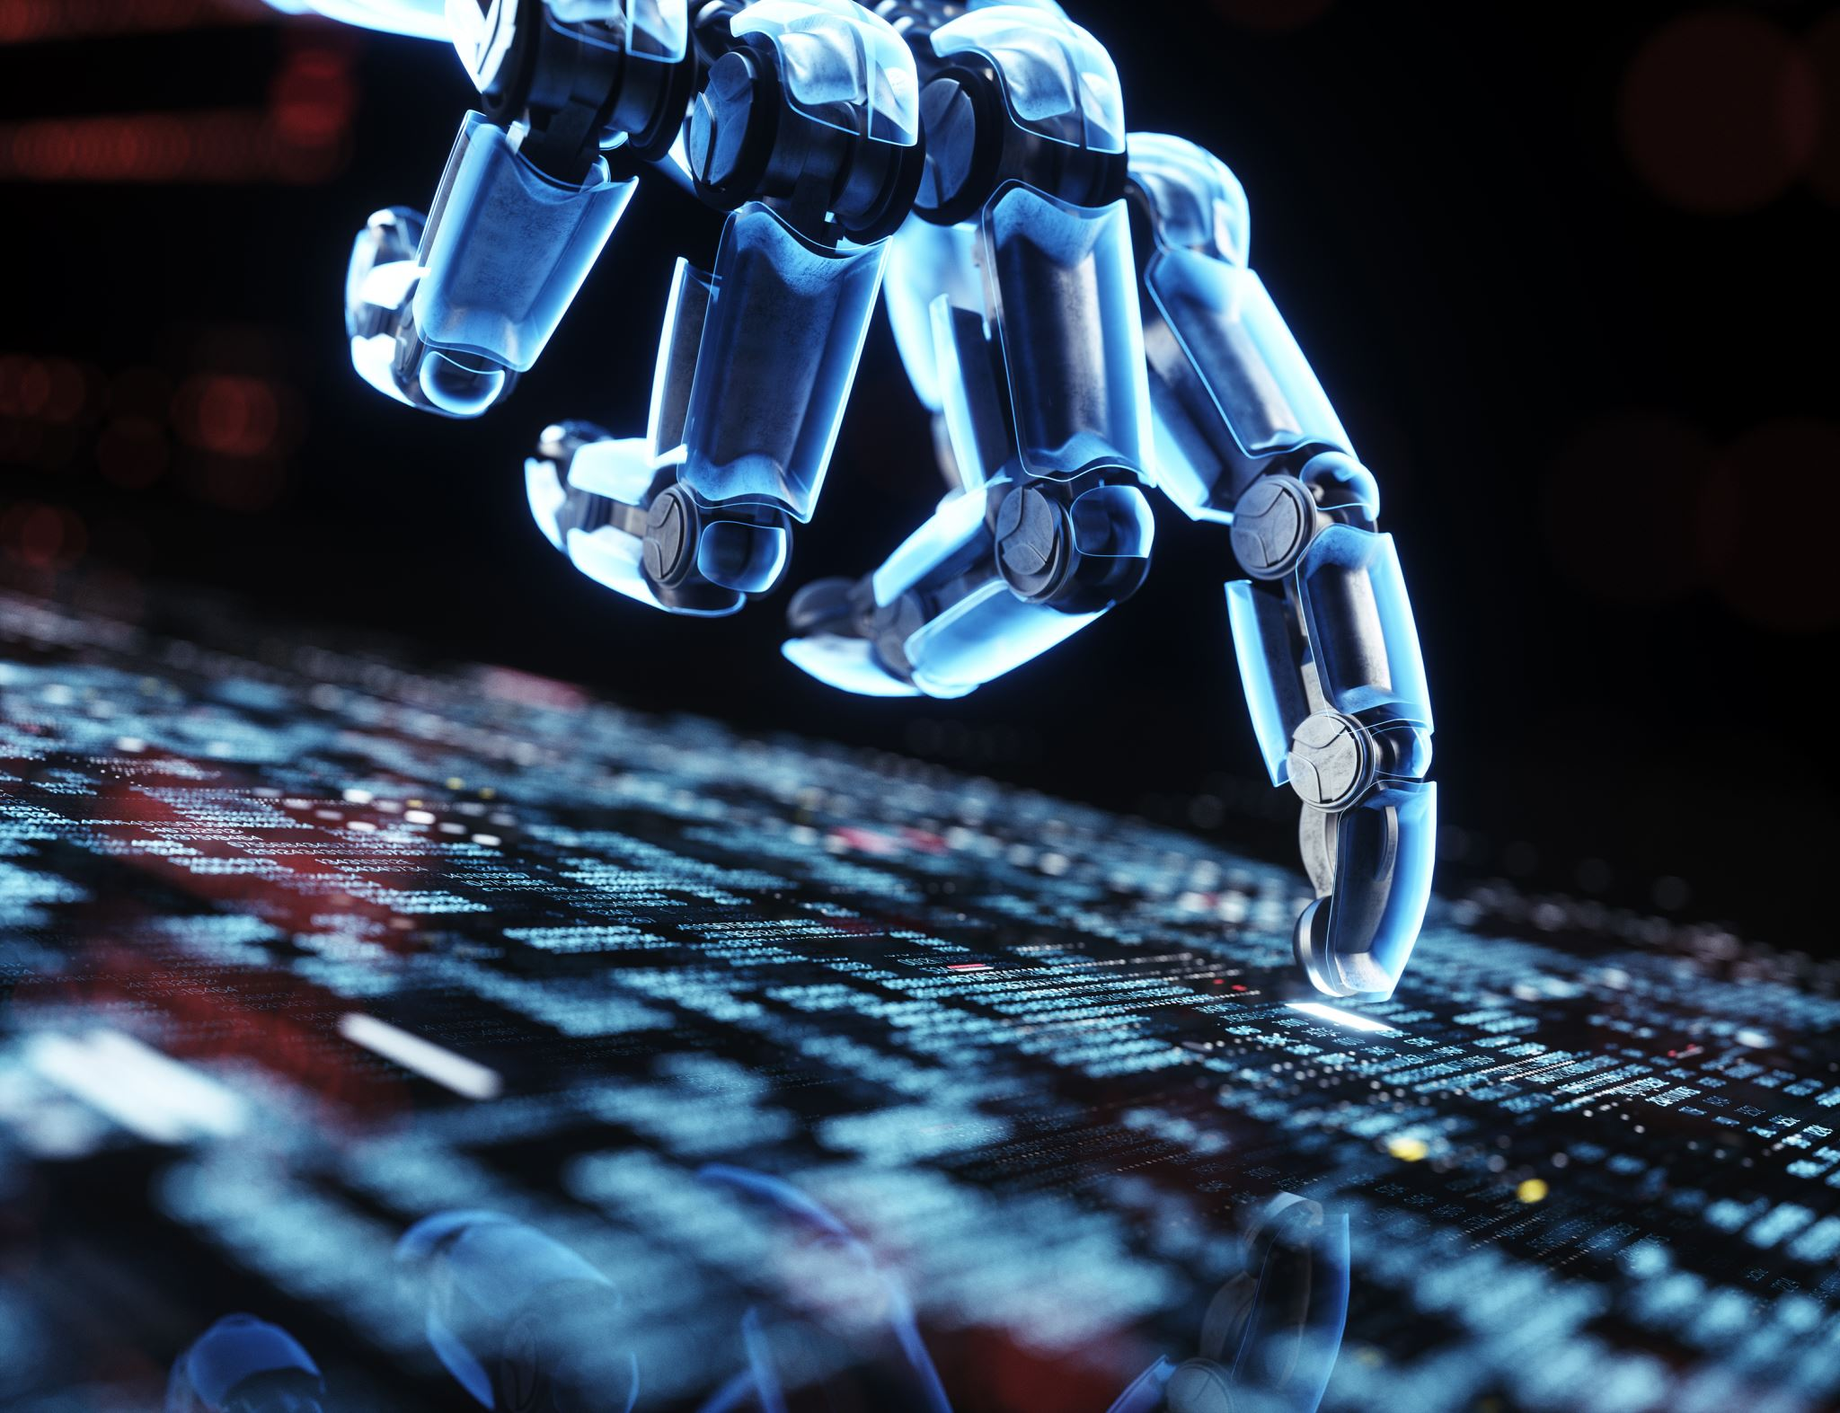
How AI can Help?
The ability of a computer or a robot controlled by a computer to perform jobs that are typically performed by humans because they call for human intelligence and judgement is known as artificial intelligence (AI).

Slide 5

Problem Statement
AI Enabled water well predictor Is a technology that uses artificial intelligence models to stimulate and forecast the quality and quantity of ground water in wells.

Slide 6
Advantages of AI:
Reduce human errors.
Easily handles big data.
Allows automating repeatitive tasks.
Pattern identification.
Improving processes and workflows.

Slide 7
Benefits of Water Well Predictor
The AI-enabled water well predictor offers a range of benefits that can help communities around the world.
It can also reduce the environmental impact of drilling by minimising the number of wells that need to be dug.
It can improve access to clean water, which is crucial for the health and wellbeing of communities everywhere.

Slide 8

Real-World Example:
A community in rural africa was able to use the AI-enabled water well predictor to find a new source of clean water, improving the lives of hundreds of peoples.
A company was able to save millions of dollars by using this technology to more efficiently locate water wells on their property.

Slide 9

Implementation Challenges
As we look towards the future, the potential of AI-enables water well predictor is truly awe-inspiring.
With its ability to accurately predict the location of water wells, this technology as the power to revolutionise the way we approach water scarcity and access to clean water.
Imagine a world where communities no longer have to worry about drilling in the wrong places or spending excessive time and money searching for water.

Slide 10

Conclusion:
In conclusion, the AI-enabled water well predictor is a game changer in the fight against water scarcity. It is important that we continue to invest in and develop this technology to ensure it wide spread adoption and maximum impact.

