Slide 1
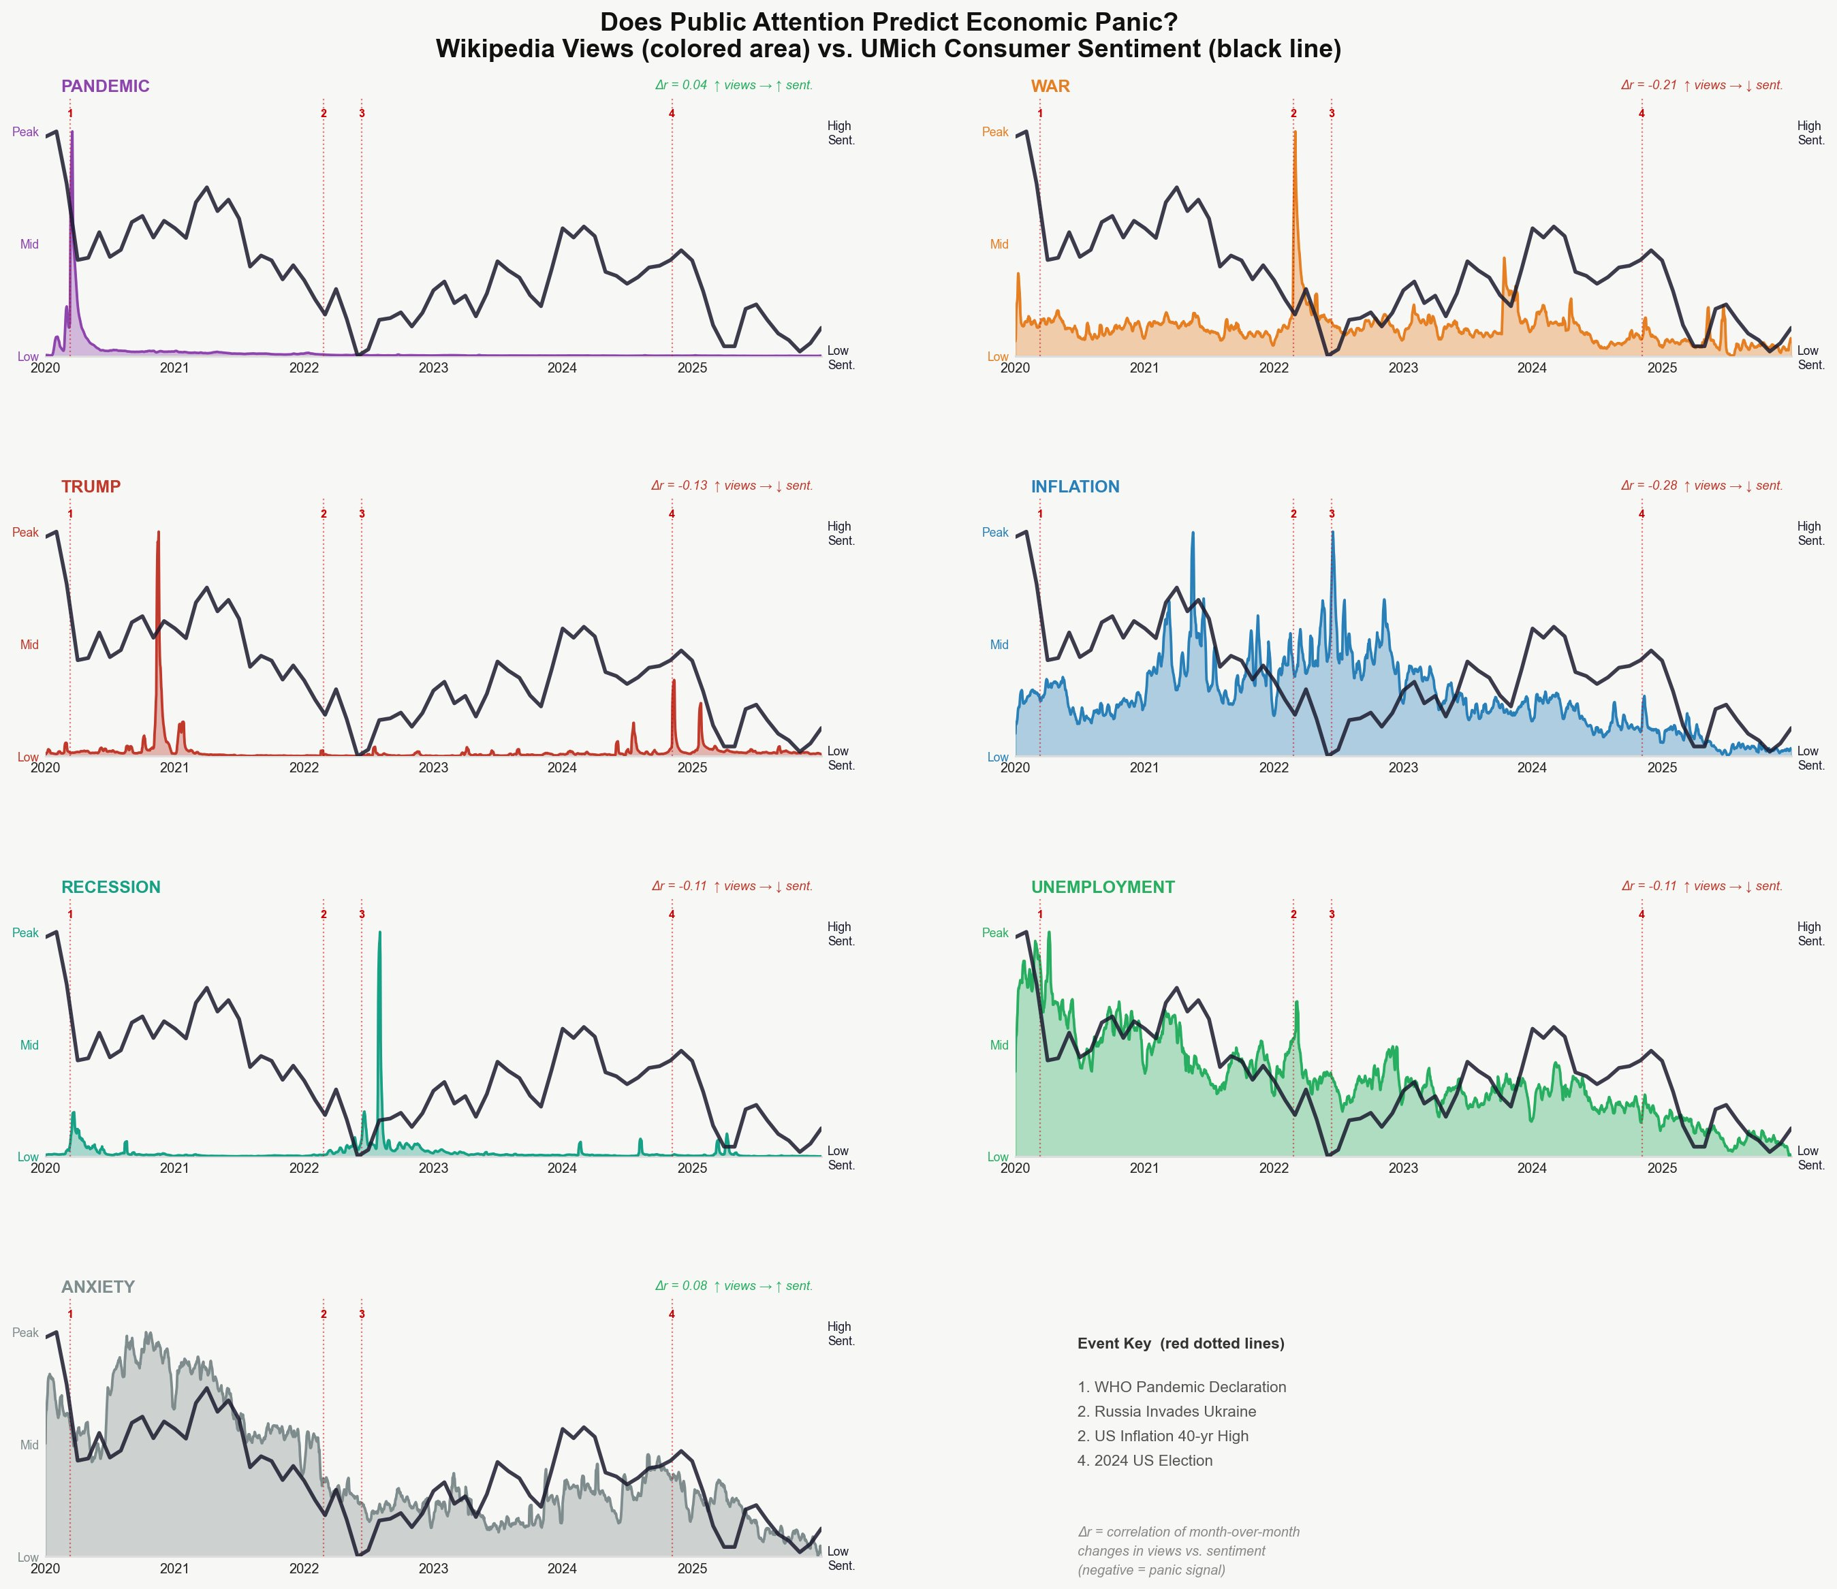
INFSCI2160 DATA MINING | FINAL PROJECT
When People Panic,
Do They Google It First?
MOTIVATION
Consumer sentiment surveys are monthly and lagged -- a slow signal
Wikipedia views are daily, free, and passively observed
Hypothesis: attention spikes for crisis topics predict sentiment drops
KEY DESIGN CHOICES
Small multiples: one panel per topic, no spaghetti overlap
Per-topic normalization: removes scale gap (Trump vs. Anxiety)
Delta-r: month-over-month changes strip trend noise and isolate spikes
Uma Sisira Akella | github.com/UmaSisira/DataMiningFinalProject

Slide 2
What the Data Shows
Delta-r = correlation of month-over-month changes in Wikipedia views vs. UMich Consumer Sentiment
WAR
INFLATION
TRUMP
RECESSION
UNEMPLOYMENT
Dr = -0.21
Dr = -0.28
Dr = -0.13
Dr = -0.11
Dr = -0.11
panic signal
panic signal
panic signal
panic signal
panic signal
PANDEMIC
ANXIETY
Dr = +0.04
Dr = +0.08
no signal
no signal
KEY INSIGHT Inflation shows the strongest panic signal (Dr = -0.28). In June 2022, Wikipedia views for Inflation, Recession, and Unemployment all spiked simultaneously while the UMich Sentiment Index hit its lowest point in the study period.
SIGNIFICANCE
HOW TO READ
Daily Wikipedia views could complement lagged sentiment surveys as a faster, real-time proxy for collective economic anxiety -- with implications for policymakers and researchers seeking earlier distress signals.
Colored area = Wikipedia views (normalized). Black line = UMich Sentiment (higher = more confident). Negative Dr means views up, sentiment down = panic.
github.com/UmaSisira/DataMiningFinalProject

