Slide 1

AMBA AHB PROTOCOL | VERIFICATION IP
AHB Verification IP
Final Project Review
Scope: AHB Master / Slave Verification IP - Functional & Assertion-Based Verification
AHB Verification IP | Final Project Review
1

Slide 2








FINAL PROJECT REVIEW
Agenda
Introduction to AHB Protocol
Project Objectives
Testbench Architecture
01
02
03
Verification Plan (V-Plan)
Master & Slave Side Operation
Scoreboard Methodology
04
05
06
Simulation Waveforms
Coverage & Assertion Results
Takeaways & Challenges
07
08
09
AHB Verification IP | Final Project Review
2

Slide 3
PROJECT INTRODUCTION
Introduction to the AHB Protocol
AHB (Advanced High-performance Bus) is part of ARM's AMBA bus family, designed for high-bandwidth, pipelined on-chip communication.
Connects one or more Masters to one or more Slaves through a central interconnect / arbiter / decoder.
Single-channel, non-pipelined-data bus: address and control are pipelined one cycle ahead of data.
Supports single transfers, burst transfers, wait-state insertion and split/error responses from slaves.
This project implements a self-checking AHB Verification IP (Master + Slave agents, scoreboard and coverage) to validate AHB-compliant DUT behaviour.
Master
AHB
Bus
Slave
Master drives address/control;
Slave returns data & response
AHB Verification IP | Final Project Review
3

Slide 4

WHAT THIS PROJECT SET OUT TO DO
Project Objectives
Build a reusable AHB Master & Slave Verification IP
Verify the AHB transfer protocol exhaustively
Independent driver/monitor agents driven through SystemVerilog clocking blocks (mdrv_cb) for a clean, race-free testbench.
Basic transfers, transfers with wait states, multi-beat bursts, and IDLE/BUSY/error transitions on HTRANS.
Self-check DUT behaviour with a scoreboard
Achieve complete functional & assertion coverage
Predict expected HRDATA / HRESP and automatically compare against monitored values every transaction.
Close all covergroup bins and protocol assertions to provide a sign-off-quality coverage report.
AHB Verification IP | Final Project Review
4

Slide 5
TB ARCHITECTURE
Testbench Architecture
AHB VERIFICATION ENVIRONMENT
Generator
Master Driver
Interface
DUT
Slave Driver
Randomized
stimulus
mdrv_cb
clocking block
AHB signals
AHB Interconnect /
Slave Memory
Response
behaviour
Master Monitor
Scoreboard
Slave Monitor
Captures driven
transactions
Predict vs Actual
comparison
Captures DUT
responses
Scorecard result (Pass / Fail) is logged per-transaction and rolled up into the final coverage & assertion report.
AHB Verification IP | Final Project Review
5

Slide 6
COVERAGE-DRIVEN VERIFICATION
Verification Plan (V-Plan)
Feature | Description | Verified By
Basic Transfer | Single read/write with no wait states (HTRANS = NONSEQ) | Functional Coverage
Transfer with Wait States | Slave inserts wait cycles via HREADY before completing | Functional Coverage
Burst Transfers | Multi-beat SINGLE / INCR / WRAP bursts of varying HBURST & length | Functional Coverage
Idle / Busy Transfers | Master de-asserts transfer via IDLE / BUSY between beats | Functional Coverage
Slave Response | OKAY and ERROR (HRESP) responses, including 2-cycle error | Assertions + Coverage
Reset Behaviour | Bus signals return to default state on Hresetn assertion | Assertions
AHB Verification IP | Final Project Review
6

Slide 7
EXPLANATION OF THE MASTER AGENT
Master Side: Driver & Monitor
Master Driver
Master Monitor
Drives address/control phase signals on the rising edge: HADDR, HTRANS, HBURST, HSIZE, HWRITE.
Drives HWDATA in the data phase, one clock after the address phase (pipelined).
Uses the SystemVerilog clocking block (mdrv_cb) so all signals are driven and sampled glitch-free relative to HCLK.
Generates randomized transfer length, address and burst type as per the V-Plan.
Passively samples HADDR, HTRANS, HBURST, HWDATA and HRESP every clock without driving the bus.
Packages each completed beat into a transaction object and forwards it to the Scoreboard.
Tracks HREADY to know exactly when a beat has actually completed (vs. wait-stated).
Runs concurrently with the driver to provide an independent, non-intrusive check on what is really on the bus.
AHB Verification IP | Final Project Review
7

Slide 8


EXPLANATION OF THE SLAVE AGENT
Slave Side: Response Behaviour
Slave Driver
Slave Monitor
Responds to every master-initiated transfer in one of three ways: complete immediately, insert one or more wait states, or signal an error.
Drives HREADY low to extend a transfer and signal additional cycles are needed.
Drives HRDATA for reads and accepts HWDATA for writes during the data phase.
Implements a 2-cycle ERROR response sequence per the AHB specification (HRESP = ERROR held across two beats).
Observes HRDATA and HRESP returned by the slave and timestamps them against the request.
Confirms HREADY/HRESP encoding matches the AHB rule table (Okay/Error x Pending/Done).
Feeds the observed response to the Scoreboard for comparison against the reference model.
Helps flag illegal HRESP transitions, e.g. an ERROR response not held for the required two cycles.
AHB Verification IP | Final Project Review
8

Slide 9
SELF-CHECKING METHODOLOGY
Scoreboard Description
1
2
3
4
Capture
Predict
Compare
Report
Master Monitor and Slave Monitor each forward a completed-transaction object to the Scoreboard.
A reference model computes the expected HRDATA / HRESP for that address, size and access type.
Expected values are compared bit-for-bit against the values actually observed on the bus.
A Pass/Fail verdict is logged per transaction and rolled up into the final regression summary.
The scoreboard is the single source of truth for functional correctness — every AHB beat driven by the Master must be matched by a correctly-predicted Slave response.
AHB Verification IP | Final Project Review
9

Slide 10
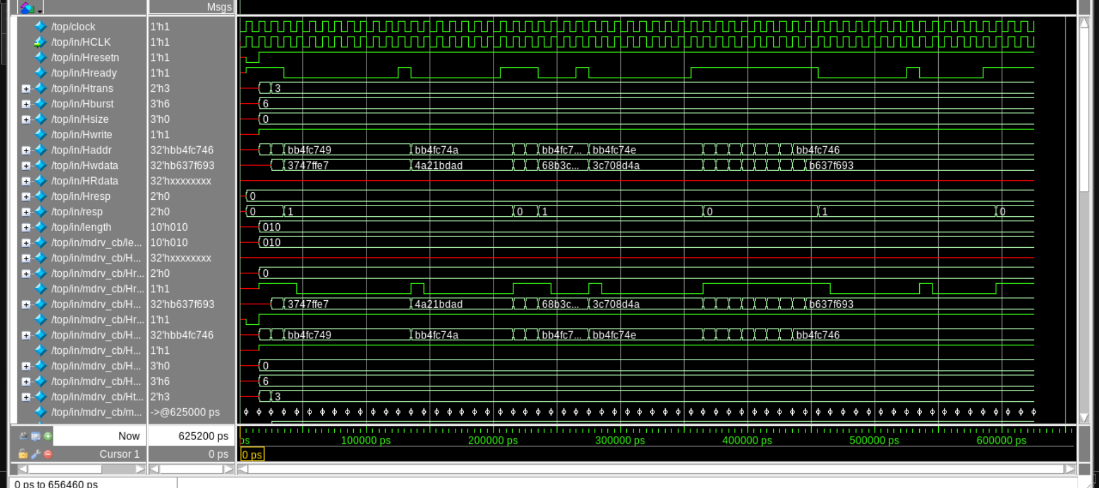
WAVEFORM EVIDENCE
Simulation Waveform: Burst Write Transfer
HTRANS = NONSEQ, HBURST = INCR, HWRITE = 1: successive write beats with auto-incrementing HADDR, captured identically by the in/ interface and the mdrv_cb clocking block.
AHB Verification IP | Final Project Review
10

Slide 11
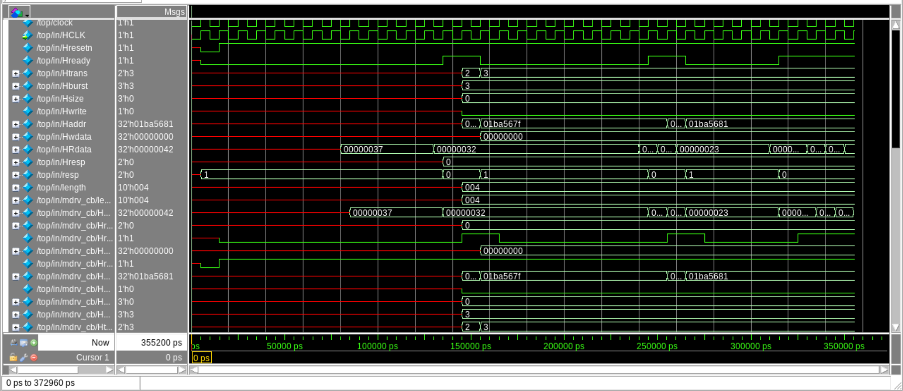
WAVEFORM EVIDENCE
Simulation Waveform: Read Transfer with Wait States
HWRITE = 0 (read), HREADY toggles low between beats: the slave inserts wait states before returning HRDATA (0x37, 0x32, 0x23 ...), exactly as predicted by the scoreboard.
AHB Verification IP | Final Project Review
11

Slide 12
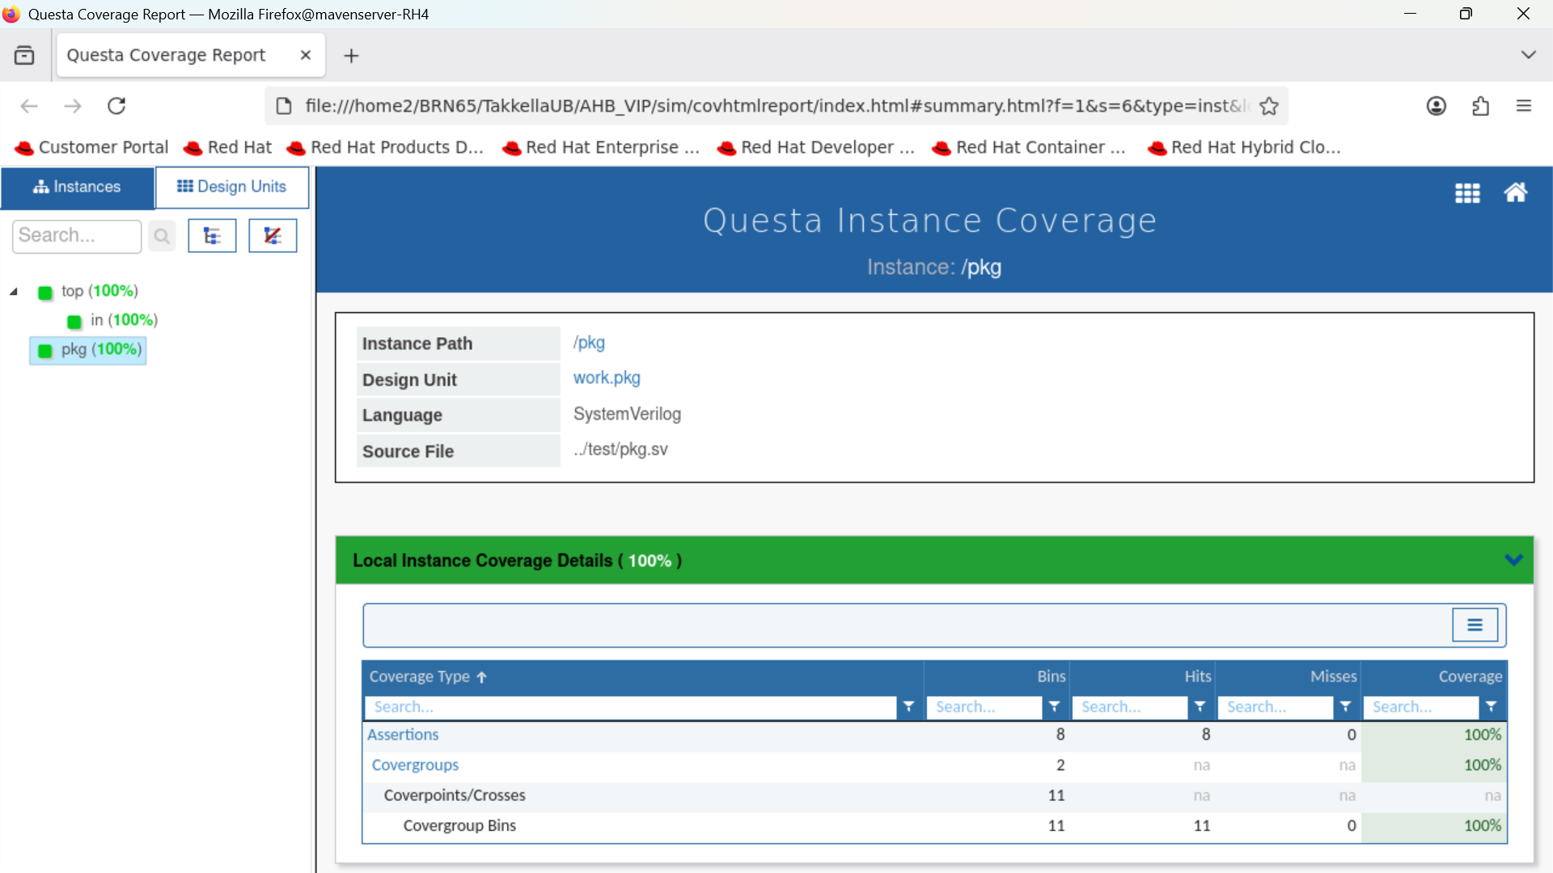
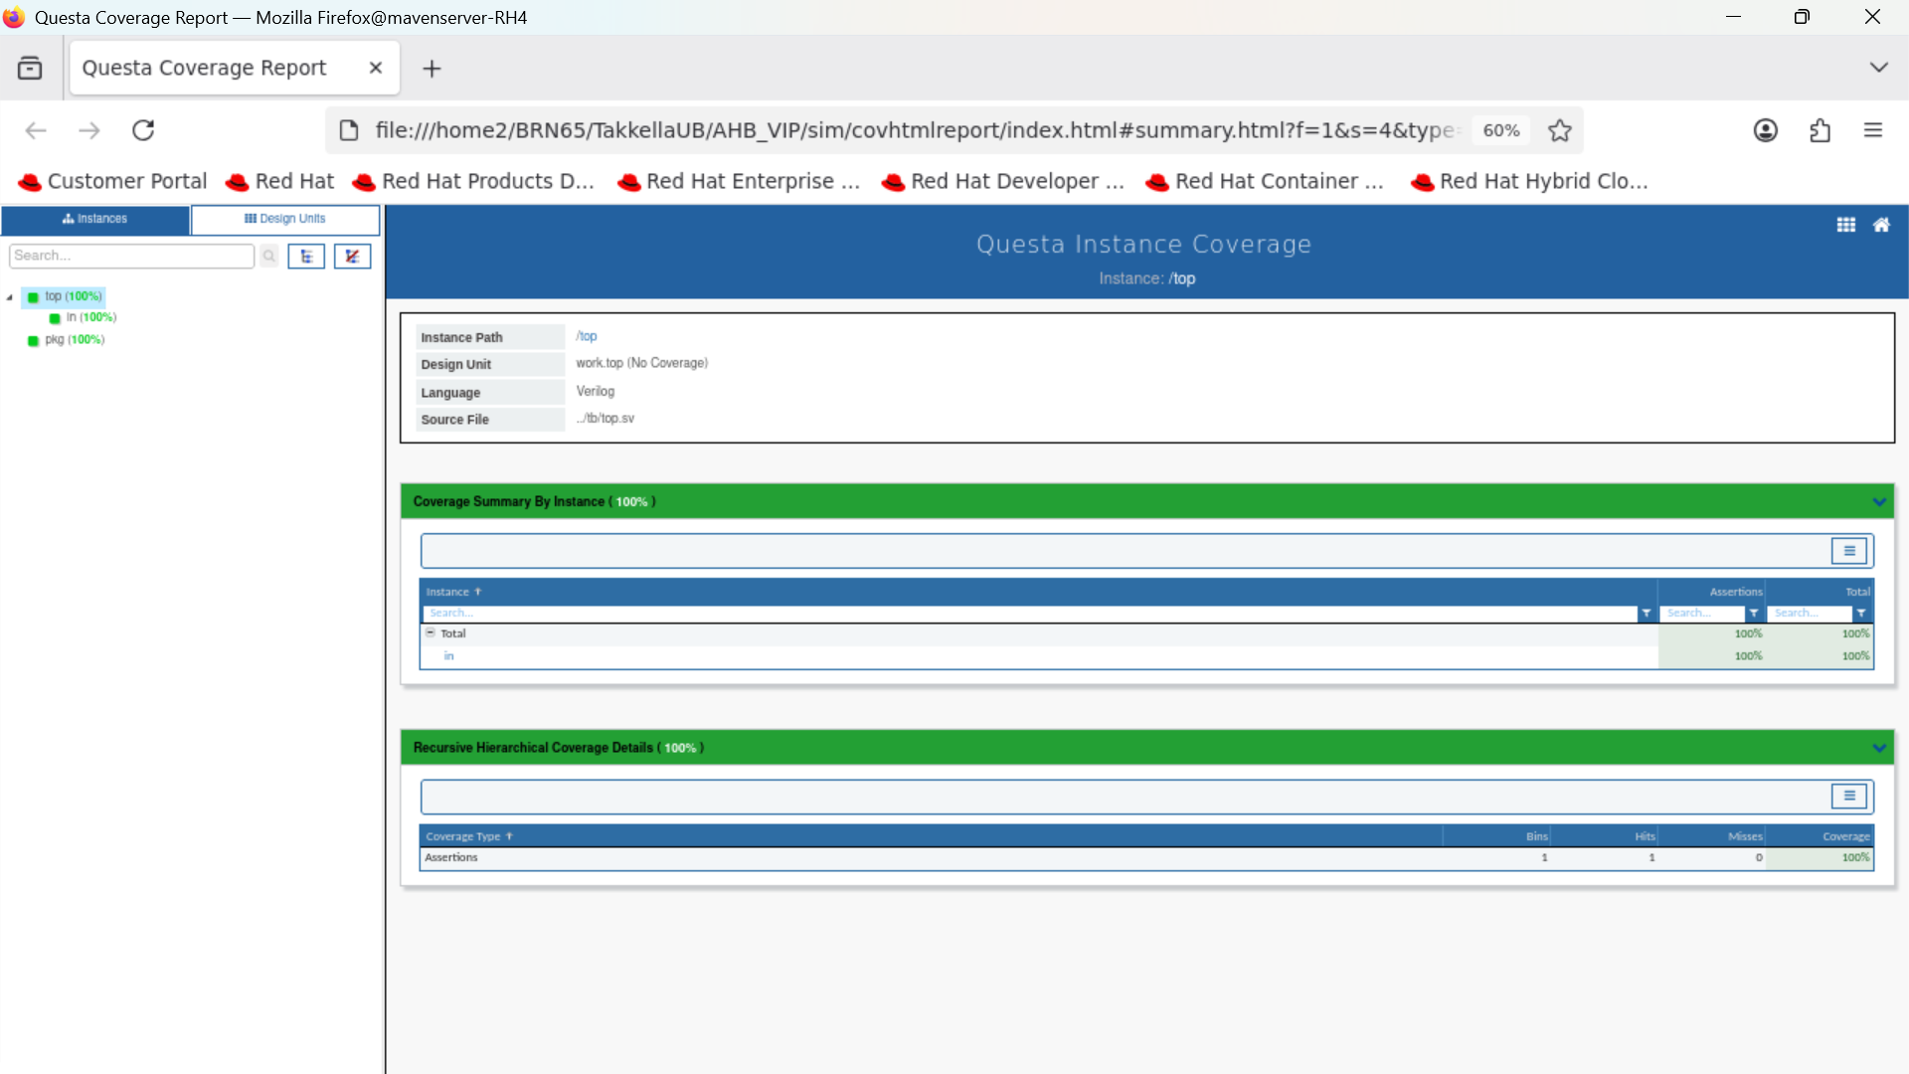
QUESTA COVERAGE REPORT
Functional & Assertion Coverage
Package (pkg) instance - 100% coverage
Top-level (top) instance - 100% coverage
AHB Verification IP | Final Project Review
12

Slide 13
SIGN-OFF METRICS
Coverage Summary
8 / 8
2 / 2
11 / 11
100%
Assertions Passed
Covergroups @ 100%
Covergroup Bins Hit
Overall Coverage
Coverage Type | Bins | Hits | Misses | Coverage
Assertions | 8 | 8 | 0 | 100%
Covergroups | 2 | na | na | 100%
Coverpoints / Crosses | 11 | na | na | na
Covergroup Bins | 11 | 11 | 0 | 100%
AHB Verification IP | Final Project Review
13

Slide 14


PROJECT RETROSPECTIVE
Takeaways & Challenges Faced
Key Takeaways
Difficulties Faced
Hands-on understanding of the AHB protocol: address/data phase pipelining, HBURST/HTRANS encoding and slave response rules.
Practical experience building a layered VIP - driver, monitor, scoreboard - using SystemVerilog clocking blocks for safe signal timing.
Coverage-driven verification methodology: writing a V-Plan first, then mapping it to covergroups and assertions.
Reading and debugging waveforms in Questa to correlate RTL behaviour with VIP-predicted results.
Synchronizing master and slave clocking blocks so that HREADY-driven wait states were sampled at exactly the right edge.
Correctly modelling the 2-cycle AHB ERROR response in the reference model used by the scoreboard.
Generating and tracking back-to-back burst transfers with unaligned addresses without losing X/unknown data on HRDATA.
Closing the final corner-case coverage bins (idle-to-nonseq transitions, error-during-burst) needed extra directed tests.
AHB Verification IP | Final Project Review
14

Slide 15
CONCLUSION
AHB VIP: Verified & Coverage-Closed
100%
100%
2
Functional Coverage
Assertions Passed
Agents: Master + Slave
The AHB Master/Slave VIP correctly drives and checks basic, wait-stated, burst and error AHB transfers.
Scoreboard-based self-checking confirmed protocol-correct behaviour on every simulated transaction.
100% functional and assertion coverage was achieved across the package and top-level instances.
Thank You | Questions & Discussion
AHB Verification IP | Final Project Review
15

